Slide 1
Cystic
Fibrosis
What is

Slide 2
What is Cystic Fibrosis ?
A genetic disease.
What is a
Genetic disease ?
Can I get
Cystic Fibrosis?
A genetic disease is something you are born with.
Notes:
Cystic Fibrosis is a genetic disease. Does anyone know what a genetic disease is? It is something that you are born with. Do you think you can get Cystic Fibrosis? No, Cystic Fibrosis is a disease that people are born with. It is not a disease or illness that can be spread from person to person.

Slide 3
Is there a cure for cystic fibrosis ?
No, but new and exciting research and medications are helping kids with cystic fibrosis healthy.
Notes:
There is no cure for cystic fibrosis, but there are many new medications that are keeping kids with cystic fibrosis healthy.

Slide 4
No, kids with cystic fibrosis can go to school, play, exercise, have friends and have fun.
Are kids with cystic fibrosis different ?
This doesn’t seem very different.
The only difference is that kids with cystic fibrosis have to take medications to help with breathing and digesting food, and they can get sick easier than the rest of us, so they have to avoid people who are sick.
Notes:
Do you think that people who have cystic fibrosis are different from the rest of us? No, they are exactly like you and me. Kids with Cystic Fibrosis can do the same things you and I can do. They go to school, have friends, play, exercise and have fun. The only difference is that kids with cystic fibrosis need to take medications to help them with breathing and digesting foods.

Slide 5
What does Cystic Fibrosis Do ?
Cystic Fibrosis causes the body to make thick mucus
pancreas
In the lungs &
Notes:
Cystic Fibrosis is a disease that causes the body to make thick mucus especially in the lungs and pancreas.

Slide 6
What does mucus do?
Mucus in the lungs makes it hard to breathe and can make it easier for kids with CF to get infections.
Notes:
We all have mucus, but in people with cystic fibrosis, this mucus is thick and hard to get out of the lungs. This makes it hard for people with cystic fibrosis to breathe. We are going to do an activity with the straws that you have.

Slide 7
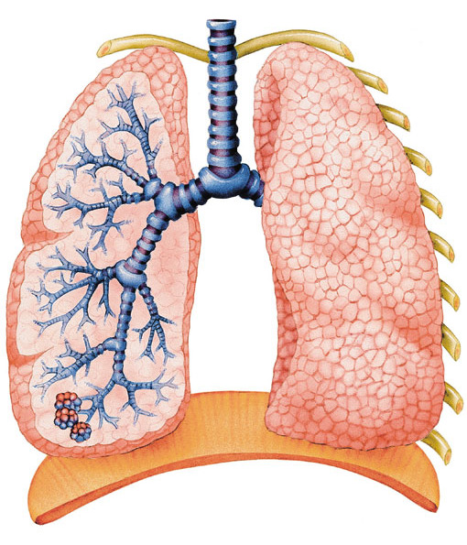
Lungs
How do you get rid of the mucus ?
With medications and therapies.
Notes:
Normally, lungs are not supposed to have mucus. Mucus blocks the airways in the lungs and makes it hard to breathe. So let’s take our straws and I want you to breathe in and out of the straw. Is it harder to breathe? This is what it is like for people with cystic fibrosis breathe when they have mucus in their lungs or when they are sick. In order to get rid of the mucus, people with cystic fibrosis take medications and do therapies that help to loosen up mucus so they can cough it out. One type of therapy that many people with cystic fibrosis use is called a vest. The vest works by vibration to help loosen the mucus in the lungs. It takes about half an hour to do and is done 2-3 times a day. Dayson has been nice enough to bring his vest today so that you can see how it works. We will be showing you the vest after the presentation. Other medications that help with cystic fibrosis are antibiotics. Antibiotics help to stop bacteria from growing in the mucus in the lungs. Some of these antibiotics are take by mouth and others are inhaled or breathed into the lungs. With the help of medications and therapies, the lungs can be clear of mucus.

Slide 8
Lungs after medications & therapy
Notes:
This is how lungs look without mucus.

Slide 9
Without food, you can’t grow
What happens if you cannot digest foods?
Cystic fibrosis also makes it hard to digest foods.
How do kids with cystic fibrosis digest food?
With medication called enzymes.
Notes:
Cystic fibrosis also makes it hard to digest foods. An organ in the body called the pancreas make enzymes that help the stomach and intestines to digest food, but the thick mucus caused by cystic fibrosis blocks these enzymes from getting to the stomach. What do you think happens if you cannot digest food? You can’t grow. People with cystic fibrosis take a medication called enzymes to help them digest the foods they eat.

Slide 10
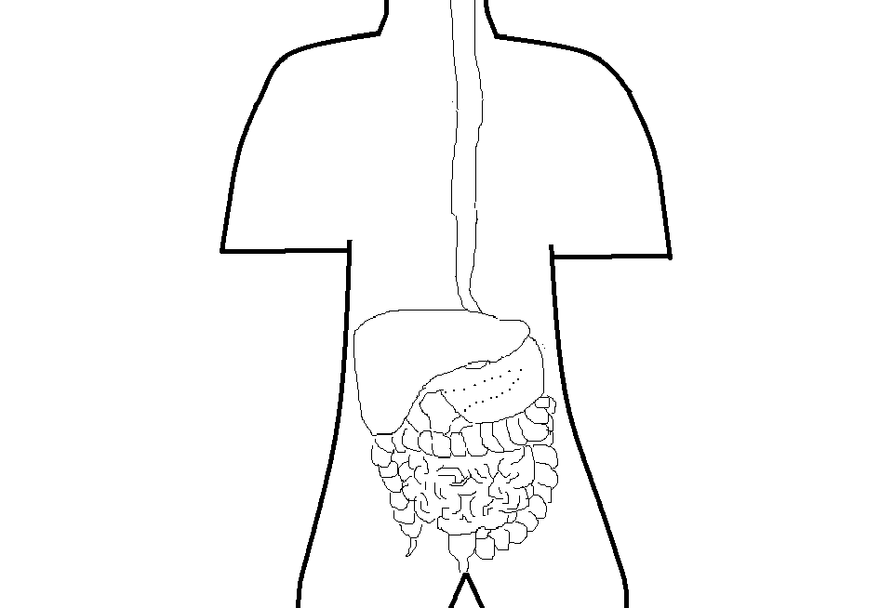
Digestive System

Slide 11
Digestive System with CF

Slide 12
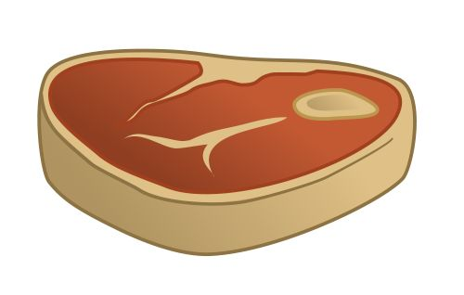
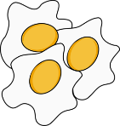
How do kids with cystic fibrosis gain weight and grow?
By taking their enzymes and eating a high fat diet.
Notes:
Before eating, people with cystic fibrosis take enzymes to help them digest the food that they eat so they can grow like the rest of us.

Slide 13
Enzymes
How do enzymes work?

Slide 14
How do kids with cystic fibrosis stay healthy?
By trying not to get sick and by taking their medications and doing their therapies.
Notes:
In order to stay healthy, it is very important that people with cystic fibrosis take their medications, do their therapies and cough. It is also important that they try not to get sick. When you and I get sick, we get better after a few days, but when a person with cystic fibrosis like Dayson gets sick, they are sick for a longer period of time and sometimes need to be in the hospital to get better. So if you are sick, it is very important to cough and sneeze into a Kleenex and wash your hands to help keep not only people with cystic fibrosis from getting sick, but everyone from getting sick.

Slide 15
Thank You
Sofhia Ytuarte, RN
University of Arizona Pediatric Pulmonary Center Nursing Trainee
June, 2015
Notes:
Thank you, I hope that I have made it easier for you to understand what cystic fibrosis is. Remember to come take a look at the vest and medications before you leave.

