Slide 1
Nutrition and Cystic Fibrosis
Module 3: Nutrition-Related CF Complications

Slide 2
Learning Objectives
Describe the development and nutrition implications of CF-related liver disease, gastrointestinal complications, and CF related diabetes in CF patients.
Discuss the nutrition management of CF-related liver disease, gastrointestinal complications, and CF related diabetes in CF patients
Describe appropriate culturally competent approaches to patient care.

Slide 3
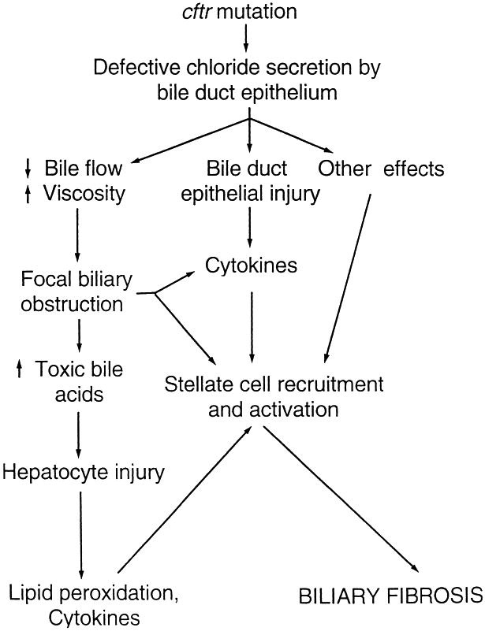
Nutrition-Related CF Complications
Proposed Mechanism of CF-related Liver Disease
CF-related liver disease
GI complications
CF related diabetes (CFRD)
Sokol et al.

Slide 4
CF-Related Liver Disease

Slide 5
CF-related Liver Disease
Liver involvement common in CF patients, with 5-10% having significant disease
Nutritional consequences primarily seen in neonatal cholestasis and cirrhosis
Hepatic Complications in Cystic Fibrosis
Type of Hepatic Complication | Prevalence Rate
Neonatal cholestasis | Rare
Hepatic steatosis | 23-67%
Focal biliary cirrhosis | 11-72%
Multilobular cirrhosis | 5-10%
Synthetic liver failure | Rare
Leeuwen et al.

Slide 6
Neonatal Cholestasis
Liver disease with ↑’d bilirubin >2 mg/dl or >20% of total bilirubin
Meconium ileus is a risk factor
Normally resolves within 9 months
↑↑ in fat malabsorption, MCT provided for increased fat absorption
Breastmilk + fortification or formula with at least 40-50% of fat as MCT
  See text Table 11.2 for breastmilk fortification options
Assess fat-soluble vitamin status
Possible enteral nutrition support with poor growth

Slide 7
Multilobular Cirrhosis
Median age of diagnosis = 10 yrs
Portal hypertension can lead to splenomegaly, esophageal or gastric varices, and ascites
Nutritional consequences
  Increased metabolic demand related ↑’d cardiac output
  Peripheral insulin resistance – less efficient use of CHO for energy
  Osteopenia commonly seen
  Small bowel edema with portal hypertension which can decrease absorption
  With ascites, early satiety can occur leading to decreased intake
  Malnutrition – increased metabolic demand, decreased nutrient absorption, decreased caloric intake

Slide 8
Cirrhosis
Weight is not a reliable indicator of nutrition status due to enlarged organs and/or ascites
Additional anthropometrics to monitor body composition – mid-arm circumference, triceps skinfold, subscapular skinfold measures
Nutrition management
  Energy needs based on individual nutrition status
  Protein – 3-4 g/kg/day (restriction only with encephalopathy, but not less than 2g/kg/d)
  Fat – 40-50% of total kcals to meet increased energy needs
  Carbohydrates – remaining kcals, normally about 45-50% of total kcals
    Monitor glucose levels
    Smaller, frequent meals may better promote euglycemia
  If diet not sufficient to meet needs, consider oral supplements or supplemental TF

Slide 9
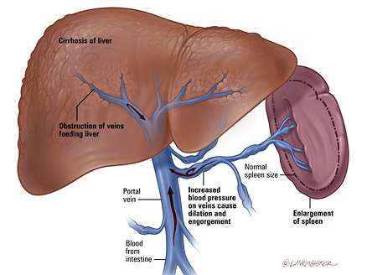
Cirrhosis
Nutrition management, cont’d
  Fat-soluble vitamins – use standard CF supplementation
  Zinc – need more research; consider 5 mg/kg/day oral elemental zinc supplement if deficiency suspected in pediatric patient
  NaCl – consider 2000 mg/d restriction
www.hopkinscf.org/what-is-cf/effects-of-cf/liver/

Slide 10
Hepatic Steatosis
Also known as nonalcoholic fatty liver disease (NAFLD)
Present in up to 70% of children undergoing liver biopsy for suspected liver disease
Cause is typically nutrition-related
  Protein calorie malnutrition
  Protein malnutrition
  Essential fatty acid (EFA) deficiency – related to fat malabsorption
  Obesity – less common in CF population
  Bile acid deficiency
  Carnitine deficiency

Slide 11
Hepatic Steatosis
Nutrition Management
  Malnutrition - address with nutrition interventions that increase energy, fat and protein intake
  EFA deficiency – target is increased linoleic acid intake → vegetable oils (corn, soybean, safflower), margarine; aim for >10% of total kcals
  Bile acid deficiency – may have higher requirement for linoleic acid as with EFA deficiency
  Carnitine deficiency
    Focus on high carnitine foods such as meats, dairy, enteral TF formulas, breastmilk, and formula
    If deficiency confirmed through plasma carnitine testing, consider carnitine supplement of levocarnitine 50-100 mg/kg/d orally (broken into 3-4 doses over the course of a day)

Slide 12
GI Complications

Slide 13
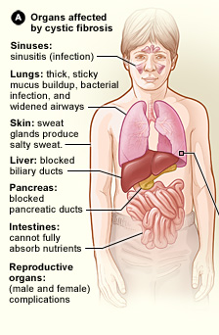
GI Complications
GI involvement can occur in utero and in the neonate
Often the first symptoms of CF to appear are GI-related
Common complications
  Malabsorption related to pancreatic insufficiency and/or viscous secretions that interfere with nutrient absorption
  Gastroesophageal reflux (GERD) - most common GI issue
  Small intestinal bacterial overgrowth (SIBO)
  Distal intestinal obstruction syndrome (DIOS)
  Constipation
  GI cancers
www.nhlbi.nih.gov/health/health-topics/topics/cf/signs

Slide 14
Gastroesophageal Reflux
Leads to poor appetite and decreased energy and nutrient intake
Initial therapy includes acid suppressor pill - PPI or H₂ blocker
  Specifically for GERD symptoms
  Recall that PPI or H₂ blocker can also be prescribed to enhance action of PERT
Surgery may be indicated for severe cases – laparoscopic fundoplication
Nutrition management – continue with high kcal, high fat diet; discontinue foods that are not tolerated on a case-by-case basis

Slide 15
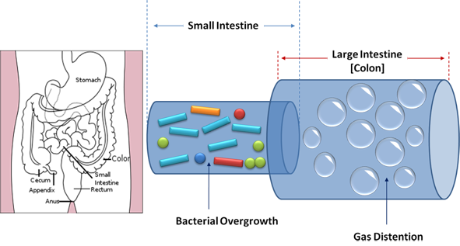
Small Intestinal Bacterial Overgrowth (SIBO)
In CF normal methods to control bacterial growth in the small intestine are disrupted
  Thick mucus secretions
  Intestinal dysmotility – decreased clearance of bacteria
  Chronic use of antibiotics in CF population – loss of “good” bacteria
  Acid suppressing medications – more bacteria make it to the small intestine
www.nutridesk.com.au

Slide 16

SIBO
Treatment
  Broad spectrum antibiotics
  Bowel hydration with osmotic agent such as polyethylene glycol (Miralax)
  Consider probiotics which may compete with pathogenic bacteria

Slide 17
Distal Intestinal Obstruction Syndrome (DIOS)
Complete or partial obstruction of the distal ileum with fecal material
Can present in CF patients of any age
Can be acute or chronic
Symptoms
  Cramps
  Abdominal pain (right lower quadrant)
  Abdominal distension
  Anorexia – poor appetite
  Weight loss
Connection between nutrition and DIOS development unclear
Treatment
  Remove obstruction with medicals or surgery (rare)
  Re-education regarding adherence to PERT regimen

Slide 18
Constipation
Cause similar to those seen with DIOS
Most chronically constipated CF patients have bowel movements everyday
Low fiber and inadequate hydration not associated with constipation in children with CF (see text pg 186 for discussion)
Treatment
  Laxatives - polyethylene glycol, lactulose, sorbitol
  Colonic stimulants – senna, bisacodyl

Slide 19
Gastrointestinal Cancers
CF patients at risk for cancers of GI tract and accessory organs
Nutritional impact and management similar to those without CF
  Maintain adequate energy and nutrient intake, if possible
  Consider enteral or parenteral nutrition support depending on tissue(s) affected

Slide 20
CF Related Diabetes

Slide 21
CF Related Diabetes (CFRD)
Can occur in up to 20% of adolescents with CF, and can occur at any age
Some residual insulin secretion present throughout life of CF patient
MNT differs in many ways to Type 1 and Type 2 DM
  High kcal, high fat diet continued – CFRD not associated with macrovascular complications
  Frequent use of oral supplements and/or enteral nutrition support necessitate individualized meal planning for euglycemia
  Primary treatment is insulin therapy
  Ketoacidosis rare
  Microvascular complications are of concern
Regular screening of CF patients for CFRD – yearly OGTT

Slide 22
CFRD
Types of Insulin and Their Action
Insulin | Onset of action | Duration of action | Peak
Rapid acting
Aspart | 10-20 min | 3-5 hr | 1-2 hr
Lispro | 10-20 min | 3-5 hr | 1-2 hr
Glulisine | 10-20 min | 3-5 hr | 1-2 hr
Short acting
Regular | 30 min | 4-6 hr | 2-4 hr
Intermediate acting
NPH | 1-3 hr | 8-12 hr | 4-6 hr
Long acting
Glargine | 1-2 hr | 18-26 hr | None
Determir | 1-3 hr | 12-20 hr | None
Nutrition management
  No diet restrictions – continue with high kcal, high fat diet
  CHO counting with insulin treatment for euglycemia
  See text, Table 13.3
Insulin therapy
  Basal-bolus regimen
  Administered prior to meals and snacks
Adapted from Nutrition in Cystic Fibrosis, Yen and Radmer Leonard, Table 13.2

Slide 23
References
Nutrition in Cystic Fibrosis, Yen and Radmer Leonard - Chapters 11-13
Sokol et al. Recommendations for management of liver and biliary tract disease in cystic fibrosis. J Ped Gastroentrology and Nutrition. 1999;28:S1-S13.
Leeuwen et al. Liver disease in cystic fibrosis. Paediatric Respiratory Reviews. 2014;15(1):69-74.
Cystic Fibrosis Foundation – www.cff.org
Johns Hopkins Cystic Fibrosis Center - www.hopkinscf.org
National Heart, Lung and Blood Institute - www.nhlbi.nih.gov
Nutridesk - www.nutridesk.com.au

