Slide 1
ARIZONA TRANSITION GUIDE FOR CYSHCN
Skylar Sularz, MSW Intern
PPC Social Work Trainee
University of Arizona
Pediatric Pulmonary Center
May 2, 2017

Slide 2
Outline
Transition
Children and Youth with Special Health Care Needs
Background
Project

Slide 3
Transition
What is health care transition?
What is the goal of transition?

Slide 4
Children and Youth with Special Health Care Needs (CYSHCN)
20% of children 18 and under have a health care need
90% of CYSHCN live to adulthood
Multiple systems
Maternal and Child Health (MCH) Transition to Adulthood

Slide 5
Background
What is known?

Slide 6
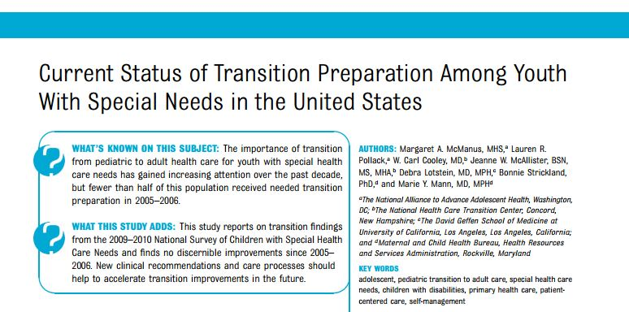

Slide 8
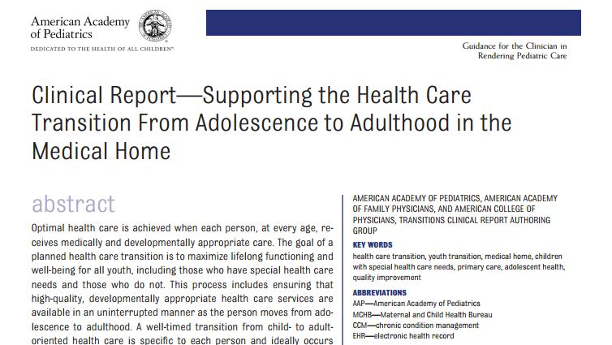

Slide 9
FloridaHATS
Florida Health and Transition Services
Tool Box

Slide 10
UA PPC
The University of Arizona Pediatric Pulmonary Center (PPC)
Cystic Fibrosis Transition Passport Program
ArizonaLEND

Slide 11
Objective
To improve the successful transition from pediatric to adult care of children and youth with special health care needs by providing comprehensive educational information to patients, parents, and caregivers

Slide 12
Methods
Create a transition flowchart with state specific resources for patients and parents/caregivers
Send flowchart to be reviewed by selected sample consisting of patients, parents/caregivers, providers, and MCHB professionals
Post flowchart with applicable links on the PPC and LEND websites for patients and parents/caregivers

Slide 13
Methods
Create and post a needs assessment survey within the PPC and LEND transition links so patients and parents/caregivers can provide feedback as to which areas they would like further information
Execute online or in-person transition fair and/or online modules to address CYSHCN transition needs based upon needs assessment results

Slide 14
Target Population
CYSHCN
Chronic pulmonary disorders
Neurodevelopmental and related disabilities

Slide 15
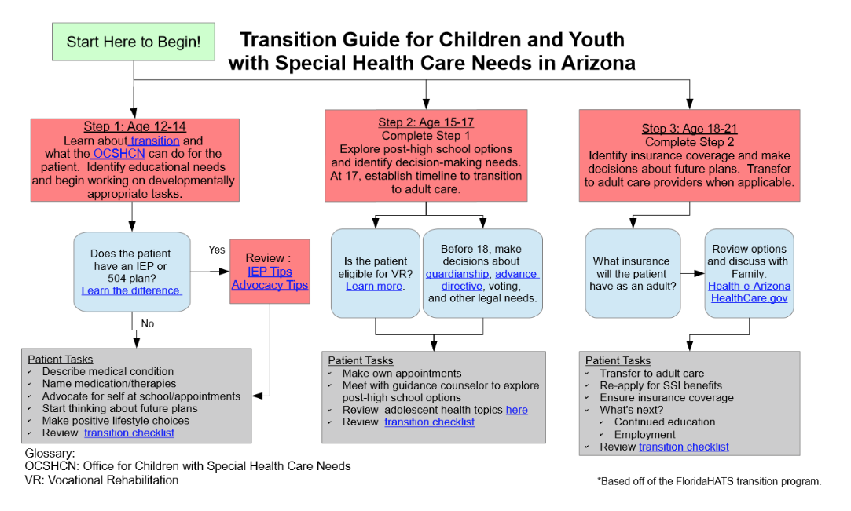

Slide 16
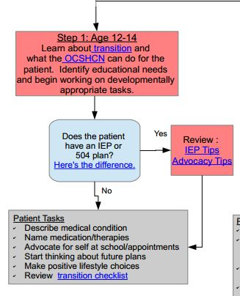

Slide 17
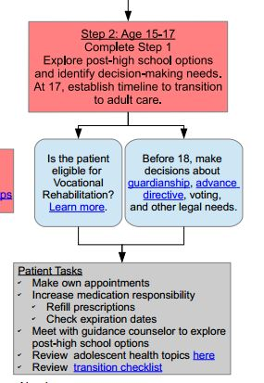

Slide 18
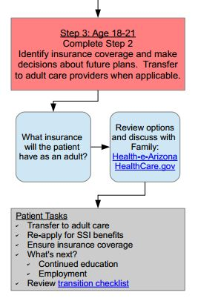

Slide 19
Survey
Sample
Patients, parents/caregivers, health care providers, MCHB professionals
Questions

Slide 20
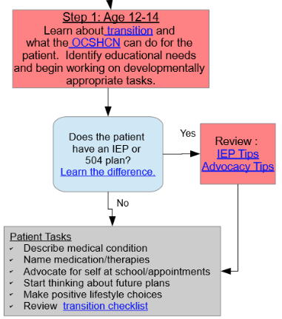
Questions
Do you feel that the information provided in this step is age/developmentally appropriate?
If no, what information would be more helpful to include?
Do you feel that the resources provided on IEP and 504 plans, IEP Tips, and Advocacy Tips are useful to prepare patients/families for transition?
If no, what information or resources would be helpful to include?

Slide 21
Questions
Are there other resources or topics you believe should be addressed in this step? If yes, please provide feedback and comments below.
Do you believe the tasks listed in this section are appropriate for this age group?
If no, what tasks would be helpful to include or change?

Slide 22
Results
Age/developmentally appropriate
Resources
Tasks
Formatting
Grammar/ phrasing

Slide 23
Conclusion
Revisions
Insurance
Medications
Grammar/phrasing

Slide 24
Transition Links- Parents/Providers
Transition Planning
Healthcare and Social Security
Decision-Making
School Resources
Mental Health
Supportive Organizations

Slide 25
Transition Links- Patient 12-14
Workbook
Transition Videos
Describe Medical Conditions
Managing Medications
Advocate for Yourself
Setting Health Goals

Slide 26
Transition Links- Patient 15-17
Workbook
Vocational Training
Making Your Own Appointments
Guardianship
Medical Self-Management
Advance Directive
Legal and Financial Planning
Effective Communication with Health Care Providers
Adolescent Health Topics

Slide 27
Transition Links- Patient 18-21
Workbook
Getting Health Insurance
Health Summary
Residential Planning
Future Planning

Slide 28
Future Directions
Post flowchart and applicable transition links on the PPC and LEND websites
Needs assessment survey
Online or in-person transition fair and/or online modules to address CYSHCN transition needs

Slide 29
References
Children with special health care needs. (2016). Health Resources & Services Administration. Retrieved from https://mchb.hrsa.gov/maternal-child-healthtopics/children-and-youth-special health-needs# Clinical report: Supporting the health care transition from adolescence to adulthood in the medical home. (2011). American Academy of Pediatrics. 182-200. For youth & families. (n.d.) FloridaHATS. Retrieved from http://www.floridahats.org/for-youth-families/
Lorenzo, S. B. (2014). Transition to adulthood. National Center for Education in Maternal and Child Health. Retrieved from https://www.ncemch.org/evidence/NPM-12-transition.php
McManus et al. (2013). Current status of transition preparation among youth with special needs in the United States. American Academy of Pediatrics, 13(6), 1091-1097.
McPherson et al. (1998). A new definition of children with special health care needs. American Academy of Pediatrics; 137-140.
The 2020 federal youth transition plan: A federal interagency strategy. (2015). Federal Partners in Transition Workgroup.
Youth & families. (2017). Got Transition. Retrieved from http://www.gottransition.org/youthfamilies/index.cfm

Slide 30
THANK YOU!
Skylar Sularz
Email: ssularz@asu.edu
http://uappc.peds.arizona.edu
Developed by Skylar Sularz, BA, MSW intern, UA PPC Social Work Trainee under the supervision of Mary McGuire, MSW, Pediatric Pulmonary Center Social Work Faculty. Support (in part) by the Maternal and Child Health Bureau, HRSA, Grant #T72MC00012

