Slide 1
Asthma Challenge
Since this is a power point game you
will need to click your mouse on certain parts of each page. If you do not click the correct spot, the game will take you to the wrong screen. If this happens you can stop the game by pushing the escape key and start over.
GOOD LUCK!!
(Click anywhere to Continue)

Slide 2
Rules
On the next page you will see a game
board. On that board you will need to pick a category and number. When you pick that box you will need to click your mouse on the little (Q) in the corner.
2) That will take you to a page with a question. On the slide with the question you will need to click on the answer.
3) On all the other slides you will need to click the
(continue) spot.

Slide 3
Asthma Challenge
Oxygen | Asthma & Triggers | Miscellaneous
100 (Q) | 100 (Q) | 100 (Q)
200 (Q) | 200 (Q) | 200 (Q)
300 (Q) | 300 (Q) | 300 (Q)
400 (Q) | 400 (Q) | 400 (Q)

Slide 4


Oxygen
True or False
Oxygen helps keep you healthy.

Slide 5
Oxygen
X
TRY AGAIN!
(Continue)

Slide 6
Oxygen
TRUE
Great Job!
(Continue)

Slide 7

Oxygen
Oxygen is important to the body because it…
A. Keeps your heart pumping C. Both A and B
B. Keeps your immune system strong D. None of the above
so you stay healthier

Slide 8
Oxygen
X
Keep Guessing!
(Continue)

Slide 9
Oxygen
GOOD JOB!
(continue)

Slide 10
Oxygen
* Keeps your heart pumping
* Moves information from your head to
the rest of your body
* Keeps your immune system strong
so you stay healthier
* It gets rid of things that are not good
for your body
* It helps you digest your food
* And lots of other cool stuff
(Continue)

Slide 11
Oxygen
The tubes that allow oxygen in and out of your lungs are called…
A. Tunnels C. Bronchial Tubes
B. Inner Tubes D. Hot Pockets

Slide 12
Oxygen
X
Oops!
(Continue)

Slide 13
Oxygen
Excellent!
(continue)

Slide 14
Oxygen
What can happen to you if your body does not get enough oxygen.
A. You laugh a lot C. None of the above
B. You wake up early D. All of the above

Slide 15
Oxygen
X
Wrong Answer!
(Continue)

Slide 16
Oxygen
Out Standing!
(continue)

Slide 17
Oxygen
* It is more likely you will get sick
* You become tired
It is harder for you to concentrate and remember
(Continue)

Slide 18
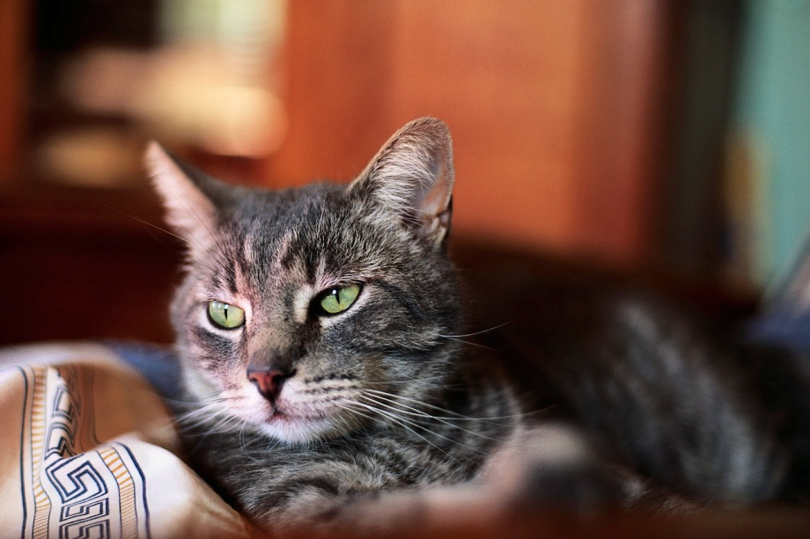
Asthma & Triggers
True or False
If you have asthma you cannot have a pet.

Slide 19
Asthma & Triggers
X
Sorry!
(Continue)

Slide 20
Asthma & Triggers
Superb!
(Continue)

Slide 21

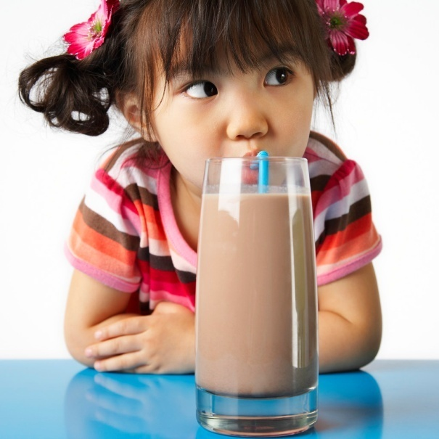
Asthma & Triggers
Does your book say that people who have asthma always have the
same triggers or is everyone different?

Slide 22
Asthma & Triggers
X
Keep Guessing!
(Continue)

Slide 23
Asthma & Triggers
Brilliant!
(Continue)

Slide 24
Asthma & Triggers
When triggers bother or irritate the lining of the airways…
A. They turn purple C. They turn green
& swell up & swell up
B. They turn yellow D. They turn red
& swell up & swell up

Slide 25
Asthma & Triggers
X
Nope!
(Continue)

Slide 26
Asthma & Triggers
Awesome!
(Continue)

Slide 27
Asthma & Triggers
What thing scan trigger
an asthma attack?
A. Dust C. Some animals
B. Some foods D. Cigarettes
E. All of the above

Slide 28
Asthma & Triggers
X
So Close!
(Continue)

Slide 29
Asthma & Triggers
GOOD JOB!
(Continue)

Slide 30
Asthma & Triggers
Dust
Foods
Animals
Cigarettes
Some perfumes/aerosol sprays
Cold or dry air
Exercise
Laughing or yelling for a long time
Flues or colds
(Continue)

Slide 31



Miscellaneous
True or False
I can get asthma by playing or spending time with others who have asthma.

Slide 32
Miscellaneous
X
TRY AGAIN!
(Continue)

Slide 33
Miscellaneous
You cannot get asthma from
spending time with others
who have asthma.
(Continue)

Slide 34
Miscellaneous
Two symptoms that can happen when a person has an asthma attack are…
A. You cough C. It is harder to breath
B. It is easier to breath D. Both A & C

Slide 35
Miscellaneous
X
Nice Try!
(Continue)

Slide 36
Miscellaneous
WOW! Nice Job!
(Continue)

Slide 37
Miscellaneous
Chest might feel tighter
Coughing
Wheezing or whistling might be heard
Might be more difficult to breath
(Continue)

Slide 38
Miscellaneous
things you can do to keep
yourself healthy are…
A. Stay away from as many C. Do not smoke
triggers as possible
D. Exercise D. All of the above

Slide 39
Miscellaneous
X
Not exactly
TRY AGAIN!
(Continue)

Slide 40
Miscellaneous
Great Job!
(Continue)

Slide 41
Miscellaneous
Stay away from as many triggers as possible
Never, never smoke
Use the medicine your doctor gives you when your doctor tells you to
Try to exercise regularly
(Continue)

Slide 42
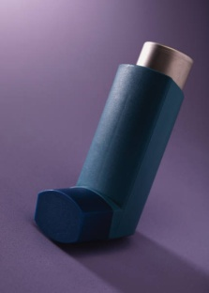
Miscellaneous
The rescue medication and a
Controller medication
do what?
A. Rescue medicines C. Controller medicines
works slowly works fast
C. None of the above

Slide 43
Miscellaneous
X
Oh No!
(Continue)

Slide 44
Miscellaneous
Fantastic!
(Continue)

Slide 45
Miscellaneous
Rescue medicines work fast to stop the symptoms after they have started, but they only work for a short time.
Controller medicines work slower and help prevent the symptoms from starting. This medicine keeps working for a longer time.
(Continue)

Slide 46
Thanks for playing Asthma Challenge. We hope you had a great time!
(Continue)

