Slide 1
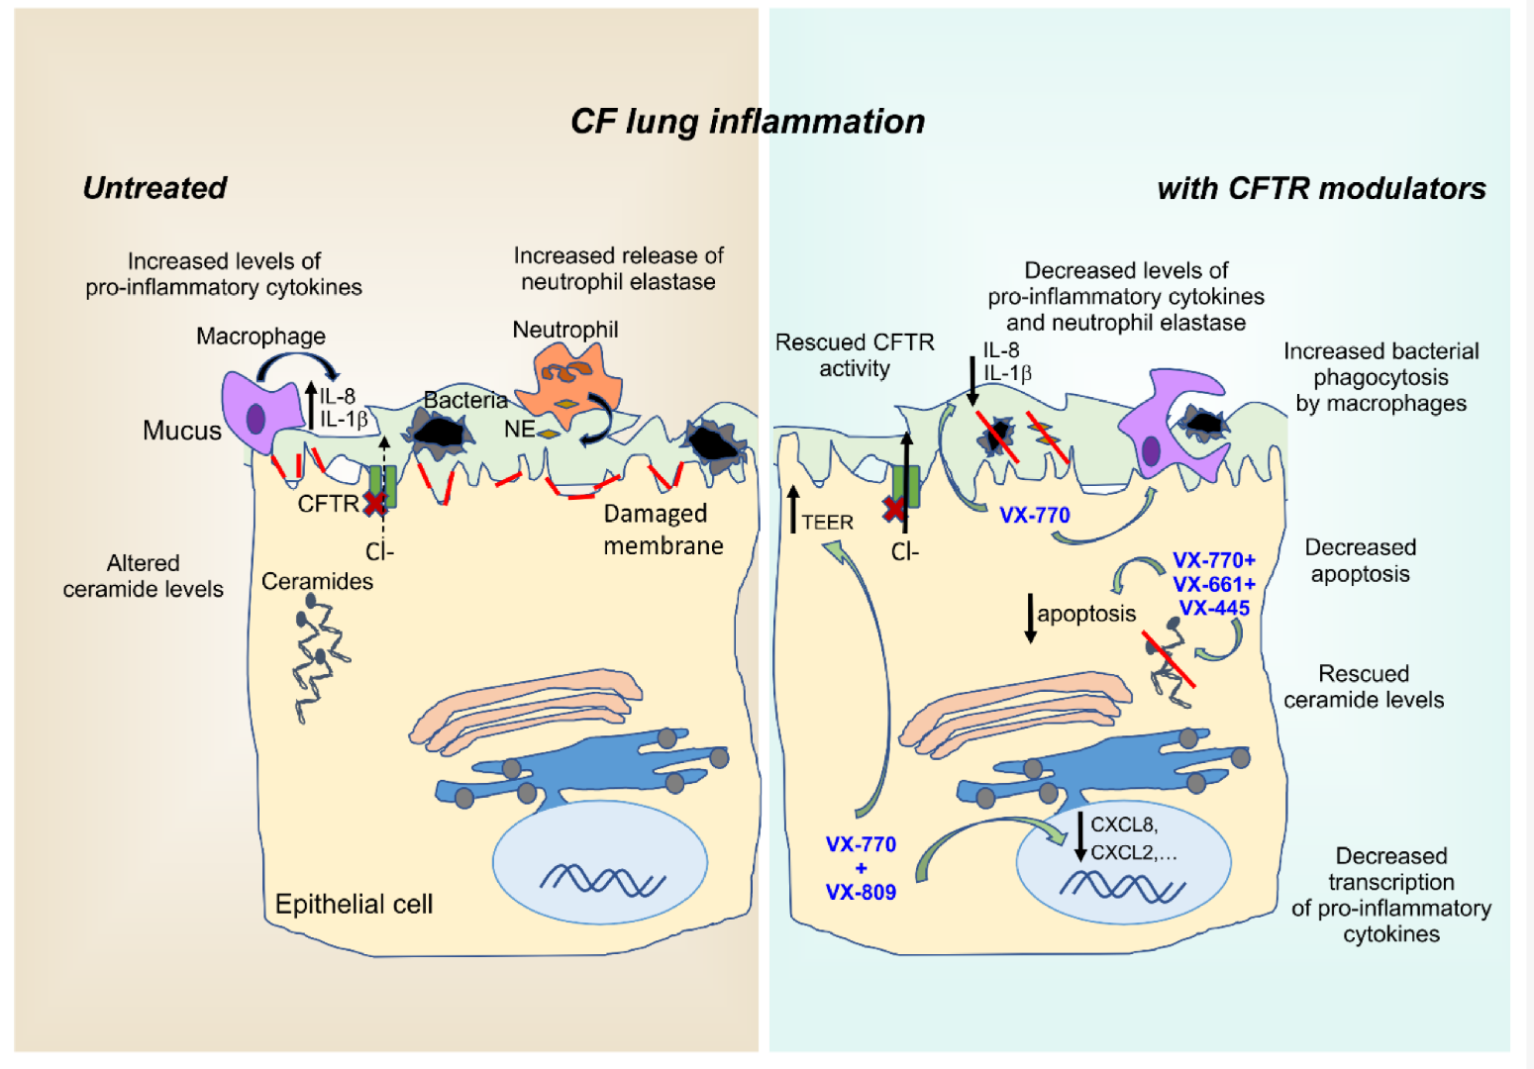
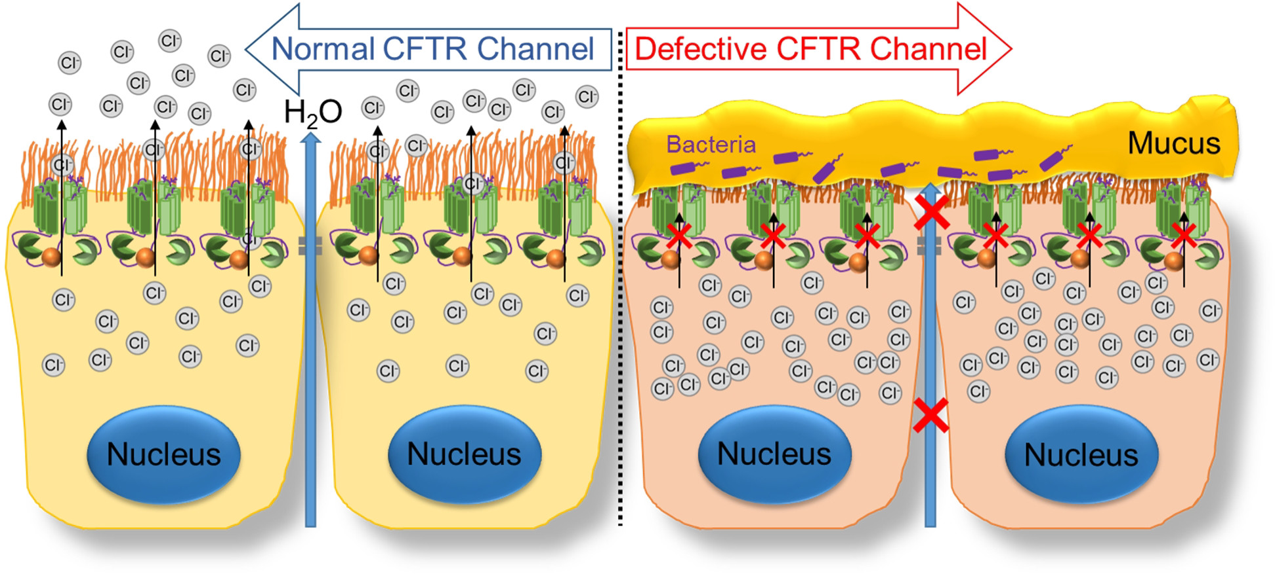
CFTR Modulators & Nutritional Status
Achie Inyang, PPC Trainee
BACKGROUND
Methods
NEXT STEPS
Cystic fibrosis (CF) is a recessive genetic disease that affects the exocrine glands. CF occurs when two copies of the defective gene are inherited (one from each parent). A mutation on the CFTR gene affects the protein responsible for transporting chloride ions across the epithelial cell membrane. CF can cause severe damage to the lungs, digestive system, and other organs. Thick, sticky mucus buildup in the lungs results in respiratory infections. CFTR modulator therapies can impact an individual's growth and nutritional status.
MODULATORS: Cystic Fibrosis Transmembrane Conductance Regulator (CFTR) Therapies consist of 4 types of modulators. The objective is to repair the dysfunction of proteins made by the CFTR gene. Specific modulators prescribed today are Kalydeco, Orkambi, Symdeko and Trikafta. The age of the CF patient and the specific mutation (CF Genotype) will guide the treatment plan.
NUTRITIONAL STATUS: Historically, high calorie, high fat and high protein diets have been prescribed to CF patients. This provides a higher caloric expenditure that addresses impaired nutrient utilization associated with pancreatic dysfunction associated with chronic lung disease and inflammation. Further research is indicated to assess effectiveness of treatment with CFTR modulators in conjunction with the overall nutritional regimen.
Design: Literature Reviews
Population: CF providers from other PPCs
Data Collection: Survey
Statistical Analysis: Descriptive Statistics
A survey was created and developed on Qualtrics to identify and assess the needs of patients attending CF clinics. The survey will be completed by the healthcare providers at various clinics across the U.S.
The survey will also gather data to assess the effectiveness of CFTR Modulators and Nutritional Status.
Create and develop infographic educational material, regarding both children and adults, for healthcare providers at CF clinics.
Educational material to include “red flags” for related health concerns during patient assessments.
REFERENCES
Bailey J, Rozga M, McDonald CM, Bowser EK, Farnham K, Mangus M, Padula L, Porco K, Alvarez JA. Effect of CFTR Modulators on Anthropometric Parameters in Individuals with Cystic Fibrosis: An Evidence Analysis Center Systematic Review. Journal of the Academy of Nutrition and Dietetics. 2021;121:7:1364-1378.e2. DOI: https://doi.org/10.1016/j.jand.2020.03.014
Bass R, Brownell JN, Stallings VA. The Impact of Highly Effective CFTR Modulators on Growth and Nutrition Status. Nutrients. 2021;13(9). DOI: 10.3390/nu13092907.
Cystic Fibrosis Foundation. CFTR Modulator Therapies. https://www.cff.org/managing-cf/cftr-modulator-therapies
Habib ARR, Kaajbafzadeh M, Desai S, Yang CL, Skolnik K, Quon BS. A Systematic Review of the Clinical Efficacy and Safety of CFTR Modulators in Cystic Fibrosis. Scientific Reports. 2019;9:7234. DOI: https://doi.org/10.1038/s41598-019-43652-2
Ratjen F, Tullis E. Chapter 44 - Cystic Fibrosis. Clinical Respiratory Medicine. 2012;4:568-579. DOI: https://doi.org/10.1016/B978-1-4557-0792-8.00044-1
Sharpe JM, Sala MA. Nutriton Management in adults with cystic fibrosis. Nutrition in Clinical Practice. 2022; DOI: https://doi.org/10.1002/ncp.10842
SPECIFIC AIMS
Collect information from clinics and create educational material for healthcare providers and their patients.
DISCLOSURES
Author AI – nothing to disclose

