Slide 1
The impact of evidence-based education about music listening on nursing knowledge
Amanda Romaine

Slide 2
Introduction
Pediatric oncology patients undergo frequent painful procedures throughout treatment.
Music listening is a low-risk, easily implemented, and cost-effective intervention that can be used in the clinic setting.
Notes:
As much as I would have liked to implement my project in the pulmonology clinic, my project was implemented in the pediatric oncology clinic due to the current COVID-19 restrictions and the inability to perform treatments in the clinic on a regular basis.
However, little research has been done in assessing nurse perception of music listening interventions and the impact of evidence-based education on nursing knowledge of music listening, so this is something that I wanted to look at for my DNP project.

Slide 3
Introduction
Research has shown that inadequately treated pain can result in significant long-term consequences, including post-traumatic stress disorder and avoidance of medical care as an adult (Friedrichsdorf & Goubert, 2019).
There is limited research on the use of psychological interventions with CF patients
Grasso et al. (2000) found that the use of recorded music resulted in a significant increase in both the child and parent’s enjoyment of chest physiotherapy.

Slide 4
Local Problem
The Diamond Children’s pediatric oncology clinic provides care for patients from birth up to 18 years of age.
The senior nurse manager and four nurses at the clinic expressed a desire for nonpharmacological interventions to provide support to their patients during painful procedures.
Notes:
Although music listening and music therapy are used on a regular basis in the clinic when Child Life is available, there is no distraction intervention used during painful procedures that can be implemented by nursing staff alone.

Slide 5
Project Question
Does an evidence-based educational intervention about music listening for adolescent patients during painful procedures increase (i) nursing knowledge regarding music listening and (ii) nursing adoption of a music listening intervention during painful procedures in the pediatric oncology clinic over a two week period?

Slide 6
Project Objectives
The primary objective of this project was to assess the effectiveness of an evidence-based educational intervention on nursing knowledge.
The secondary objective of this project was to assess the impact of an evidence-based educational intervention on nursing adoption of music listening with patients during painful procedures.

Slide 7
Literature Synthesis
Research indicates that individuals with cancer experience higher levels of depression and anxiety in response to diagnosis and treatment, and childhood cancer survivors (adolescents especially) are particularly vulnerable to these effects (Nathan et al., 2016).
Non-pharmacological methods can improve the experiences of pediatric patients going through cancer treatment (Coughtrey et al., 2018).
Training programs that reinforce care behaviors supportive of patient individuality may contribute to increased nurse and patient satisfaction (Danaci & Koc, 2020).
Patient perception of care is positively associated with provider job satisfaction (Fustino et al., 2018).
Notes:
Compassion satisfaction, or the fulfillment derived from helping others, is thought to protect against secondary traumatic stress and burnout (Sullivan et al., 2019).
28 articles in total were included.

Slide 8
Literature Synthesis
Strengths
Published research uses a wide range of assessors (patients, parents, nursing staff, research staff) to evaluate a diverse group of variables (experience, pain, anxiety, distress, coping, vital signs) relating to the effectiveness of music interventions.
Many of the studies involved large sample sizes of greater than 100 participants and several included over 200 participants.
Weaknesses
Difficulty of conducting double-blind trials using music interventions
Potential for methodological difficulties to undermine the internal validity of the research
Gaps
Based on this literature review, no research has been done on what nurses know about music listening, what methods are best to educate them about it, and how the implementation of music listening might benefit them as medical professionals.
Notes:
Strengths
Due to the low risk and relatively low cost of implementation, researchers are often able to include larger numbers of participants in trials using music listening. This can give us greater confidence in the reality of the effects detected.
Weaknesses
Of course, it is difficult to conduct double-blind trials using music interventions. One study (Franzoi et al., 2016) used music in both the experimental and control group and only incorporated the music after the painful procedure was completed. However, it may still be obvious to the participants that they were not part of the true experimental group, as music was not playing during the procedure.
Gaps
Although it has been established that pediatric pain is a serious problem, there are still many gaps in the understanding of pediatric pain, including its assessment and management. More research is needed in the area of non-pharmacological pain interventions and the social, psychological, and cognitive factors associated with pain symptoms in pediatric patients (Chambers, 2018).

Slide 9
Methodology
Project Design
Quality improvement with a pre- and post-test design.
Setting
Diamond Children’s pediatric oncology clinic in Tucson, Arizona.
Sample
A convenience sample of 8 nurses was utilized for this study.
Inclusion criteria: Registered nurse in the Diamond Children’s oncology clinic
Recruitment
One month prior to implementation, the senior manager of the clinic sent out an email to staff members to let them know about the educational session.
A flyer was placed in the staff breakroom 2 weeks prior to the session.
Notes:
Participation is voluntary and employment will not be impacted by willingness or refusal to participate.

Slide 10
Consent and Ethical Considerations
Staff that agreed to participate in the education session consented to participate or decline to participate in the study by answering the following pre-test item:
Below, please indicate your decision to either participate in the study or withdraw from the study (circle one): I agree (participate in study and take test) I disagree (withdraw from study and end test) Pre-tests and post-tests were matched using a unique identifier created by the participant.
Notes:
Again, participation was voluntary and willingness or refusal to participate had no effect on employment status.

Slide 11
Music Listening Intervention Educational Session Learning Objectives
Upon completion of the educational session, participants will be able to:
Describe the process of implementing music listening for a patient undergoing a painful procedure, including what type of music to use, when to start and stop the music, and how the music should be played (using headphones or speakers).
State possible benefits and risks of the music listening intervention for patients in the oncology clinic.
Describe inclusion criteria for oncology patients with whom the music listening intervention can be used.

Slide 12
Methods of Evaluation
Pre-test and post-test
All nurses that attended the education session completed an 8 question pre-test and 6 question post-test.
Procedure form
Nursing staff that agreed to participate had the opportunity to fill out a form each time they cared for a patient undergoing a painful procedure to indicate whether music listening was used.
Post-project evaluation survey
All nurses that participated in the project were invited to complete an evaluation survey 2 weeks after the initial education.

Slide 13
Data Analysis
Data collected through paper surveys during the implementation stage was visualized and analyzed using Microsoft Excel and Stata.
Given the within-subjects design of this project, statistical significance was assessed using a paired t-test. The p-value selected to indicate statistical significance was 0.05.

Slide 14
Results
The education session occurred on September 30th, 2021. The project evaluation survey was done 2.5 weeks later, on October 18th, 2021.
The pre-test, post-test, and project evaluation surveys were matched using the unique participant identifier.
 | n
Completed pre-test | 8
Completed post-test | 8
Completed project evaluation survey | 6
Notes:
The education was open to all registered nurses in the clinic who attended the staff meeting.

Slide 15
Results
The first objective of this project was to determine the effectiveness of an evidence-based educational presentation on music listening in adolescent patients during painful procedures on nursing knowledge of music listening.
All eight participants (n=8) answered all the knowledge-based questions correctly on the post-test following the education session.
Notes:
A comparison of the pre-test and post-test answers can be seen here. The first question asked about the type of music that should be used, the second question asked about when the music should be started and stopped in relation to the procedure, and the third question discussed the method of delivery for the music (i.e., headphones or a speaker).

Slide 16
Results
A two-tailed paired t-test was done using Stata. The p-value was 0.0209, which is statistically significant, as p<0.05.
 | Pre-test | Post-test | P-value*
Mean (sd) | 2.13 (0.83) | 3.00 (0) | 0.0209
Median (min, max) | 2 (1,3) | 3(3,3)
*p<0.05

Slide 17
Results
Nursing confidence with using music listening was assessed on both the pre-test and post-test using the following question: How do you feel about using music listening with your adolescent patients during painful procedures without the help of Child Life?
Notes:
This figure demonstrates the paired answers for participants on the pre-test and post-test.
Likert scale

Slide 18
Results
The p-value was calculated in Stata using a two-tailed paired t-test. The p-value was 0.0514, which is not statistically significant (p<0.05).
 | Pre-test | Post-test | P-value*
Mean (sd) | 2.125 (1.13) | 3.25 (0.89) | 0.0514
Median (min, max) | 2 (0,4) | 3.5 (2,4)
*p<0.05

Slide 19
Results
The second objective of this project was to determine the effectiveness of an evidence-based educational presentation on nursing adoption of a music listening intervention in the pediatric oncology clinic.
No nurse procedure forms were filled out in the 2.5-week period between the education session and the project evaluation survey.
Notes:
When the PI distributed the project evaluation surveys, several participants indicated that they had used music listening with their patients but did not have time to fill out a procedure form each time.

Slide 20
Results
The project evaluation survey assessed nurses’ perceptions of the music listening intervention and the project itself.
When asked what changes they would make to the project:
5 participants said that they feel they would have been able to successfully implement the intervention with more time.
1 participant suggested providing headphones to patients.
1 participant suggested having a handout to give to patients explaining music listening.
When asked about other uses for this type of intervention in the clinic:
1 participant stated that music listening would be useful during lumbar punctures and bone marrow biopsies.
1 participant thought it could be useful for staff stress reduction.
1 participant suggested it become part of the standard of care for patients during clinic appointments.

Slide 21
Key Findings
The evidence-based education session did increase nursing knowledge of music listening with patients during painful procedures and this increase was statistically significant (p=0.0209).
The educational intervention did not result in a statistically significant increase in nursing confidence with using music listening with patients during painful procedures (p=0.0514).
While the nursing staff felt like this was an intervention that could be useful in improving the experiences of their patients, it was difficult to find the time to implement such an intervention in addition to their other responsibilities.

Slide 22
Strengths
To maintain the external validity of this project, two content experts at Banner Diamond Children’s Hospital reviewed the educational content for accurate information. They also reviewed the pre-test and post-test to ensure that they were a good representation of the information presented in the PowerPoint. Based on their feedback, some minor changes were made to the wording on the PowerPoint to clarify the instructions for conducting the music listening intervention.

Slide 23
Limitations
The major limitation of this project is that it is not generalizable to other settings due to the small sample size (n=8) and the specific setting in which it was implemented. While there was a statistically significant change in nursing knowledge, it is not possible to infer whether the evidence-based education would have the same effect in a larger sample size or in a different setting.
Staffing changes related to the COVID-19 pandemic may have had an impact on the nursing staff’s ability and motivation to incorporate another task into their schedule.
Notes:
Staffing changes related to the COVID-19 pandemic may have had an impact on the nursing staff’s willingness and motivation to incorporate another task into their schedule.
Although not statistically significant, confidence levels did increase following the education intervention, and this could have been a result of the participants’ increased knowledge on the subject or a result of acquiescence bias.

Slide 24
Dissemination
A summary of the results of this project will be shared with stakeholders within the oncology clinic. Per stakeholder request and due to the difficulty of coordinating participant schedules, the results of this project will be disseminated through e-mail using a PowerPoint presentation.
The results of this project were also shared with the Banner Health Research Determination Committee.

Slide 25
Future Implications
As demonstrated by nursing feedback collected through the project evaluation survey, the nurses were very interested in using music listening during painful procedures but sometimes felt that a lack of time and a lack of equipment were barriers to implementation.
There may be a use for this type of intervention in a pediatric primary care office, as painful procedures frequently occur in the primary care setting (e.g., immunizations), but Child Life is not a resource that is available in this setting.
Notes:
While improved staffing is not always feasible, there could be a flyer placed in each room explaining music listening to families and encouraging them to bring their device and headphones to use at their next appointment. This would take some of the pressure off the nursing staff and allow patients and families to be more directly involved in their care.
Perhaps this type of education could be provided in the orientation process for new nurses or in the packet for patients that are new to the clinic.
The fact that people who have Child Life readily available had difficulty implementing this intervention means that we need to think carefully about how to implement this in a way that does not impose a burden on the nursing staff.

Slide 26
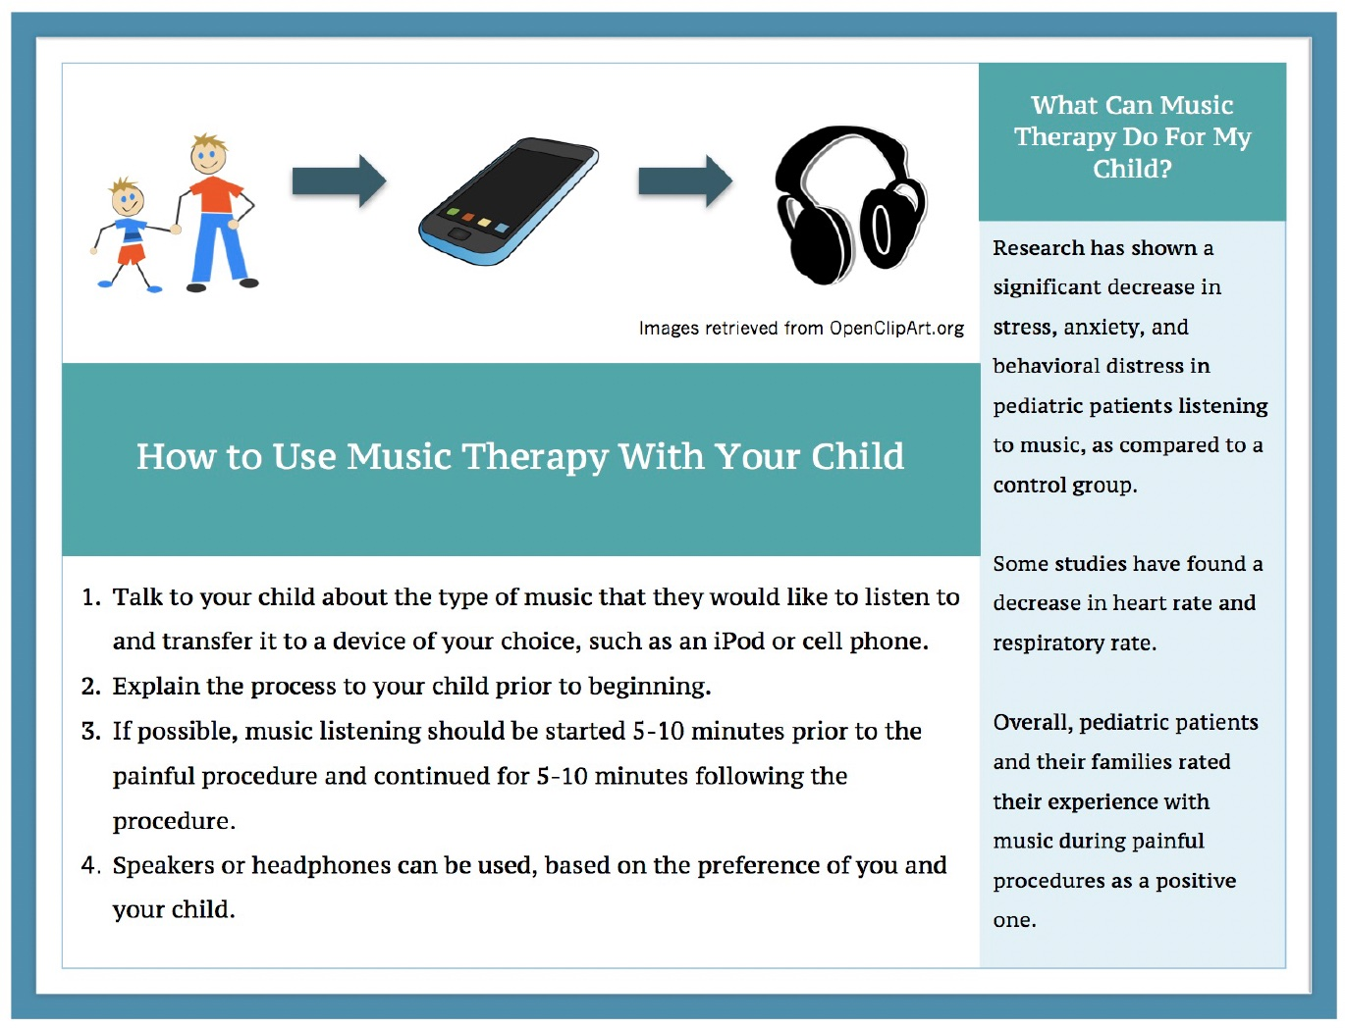
In the Pulmonology Setting
As demonstrated by this project, nursing staff often do not have the time to implement an intervention like music listening.
Another direction would be for families to use music listening at home with their children during respiratory treatments.

Slide 27
Conclusion
There was a statistically significant increase in nursing knowledge following the evidence-based education, but there was not a statistically significant increase in nursing confidence.
There was not an increase in nursing adoption of the music listening intervention, and many of the participants cited a lack of time as a barrier to implementation.
This project indicates that an evidence-based education session was an effective method to increase nursing knowledge of music listening and that nursing knowledge was not the primary barrier to adoption.

Slide 28
References
Birnie, K.A., Noel, M., Chambers, C.T., Uman, L.S., & Parker, J.A. (2018). Psychological interventions for needle‐related procedural pain and distress in children and adolescents. Cochrane Library, 2020(10), CD005179.
Chambers C. T. (2018). Introduction to special issue on innovations in pediatric pain research and care. Pain Reports, 3(Suppl 1), e684. https://doi.org/10.1097/PR9.0000000000000684
Coughtrey, A., Millington, A., Bennett, S., Christie, D., Hough, R., Su, M. T., Constantinou, M. P., & Shafran, R. (2018). The effectiveness of psychosocial interventions for psychological outcomes in pediatric oncology: A systematic review. Journal of Pain and Symptom Management, 55(3), 1004–1017. https://doi.org/10.1016/j.jpainsymman.2017.09.022
Danaci, E., & Koç, Z. (2020). The association of job satisfaction and burnout with individualized care perceptions in nurses. Nursing Ethics, 27(1), 301–315. https://doi.org/10.1177/0969733019836151
Friedrichsdorf, S. J., & Goubert, L. (2019). Pediatric pain treatment and prevention for hospitalized children. Pain Reports, 5(1), e804. https://doi.org/10.1097/PR9.0000000000000804
Fustino, N. J., Wohlfeil, M., & Smith, H. L. (2018). Determination of key drivers of patient experience in a midsize pediatric hematology-oncology ambulatory clinic. The Ochsner Journal, 18(4), 332–338. https://doi.org/10.31486/toj.18.0091
Institute for Health. How to improve. Retrieved from http://www.ihi.org/resources/Pages/HowtoImprove/default.aspx
Polit, D. F. & Beck, C. T. (2017). Nursing research: Generating and assessing evidence of nursing practice. Philadelphia, PA: Wolters Kluwer.
Poulsen, M. J., & Coto, J. (2018). Nursing music protocol and postoperative pain. Pain Management Nursing: Official Journal of the American Society hcare Improvement. (2020of Pain Management Nurses, 19(2), 172–176. https://doi.org/10.1016/j.pmn.2017.09.003
Rogers, E. M. (2015) Evolution: diffusion of innovations. In J. D. Wright (Ed.), International Encyclopedia of the Social & Behavioral Sciences, (2nd ed., vol. 8, pp. 378-381). Elsevier. https://doi.org/10.1016/B978-0-08-097086-8.81064-8
Sullivan, C. E., King, A. R., Holdiness, J., Durrell, J., Roberts, K. K., Spencer, C., Roberts, J., Ogg, S. W., Moreland, M. W., Browne, E. K., Cartwright, C., Crabtree, V. M., Baker, J. N., Brown, M., Sykes, A., & Mandrell, B. N. (2019). Reducing compassion fatigue in inpatient pediatric oncology nurses. Oncology Nursing Forum, 46(3), 338–347. https://doi.org/10.1188/19.ONF.338-347

