Slide 1
The Road to Transition
a protocol for transitioning pediatric patients into adult clinic
Haley Martin, Social Work Trainee
Jude Sammani, Pharmacy Trainee

Slide 2
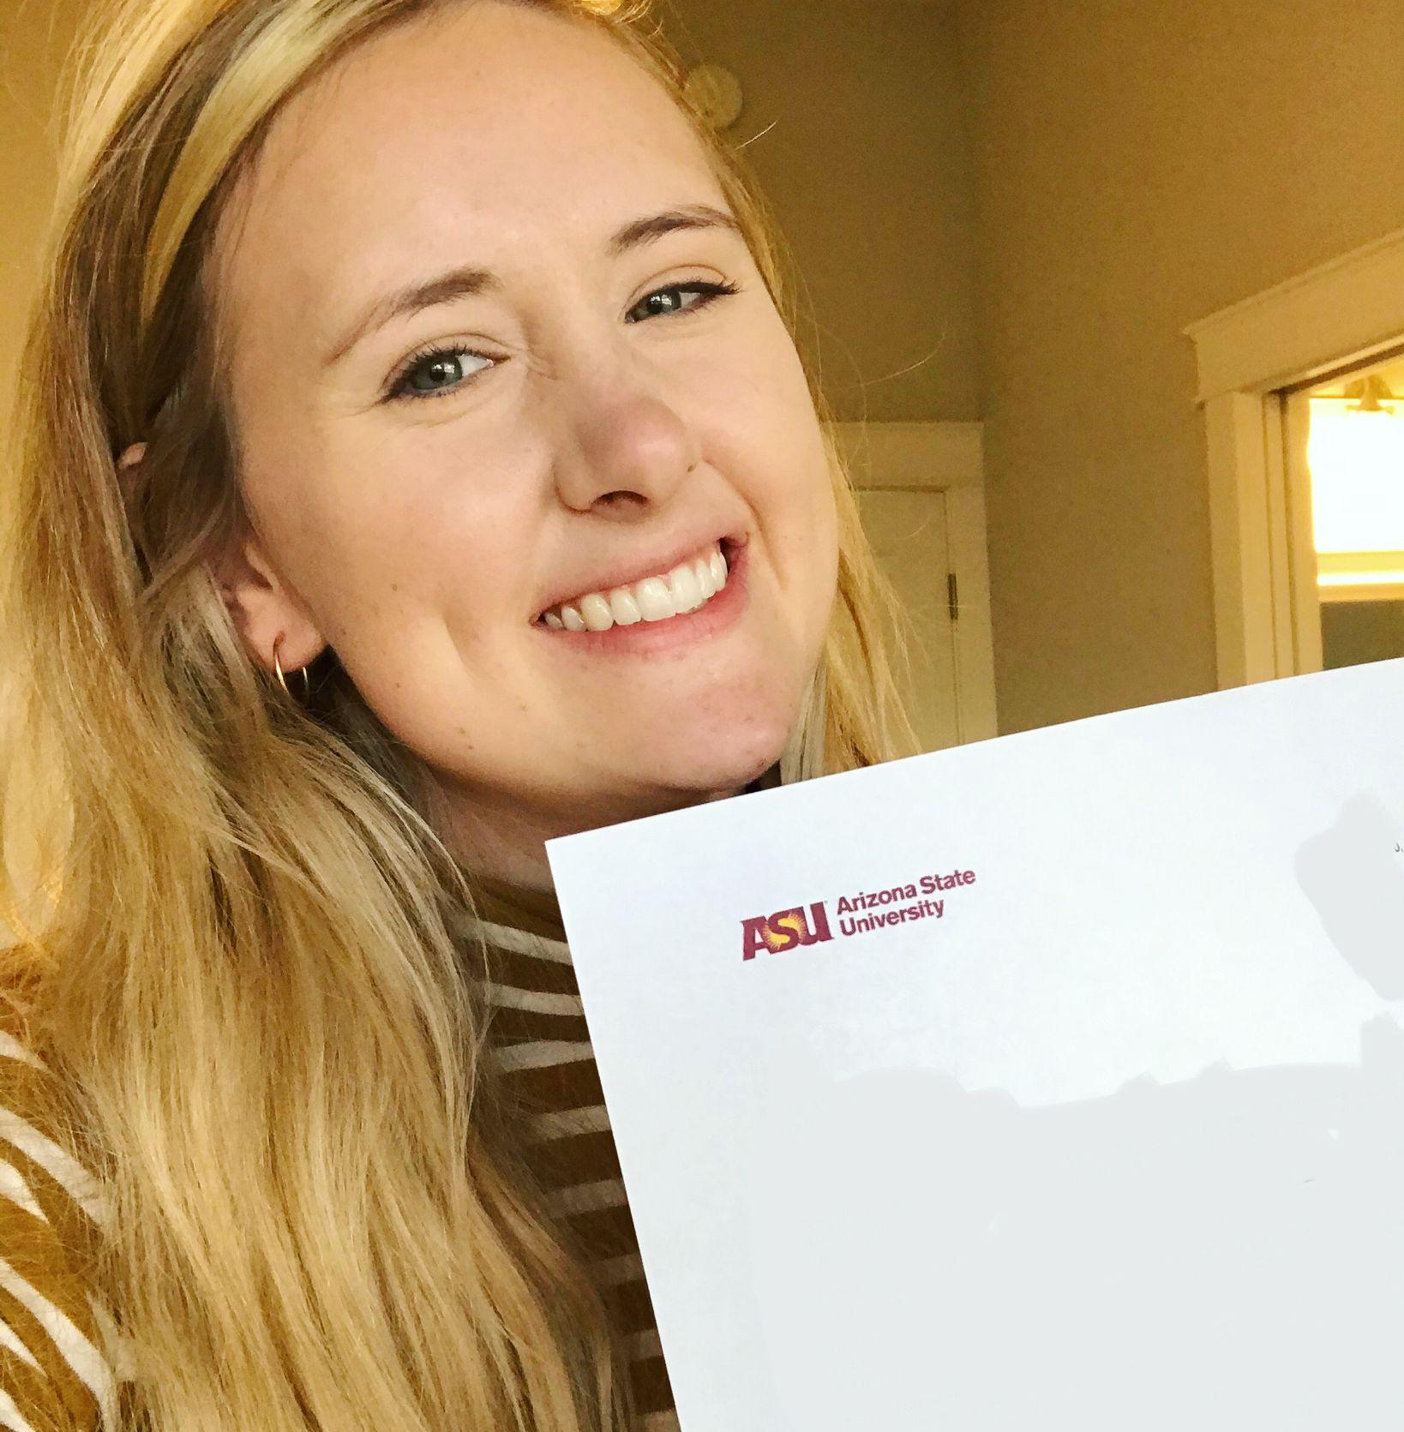
Our Team
Haley Martin
B.S. Psychology
MSW
Jude Sammani
PharmD Candidate

Slide 3
01
Introduction to CF Transitions
TABLE
OF
CONTENTS
02
Needs Assessment
03
Proposed Clinic Protocol
04
Protocol Implementation
05
Tying it All Together

Slide 4
01
An Introduction to CF Transitions
Notes:
Jude

Slide 5
An Introduction to Cystic Fibrosis (CF)
Mutation on chromosome 7, coding for CFTR proteins
Transmembrane cAMP-activated chloride channel
Over 2,000 types of mutations
All mutations: ↓ Cl⁻ secretion, ↑ Na+ resorption into cells
Thicker mucus secretions involving many organ systems
Lungs
Pancreas
Biliary/Hepatic systems
Intestines
Sinuses
Sweat glands
Notes:
Jude

Slide 6
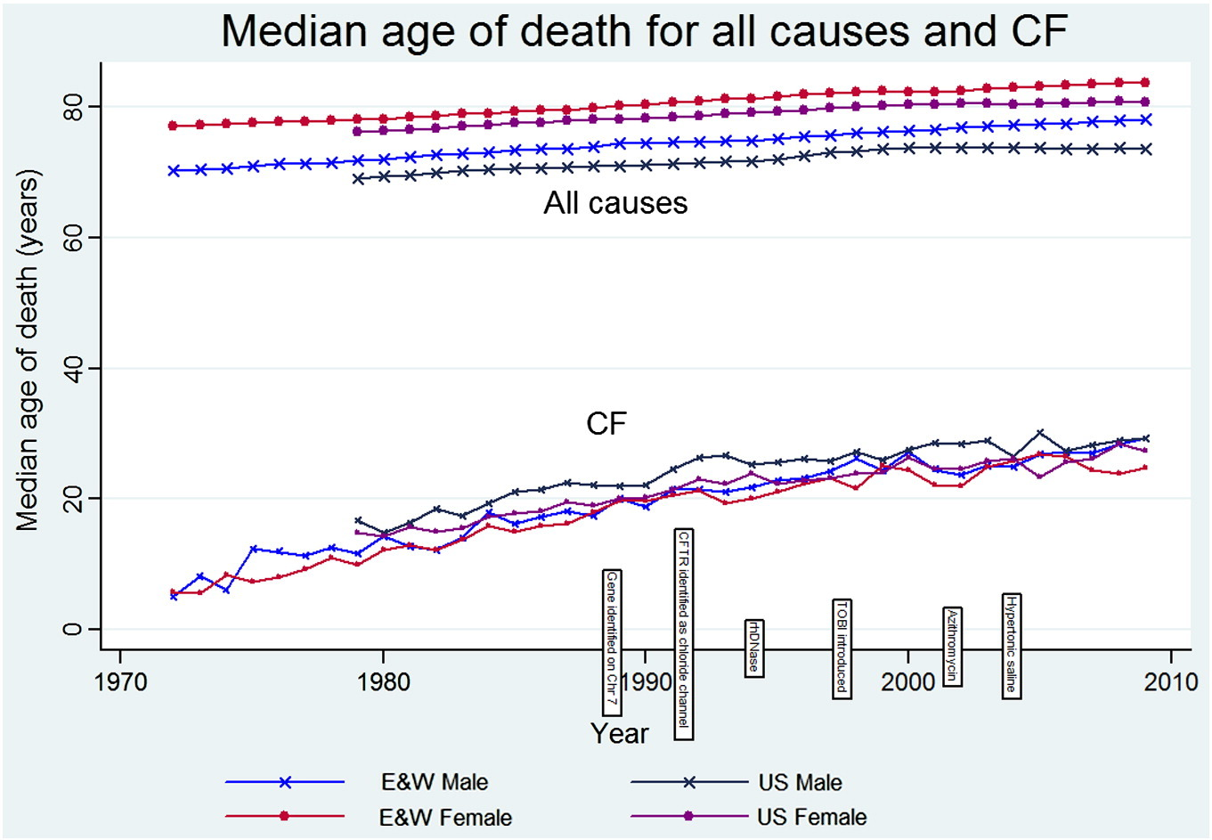
Developments in Cystic Fibrosis
More accessible CF-specific care and therapeutic options are contributing to increases in predicted survival.
Notes:
Jude

Slide 7
Developments in Cystic Fibrosis
CF Foundation 2022 Patient Registry Annual Data Report
Life expectancy of those with CF born between 2018-2022
56 years
Patients with CF born after 2021
Half are expected to live past 65 years
Many patients with CF are living well into adulthood, and newer patients are predicted to do the same.
Where do we come in as a pediatric professionals?
What are our responsibilities as an interdisciplinary team?
Notes:
Jude

Slide 8
Current Practices in Clinic
Usually, at 18, patients are transitioned from Pediatric CFC to Adult CFC.
Currently, there is no system consistently used in clinic to document transitioning.
Examples of a recent patient transition:
Patient #1
Discussions involving upcoming medical changes
Printed flyer with pictures of the adult CFC team and directions to the office
Patient #2
Asked questions regarding CFC that they had
Notes:
Haley
no one system used to document the transition process

Slide 9
Current Resources for Our Patients
CF R.I.S.E
Helps people with CF gain the knowledge/skills needed to independently manage their CF
Designed for people with CF to use with caregivers and CF care team
Requires out-of-clinic involvement from patients and follow-up from care team to be effective
Passport program by past PPC trainees
Use not observed in clinics this past year
Notes:
Haley

Slide 10
02
Needs Assessment
Why did we make a new program?
Notes:
Haley

Slide 11
Why an in-clinic program?
Goal: To develop a tool that could be used in clinic to initiate discussion around important topics for transitions of care
Patients have access to many different tools, but none that can be entirely utilized during their visits.
Prevent additional burden of care for patients
Our well-developed, long-term relationships with patients lend themselves well to discussion-based learning.
Notes:
Haley

Slide 12
Need Assessment
Tool to start conversations and track goals/understanding
Realistic and thoughtful to patients and their burden of care
Utilization of developed relationships that our team builds with our CF patients
Starting the Process:
Where are our patients at?
What can our patients benefit from learning more about?
Upon Completion: Our patients are ready to independently manage their care!
Notes:
Haley
NEED: an easy to use transition tool that doesn’t to patient’s burden or provider’s burden

Slide 13
03
Proposed Clinic Protocol
Notes:
Jude

Slide 14
The Traffic Light Assessment Tool
Traffic light motif symbolizes the different phases a patient moves through to transition to adult clinic
Patients must go through each “light” stage to move forward, earning prizes at the completion of different phases.
Elementary School-Aged Patients
Middle School-Aged Patients
High School-Aged Patients
Notes:
Jude

Slide 15
Items Included in this Program
Patient, Parent/Caregiver, and Provider Evaluations
Focus on items related to:
Physiologic CF understanding
Obtaining and remaining adherent to medications
Transitions of insurance coverage
Building/Maintaining care and networks for support
Game Board & Incentives for Progress
Notes:
Jude

Slide 16
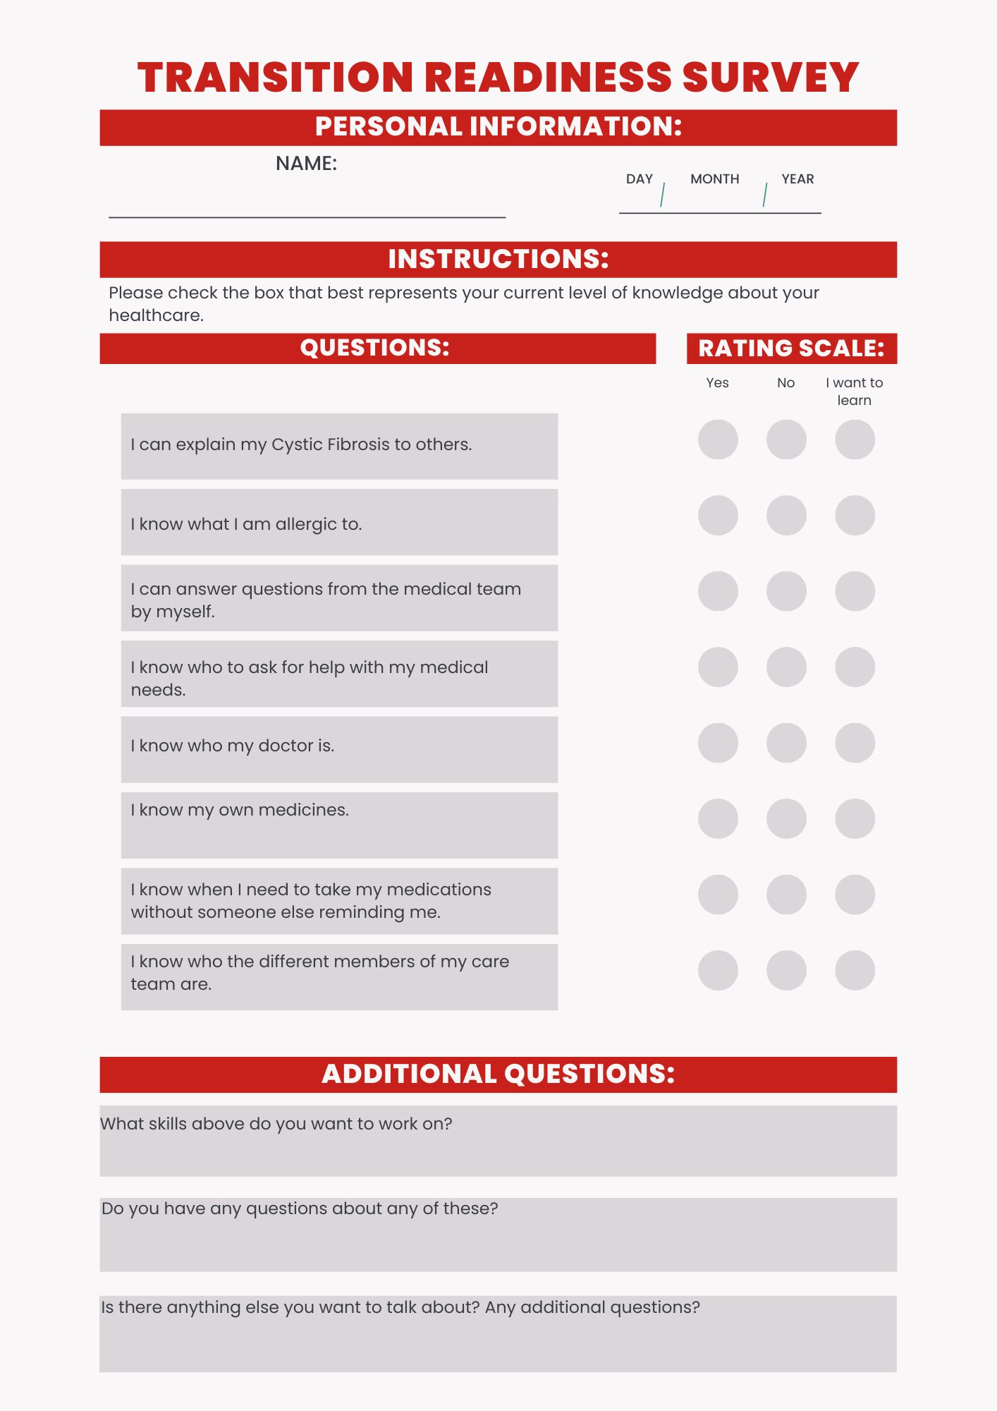
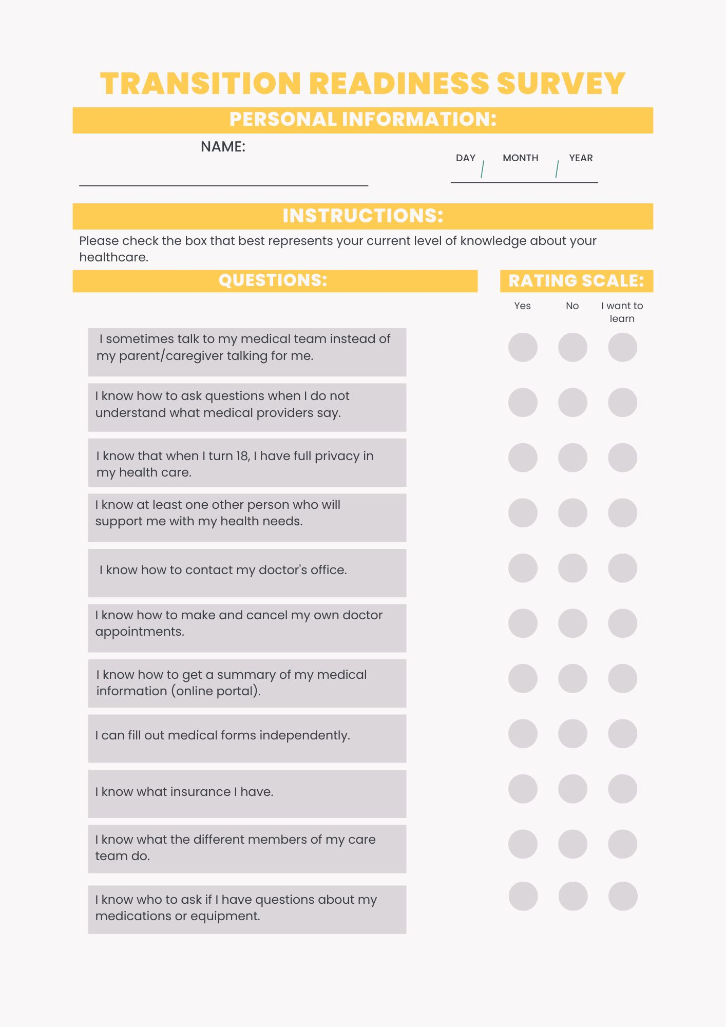
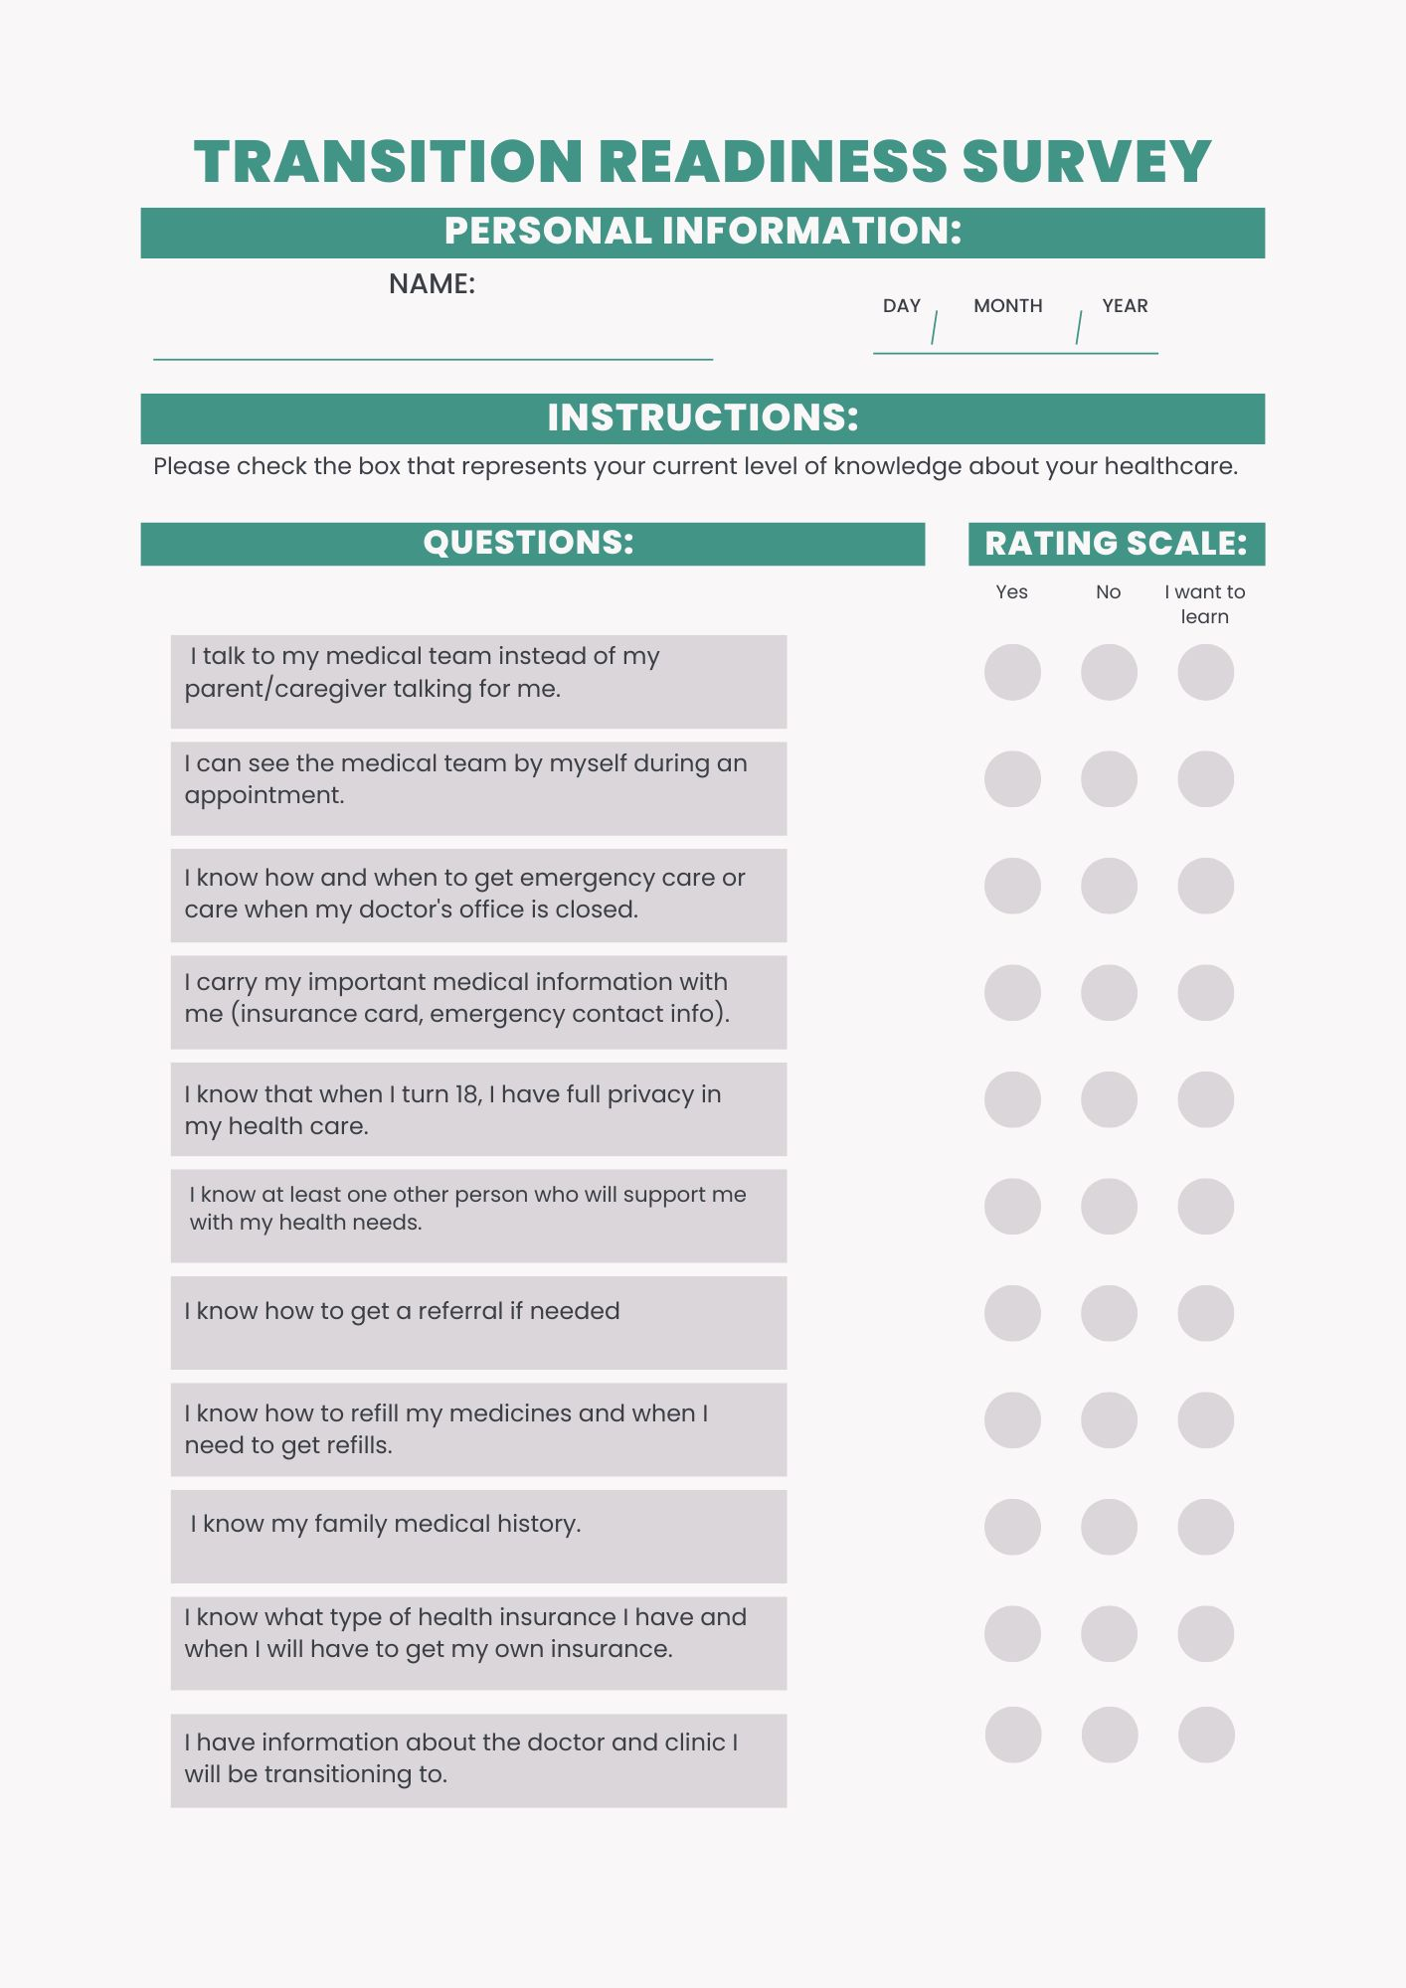
Assessment Examples
Notes:
Haley

Slide 17
Red Level Assessment Examples
“I can explain my Cystic Fibrosis to others”
“I answer questions from providers by myself”
“I know my own medicines”
“I know who the different members of my care team are”
“I know to take my medicines without someone reminding me”
Notes:
Haley

Slide 18
Yellow Level Assessment Examples
“I know how to contact my doctor’s office”
“I can fill out medical forms independently”
“I know who to ask if I have questions about my medications or equipment”
“I know what insurance I have”
“I know that when I turn 18, I have full privacy in my health care”
“I know what the different members of my care team do”
Notes:
Jude

Slide 19
Green Level Assessment Examples
“I see the medical team by myself during an appointment”
“I know how to get a referral if needed”
“I know my family medical history”
“I know what type of health insurance I have and when I will have to get my own insurance”
“I have information about the doctor and clinic I will be transitioning to”
“I know how to refill my medicine and when I need to get refills”
Notes:
Haley

Slide 20
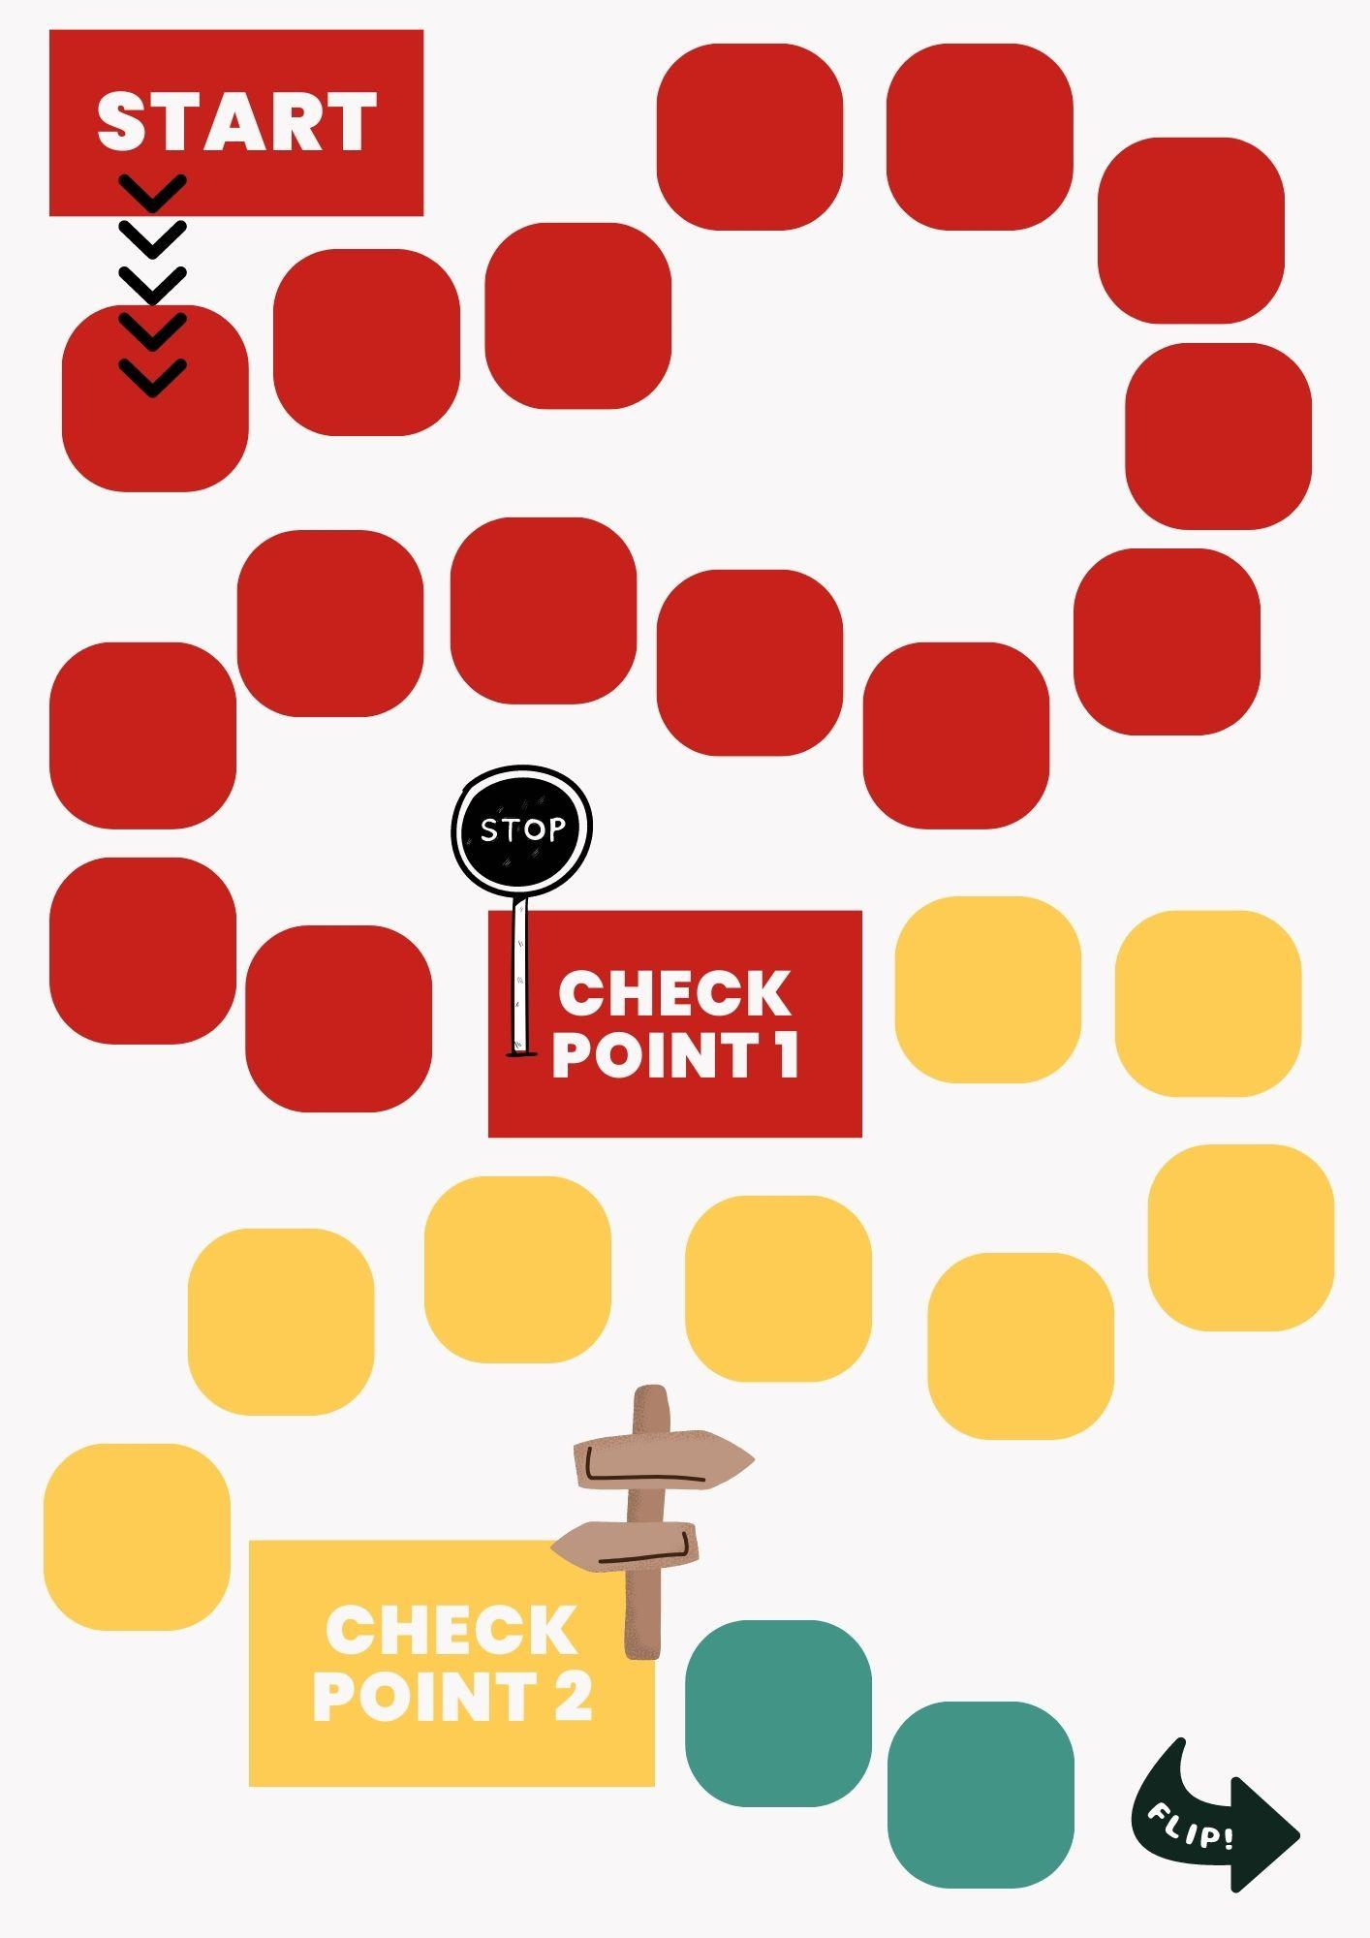
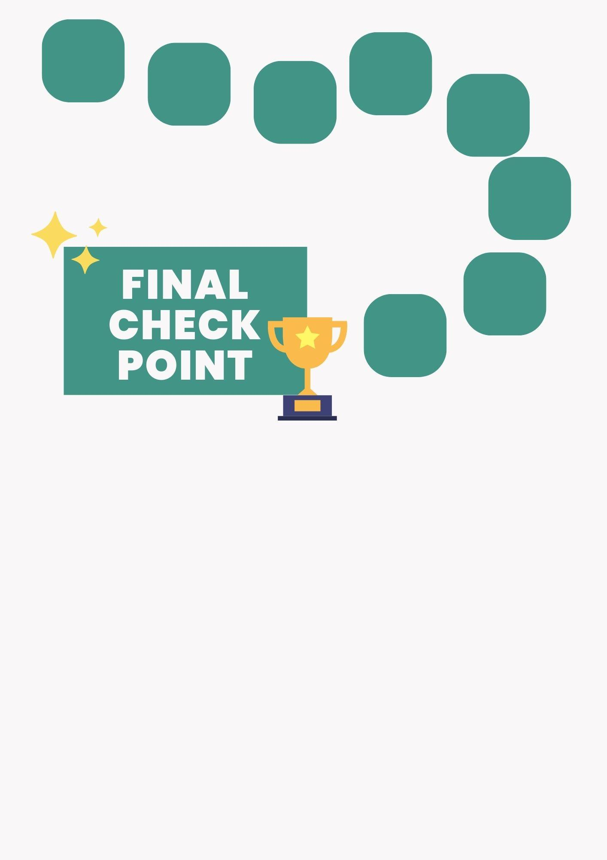
Gameboard
Notes:
talk about numbers in each area

Slide 21
Incentives and Prizes
Patients receive one sticker for attending clinic.
One additional sticker can be earned each visit by demonstrating an understanding of assessment survey items.
When patients reach a new color, or phase, on the gameboard, they get to pick a prize.
Proposed prizes have a monetary value of around $10.
Notes:
Jude

Slide 22
04
Protocol Implementation
How to integrate this tool into clinic

Slide 23
Proposed Clinic Workflow
Patient checks in, does PFTs, and is roomed.
Family planner goes in to agenda-set.
Handouts given to patient/family
Providers go in during their respective slots to see the patient.
Social Work and Pharmacy review their respective items.
Pharmacy/SW will do one of two things biannually:
Complete provider form and scan it into the patient’s chart
Include their general assessment in their note
Pharmacy/SW will decide if the patient get an additional sticker for their board.
When the nurse goes in to wrap up the visit, they will sticker the patient’s board.
Notes:
Jude

Slide 24
Storage & Housekeeping
Surveys and game boards will be laminated and kept in clinic.
Utilization of accordion folders
Allows for consistency in participation
Once patients have either completed the program, or no longer come to clinic, stickers can be removed from boards and reused for the future.
Peds CFC sees about 60 patients in total
Feasible number of items to store in clinic
Notes:
Haley

Slide 25
05
Future Directions
Opportunities of Growing This Program

Slide 26
Limitations and Improvements
Time constraints
Not yet piloted in clinic
More patient & family feedback needed
Self-Reported knowledge; requires SW/Pharm to verify
Notes:
Haley
Patient feedback
One patient found the wording on the assessment confusing (red level)
One parent appreciated the simple nature of the knowledge needed (listed bullet points gave them an outline topics to work on or discuss with their child).

Slide 27
Next Steps & Follow-Up Items
Continue to receive feedback from patients
Make appropriate design and language changes
Trial the full-fledged program in clinic
Creation of a Red Cap survey
Longitudinal data collection and tracking
Cerner documentation template for provider assessments
Easier access to information
Notes:
Jude

Slide 28
References
Yu E, Sharma S. Cystic Fibrosis. [Updated 2022 Aug 8]. In: StatPearls [Internet]. Treasure Island (FL): StatPearls Publishing; 2023 Jan-. Available from: https://www.ncbi.nlm.nih.gov/books/NBK493206/
Matthew N. Hurley, Tricia M. McKeever, Andrew P. Prayle, Andrew W. Fogarty, Alan R. Smyth, Rate of improvement of CF life expectancy exceeds that of general population—Observational death registration study, Journal of Cystic Fibrosis, Volume 13, Issue 4, 2014, Pages 410-415, ISSN 1569-1993, https://doi.org/10.1016/j.jcf.2013.12.002.
Understanding Changes in Life Expectancy | Cystic Fibrosis Foundation. (n.d.). Www.cff.org. Retrieved April 30, 2023, from https://www.cff.org/managing-cf/understanding-changes-life-expectancy#what-does-the-registry-data-mean-for-me.
Welcome to CF R.I.S.E. Cystic Fibrosis Education & Support Resource: CF R.I.S.E. (n.d.). Retrieved April 28, 2023, from https://www.cfrise.com/

Slide 29
Thanks!
Questions?

