Slide 1

PPC 2021 Capstone Project
Amanda Rader and Kelsey Pinckney
Social Work Trainees

Slide 2
What is Creative Wellness?
Therapeutic poetry | a form of expressive writing
Tied to positive health outcomes related to physical health, psychological health, physiological functioning, and general functioning (Lowe, 2006)
Facilitates self-expression and improves self-esteem, confidence, and resilience in relation to readiness for transition to adult care (Calinan & Coye, 2020)
Improves communication with caregivers (Murali et al., 2014) and care providers (Kaptein et al., 2015)
Mindfulness | paying attention on purpose, in the moment, non-judgmentally
(Jon Kabat-Zinn)
Through mindfulness practices, neural activity can be changed and old patterns disrupted (Seigel, 2007)
Has been found to reduce symptoms of anxiety, depression, and stress (Khoury et al., 2013; Blanck et al., 2018)
Studies around mindfulness show improved psychological well-being in patients in CF and other chronic diseases (Akenson, 2018; Mantzios & Egan, 2016)
Notes:
In short, Creative Wellness is a curriculum that combines expressive writing and mindfulness techniques geared toward young patients with chronic pulmonary conditions between the ages of 12 and 17 and their caregivers.
We think of this model as working with both the internal world, with the mindfulness tools, and the external expression of that, through expressive writing and reading of expressive literature. Both of these practices have a rich and deep history in research and medicine. Several researchers have found a link between expressive writing exercises and positive health outcomes, particularly in the realm of self-expression, self-esteem, and communication. Children with illnesses such as Cystic Fibrosis and Asthma have been included in several of these studies, and they have focused on things such as immune function, medication adherence, symptoms of depression and anxiety, communication with caregivers and medical providers, and transitioning from pediatric to adult care. In several studies, focused expressive writing techniques have had positive impact in these areas.
Mindfulness has also been heavily researched, and specific therapeutic modalities have been derived from this practice, such as Mindfulness Based Stress Reduction. Various research studies have shown positive results when individuals practice mindfulness regularly, including reduction in depression and anxiety by equipping both patients of chronic illness as well as their caregivers with mindfulness tools.
And so, Creative Wellness seeks to combine the power between these two unique practices, utilizing the background knowledge of both Amanda and I to marry the two together. The curriculum employs brief structured writing and mindfulness exercises that are meant to encourage reflection, expression, and the reclaiming of an individual’s personal narrative through their own perspective. This is not formal therapy, but is meant as an augmentative and integrative treatment for those living with chronic conditions.

Slide 3
“There is in fact a plentitude of scientific data speaking to the ability of art to enhance our physical and psychological health. We now know that art-making can lower blood pressure, alleviate pain, improve oxygenation and circulation, facilitate weight gain or loss, and shorten hospital stays...art-making can alleviate anxiety and depression, facilitate the expression of feelings, improve patient acceptance and compliance.” (Graham-Pole, 2001, p. 24)
Notes:
J. R. Graham-Pole, a pediatric oncologist who founded and manages an arts in medicine program out of Shands Hospital at the University of Florida, states:

Slide 4
Why is this needed?
Building on insights of past social work trainees
Need for mental health resources knowledgeable of CF experiences (Radnothy, 2016)
Reports of physical exhaustion, emotional challenges, inability to “turn off” from duties; importance of emotional and community support for respite (Kennedy, 2020)
Connection between mental and physical health
Individuals with CF, and their caregivers, are 2-3x more likely to experience psychological difficulties (Smith et al., 2016)
Emotional issues shown to to be triggers for asthma attacks (Licari et al, 2019)
Depression & anxiety associated with: worse health outcomes, less adherence, lower quality of life, and more exacerbations (Smith et al., 2016), longer hospitalizations, and health care costs (Munoz et al, 2020)
Context of pandemic
Notes:
Amanda. add literature references.

Slide 5
Research Question
Are short workshops that teach mindfulness and expressive writing techniques useful in promoting patient/caregiver well-being?
Anticipated Outcomes:
  More knowledge regarding mindfulness and expressive writing practices
  Expressed interest in continued engagement in these practices in groups and alone
  Greater self-perceived ability to handle stress, anxiety, and/or depression
  Improved self-esteem and ability to self-express
  Expanded set of coping skills
Notes:
So our research question is simple: Are short workshops that teach mindfulness and expressive writing techniques useful in promoting patient and caregiver well-being?
This study is very much an introduction to the idea of providing patients and caregivers with this type of augmentative treatment. We implemented the curriculum with the hopes of discovering a few things, like: will the PPC patients and caregivers be interested in this? Will they find it meaningful? Does providing this type of introductory information about these exercises add to their well-being? Is this information new to them, or do they do these types of things already? And Will they engage in the types of practices we teach them later, on their own, or with their family or friends?
And if so, based on the research, we have some anticipated benefits such as: participants feeling more equipped to handle stress, anxiety, and depression and to express themselves to those around them; improved self-esteem, and overall, that they would be able to add these writing and mindfulness techniques to their toolbox of coping skills

Slide 6
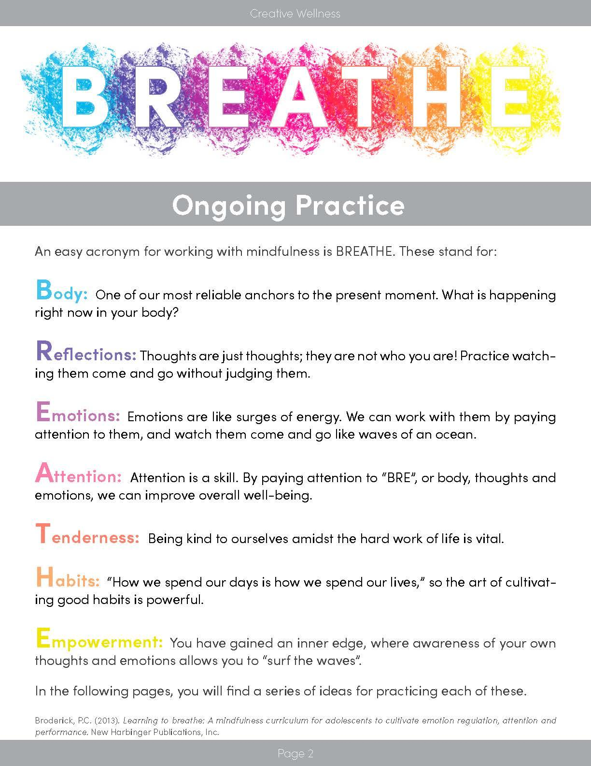
Methods
Workshops
  Patients ages 12-17
  English-speaking caregivers
  Spanish-speaking caregivers
Wellness Kits
Resources for ongoing practice
Evaluation
Notes:
Amanda
1-2 hour workshops for children with CF and severe asthma, their caregivers, and whole families
Tangible resources to guide practice at home
Psychoeducation on the uses of this practice and how it impacts your wellbeing, as well we how to create the practice on your own

Slide 7
Results
 | Registered | Attended
Patients | 6 | 5
Caregivers | 10 | 7
Notes:
So here are our results from the evaluation we conducted to measure the effectiveness of the workshop and get some answers to our questions. Overall, we had 6 patients register to participate, with 5 showing up to the workshop. Likewise, we had 10 caregivers register, with 7 showing up.

Slide 8
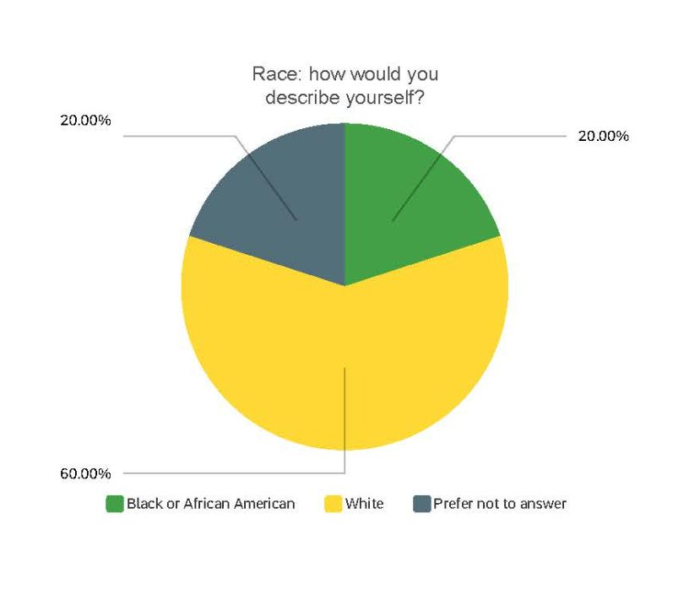
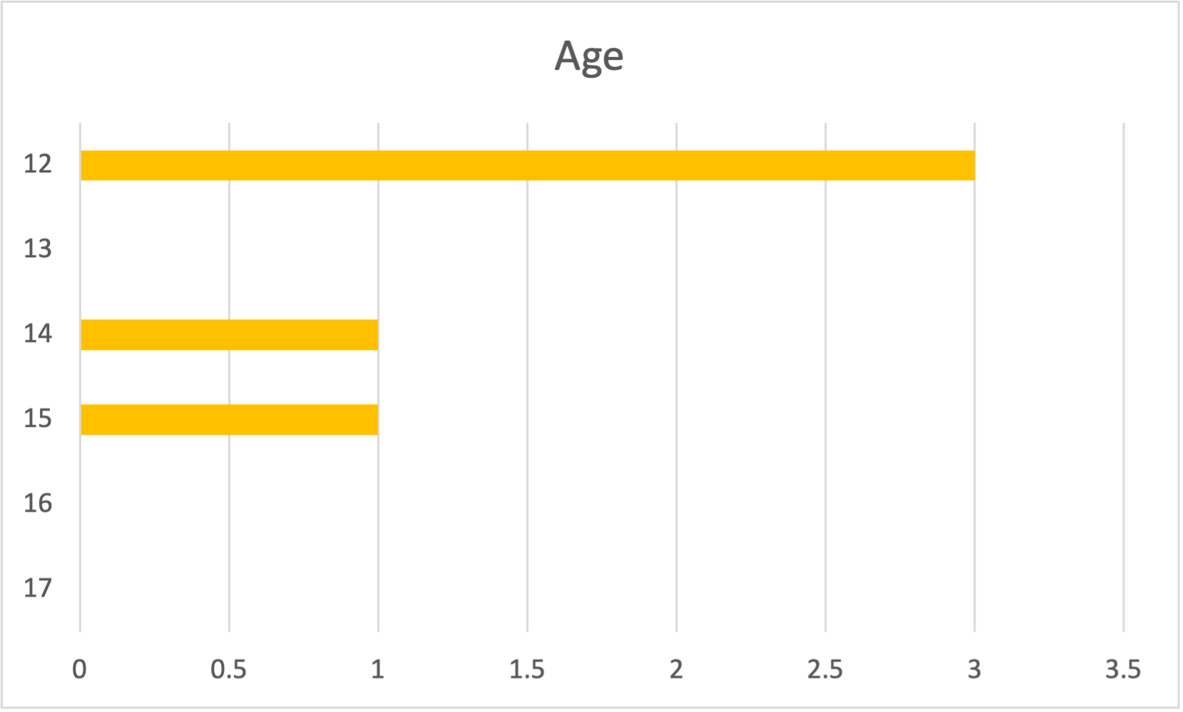
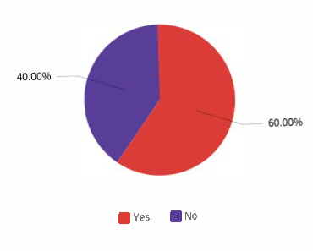
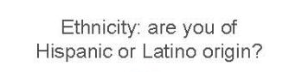
Who attended: Patients
Cystic Fibrosis | 2
Severe Asthma | 3
Total | 5
Male | 1
Female | 4
Total | 5
Notes:
Here are some simple demographics of the patients who came to the virtual workshop. Obviously, the sample sizes for these graphs and charts will be small, but I still find it is easiest to understand results through this type of visualization. Most patients were 12 years old, with a couple older. Almost an even split of SA and CF diagnosis, as well as even split in ethnicity. Most patients identified as White, and most participants were female.

Slide 9
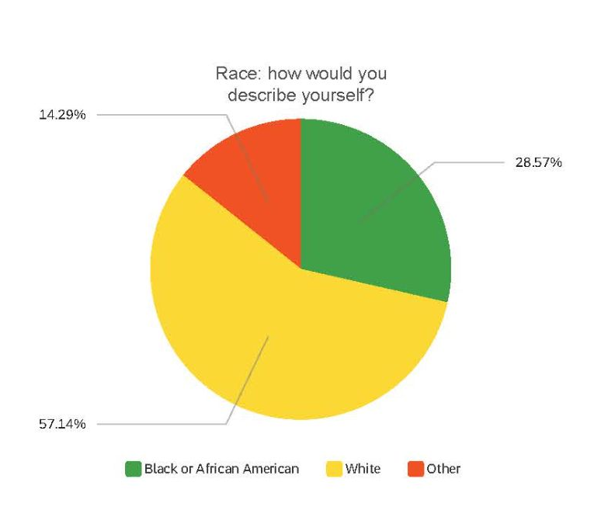
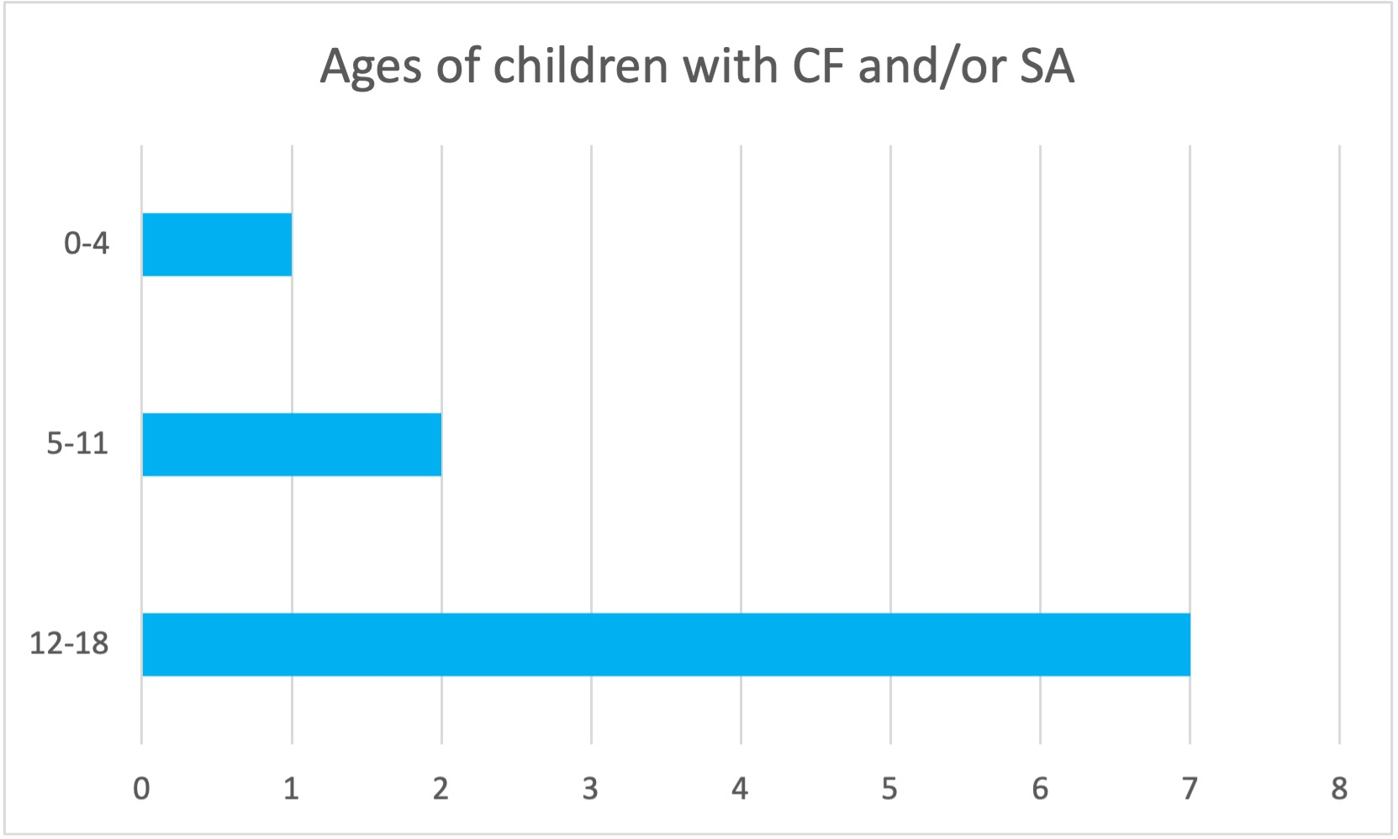
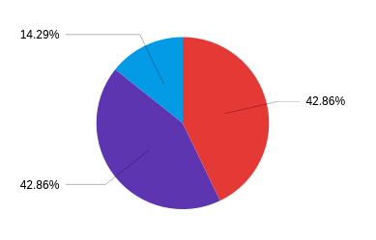
Who attended: Caregivers
Cystic Fibrosis | 5
Severe Asthma | 1
Both | 1
Total | 7
Male | 1
Female | 6
Total | 7
Notes:
For the caregivers, the data for age and diagnosis is for the children they care for, so most of the caregivers were parents of CF patients, and mostly between the ages of 12 and 18. Caregivers were also mostly female, identified as white, and almost even split on ethnicity again.

Slide 10
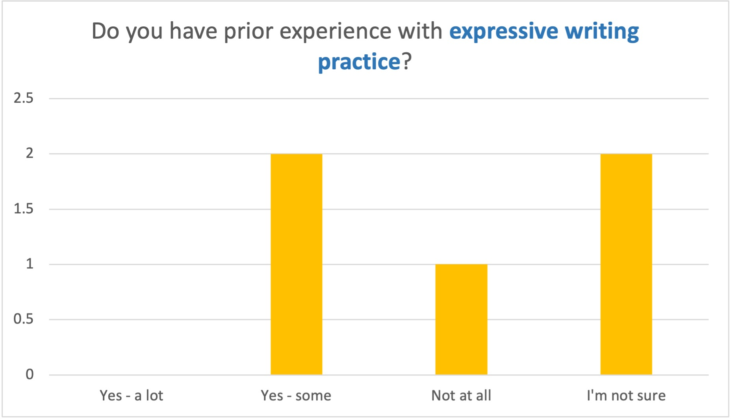
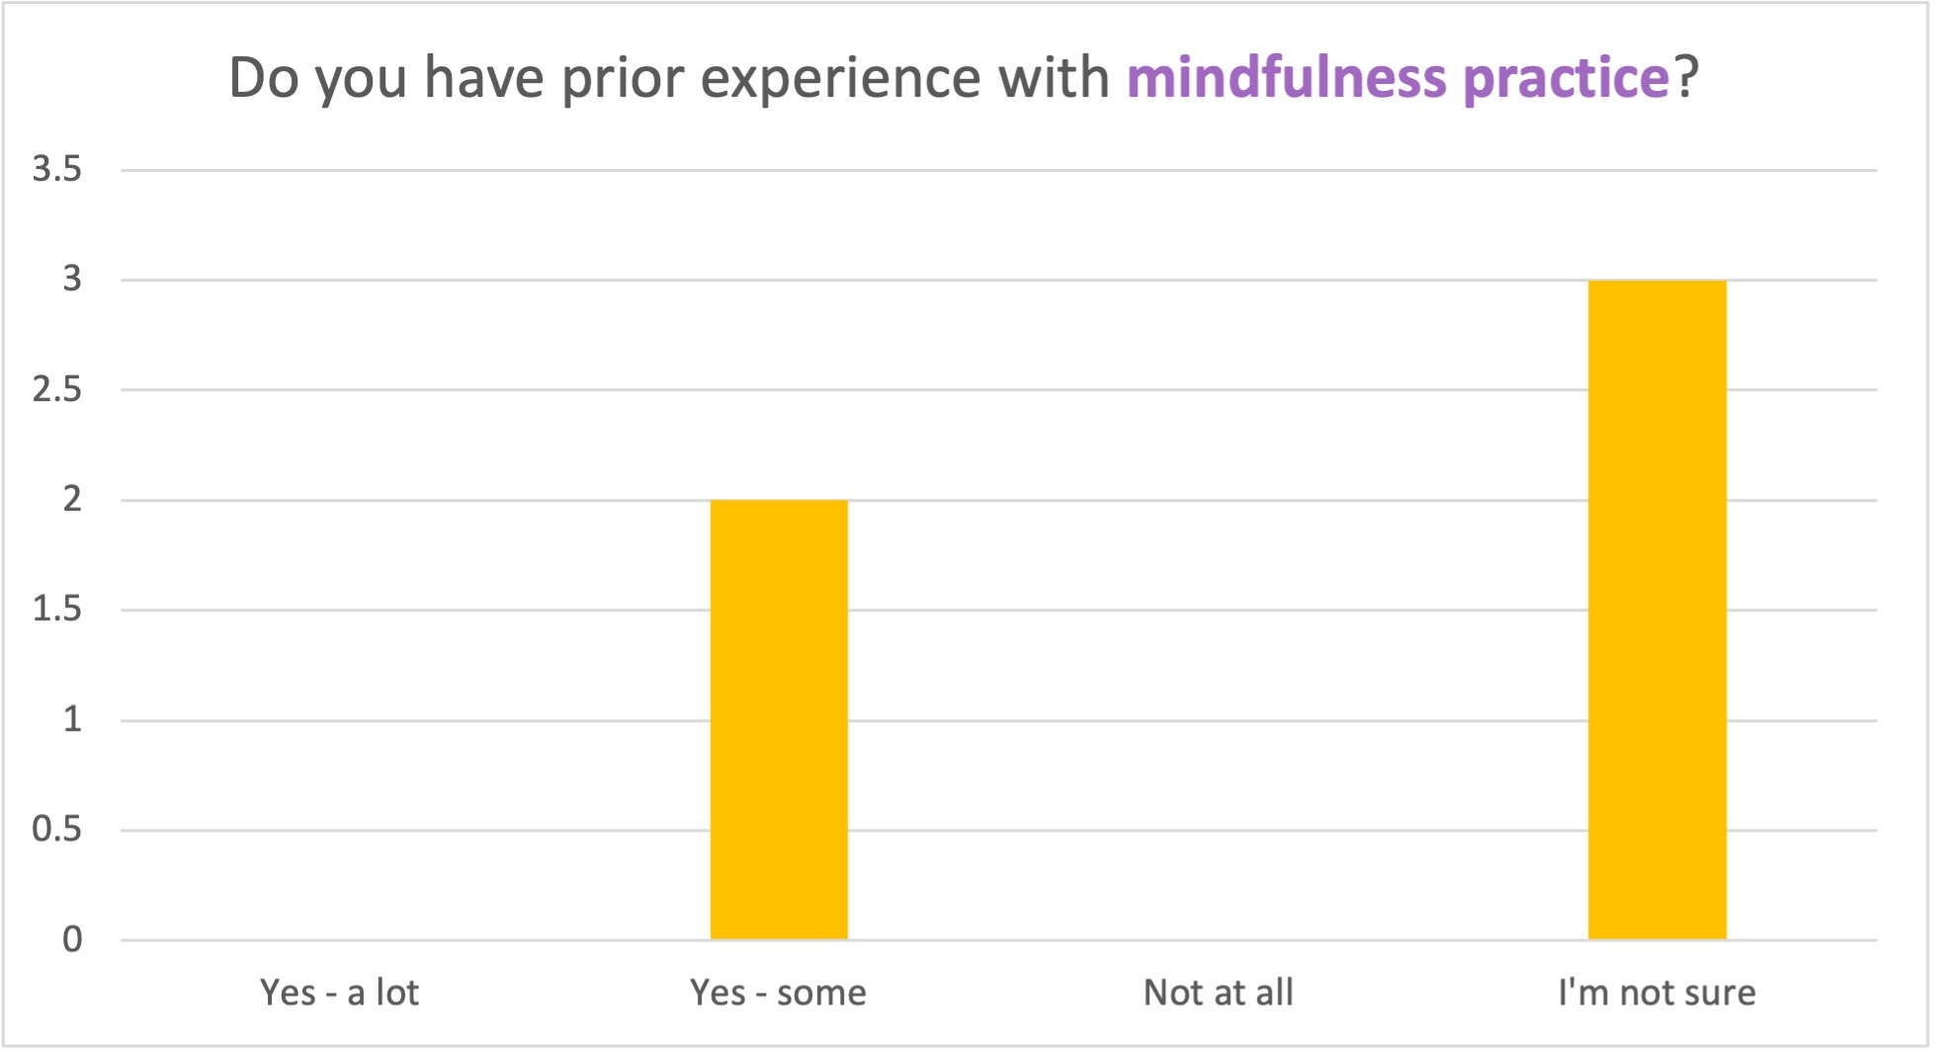
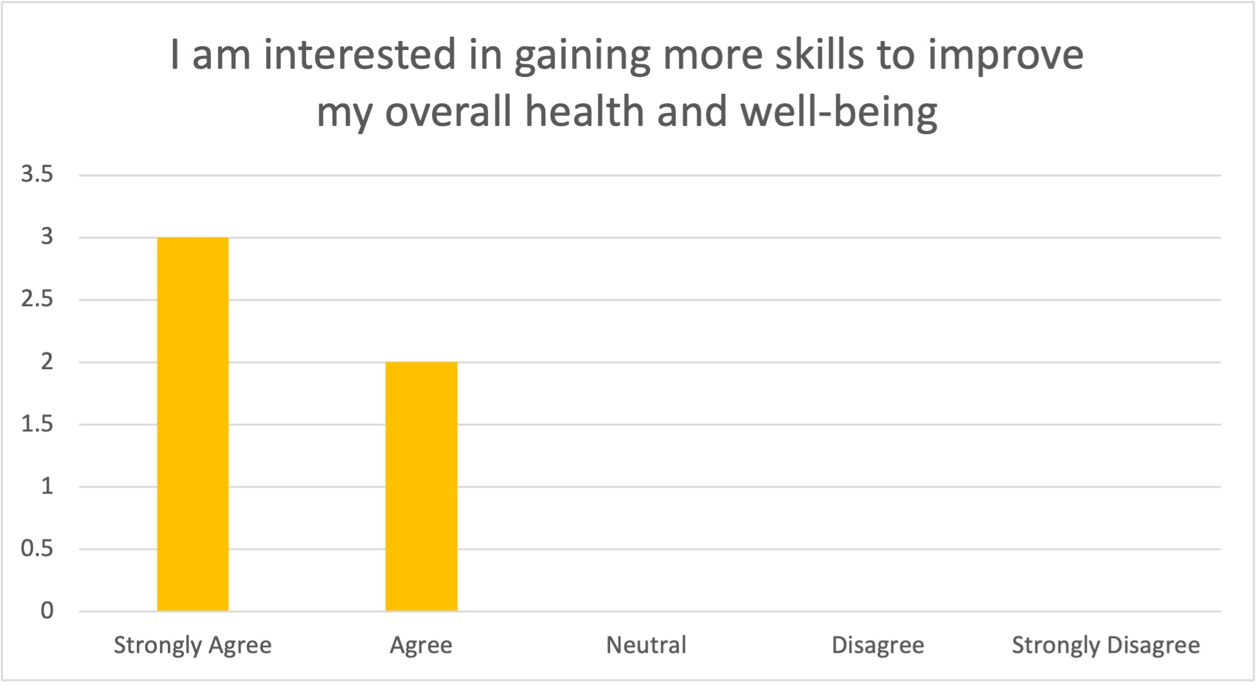
Before the workshop:
CF and SA patients
Notes:
And here are some data points that just give us an idea of how much experience the participants had with mindfulness and expressive writing already, before the workshop. As you can see, there is some experience with both practices, but also a fair amount of unsuredness on what these practices even are, which tells us that this group would be a good group to introduce these exercises to, especially because they all agreed or strongly agreed that they want to gain more skills to improve their overall well-being, so they are enthusiastic and willing!

Slide 11
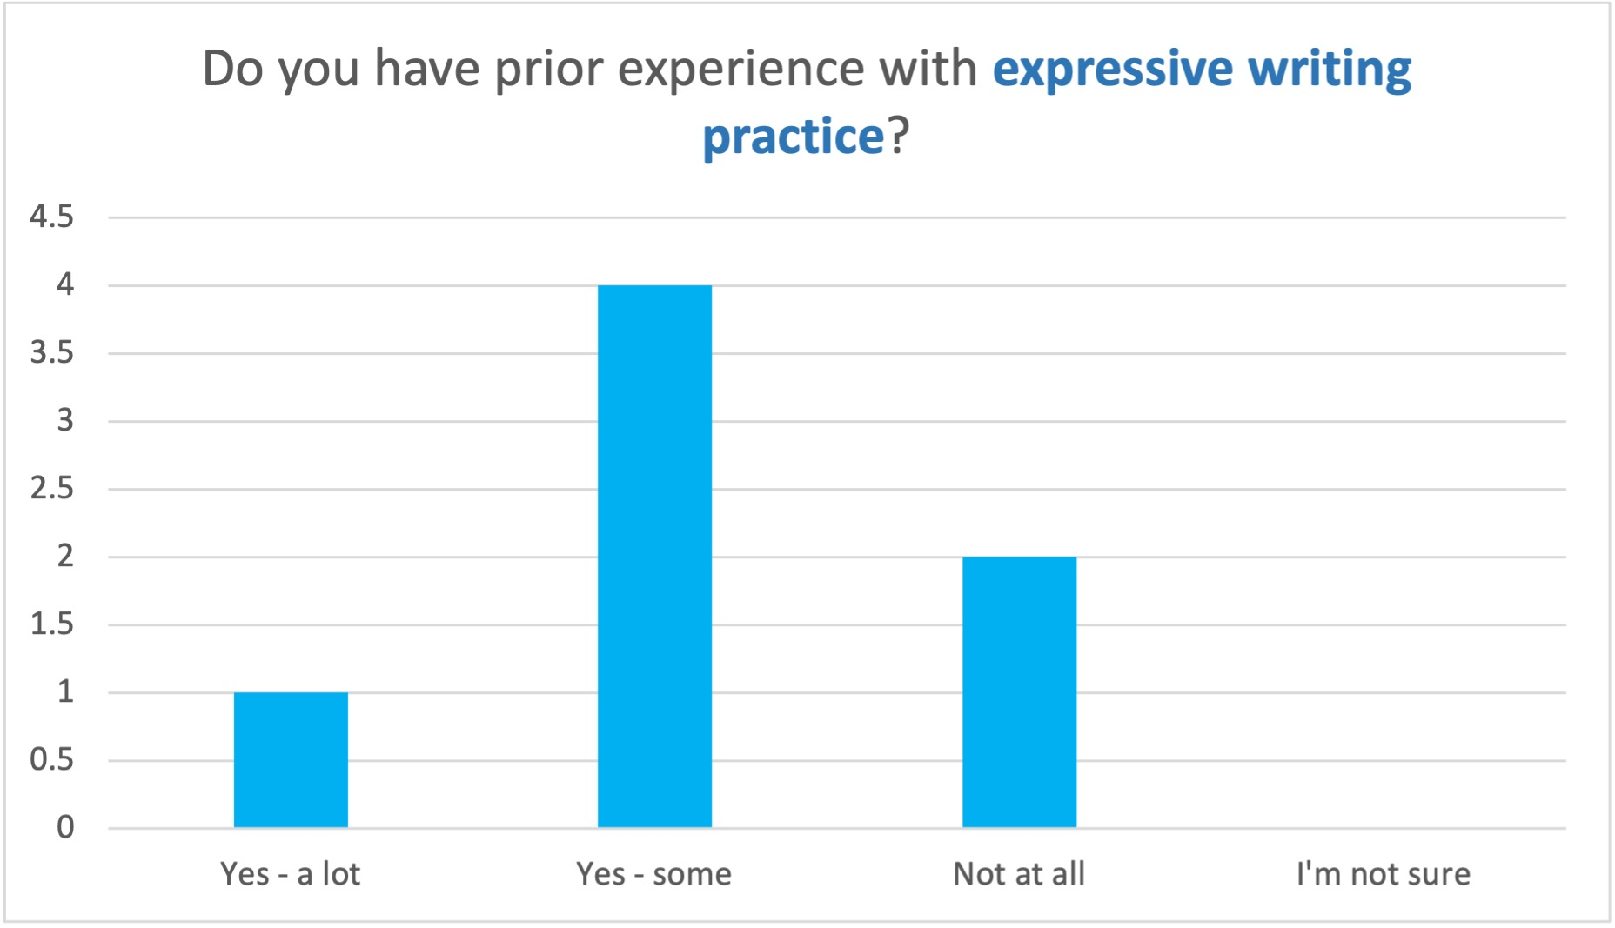
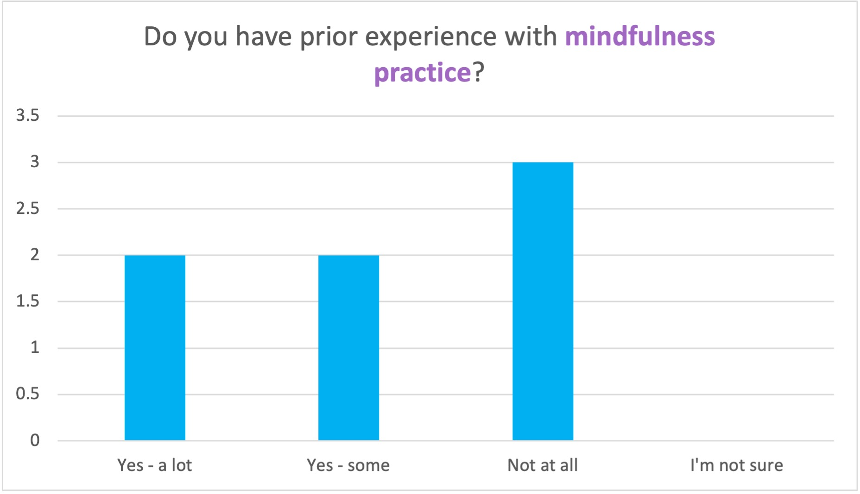
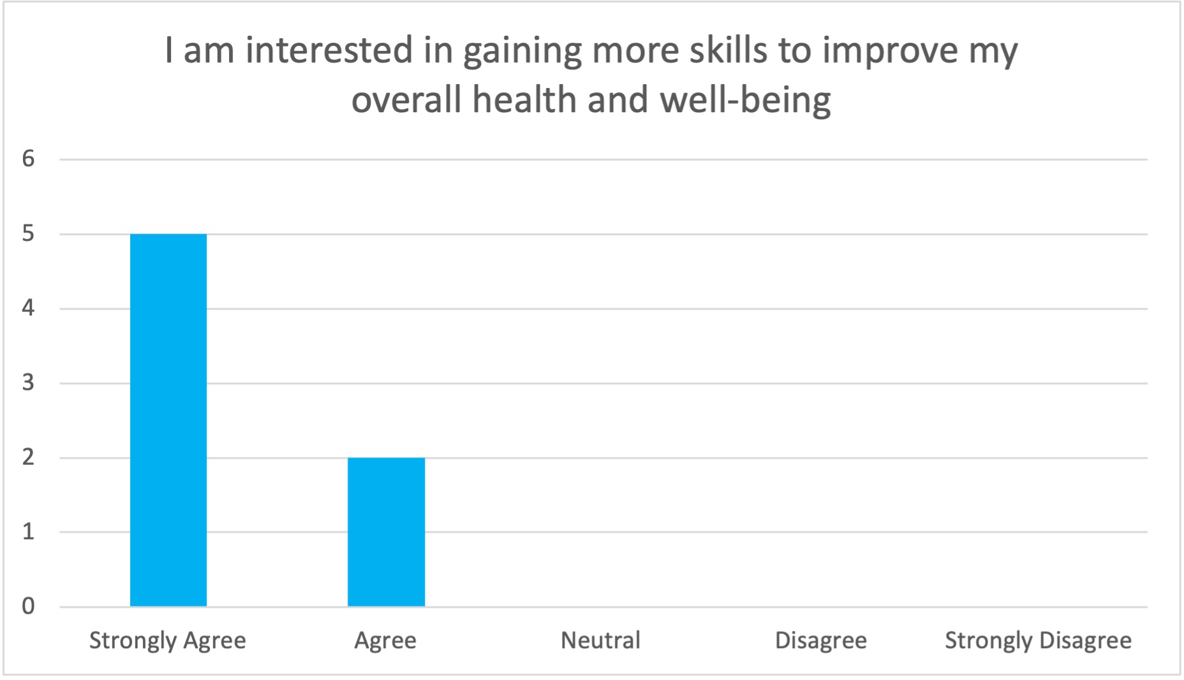
Before the workshop: Caregivers of
CF and SA patients
Notes:
Similar results here for the caregivers, with some participants having a lot of experience with these practices, and others not at all. All in all, they are also enthusiastic and willing to jump into gaining more coping skills, and it is interesting to see that both people who have experience with mindfulness and expressive writing and those that don’t are equally as interested in taking part in the workshop opportunity.

Slide 12
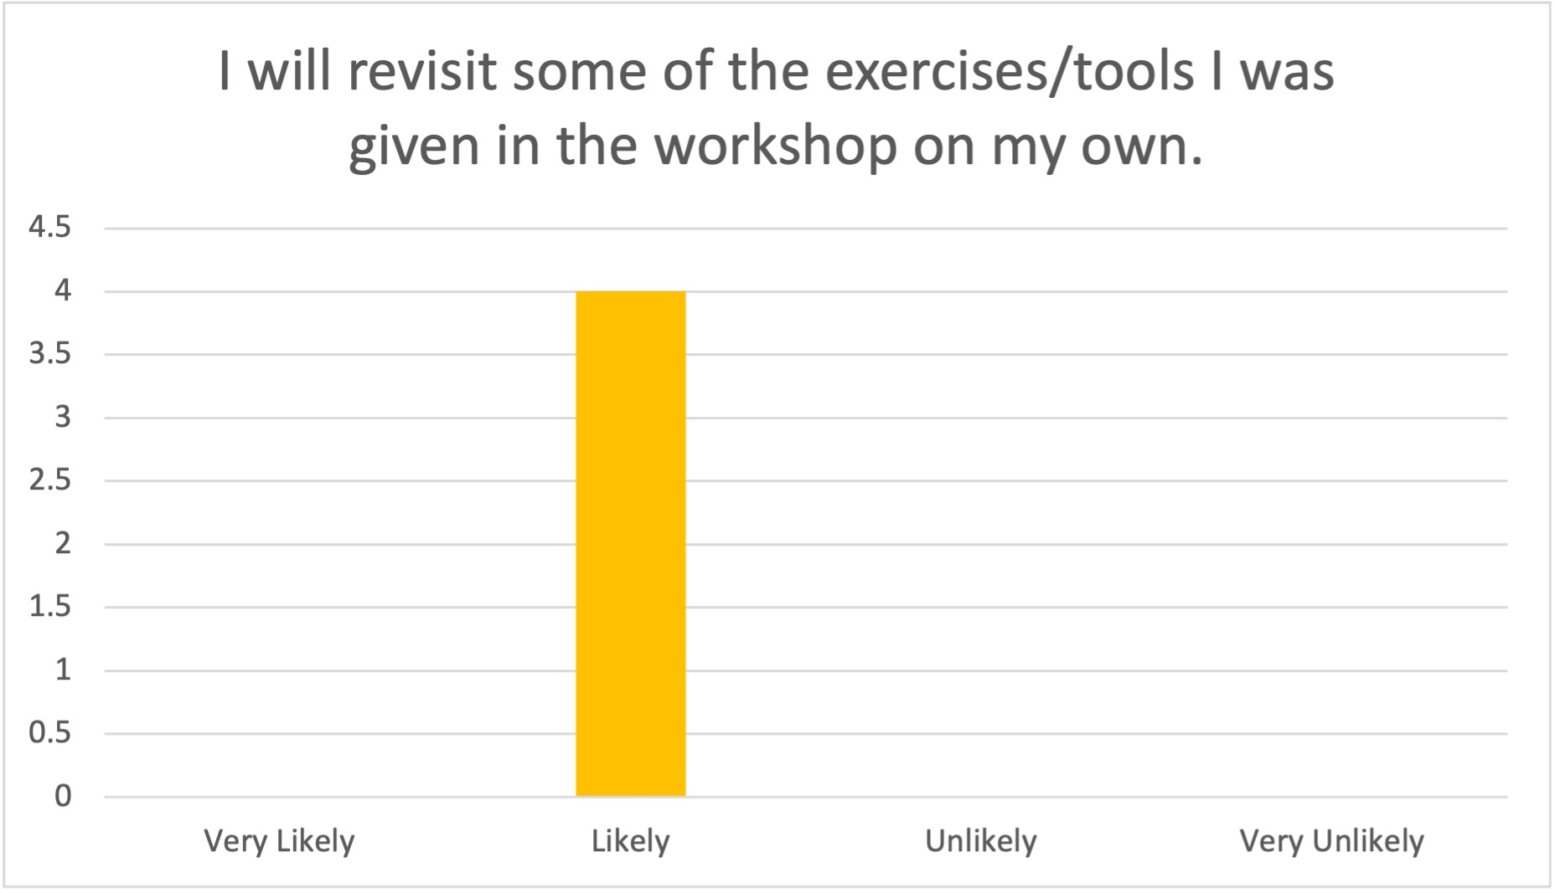
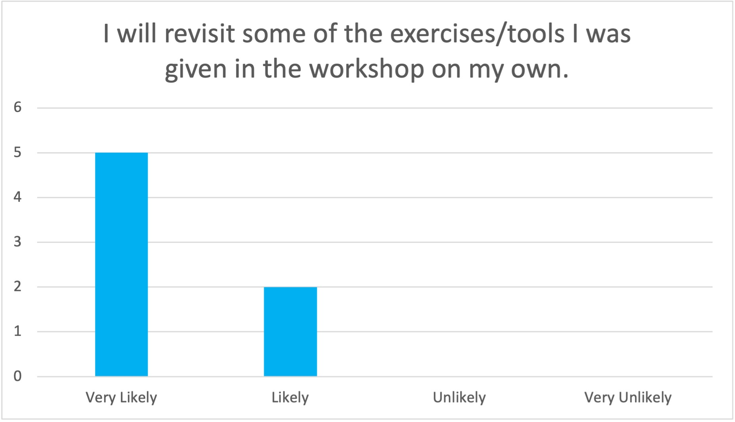
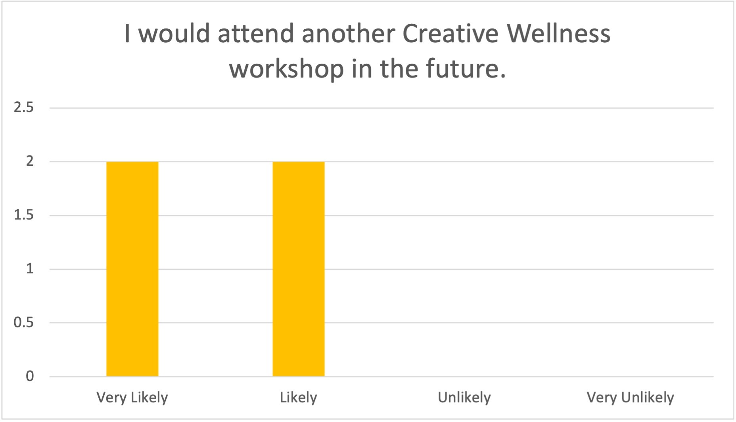
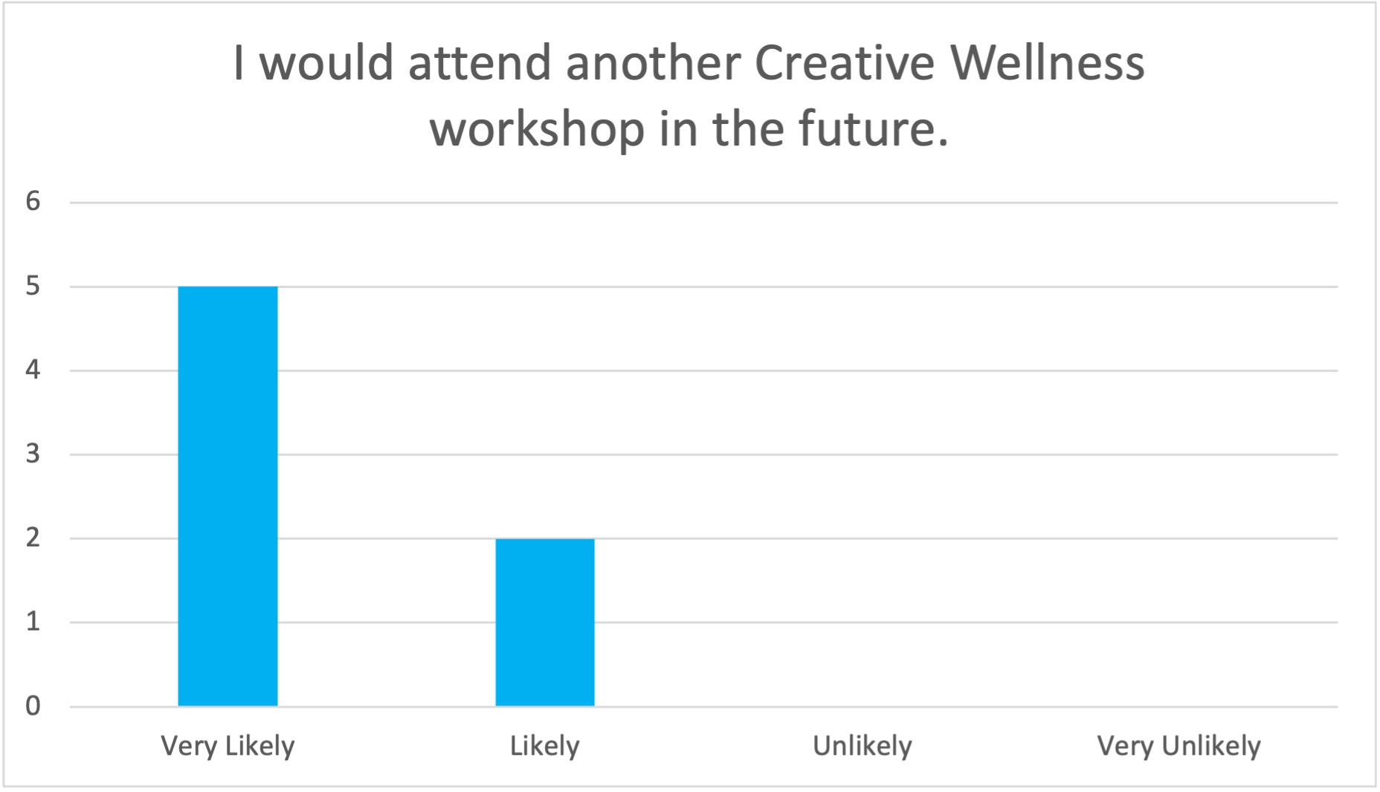
After the workshop: Patients
After the workshop: Caregivers
Notes:
And here are some results from after the workshop! After having attended the one-hour workshop with peers, both caregivers and patients all said they would likely or very likely attend another Creative Wellness workshop! Also important to note is that they also said they would revisit some of the exercises shared in the workshop - which is good because they all received an Ongoing Practice packet in order to help them do just that! So this data shows that our efforts in putting together that packet were in fact beneficial to participants, and we have hopefully given them tools that they can continue to use throughout their daily lives.

Slide 13
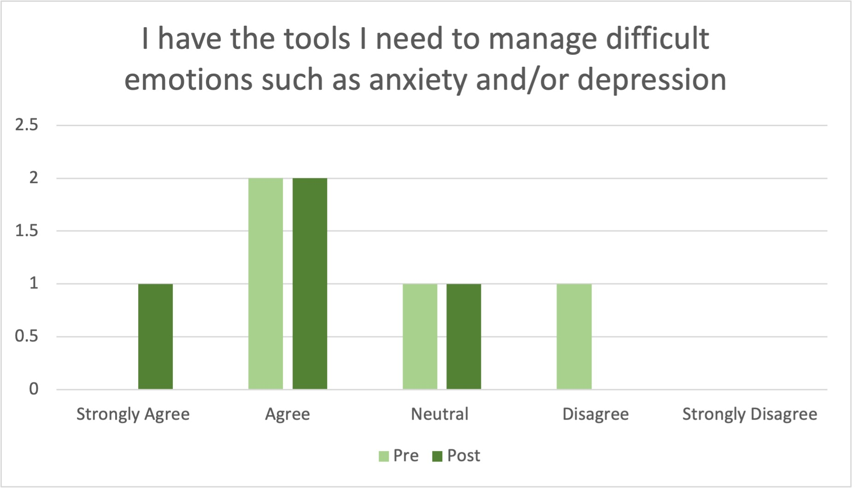
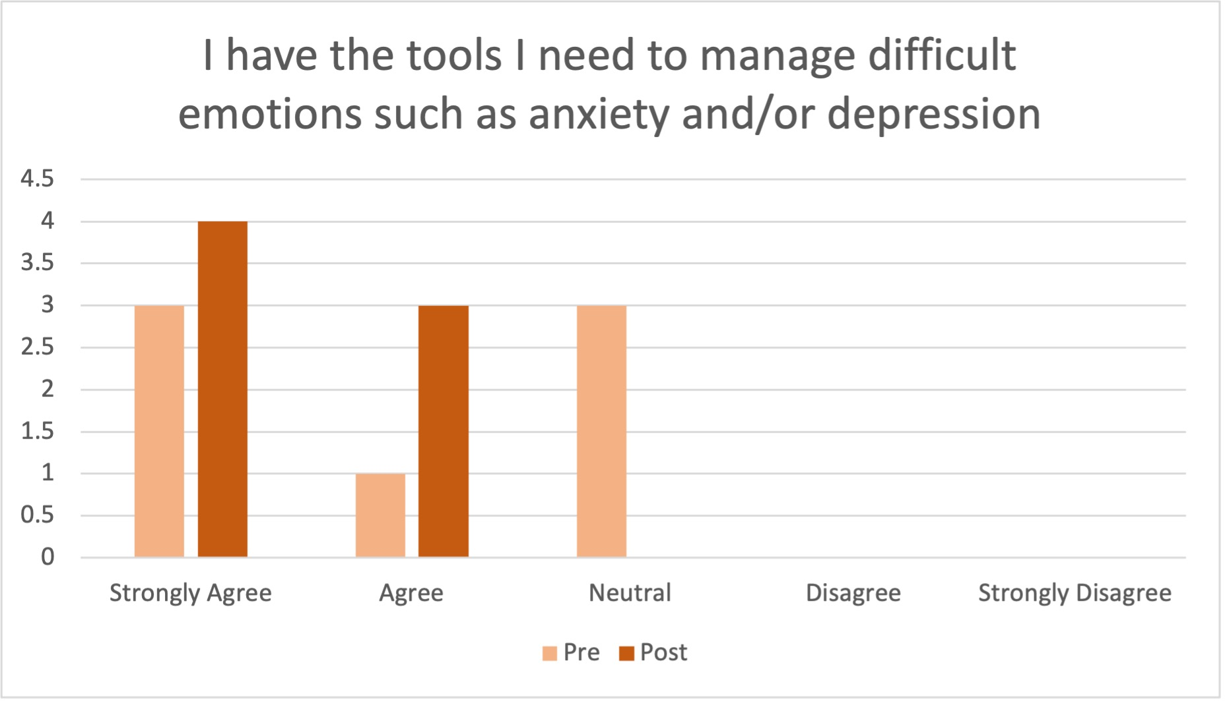
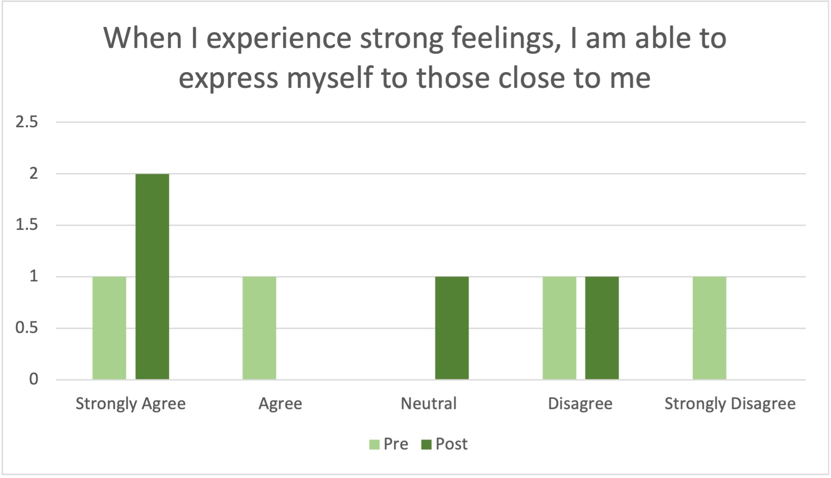
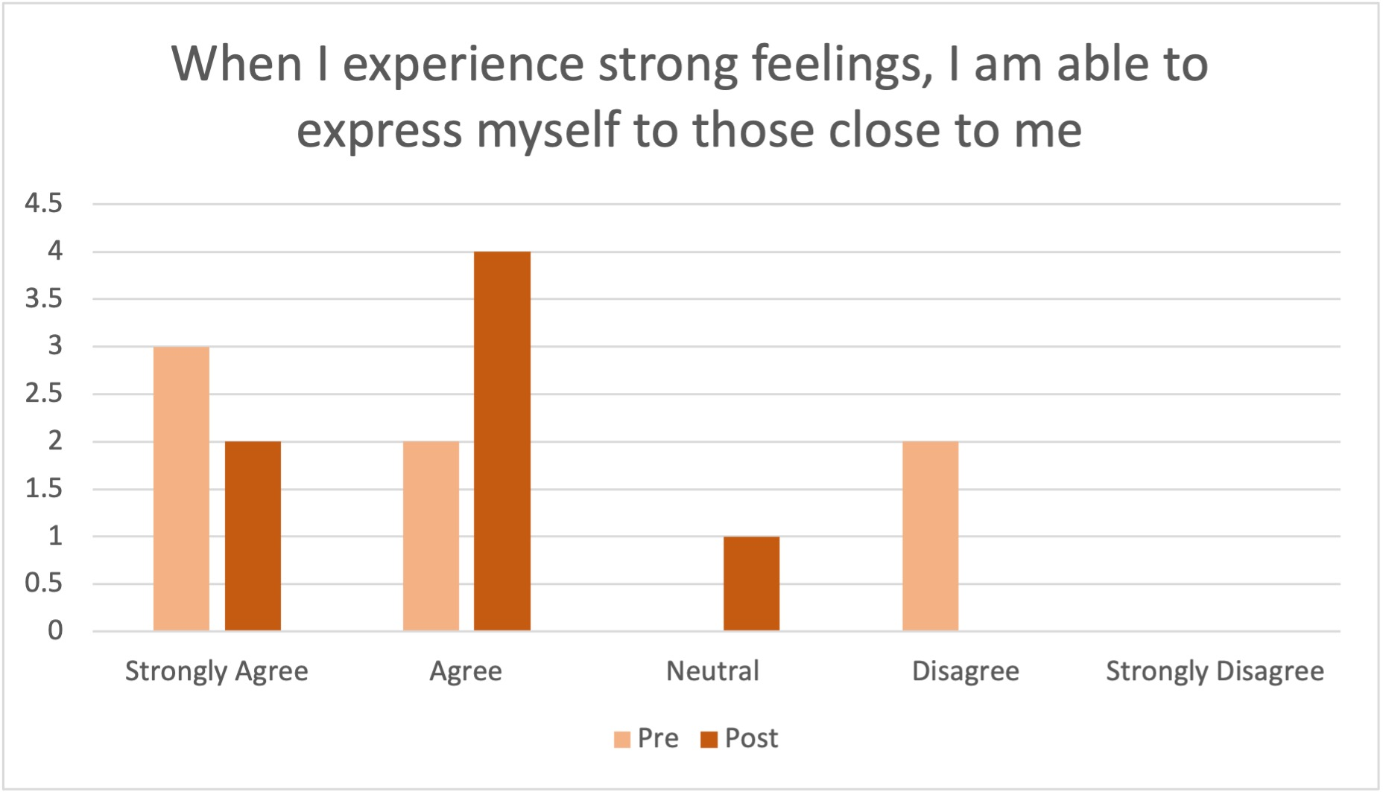
After the workshop: Patients
After the workshop: Caregivers
Notes:
Here are some questions we asked both before and after the workshop. The light bars are from before the workshop, with the darker ones being answers from after the workshop. There is overall some growth in both patients and caregivers reporting that they have the tools to manage difficult emotions--one patient disagreed that they did, but then after the workshop, stated that they might. The second question is about self-expression. some really great growth from disagrees and strongly disagrees over to agree and neutral, with one patient still disagreeing, but moving up from strongly disagree. It should be noted that participants took this survey about 1 week before the workshop, and then completed the post survey 1-2 days after the workshop.

Slide 14
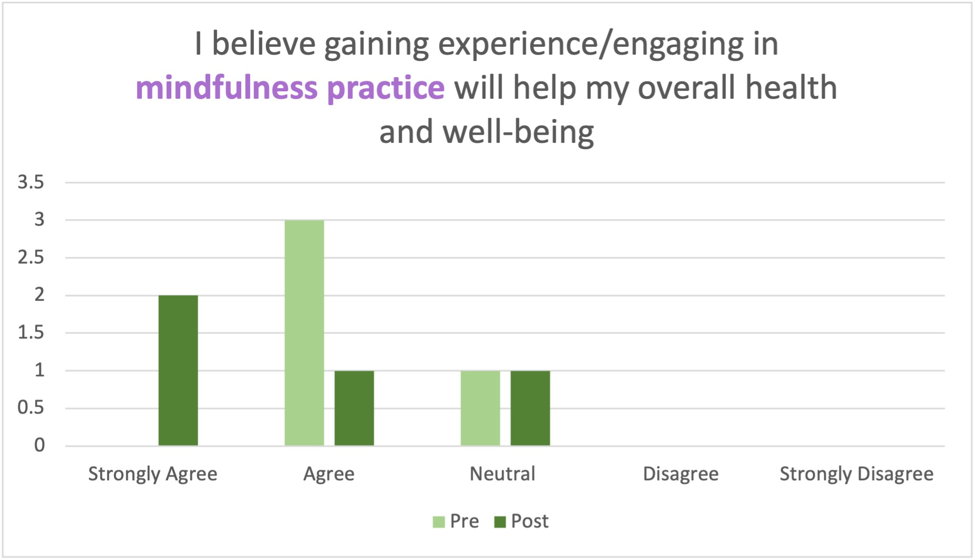
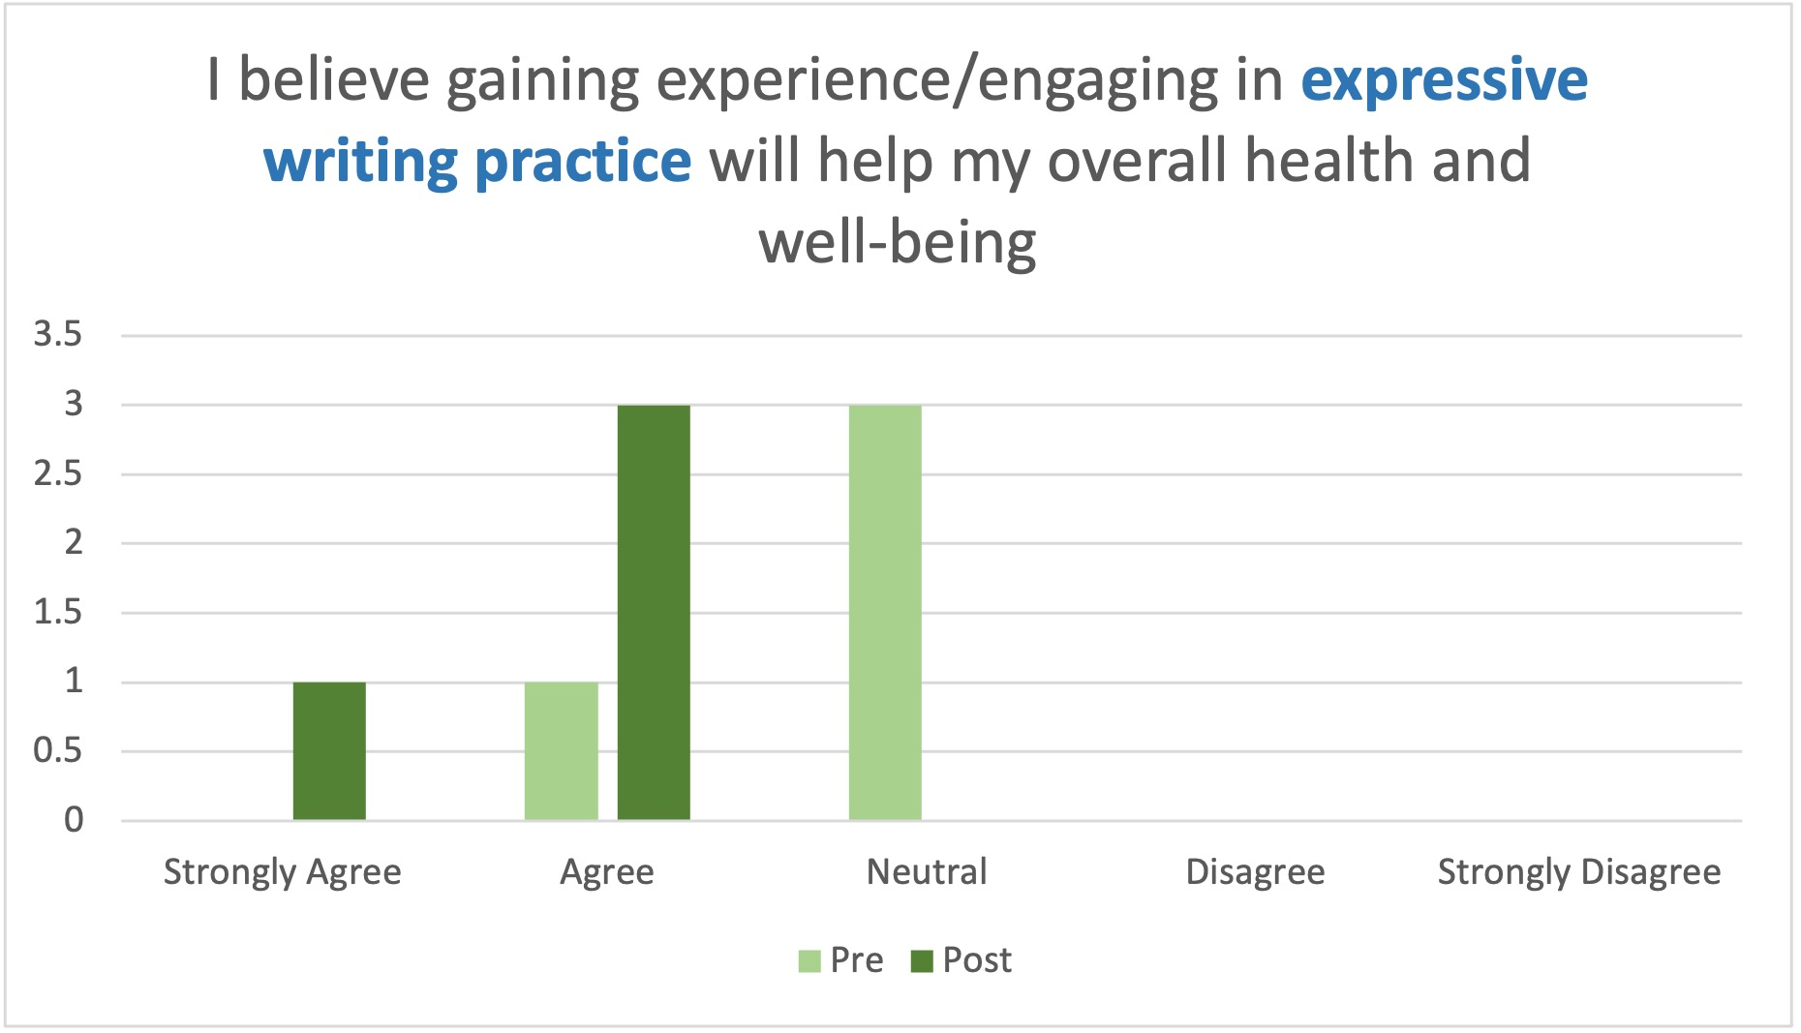
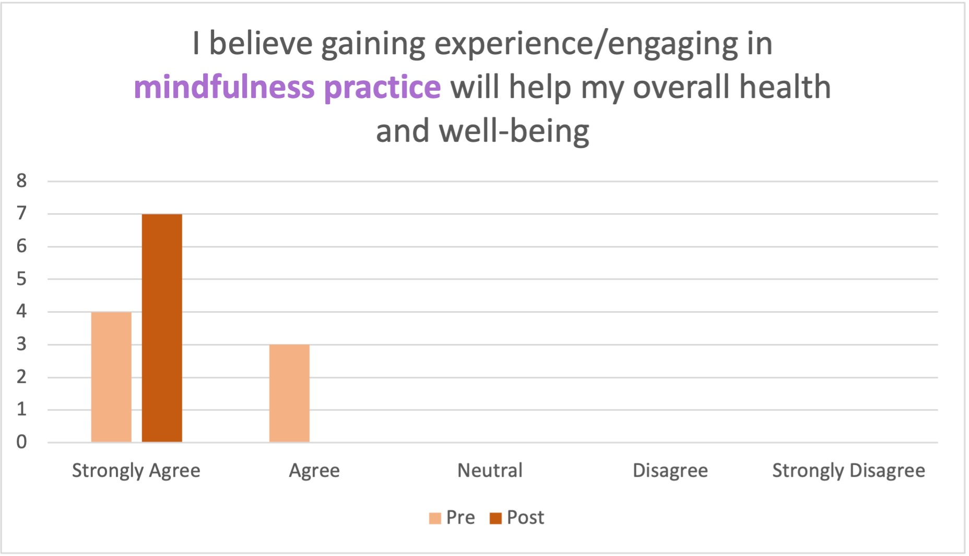
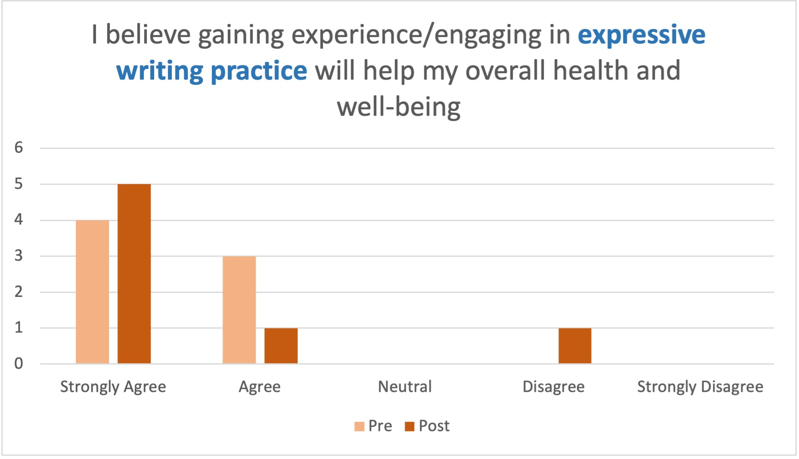
After the workshop: Patients
“I thought that it was a very good experience, and I liked having things that I could work with.”
After the workshop: Caregivers
“I loved this workshop”
“I think that this would be cool as a multiple week workshop”
Notes:
And finally, we asked the participants if they believe gaining experience or engaging in mindfulness and expressive writing will help their overall health and well-being, and it seems we have converted some believers here! Patients jumping over mostly to agree and strongly agree for both, with caregivers all strongly agreeing that mindfulness can help them! And I actually like this result here on the expressive writing side, from one caregiver who engaged in the expressive writing workshop, and through that, found out that it is not something they want to engage in, which I’m glad we could help them figure that out for themselves!
One patient said “I thought that it was a very good experience, and I liked having things that I could work with.” and caregivers reported “I loved this workshop” and “I think that this would be cool as a multiple week workshop”
I will pass it off to Amanda for some discussion points with this knowledge under our belts.

Slide 15
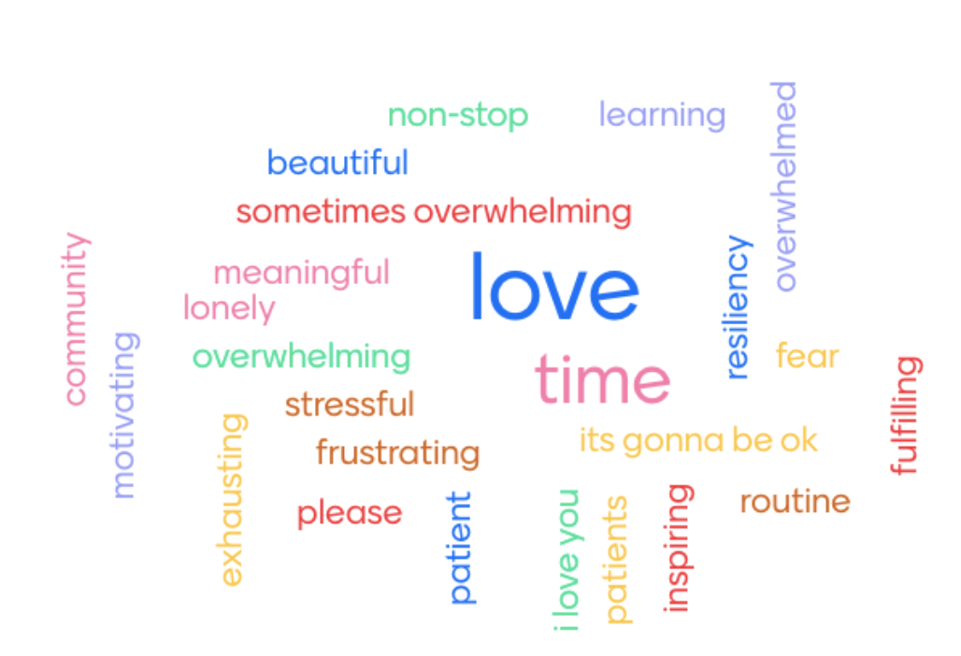
Discussion and Limitations
Limitations
Limited number of participants
One-hour workshop
Digital divide
Our particular cultural lens
Measurement of impact of group experience
Realizations
Group cohesion
Could this lay groundwork for more openness in clinic?
Willing participants
Notes:
Amanda

Slide 16

Next Steps
Future opportunities for integrative care
  enthusiastic participants
  peer interaction and support among patient and caregiver caseload
  referrals to similar services in area?
Incorporate mindfulness and/or writing into care practice?
  Ongoing Practice packet is available for patients as care team deems appropriate intimacy and build trust in workshops
  Creative Wellness workshop curriculum
Participant feedback: “More time!”
Notes:
Based on this very preliminary study, then, we have a few recommendations for the future.
It is clear that the participants enjoyed the workshops, and are interested in future opportunities to engage in unique exercises and techniques that can help build up their coping skills. A common theme in their feedback was that they wanted more time in the workshop, or more workshops! This positive feedback could point to the possibility that more PPC patients and caregivers, who did not get to participate in this study, would be interested in future opportunities as well. Perhaps this consideration can be incorporated into future support group themes, or effort can be made to create virtual spaces for patients and caregivers to connect and collaborate, as, at least, anecdotally, that feature of the workshop seemed to be very meaningful for participants.
Another recommendation would be to locate local opportunities for different kinds of art therapy or mindfulness classes to refer patients and families to.
Finally, the Ongoing Practice packet and the Creative Wellness workshop curriculum are both complete and available for future use, if any PPC faculty or future trainees wish to utilize them in their practice. We recommend keeping these resources available for patients and caregivers

Slide 17
References
Akenson, A. B. (2018). Since Feeling Is First and No Feeling Is Final: The Mindfulness-based Stress Reduction Implementation for Chronic Illnesses
(MBSR-ICI) Program Planning and Evaluation Model (Order No. 10784584). Available from ProQuest Dissertations & Theses Global.
(2050020595).
Callinan, J. & Coyne, I. (2020). Arts-based interventions to promote transition outcomes for young people with long-term conditions: A review. Chronic
Illness, 16(1), 23-40. https://doi.org/10.1177/1742395318782370
Graham-Pole, J. R. (2001). The marriage of art and science in health care. The Yale Journal of Biology & Medicine, 74(1).
https://www-ncbi-nlm-nih-gov.ezproxy1.lib.asu.edu/pmc/articles/PMC2588678/
Kabat-Zinn. (1994). Wherever you go, there you are: Mindfulness meditation in everyday life. Hyperion.
Kaptein, A. A., Meulenberg, F., & Smyth, J. M. (2015). A breath of fresh air: Images of respiratory illness in novels, poems, films, music, and painting.
Journal of Health Psychology, 20(3), 246-258. https://doi.org/10.1177/1359105314566613
Kennedy, A. (2020, April 20). Caregiver Needs Assessment [PowerPoint slides]. University of Arizona Pediatric Pulmonary Center.
https://uappc.peds.arizona.edu/sites/default/files/caregiver_needs_assessment_kennedy.pptx

Slide 18
References
Khoury, B., Lecomte, T., Fortin, G., Masse, M., Therien, P., Bouchard, V., Chapleau, M., Paquin, K., & Hofmann, S.G. (2013).
Mindfulness-based therapy: A comprehensive meta-analysis. Clinical Psychology Review, 33(6), 763-771. https://doi.org/10.1016/j.cpr.2013.05.005
Licari, A., Ciprandi, R., Marseglia, G., & Ciprandi, G. (2019). Anxiety and depression in adolescents with severe asthma and in their parents:
Preliminary results after 1 year of treatment. Behavioral Sciences, 9(78). https://doi.org/10.3390/bs9070078
Lowe, G. (2006). Health-related effects of creative and expressive writing. Health Education, 106(1), 60-70. https://doi.org/10.1108/09654280610637201
Munoz, F. Benton, L., Kops, S., Kowalek, K, & Seckeler, M. (2020). Greater length of stay and hospital charges for severe asthma in children
with depression or anxiety. Pediatric Pulmonology, 55(11). https://doi.org/10.1002/ppul.25061
Murali, C., Fernbach, S., & Potocki, L. (2014). Handing the pen to the patient: Reflective writing for children and families affected by genetic conditions.
American Journal of Medical Genetics, 164(12), 3021-3026. https://doi.org/10.1002/ajmg.a.36776
Radnothy, C. (2016, March 25). Cystic Fibrosis and Mental Health [PDF file]. University of Arizona Pediatric Pulmonary Center.
https://uappc.peds.arizona.edu/sites/default/files/cf_mental_health_ppc_presentation_final1_ppc_paragraph_0.pdf
Smith, B. A., Georgiopoulos, A. M., & Quittner, A. L. (2016). Maintaining mental health and function for the long run in cystic fibrosis.
Pediatric Pulmonology, 51(4). https://doi.org/10.1002/ppul.23522

Slide 19
Thank you!
We welcome comments and questions.

