Slide 1
Cystic Fibrosis for School Healthcare Staff
Dr. JP Jarczyk, MD
February 11, 2023

Slide 2
Disclosures
I have no conflicts of interest to disclose

Slide 3
Objectives
Understand basic genetics of CF
Understand basic pathophysiology of CF
Understand treatments for pediatric patients with CF

Slide 4
Genetics
Autosomal recessive inheritance
  gene on chromosome 7
Codes for CFTR, a chloride channel in the cell membrane
  CFTR = cystic fibrosis transmembrane conductance regulator
As of 2023, over 1,700 known mutations of the CFTR gene
  most common is the ΔF508
Most are now diagnosed via newborn screening

Slide 5
Genetics
Five classes of CF gene mutations
  eligibility for “modulator” therapy dependent on class of mutation
Highly variable phenotype within specific genotypes
  same gene mutations can cause very different disease severity

Slide 6
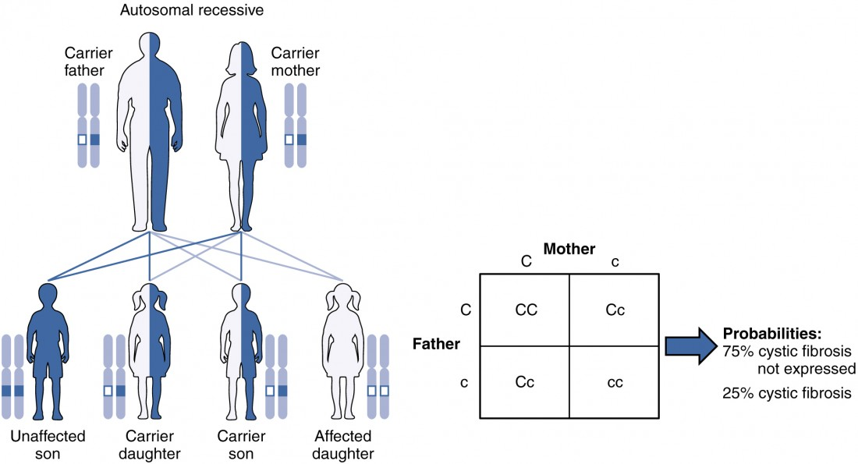
Genetics
1. https://courses.lumenlearning.com/suny-ap2/chapter/patterns-of-inheritance/

Slide 7
Genetics
Incidence by race^{2,3,4}
  1 in 2,500-3,500 for Caucasians
    91% of CF patients
  1 in 17,000 for African Americans
    3.5% of CF patients
  1 in 10,900 for Native Americans
  1 in 31,000 for Asian Americans
Incidence among Hispanic ethnicity
  1 in 9200 for Hispanics
    9.8% of CF patients
2. https://medlineplus.gov/genetics/condition/cystic-fibrosis/#inheritance
3. https://www.cff.org/medical-professionals/patient-registry
4. https://www.sciencedirect.com/science/article/pii/S1525157815002172

Slide 8
Diagnosis
Clinical symptoms consistent with CF in at least one organ system, or positive newborn screen or having a sibling with CF
AND
Evidence of CF transmembrane conductance regulator (CFTR) dysfunction (any of the following):
  Elevated sweat chloride ≥60 mmol/L
  Presence of two disease-causing mutations in the CFTR gene, one from each parental allele
  Abnormal nasal potential difference

Slide 9
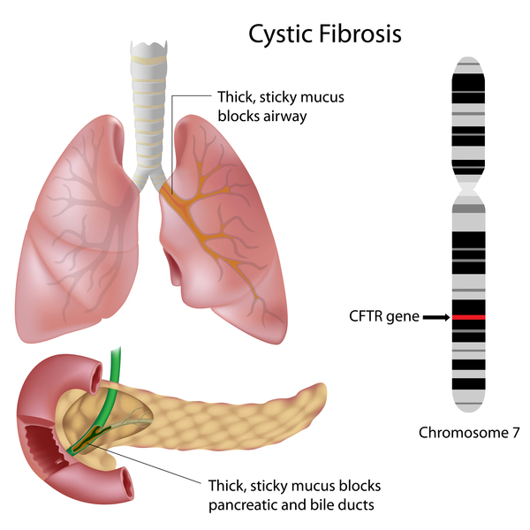
Pathophysiology
2.https://medlineplus.gov/genetics/condition/cystic-fibrosis/#inheritance

Slide 10
Pathophysiology
The defect in the chloride channel leads to thick and sticky mucus
  Mucus is produced in large amounts in the airway and digestive tracts to help form a barrier and to aid in the removal of certain material
  Thicker mucus causes impaired movement of intraluminal secretions

Slide 11
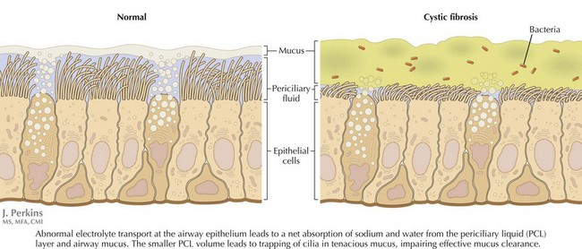
Pathophysiology
(Lungs)
5. https://obgynkey.com/cystic-fibrosis-2/

Slide 12
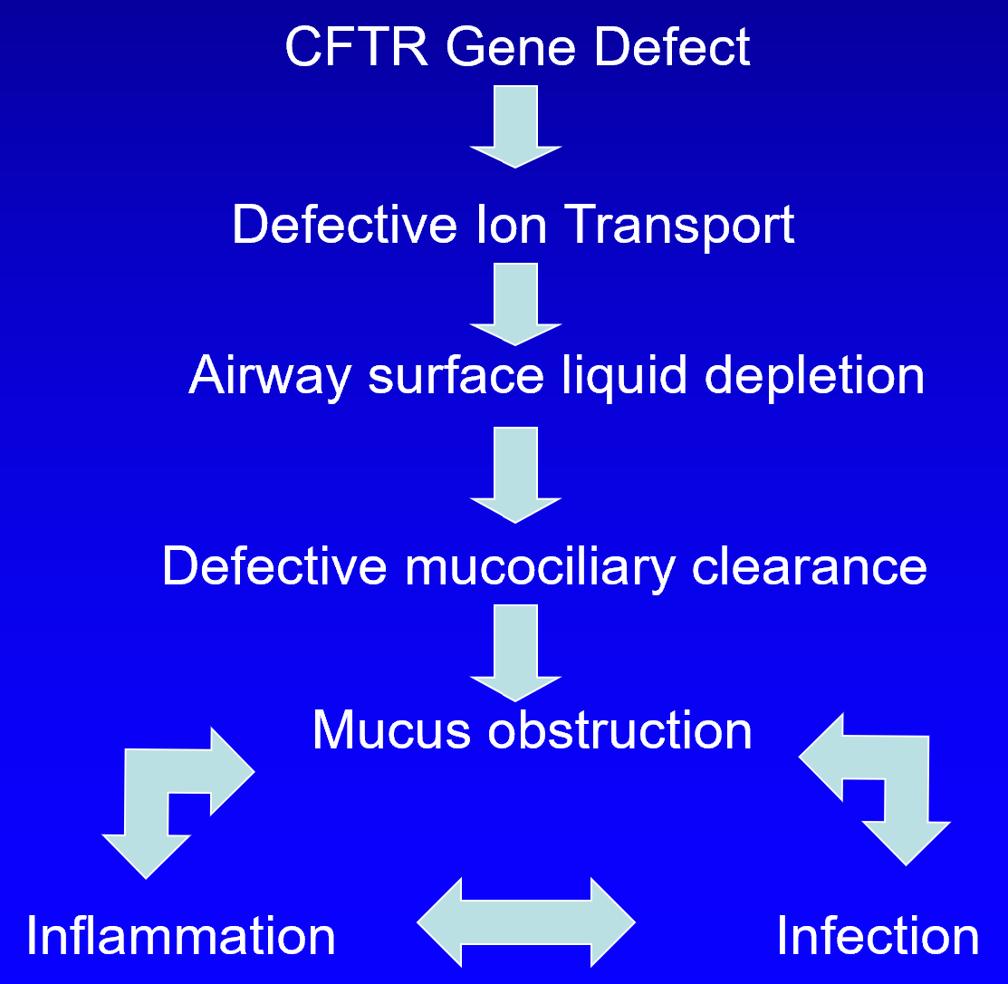
Pathophysiology
(Lungs)
Thick mucus leads to difficulty clearing lower airway which leads to persistent inflammation and recurrent infection

Slide 13
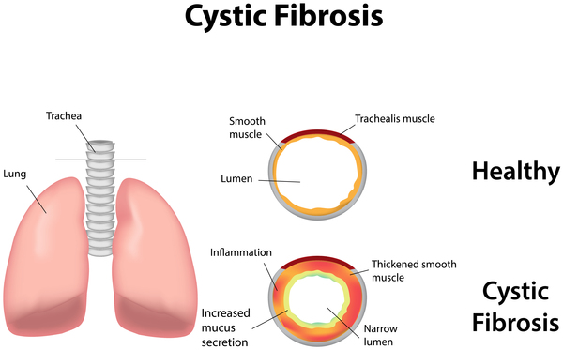
Pathophysiology
(Lungs)
2.https://medlineplus.gov/genetics/condition/cystic-fibrosis/#inheritance

Slide 14
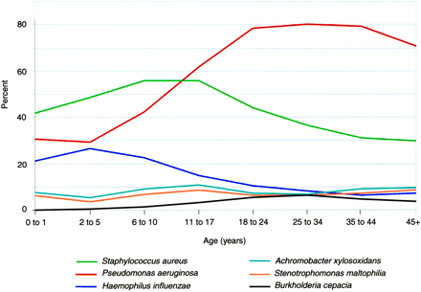
Pathophysiology
(Lungs)
6. Gibson, RL, Burns, JL, and Ramsey, BW. Pathophysiology and Management of Pulmonary Infections in Cystic Fibrosis. AJRCCM 168 (918-951); 2003.

Slide 15
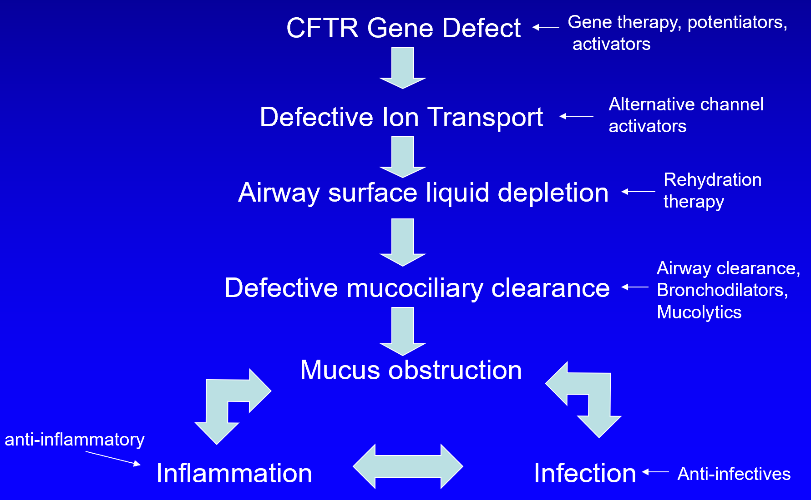
Treatments
(Lungs)

Slide 16
Treatments
(Lungs)
Bronchodilation
  Beta-agonists
    Short-acting (albuterol)
    Long-acting (salmeterol/formoterol)
  Anticholinergics (ipratropium)
Hypertonic saline nebs (3% or 7%)
Chest physiotherapy
  manual chest percussion
  high frequency chest wall oscillation (vibrating vest)
  huff coughing
  oscillatory positive expiratory pressure flutter valve
Dornase alfa
  cleaves DNA from degenerating neutrophils in the sputum making it easier to clear the sputum
Exercise

Slide 17
Pathophysiology
(Lungs)
5. https://obgynkey.com/cystic-fibrosis-2/

Slide 18
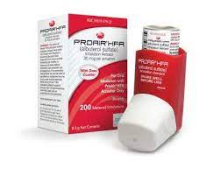
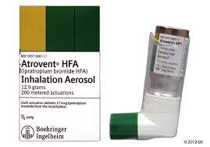
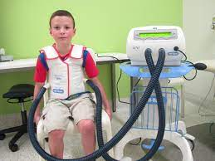
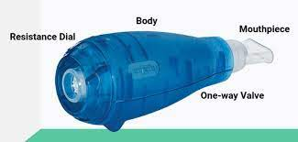
Treatments
(Lungs)

Slide 19
Treatments
(Lungs)
Anti-inflammatories
  macrolide antibiotics
    suppress excessive inflammatory response in the lungs
    most often azithromycin given M/W/F
  ibuprofen
  systemic glucocorticoids
  inhaled corticosteroids
    useful when asthma also present
Anti-infectives
  inhaled antibiotics
    cycled tobramycin
    cycled aztreonam
  oral antibiotics

Slide 20
Treatments
(Lungs)
Exacerbations
  Home treatment
    Oral antibiotics
    Increased frequency of pulmonary clearance
  Hospitalization
    IV antibiotics
    Increased frequency of pulmonary clearance
    Therapeutic bronchoscopy

Slide 21
Pathophysiology
(Pancreas)
Pancreas
  Exocrine (digestive)⁷
    insufficiency of the exocrine pancreas is present from birth in approximately 2/3 of patients with CF and 20-25% develop pancreatic insufficiency during the first several years of life (leading to 85-90% of CF patients with insufficiency)
    symptoms of pancreatic insufficiency include:
      steatorrhea, characterized by frequent, bulky, foul-smelling stools that may be oily
      poor weight gain due to malabsorption of fat & protein
      deficiencies of the fat-soluble vitamins A, D, E, and K
    about 10% of those who are pancreatic sufficient develop inflammation of the pancreas (pancreatitis)
      presents with severe, sometimes recurrent, abdominal pain
7. https://www.uptodate.com/contents/cystic-fibrosis-clinical-manifestations-and-diagnosis

Slide 22
Pathophysiology
(Pancreas and GI tract)
Pancreas
  Endocrine (blood sugar regulation)⁷
    named CF-related diabetes (CFRD) where the islet cells which help control blood sugar with hormones (like insulin and glucagon) are damaged
    approximately 25% of patients develop CFRD by 20 years of age and about 50% of adults with CF have CFRD
Intestines
  Diarrhea/constipation
  Distal intestinal obstructive syndrome (DIOS)
    small bowel obstruction due to dehydrated intestinal contents
  Rectal prolapse
    straining from too many or too few enzymes
7. https://www.uptodate.com/contents/cystic-fibrosis-clinical-manifestations-and-diagnosis

Slide 23
Treatments
(Pancreas and GI tract)
Pancreatic enzyme replacement
  given with all meals and snacks
  dosed according to patient weight
  acid blocking medications help pancreatic enzyme capsules work better
Supplement fat-soluble vitamins (A, D, E, K)
Nutritional supplements
  calorie/fat/protein dense foods and supplements
  tube feedings (via NG or g-tube)
For constipation
  hydration, medications (Miralax, stool softeners, enemas), limit opiate pain medication and activity

Slide 24
Pathophysiology
(Upper airway)
Upper airway (nose and sinuses)⁷
  radiographs reveal panopacification of the paranasal sinuses in 90-100% of patients older than eight months of age
  nasal polyposis is seen in 10-32% of patients and is caused by chronic rhinosinusitis
  symptoms include rhinorrhea, nasal congestion, nasal obstruction, postnasal drip, snoring, obstructive sleep apnea, hyponasal speech, nosebleeds, taste/smell abnormalities, facial pain, headache
Treatment
  can use nasal steroid spray, oral antihistamines, saline nasal washes
7. https://www.uptodate.com/contents/cystic-fibrosis-clinical-manifestations-and-diagnosis

Slide 25
Pathophysiology
(Skin/Electrolytes)
Excessive excretion of sodium and chloride in the sweat
  sweat gland resorb chloride so abnormal function prevents resorption of chloride
  worse here in hotter climates
Treatment
  hydration
  addition of salt to diet, especially infants
    1/8 teaspoon from birth to 6 months
    1/4 teaspoon from 6 to 12 months

Slide 26
Pathophysiology
(Reproductive)
Men
  Congenital absence of the vas deferens in 97-98%
    sperm is produced in the testes but cannot enter semen
Women
  20% may be infertile
    secondary amenorrhea due to chronic disease and poor nutrition
    cervical mucus can be very thick preventing passage of sperm

Slide 27
Treatments

Slide 28
Treatments
Modulators⁸
  CFTR protein regulates the proper flow of water and chloride in and out of cells lining the lungs and other organs
  CFTR modulator therapies partially correct the malfunctioning protein
  current modulators developed are effective in about 90% of CF patients
    non-white CF patients are less likely to be eligible for Trikafta® than white patients⁹
  four CFTR modulators available:
    Kalydeco® (ivacaftor)
    Orkambi® (lumacaftor/ivacaftor)
    Symdeko® (tezacaftor/ivacaftor)
    Trikafta® (elexacaftor/tezacaftor/ivacaftor)
  more potential CFTR modulators are in development
8. https://www.cff.org/managing-cf/cftr-modulator-therapies 9. https://pubmed.ncbi.nlm.nih.gov/35633605/

Slide 29
School
Considerations
Coughing
Medication administration
Treatment adherence
Restroom privileges
Recurrent absences
Growth and development
Disclosure of child’s condition
Financial & insurance issues

Slide 30
References
1. Lumen Learning. Anatomy and Physiology II. Module 12: Development and Inheritance. Accessed on Jan 30, 2023 at https://courses.lumenlearning.com/suny-ap2/chapter/patterns-of-inheritance/
2. MedlinePlus [Internet]. Bethesda (MD): National Library of Medicine (US). Cystic Fibrosis. Accessed on Jan 30, 2023 at https://medlineplus.gov/genetics/condition/cystic-fibrosis/
3. Cystic Fibrosis Foundation. Patient Registry. Accesses on Jan 20, 2023 at https://www.cff.org/medical-professionals/patient-registry
4. Iris Schrijver, Lynn Pique, Steve Graham, Michelle Pearl, Athena Cherry, Martin Kharrazi. The Spectrum of CFTR Variants in Nonwhite Cystic Fibrosis Patients: Implications for Molecular Diagnostic Testing. The Journal of Molecular Diagnostics. Volume 18, Issue 1, 2016, Pages 39-50. Accessed on Jan 30, 2023 at https://www.sciencedirect.com/science/article/pii/S1525157815002172.

Slide 31
References
5. Obgyn Key. Cystic Fibrosis. Accessed on Jan 30, 2023 at https://obgynkey.com/cystic-fibrosis-2/
6. Gibson, RL, Burns, JL, and Ramsey, BW. Pathophysiology and Management of Pulmonary Infections in Cystic Fibrosis. AJRCCM 168 (918-951); 2003.
7. Katkin JP. Cystic fibrosis: Clinical manifestations and diagnosis. In: UpToDate, Post TW (Ed), UpToDate, Waltham, MA. (Accessed on January 30, 2023.)
8. Cystic Fibrosis Foundation. CFTR Modular Therapies. Accessed on Feb 1, 2023 at https://www.cff.org/managing-cf/cftr-modulator-therapies.
9. Desai M, Hine C, Whitehouse JL, Brownlee K, Charman SC, Nagakumar P. Who are the 10%? - Non eligibility of cystic fibrosis (CF) patients for highly effective modulator therapies. Respir Med. 2022 Aug;199:106878. doi: 10.1016/j.rmed.2022.106878. Epub 2022 May 16. PMID: 35633605.

