Slide 1

Medication Use in Schools
The University of Arizona Pediatric Pulmonary Center: School Nurse Training Event
Kalia Anderson, PharmD
PGY-2 Pediatric Pharmacy Resident
Catherine B. Hobart, PharmD, BCPPS
Pediatric Clinical Pharmacist
Ambulatory Clinical Pharmacist
healthy-students_badge6.pdf (cdc.gov)

Slide 2
Disclosures
We have no relevant financial relationships or conflicts of interest to disclose related to the content of this presentation. We may discuss off-labeled use of medication therapy during this presentation.

Slide 3
Objectives
Define terminology related to medication administration
Review laws and regulations pertinent to medication use and administration in schools
Discuss storage and administration of common medications used in the school setting, including emergency response medications
Notes:
40 minutes presentation (45 minutes allotted)
Definitions – over-the-counter medications; prescription medications; administration; etc
AZ laws
Schools are able to make their own rules/regulations
Nursing delegation of responsibilities
Common disease states / statistics
AAP guidance on medication use in schools
Security/Storage of medications
Labels in ORIGINAL packaging (no extra inhaler OTC from another country)
Documentation of administration

Slide 4

How Many Medications are Administered Throughout the School Day?
https://www.mayoclinichealthsystem.org/hometown-health/speaking-of-health/pharmacogenomics-getting-the-right-drug
Notes:
ASK FOR AUDIENCE PARTICIPATION – HOW MANY MEDICATIONS ARE ADMINISTERED THROUGHOUT THE SCHOOL DAY?

Slide 5

Terminology
https://www.facultyfocus.com/articles/effective-teaching-strategies/encouraging-students-to-use-the-dictionary-the-results/

Slide 6
Abbreviations
EAP: Emergency Action Plan
FERPA: Family Education Rights Privacy Act
HIPAA: Health Insurance Portability and Accountability Act
IDEA: Individuals with Disabilities Education Act
IEP/IHP: Individualized Education Plan / Individualized Healthcare Plan
NASN: National Association of School Nurses
NPA: State Nurse Practice Act
UAP: unlicensed assistive personnel

Slide 7
Medication Terminology
Alternative Medication
Controlled substance medications
Experimental medication
Homeopathic medication
Off-label medication
Over-the-counter medication (OTC)
Stock medication

Slide 8
Nonprescription vs. Prescription Medication
Nonprescription or
“Over-the-Counter”
Medicine that may be purchased without a prescription
Regulated by FDA
Prescription Medications
Rx
Regulated by FDA
Intended for consumer use
Medication with potentially harmful effects, except by under the supervision of a medical provider
Arizona State Board of Pharmacy Law Book. Updated October 2021.
Miller AE, Nicolas S. Federal Regulation of Medication Dispensing. [Updated 2022 Jun 22]. In: StatPearls [Internet]. Treasure Island (FL): StatPearls Publishing; 2022 Jan-. Available from: https://www.ncbi.nlm.nih.gov/books/NBK582130/
Notes:
Another helpful resource: Miller AE, Nicolas S. Federal Regulation of Medication Dispensing. [Updated 2022 Jun 22]. In: StatPearls [Internet]. Treasure Island (FL): StatPearls Publishing; 2022 Jan-. Available from: https://www.ncbi.nlm.nih.gov/books/NBK582130/
OTC does NOT include samples, controlled substances, Rx only, hypodermic injections
Some schools stock pain/fever medications for use with parental consent
May need physician approved protocols for administration

Slide 9
Examples: Prescription vs. OTC
Prescription
Inhalers
Albuterol, Levalbuterol
Budesonide/formoterol, Mometasone/formoterol
Oral Medications
Pancreatic enzyme replacement therapy
(ex. Pancrealipase)
Controlled substances
(ex. Dextroamphetamine)
Antiepileptic drugs (ex. Levetiracetam)
Over-the-Counter
Pain Relievers and Antipyretics
Acetaminophen
Cough and cold medicine
Stomach acid reducers
Ibuprofen
Antibiotic therapy (ex. Amoxicillin, Cephalexin, etc.)
Nutritional supplementation
Notes:
Prescription
May be administered by designated school professional
Physicians give written material on ADR
Require documentation from parents/MD - name, dose, frequency of medication given in school
Non-prescription medications may be necessary to take with parental/physician approval for conditions
Schools may stock OTC pain/fever meds to give w/ parental consent

Slide 10
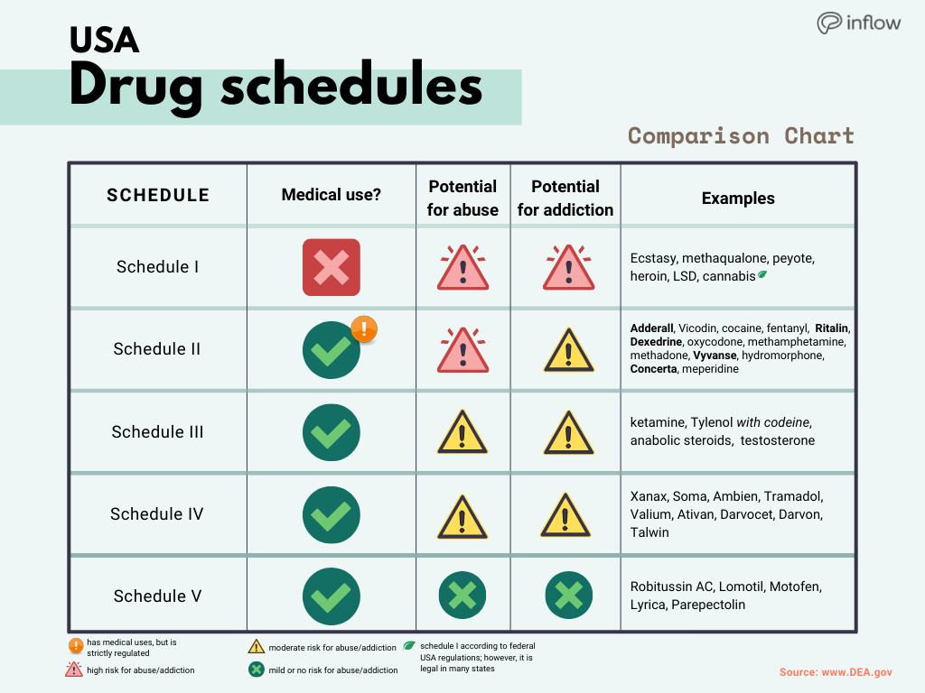
Controlled Substances
Federal classification of medication based on substance use, potential to abuse medication, safety of substance, and potential dependence liability
DEA. . Drug Enforcement Agency on DEA website. https://www.dea.gov/drug-information/csa. 25 July, 2018. Accessed 31 January, 2023.
Drug scheduling DEA. Available at: https://www.dea.gov/drug-information/drug-scheduling. Accessed 6 February 2023.
School nursing evidence-based clinical practice guideline: Medication Administration in schools implementation toolkit: NASN learning center nasn.org. Available at: https://learn.nasn.org/courses/36927. Accessed 6 February 2023).
https://www.getinflow.io/post/adhd-medication-stimulant-controlled-schedule-ii
Notes:
Scheduling is based on addictive/abuse potential and acceptable medical use
I: high potential for abuse
II: high potential for abuse
III: potential for abuse
IV: low potential for abuse
V: least potential for abuse
Schedules I – V medications
I: Marijuana, Mescaline (peyote), LSD
II: Adderall, Vyvanse, Oxycodone, Fentanyl
III: Ketamine, Marinol, Subutex
IV: Lorazepam, Diazepam, Tramadol
V: Lacosamide, Lyrica, Codeine preparations

Slide 11
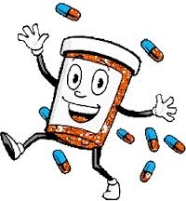
Why is this Important?
https://sites.google.com/a/nhcs.net/marthanarayan/medication-at-school-policy

Slide 12
Medication Use in Schools
Asthma: ~6% (2020)
Diabetes: 0.35%
Epilepsy: 0.6%
Obesity: 19.7%
Allergies: 0.04 – 1.8%*
Over 74 million children in the US
  Over 40% school-aged children and adolescents have >1 chronic health condition
  Many children require medication
  administration throughout the school day
    Chronic care
    Acute care
    Life threatening emergencies
    As needed transient health issues
* Global estimated prevalence
J Pediatr Pharmacol Ther. 2020 Jan-Feb;25(1):7-24.
Postepy Dermatol Alergol. 2022 Feb;39(1):13-19.
POP1 child population: Number of children (in millions) ages 0–17 in the United States by age, 1950–2021 and projected 2022–2050. https://www.childstats.gov/americaschildren/tables/pop1.asp. Accessed 6 February 2023.
Managing chronic health conditions in schools. Centers for Disease Control and Prevention. https://www.cdc.gov/healthyschools/chronicconditions.htm. Published October 20, 2021. Accessed 6 February 2023.

Slide 13
Coordination of Care
Families
Health care providers
Teachers
Out-of-school time staff
Other school staff
Child
CDC Healthy Schools: Care Coordination
Notes:
https://www.cdc.gov/healthyschools/shs/care_coordination.htm
Care coordination
Improved medical management
Improved follow-up and detailed links to other services
Identify need for additional resources

Slide 14

Policy and Procedure Development
https://www.nytimes.com/2022/10/19/opinion/midterms-polling-politics.html
Notes:
ASK AUDIENCE – WHO IS COMFORTABLE WITH CURRENT POLICIES AND PROCEDURES

Slide 15
National Legislation
Section 504 of Rehabilitation Act and the Individuals With Disabilities Education Act (IDEA)
  Federally funded schools required to make reasonable accommodations for children with disabilities
  Does not cover short-term needs
  No specific guidance on medication administration
Pediatrics. 2009; 124(4): 1244-1251
Notes:
When standards are insufficient – school boards, superintendents can work with school health professionals, consulting physicians, and AAP for policy/procedure development
This legislation provides protection from discrimination for children with special needs
First disability law to be enacted in US to protect people with disabilities in programs receiving federal funding
Set the stage for Americans with stabilities Act Section 504

Slide 16

Considerations in Policy Procedure Development
State and federal laws, regulations, and standards
Recommend incorporation of policies established by the National Association of School Nurses (NASN) and American Nurses Association
State nurse practice acts
Uniformity across all schools within the district
Liability coverage
(Ex. nurses, teachers, athletic staff, etc.)
Documentation and accountability systems
Pediatrics. 2009;124(4):1244-1251.
School nursing evidence-based clinical practice guideline: Medication Administration in schools implementation toolkit: NASN learning center nasn.org. Available at: https://learn.nasn.org/courses/36927. Accessed 6 February 2023.
Notes:
School boards and superintendents are responsible for establishing policies and detailed procedures for safe administration of medication in school settings
Schools may want to seek legal advice as they assume responsibility for med administration during/after school

Slide 17
Goals of NASN Clinical Practice Guidelines
Increase medication adherence
Decrease medication errors
Decrease morbidity
Standardize reports of medication errors
Increase security measures and resources
Increase medication administration audits
Adopt medication reconciliation practices
School nursing evidence-based clinical practice guideline: Medication Administration in schools implementation toolkit: NASN learning center nasn.org. Available at: https://learn.nasn.org/courses/36927. Accessed 6 February 2023.
Notes:
School_Nursing_Evidence-based_Clinical_Practice_Guideline_Medication_Administration_in_Schools.pdf (sharepoint.com)
School nursing evidence-based clinical practice guidelines: medication administration in schools
Decrease in medication errors • Adoption of standardized reporting of medication errors • Strengthen security measures and resources • Increase annual medication administration audits across school systems • Increase adoption of Fair and Just Culture • Adoption of medication reconciliation practices
https://learn.nasn.org/courses/33787
“The purpose of the CPG is to give the school nurse evidence-based recommendations for the safe care of Pre-K–12 grade students who receive medications during the school day”

Slide 18

Quality Improvement Recommendations
Annual review of medication administration
  Alignment with state laws and district policies
  Audit medication administration process
Culture of safety
  Nonpunitive, fair, just culture
  Decrease stigma and increase vigilance for medication errors
Encourage reporting of “sentinel events”
Consider engaging community pharmacists and providers in quality improvement
Develop Second-Victim support resources
School nursing evidence-based clinical practice guideline: Medication Administration in schools implementation toolkit: NASN learning center nasn.org. Available at: https://learn.nasn.org/courses/36927. Accessed 6 February 2023.
Notes:
“An audit should include all documentation: licensed provider prescribing form, written parent approval; medication administration record, current medication list, current list of allergies, current weight in kilograms and, if pertinent, IHP, IEP, Individual Action Plans, 504 plans, permission for self-administration of medication”

Slide 19
Arizona Revised Statutes Title 15. Education § 15-344
Medication administration of prescriptions by employees
School district governing boards establish policies and procedures for medication administration by employees
  Administration can only occur if written request or authorization
    Except for emergency administration (see §15-157, 15-158, 15-341)
  Immune from civil liability for “good faith” implementation
    School districts, charter schools, and employees
Arizona Revised Statutes Title 15. § 15-344
Notes:
https://codes.findlaw.com/az/title-15-education/az-rev-st-sect-15-344.html
For the purposes of this section, “administration of a prescription medication or a patent or proprietary medication” means the giving of a single dose of medication or the giving of a treatment package in its original container.
Governing board establishes policies and procedures regarding the administration of medications to students by employees
Administration can only occur if written request or authorization
Except for emergency administration (see sections 15-157, 15-158, 15-341)
School districts, charter schools, and employees are immune from civil liability for “good faith” adoption and implementation of policies and procedures

Slide 20

Recommendations for Medication Administration Policies
Protect student safety and prevent errors
Nursing services should be confidential, timely, and accurately documented
Identify responsible healthcare professional for execution
Systematic review of documentation
Create and maintain training for UAP
New medications not to be started in
school setting
Pediatrics. 2009;124(4):1244-1251.
School nursing evidence-based clinical practice guideline: Medication Administration in schools implementation toolkit: NASN learning center nasn.org. Available at: https://learn.nasn.org/courses/36927. Accessed 6 February 2023.
Notes:
Execution = (storage, administration, documentation)
Right person: Verify correct patient – name verification; photo verification

Slide 21
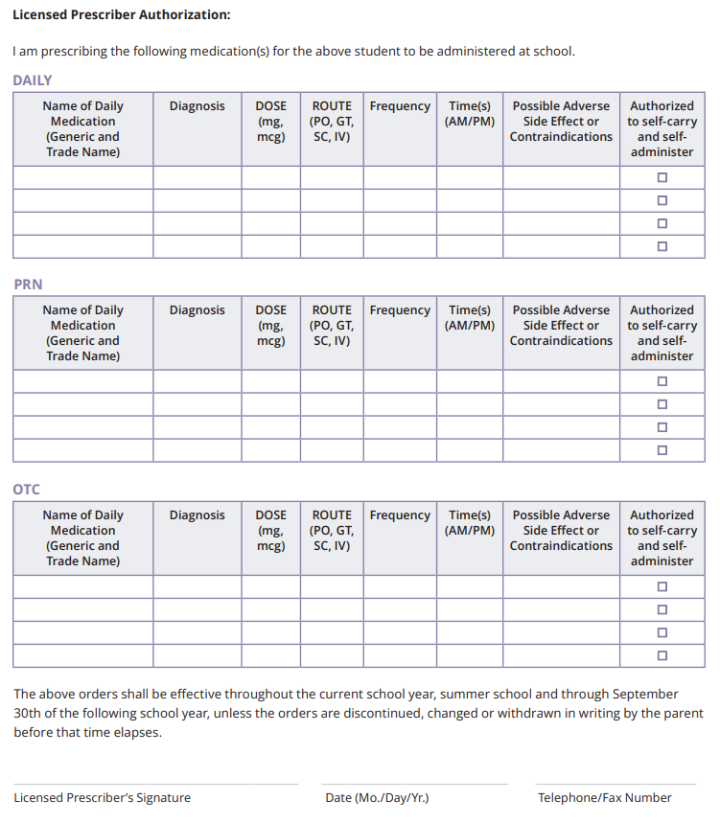
Documentation for Medication Use in School
Physician documented use of medication
  Medication name
  Dose
  Frequency of medication administration
  Anticipated adverse effects
Pediatrics. 2009;124(4):1244-1251.
School nursing evidence-based clinical practice guideline: Medication Administration in schools implementation toolkit: NASN learning center nasn.org. Available at: https://learn.nasn.org/courses/36927. Accessed 6 February 2023.
Notes:
Document medication administration clearly promptly after administration
Medication administration record
Document refusal and notify parents
Document errors (wrong patient, wrong dose, etc)
Document if medication administered prior to school (no dose needed in school)
Document lost, wasted, dropped, stolen, etc.

Slide 22

Best Situation for Medication Administration
American Academy of Pediatric strongly endorses presence of full-time, licensed registered nurse in schools
  Administer routine medications
  Administer emergency use medications
Pediatrics. 2009;124(4):1244-1251.
School nursing evidence-based clinical practice guideline: Medication Administration in schools implementation toolkit: NASN learning center nasn.org. Available at: https://learn.nasn.org/courses/36927. Accessed 6 February 2023.
https://quietrev.com/when-your-ideal-self-isnt-your-real-self/
Notes:
AAP wants licensed RN in schools as they have the knowledge/skills necessary to administer medications, knowledge of disease states, and responsibility to protect health/safety of all students

Slide 23

Real World Medication Administration
Delegation: allows RN to allow unlicensed assistive personnel (UAP) to perform standardized, routine health services under supervision of nurse
  Requires training and supervision to provide safe, accurate, and timely administration of medications
  CANNOT replace nursing assessment
Pediatrics. 2009;124(4):1244-1251.
https://quietrev.com/when-your-ideal-self-isnt-your-real-self/
Notes:
Butler JPPT
Many budget cuts force schools to eliminate full-time RN in schools
Risks of untrained school staff creates
Medical liability for school, RN
Increased risk for medication errors
UAP need to have appropriate knowledge, skills, and composure to administer medications
Delegation is the responsibility of the RN or school physician
RN is responsible for initial and ongoing education and assessments of UAP
Must document training of medication administration and assessments
Must provide ongoing supervision for all UAP involved in medication delivery within school setting
Ongoing process, NOT once-a-year event
Determined by rules/regulations of school districts
Ideally, responsibilities should NOT be delegated to >3 UAP and not more than 3 school sites
CRITICAL TO UNDERSTAND: Parents CANNOT direct personnel on medication administration, this can ONLY be completed by licensed prescribers

Slide 24

Training Checklist
Recognizing common emergencies
Review of medication uses, administration, and side effects
Where to find action plans and policies
Student-specific instructions
Legal and practice standards
Student privacy and confidentiality
Storage requirements
When to ask for help
Medication errors: define, prevention, and reporting
School nursing evidence-based clinical practice guideline: Medication Administration in schools implementation toolkit: NASN learning center nasn.org. Available at: https://learn.nasn.org/courses/36927. Accessed 6 February 2023.

Slide 25
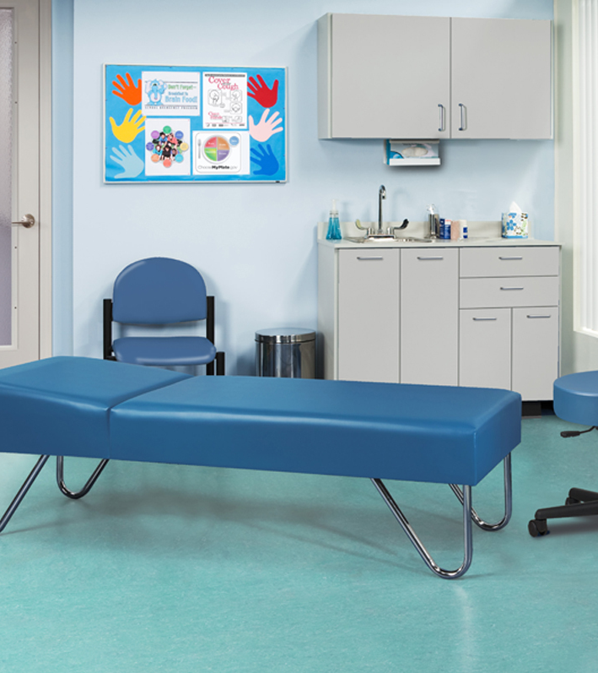

`
Security and Storage of Medications
Notes:
Medications may be with nurse/administrative office or self carried by children

Slide 26

Medication Storage
Original containers with appropriate label
Store securely (see manufacturer labeling)
Refrigerated medications
  Monitor temperatures on a regular basis
  Separated from food
Controlled substances must be
double locked
  Count upon receipt and with each dose
  Document counts by two personnel at least weekly
Emergency medications must be easily accessible at all times
Pediatrics. 2009;124(4):1244-1251.
School nursing evidence-based clinical practice guideline: Medication Administration in schools implementation toolkit: NASN learning center nasn.org. Available at: https://learn.nasn.org/courses/36927. Accessed 6 February 2023.
https://news.unl.edu/newsrooms/unltoday/article/cvs-caremark-walgreens-reach-agreement/
Notes:
Label should be completed by physician or pharmacist
Do not flush medications for disposal

Slide 27
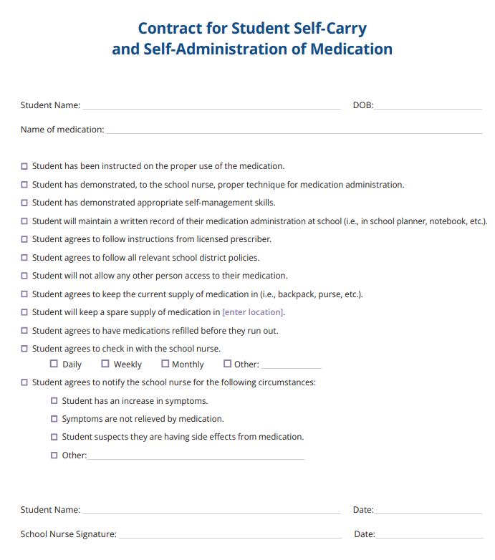
To Self-Carry or
Not Self-Carry
School nurses may delegate storage and administration directly to student
  Assess risk and safety within school
  Collaborate with family and school administration
Recommended for patients with acute medical needs (ex. asthma, allergies, etc.)
Not all medications are appropriate for "self-carry"
  Refrigerated medications
  Controlled substances
Must be kept with the student; not to be left unattended
Additional supply may be kept in nursing office as back-up
Pediatrics. 2009;124(4):1244-1251.
School nursing evidence-based clinical practice guideline: Medication Administration in schools implementation toolkit: NASN learning center nasn.org. Available at: https://learn.nasn.org/courses/36927. Accessed 6 February 2023.

Slide 28
Recommendations for Self-Carry Policy
Renew authorization for self-carry annually
Requirements:
  Written permission and request from parent for child to carry and self-administer
  Medication must be prescribed to be used during school hours
  Prescriber must provide written agreement for child to carry medication
  Child must demonstrate correct and responsible administration to school nurse
  School nurse provides authority for child to self-carry
  School provided back-up supply of medication
Controlled substances EXCLUDED
May revoke ability at any time
School nursing evidence-based clinical practice guideline: Medication Administration in schools implementation toolkit: NASN learning center nasn.org. Available at: https://learn.nasn.org/courses/36927. Accessed 6 February 2023.
Notes:
Self-carry requires written consent from parent for patient to carry and administer medication
Prescriber should educate patient on appropriate and responsible use of medication
Students must demonstrate appropriate administration and knowledge to the school nurse prior to allowing them to self-carry

Slide 29
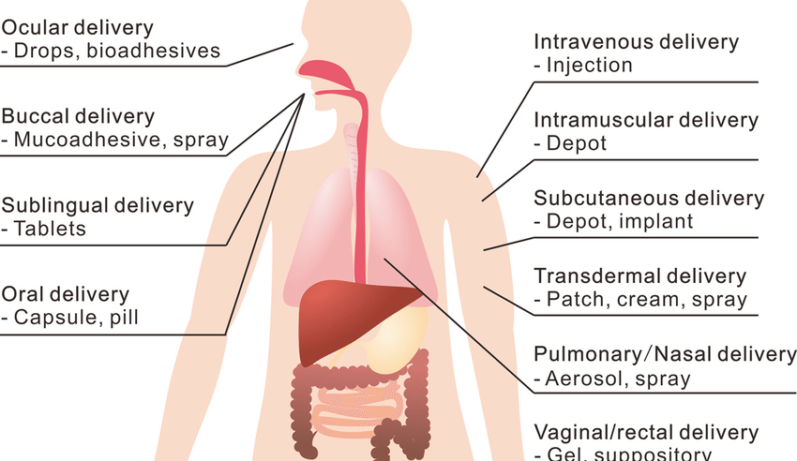
Medication Administration
Administration: Directly applying a drug (OTC or prescription) by injection, inhalation, ingestion, or any other means, to the human body
Documentation:
Medication administration document
  MAR
  Up-to-date medication list
  Allergies
  Adverse reactions
  Weight (kg)
  Prescriber orders
  IHP, IEP, consent forms
Medication administration record (MAR)
  Date and time
  Dosage
  Individual dispensing medication
  Extension/disruption of medication
  Changes
  Adverse reactions
  Errors
  Refusal of administration
http://www.nationalpain.com/routes-of-administration
Arizona State Board of Pharmacy Law Book. Updated October 2021.
School nursing evidence-based clinical practice guideline: Medication Administration in schools implementation toolkit: NASN learning center nasn.org. Available at: https://learn.nasn.org/courses/36927. Accessed 6 February 2023.
Center for Drug Evaluation and Research. Route of Administration. U.S. Food and Drug Administration. https://www.fda.gov/drugs/data-standards-manual-monographs/route-administration. Accessed February 6, 2023.
Kim J, De Jesus O. Medication Routes of Administration. [Updated 2022 Nov 26]. In: StatPearls [Internet]. Treasure Island (FL): StatPearls Publishing; 2022 Jan-. Available from: https://www.ncbi.nlm.nih.gov/books/NBK568677/
White R, Bradnam V. Handbook of Drug Administration via Enteral Feeding Tubes. London, UK: Pharmaceutical Press; 2007.
Notes:
MAR should include patient picture to serve as second verification correct patient
Types
Many types, lengths, sizes, and exit a variety of places along the GI tract
Gastrostomy tube (G tube)
Gastrostomy-jejunostomy tube (G-J tube)
Percutaneous gastrostomy tube (PEG tube)
Medication Administration
Flush tube with warm water (15-30 mL)
Prepare medications for administration
Dissolve tablets in warm water
Shake suspensions
Pour medication into syringe
Rinse med cup with water and administer medication slowly
Flush tube with warm water (15-30 mL)
Wash hands
Positioning the child
Lateral position with right leg flexed
Lubricate suppositories/insertion tip with water-soluble lubricating jelly
Gently insert the apex past the internal anal sphincter, against rectal wall
Hold buttocks together until child relaxes or loses urge to push

Slide 30

Medication Disposal
Return to parents
  End of school year
  Transfer to another school
  Expired or discontinued medications
Document medication return to parents
Medications not retrieved by parents
  Dispose of according to packaging instructions and state health and environmental protection requirements
  Do not flush medications
Document if/when medication was disposed
Consider “take back” programs
Takebackdrugs.org
Pediatrics. 2009;124(4):1244-1251.
School nursing evidence-based clinical practice guideline: Medication Administration in schools implementation toolkit: NASN learning center nasn.org. Available at: https://learn.nasn.org/courses/36927. Accessed 6 February 2023.
Notes:
Meds should be returned not just at the end of the school year, but also upon transfer to another school, or if medication is discontinued or expired
Take back programs are usually offered through police departments, pharmacies, colleges of pharmacy, hospitals, clinics

Slide 31

Field Trips and School-Sponsored Events
School policies that apply to school-sponsored and off-campus events
Self-carry is an option
School nurse must provide any UAP supplies, training, medication, instructions for use, schedule, and a method to document the medication was administered
School nursing evidence-based clinical practice guideline: Medication Administration in schools implementation toolkit: NASN learning center nasn.org. Available at: https://learn.nasn.org/courses/36927. Accessed 6 February 2023.
This Photo by Unknown author is licensed under CC BY-NC-ND.

Slide 32
Arizona Stock Medication Programs and New Emergency Response

Slide 33
Arizona Stock Medication Programs
Albuterol
Epinephrine
Narcan
Standing order: pre-written order that allows non-prescribers (paramedics, RN, pharmacist, etc.) to administer medication in particular circumstance
Stock medication: medication supply that may be used for numerous people
  Emergency response medications
  Over-the-counter medications
Store in readily accessible location within school
School nursing evidence-based clinical practice guideline: Medication Administration in schools implementation toolkit: NASN learning center nasn.org. Available at: https://learn.nasn.org/courses/36927. Accessed 6 February 2023.
School Nursing and Health Services. Arizona Department of Education. https://www.azed.gov/wellness/school-nursing-and-health-services. Published February 6, 2023. Accessed February 6, 2023.
Notes:
School_Nursing_Evidence-based_Clinical_Practice_Guideline_Medication_Administration_in_Schools.pdf (sharepoint.com)
https://www.azed.gov/wellness/school-nursing-and-health-services

Slide 34

Stock Albuterol Inhaler Program
Approved as Arizona state law in 2017
Tucson Schools 2-year pilot program outcomes
  20% reduction in 911 calls
  40% reduction in emergency transports
Permits stock inhalers and spacers to be dispensed to schools
Permits trained professionals to administer in emergencies
Standing order issued by chief medical officer, physician, or nurse practitioner
  Implementation Questions?
  Ashley Lowe Stockinhaler@
  email.arizona.edu
  General Questions? azasthmacoalition@
  gmail.com
ARS 15-158. Stock Albuterol Program.
LB Gerald, et al. Implementation and Evaluation of a Stock Albuterol Program for Students with Asthma. Annals ATS. 2016.
Arizona Asthma Coalition. Arizona Asthma Coalition - Stock Inhaler Program. https://www.azasthma.org/take-action. Accessed February 6, 2023.
Notes:
at least 2 designated employees per school must complete annual online training to recognize symptoms of respiratory distress, how to render emergency treatment, proper storage of medication, and emergency follow-up procedures
Discuss $100 enrollment fee (may be fundraised) – includes 60-dose albuterol inhaler and 5 spacers
Prescriptions are good for 2 years

Slide 35
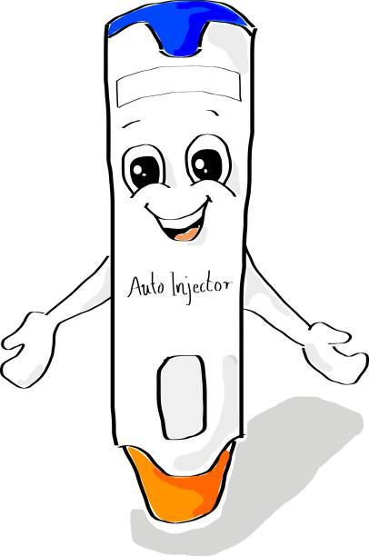
Stock Epinephrine Program in Schools
Established in 2018
Allows emergency administration of epinephrine auto-injectors by trained personnel to those exhibiting symptoms of anaphylaxis at school or school-sponsored activity
Protected by good faith administration
State Board of Education
  Training of >2 designated personnel for each site
  Storage
  Use of medication in schools
Must report incidents to Arizona Department of Health Services
Kyah Rayne Foundation
ARS 15-157
R7-2-809
Notes:
Immediate access to emergency medication – local procedures must specify where medications will be stored, who is responsible for the medication, and who will regularly review and replace outdated medication, who will carry the medication for field trips
Each school district / charter school may have 2+ epi JR and 2+ adult epi autoinjectors
Annual training for administration
Training should be with public health organization (recognition s/s, dosage selection, procedures to respond [admin, call 911, stabilize pt, repeat admin, document incident/administration, notify parents/guardian])
Recognizing anaphylaxis
Sudden breathing difficulty
Difficulty swallowing, swollen tongue
Dizziness
Pale, floppy, suddenly sleepy
Unconscious

Slide 36
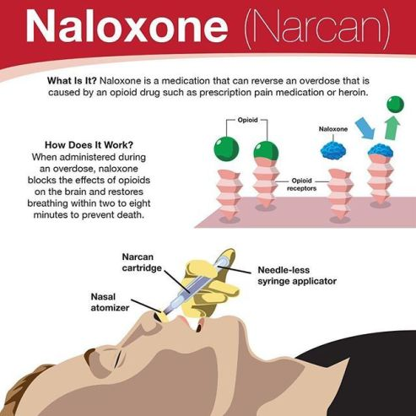
Stock Narcan Programs in Schools
Implemented in 2018 as part of the AZ Opioid Epidemic Act/Action Plan
Reversal for opioid overdoses
ADHS website
  Standard order for Narcan
  Form to complete to receive supply of the medication
ADHS: Arizona Department of Health Services (visit www.azdhs.gov/opioid/#naloxone)
Notes:
Infants, Children, and Adolescents: Intranasal: 4 mg or 8 mg (contents of 1 nasal spray) as a single dose; may repeat every 2 to 3 minutes in alternating nostrils if needed until medical assistance becomes available

Slide 37
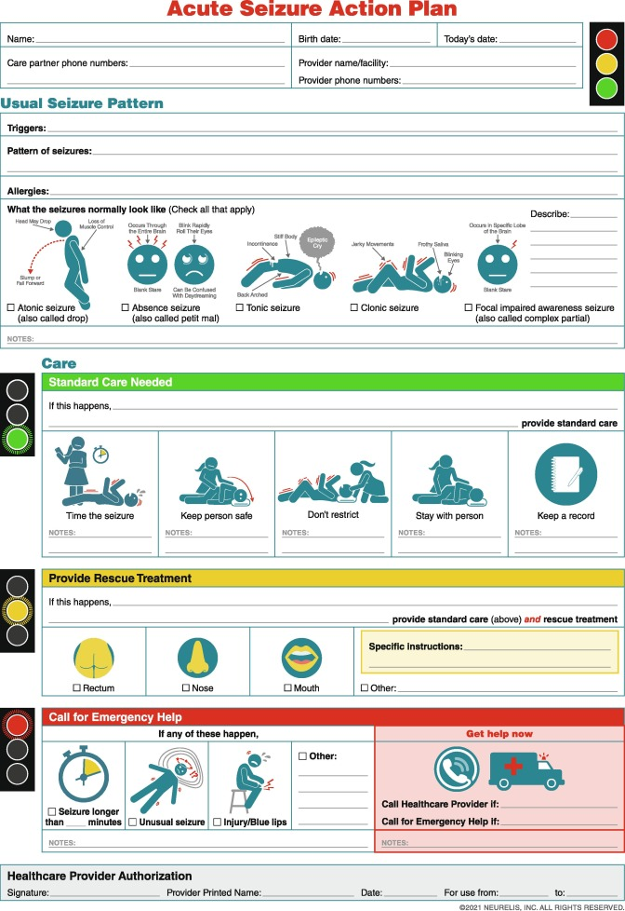
The Arizona Seizure Safe Schools Act and Seizure Action Plan
SB 1654 signed April 29, 2022
Allows parents/guardians to submit seizure management and action plan to school district
School personnel online training
  Educates about seizure recognition and first aid
  Must be completed and submitted every 5 years
Arizona Department of Education hosting Seizure Action Plan Training in March 2023
ARS 15-160.02. Seizure management and treatment plans; requirements; immunity; online instruction; rules
School Nursing and Health Services. Arizona Department of Education. https://www.azed.gov/wellness/school-nursing-and-health-services. Published February 6, 2023. Accessed February 6, 2023.
Notes:
School Nursing and Health Services | Arizona Department of Education (azed.gov)
View Document (azleg.gov)
School personnel that are in close contact with patients w/ seizure management plan

Slide 38

How many schools have these programs?
Which ones?
This Photo by Unknown author is licensed under CC BY.

Slide 39

Barriers to Medication Use in Schools
Obtaining medications from out of the country
Insurance limits on distribution of medications
Parents not able to provide instruction on medication administration
As needed and over-the-counter medications
https://clearthinkingonhealthcare.com/2019/01/20/building-a-healthcare-system-from-scratch-part-6-barriers-to-choosing-the-highest-value-options/
Notes:
SMART is difficult to get extra inhaler for school use
https://clearthinkingonhealthcare.com/2019/01/20/building-a-healthcare-system-from-scratch-part-6-barriers-to-choosing-the-highest-value-options/
Medications should be in original pharmacy/dispensing container and original OTC containers → difficult because many OTCs are patient/consumer directed without physician involvement – encourage schools to guide policy and guidance on OTC use

Slide 40
Pharmacist’s Role in Medication Use in Schools
Provide education, resources, support for school nurses
Engage in research and development of policies/procedures to optimize use of medications in the schools
Ensure appropriate dispensing requirements are met for medication administration in school
  Products contained in boxes for school use, label the box AND the product itself
Provide educational materials to parents and caregivers to take to schools about potential side effects of medications to be administered at school
Provide extra bottles with appropriate pharmacy labeling for supply to be sent to school
Notes:
Potential Questions for Pharmacist:
Can I purchase medications outside of the country for use in school? (Ex. Mexico)
Why doesn’t my insurance cover 2 inhalers? How can I have supply for home and school?
Can my children (2+) share an inhaler at school?
How do I get school health staff to give medication according to changes from the prescription label (ex. “My Dr. Says)
Educate:
Provide education to schools about medications
Volunteer with American Lung Association (ALA) to collaborate with others on educational materials or serve at asthma camp
Volunteer at local schools to provide in-service learning opportunities to education staff and families about medications
Take the opportunity to counsel patients to find out about asthma control and refer to physician as necessary
Inquire about asthma action plans and if patients have one prior to start of the school year
Advocate for patients
Advocate for insurance companies to cover additional medication supplies for school supply
Prepare current medication lists for all patients to take for school records
Objective 3:
Being a resource for school districts
Independent pharmacies
Immunization clinics for schools
Pharmacists can suggest peak flow meters and explain who is a good candidate
ALA and open airways
Inservices – volunteer work
Dr gerald supervised inhaled therapy
Pharmacist
ALA partner (asthma camp, open airways)
Volunteer talks
Educate patients
Advocate for patients insurance
Counsel on frequent dispensing, do you have an asthma action plan
Peak flow promotionfor routine patients

Slide 41
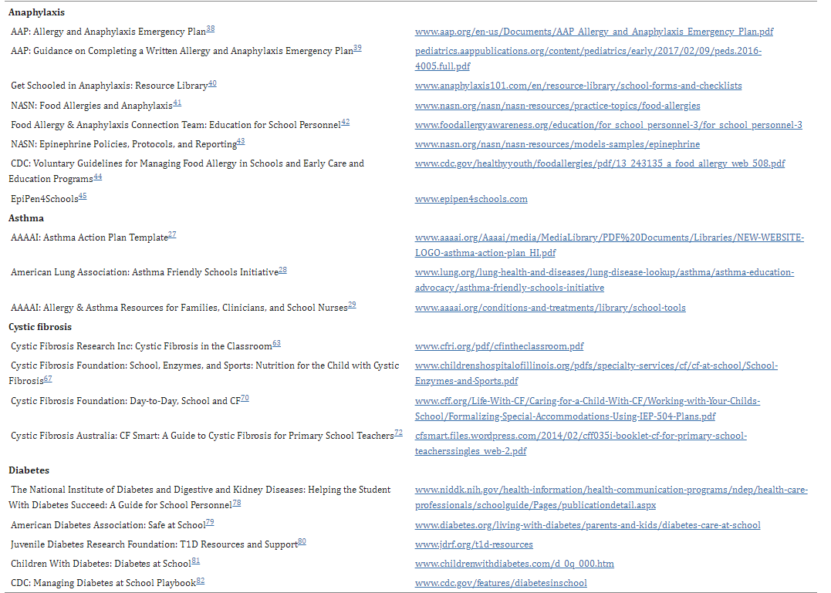
Additional Resources
J Pediatr Pharmacol Ther. 2020 Jan-Feb;25(1):7-24.
Notes:
Butler SM, Boucher EA, Tobison J, Phan H. Medication Use in Schools: Current Trends, Challenges, and Best Practices. J Pediatr Pharmacol Ther. 2020 Jan-Feb;25(1):7-24. doi: 10.5863/1551-6776-25.1.7. PMID: 31897071; PMCID: PMC6938291

Slide 42
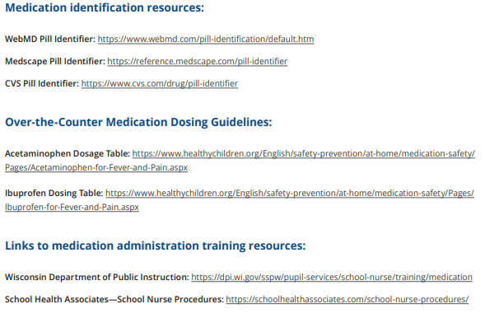
Additional Resources
School nursing evidence-based clinical practice guideline: Medication Administration in schools implementation toolkit: NASN learning center nasn.org. Available at: https://learn.nasn.org/courses/36927. Accessed 6 February 2023.

Slide 43
Conclusions
School districts have the autonomy to establish policies and procedures for safe medication use within the schools
Policies and procedures should address federal, state, and local laws as well as incorporate recommendations from NASN
Stock medication programs (ex. Albuterol, epinephrine, and Narcan) allow for emergency response and life-saving medication administration
Pharmacists are available resources to support school nurses and medical staff to optimize safe medication use in schools

Slide 44

Questions?
https://www.forbes.com/sites/jarretjackson/2020/08/12/as-a-leader-are-you-asking-the-right-questions/?sh=5ea0d3f76e7d

Slide 45
Medication Use in Schools
The University of Arizona Pediatric Pulmonary Center: School Nurse Training Event
Kalia Anderson, PharmD
PGY-2 Pediatric Pharmacy Resident
Catherine B. Hobart, PharmD, BCPPS
Pediatric Clinical Pharmacist
Ambulatory Clinical Pharmacist
healthy-students_badge6.pdf (cdc.gov)

