Slide 1
Caring for Children with Diabetes
Dr Sarah Green, Dr Mark Wheeler

Slide 2
Objectives
Understand type 1 vs type 2 diabetes
Understand the difference between short-acting and long-acting insulin
Identify symptoms of hypoglycemia
Give examples of how to treat hypoglycemia
Be able to define DKA
Know when to use urine ketone strips

Slide 3
Outline
All About Diabetes
Diabetes Treatment and Technology
Hypoglycemia
Hyperglycemia
Exercise
Nutrition
Social and Developmental Considerations

Slide 4
Outline
All About Diabetes
Diabetes Treatment and Technology
Hypoglycemia
Hyperglycemia
Exercise
Nutrition
Social and Developmental Considerations

Slide 5
Diabetes: Prevalence and Incidence
One of the most common chronic diseases in school aged children
In 2019, 37.3 million Americans (11.3% of the population) had diabetes
Type 1 diabetes: ~5%, Type 2 diabetes: ~95%
In 2014-2015, the annual incidence of diagnosed diabetes in youth was estimated at 18,200 with type 1 diabetes (75%) and 5,800 with type 2 diabetes. (25%)
Notes:
ADA: https://diabetes.org/about-us/statistics/about-diabetes#:~:text=Diabetes%20in%20youth,approximately%200.35%25%20of%20that%20population.

Slide 6
What is Diabetes?
Types:
Type 1 Diabetes
Type 2 Diabetes
Gestational Diabetes
MODY
CFRD
Medication-induced Diabetes
After pancreatomy
Chronic disease in which the body cannot properly regulate glucose
Diabetes occurs when:
the pancreas produces little or no insulin
or, when the body’s cells are unable to access and use insulin properly
Notes:
- Glucose, an important source of energy for the body, is made by the body from food that primarily contains carbohydrate. Insulin, a hormone made in the pancreas, allows glucose in the blood to enter the body’s cells where it is used for energy.
As a result, glucose cannot enter the cells and be used as energy for the body. Glucose builds up in the blood and is transported to the kidney, where it is eliminated from the body in the urine. Thus, the body loses its main source of energy even though the blood contains large amounts of glucose. The additional glucose in the urine causes additional loss of water, giving rise to more frequent urination.

Slide 7
Symptoms of Diabetes

Slide 8
Type 1 Diabetes (T1DM)
Formerly called juvenile diabetes or insulin-dependent diabetes
Can occur at any age, but onset most often occurs in children and young adults
There is no cure for T1DM
Notes:
- Caused by an autoimmune reaction. The immune system attacks the beta cells and severely damages/destroys them
- The pancreas no longer produces insulin, so people with T1DM must take insulin daily to live

Slide 9
Type 2 Diabetes (T2DM)
Formerly called adult onset diabetes
Can occur at any age, but risk increases with age
Managing type 2 diabetes requires weight loss, healthy lifestyle and sometimes oral medication and/or insulin
Notes:
insulin resistance, a condition in which cells do not respond to insulin properly
- A progressive disease that usually begins with insulin resistance
- Over time, the pancreas loses its ability to produce enough insulin

Slide 10
Notes:
Long Term: effective diabetes management helps to prevent or delay the serious complications of diabetes such as heart disease, stroke, blindness, kidney failure, gum disease, nerve disease, and amputations of the foot or leg

Slide 11
Outline
All About Diabetes
Diabetes Treatment and Technology
Hypoglycemia
Hyperglycemia
Exercise
Nutrition
Social and Developmental Considerations

Slide 12
Treatment
 | Type 1 Diabetes | Type 2 Diabetes
Glucose Monitoring | Always | Sometimes
Insulin | Always | Sometimes
Oral medication | Rarely | Usually
Healthy Diet | Yes | Yes
Physical activity | Yes | Yes
Notes:
Maintaining blood glucose levels within the target range also can help to optimize the student’s ability to learn by avoiding the effects of hypoglycemia (low blood glucose) and hyperglycemia (high blood glucose) on cognition, attention, behavior, and athletic ability

Slide 13
Checking Blood Glucose
Glucose Monitoring:
> 4 times/day
Continuous Glucose Monitoring (CGM)
Notes:
The school nurse should notify the parent/guardian to contact the student’s diabetes provider if the student is below or above target range at the same time of day for more than two hypoglycemic episodes or three hyperglycemic episodes for three or more days per week.

Slide 14
Glucose Meters

Slide 15
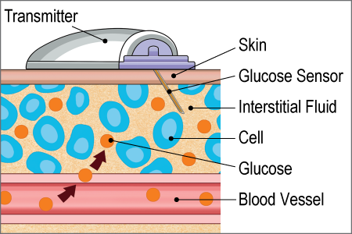
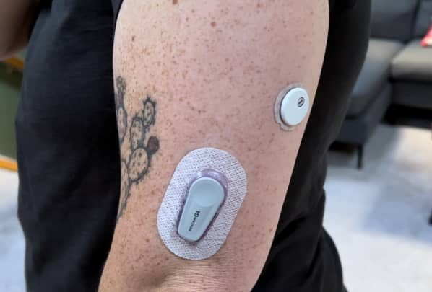
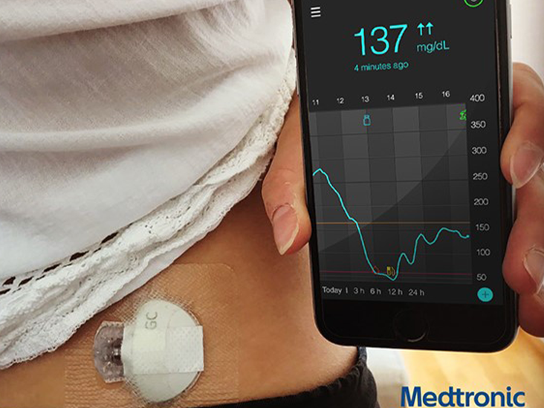
Continuous Glucose Monitors (CGMs)
z
Notes:
- Replaced every 1-2 weeks
- When in doubt, get a fingerstick
- Can share to parents' phone if connected to cell service or wifi
- Have alerts for highs and lows
measures interstitial glucose levels
CGM alerts can be set for when blood glucose levels are too high or too low, when they are increasing or decreasing at a rapid rate and provide predictive alerts

Slide 17
Insulin: Basal-Bolus Treatment
Basal insulin
Controls glucose production between meals and overnight
Usually ~50% of daily needs
Bolus insulin (mealtime or prandial)
Limits hyperglycemia after meals
Immediate rise and sharp peak at 1 hour postmeal
10% to 20% of total daily insulin requirement at each meal

Slide 18
Types of Insulin
Notes:
Aspart (Novolog)
Glulisine (Apidra)
Lispro (Humalog)
Detemir (Levemir)
Glargine (Lantus, Basaglar)
Degludec (Tresiba)

Slide 19
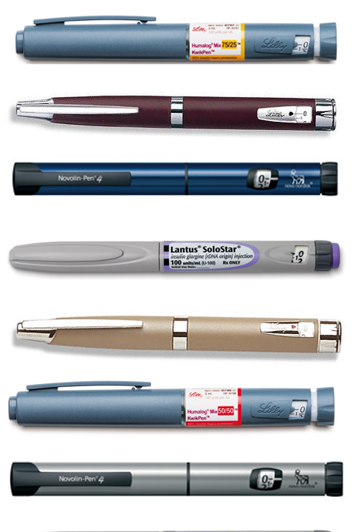
Subcutaneous Insulin Injections
z
You can inject insulin in the stomach, upper arm, upper leg, or buttocks
Do not inject into muscles, scars, or moles

Slide 20
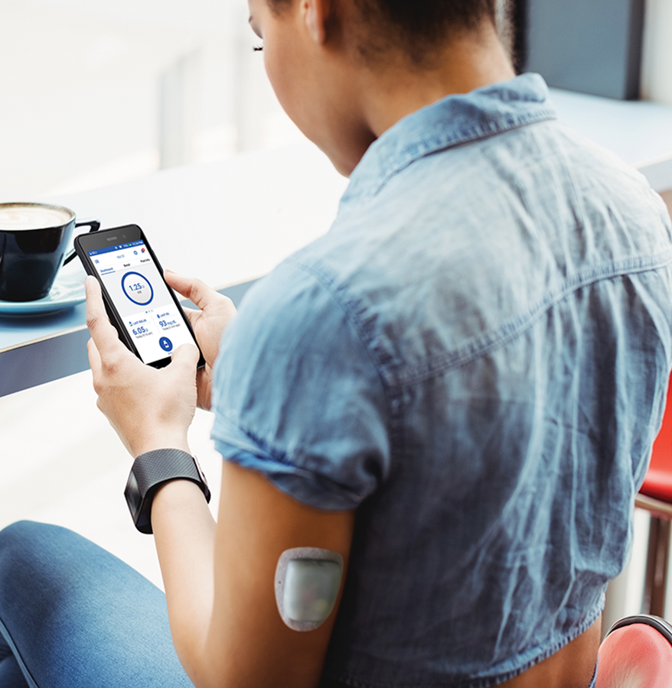
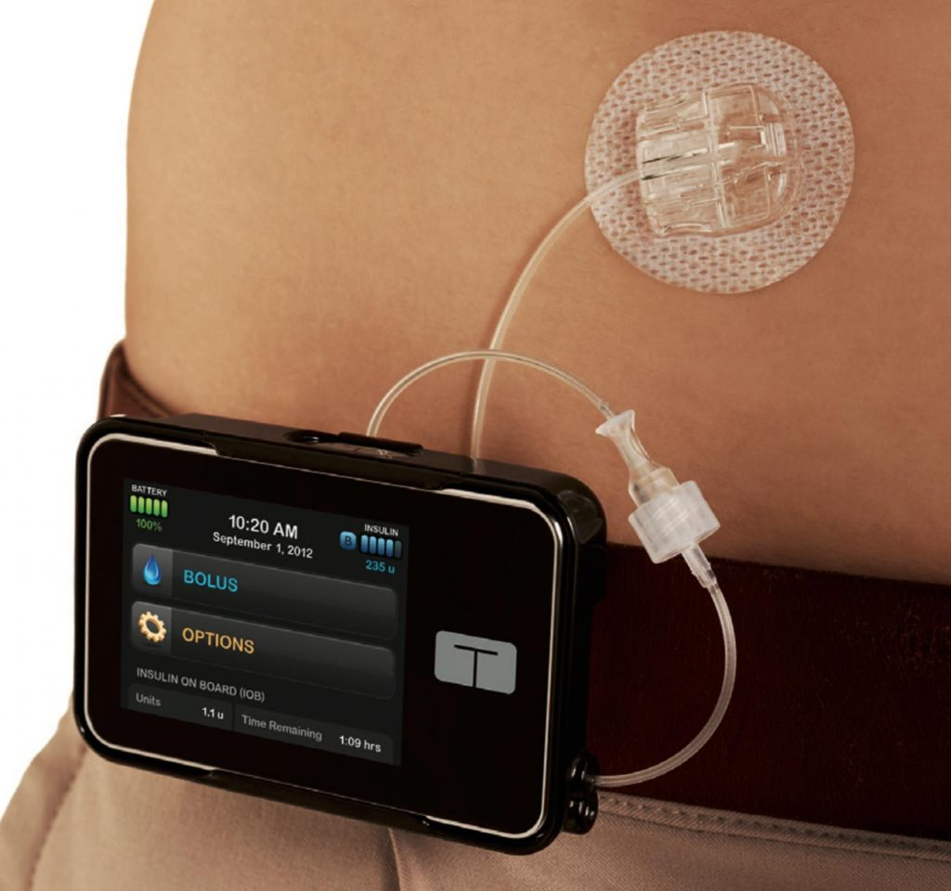
Insulin Pumps
z
Give short acting insulin continuously
Infusion set changed about every 3 days
If removed, do not have any long-acting insulin on board
Notes:
- Give short acting insulin continuously
- Infusion set changed about every 3 days
- If removed, do not have any long-acting insulin on board

Slide 21
Insulin: How to calculate bolus dosing
Insulin to Carbohydrate (CHO) ratio: Units of insulin needed to cover CHO intake
Example: 1 unit : 15 grams of carbohydrates
1:15
Total Grams of CHO ÷ 15 = Dose
Correction/Insulin Sensitivity Factor: Units of insulin needed to correct a blood sugar level
Example: 1 unit of rapid acting insulin/50 mg/dl > 150 mg/dl
1:50 > 150
(BG – 150) ÷ 50 = Dose

Slide 22
Calculating Bolus Insulin: Example
Carbohydrate dose 1:15, Total grams/15 = dose
Burrito = 55 grams
½ cup fruit = 15 grams
1 cup milk = 11 grams
Total = 81 grams / 15 = 5.4 units
Correction dose = 1:50 > 150, (BG – 150) = dose
Blood glucose = 195 50
(195-150) = 45 = 0.9 units
50 50
Carb dose 5.4 units
+ Correction dose 0.9 units
Total dose = 6.3 units
*Round to closet 0.5 unit*
Dose = 6.5 units

Slide 23
Outline
All About Diabetes
Diabetes Treatment and Technology
Hypoglycemia
Hyperglycemia
Exercise
Nutrition
Social and Developmental Considerations

Slide 24
Hypoglycemia
Blood glucose <70 mg/dL
Common causes:
Too much insulin
Missing or delaying food/snack
Not eating enough food
Extra or intense exercise
Illness
Notes:
- Some children and adolescents may have hypoglycemia unawareness.

Slide 25
Treatment: Mild to Moderate Hypoglycemia
z
“Rule of 15s”
Examples of fast acting sugars:
½ cup fruit juice or regular soda
3-4 glucose tablets
15 skittles
Tube of glucose gel
4 teaspoons white sugar
Notes:
Avoid giving foods with fat as this slows the absorption of carbs into the body. Examples to avoid: chocolate, peanut butter, caramel

Slide 26
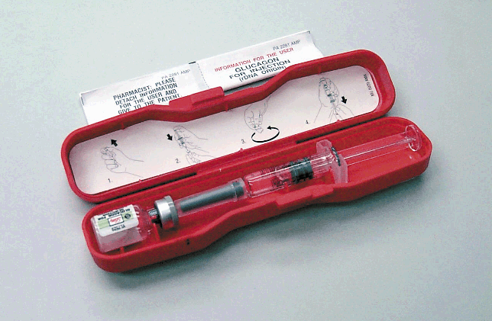
Treatment: Severe Hypoglycemia
If having a seizure, unconscious, or cannot swallow without choking:
Provide safety
Administer Glucagon
Turn student on their side
Call 911
Notes:
If it is not treated promptly, however, hypoglycemia can lead to loss of consciousness and seizures and can be life threatening.
Although it may cause nausea and vomiting when the student regains consciousness, glucagon is a potentially lifesaving treatment that cannot harm a student.

Slide 27
Glucagon
Glucagon is a hormone that raises blood glucose levels by causing the release of glycogen from the liver

Slide 28
Outline
All About Diabetes
Diabetes Treatment and Technology
Hypoglycemia
Hyperglycemia
Exercise
Nutrition
Social and Developmental Considerations

Slide 29
Hyperglycemia
Blood glucose >180 mg/dl
Common causes:
Too much food
Too little insulin
Illness
Emotional/Physical Stress
Medications
Malfunction of insulin pump

Slide 30
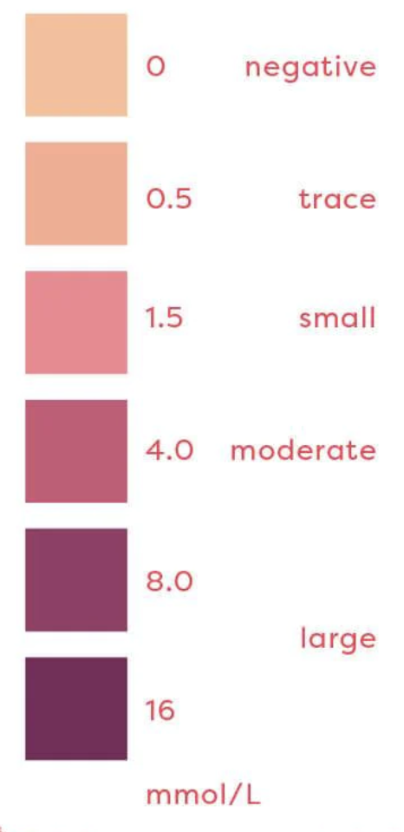
Treating Hyperglycemia
Blood glucose levels >250 mg/dL require immediate action
Increase fluid intake - water
Check urine ketones
If Moderate ketones: needs 10% increase to bolus insulin
If Large ketones: needs 20% increase to bolus insulin
May need additional insulin
Notes:
ketones, which are chemical byproducts from the breakdown of fat for energy due to inadequate insulin in the blood.
Students with type 2 diabetes usually still make a significant amount of insulin, and therefore, ketone checks may not be prescribed.
Ketones are usually associated with high blood glucose levels but also may occur when a student is ill and blood glucose levels fall below the student’s target range.

Slide 31
Diabetic Ketoacidosis (DKA)
Symptoms:
Dehydration
Nausea & Vomiting
Abdominal Pain
Fatigue
Acetone smell
Increased thirst
Frequent urination
Kussmaul breathing
DKA is a medical emergency
A buildup of ketones and acid in the blood
DKA develops over hours to days
Higher risk in students with insulin pumps
Notes:
- At first, ketones will be cleared by the kidneys into the urine, but as the process progresses, they are accompanied by increased acid levels in the bloodstream that cause DKA

Slide 32
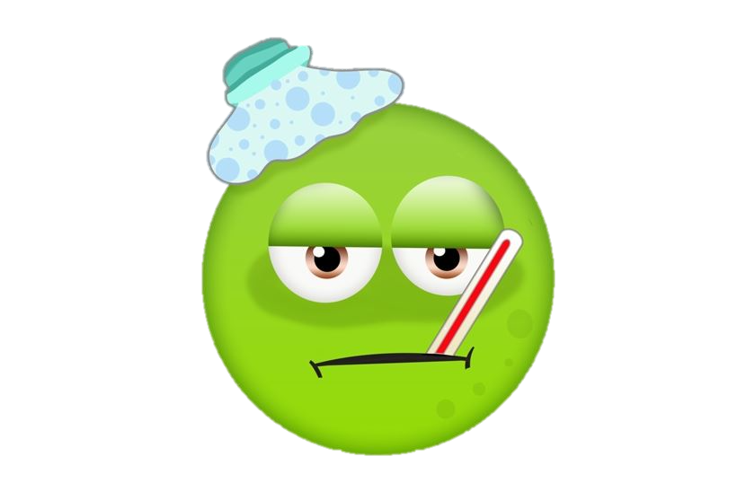
Sick Day Management
Insulin therapy must always be continued
Provide usual insulin dosing if eating
Encourage carbohydrates throughout the day
Encourage regular fluid intake (water)
Check blood glucose every 2 hours
Urine ketones every void until negative
If moderate or large ketones:
Moderate needs 10% increase to bolus insulin
Large needs 20% increase to bolus insulin
If on an insulin pump, change site and give correction via injection

Slide 33
Management of Ketones in School Setting
without nausea/vomiting
If trace or small ketones:
Encourage increased water intake
Give normal correction bolus if appropriate for hyperglycemia
If moderate or large ketones:
Parents need to be contacted by school nurse and parent may decide that the student remain at school for observation
Nurse will give correction dose, encourage increased water intake and reassess urine ketones in 1-2 hours
If student continues to have moderate to large ketones after 2 hours, parents need to be notified and student needs to be taken home for ongoing care

Slide 34
Management of Ketones in School Setting
with nausea/vomiting
If moderate or large ketones:
Notify parents for pick-up
Provide correction dose (sick day guidelines)
Encourage oral fluids
If student is not taken home after 2 hours of notifying the parent or the parent cannot be reached, nurse should consider calling 911 for transport to nearest healthcare facility

Slide 35
Outline
All About Diabetes
Diabetes Treatment and Technology
Hypoglycemia
Hyperglycemia
Exercise
Nutrition
Social and Developmental Considerations

Slide 36
Exercise and Diabetes
Whether T1DM or T2DM, same as children without diabetes:
60 min/day – moderate to vigorous intensity aerobic activity
>3 day/week vigorous bone/muscle strengthening
When NOT to exercise:
Glucose >350 mg/dL
Moderate-large ketones
Notes:
Risk of worsening hyperglycemia and ketones with exercise
Address cause of ketones before exercise

Slide 38
Exercise and Diabetes: Tips
Check blood glucose before, during and after exercise
Eat before heavy exercise
Always carry fast acting carbs
Have extra carb snacks available
Reduce insulin dosage
Be aware of delayed hypoglycemia

Slide 39
Outline
All About Diabetes
Diabetes Treatment and Technology
Hypoglycemia
Hyperglycemia
Exercise
Nutrition
Social and Developmental Considerations

Slide 40
Nutrition
Important to eat a well-balanced diet
Students on insulin will likely count carbohydrates
Carbohydrates cause a rise in glucose levels

Slide 41
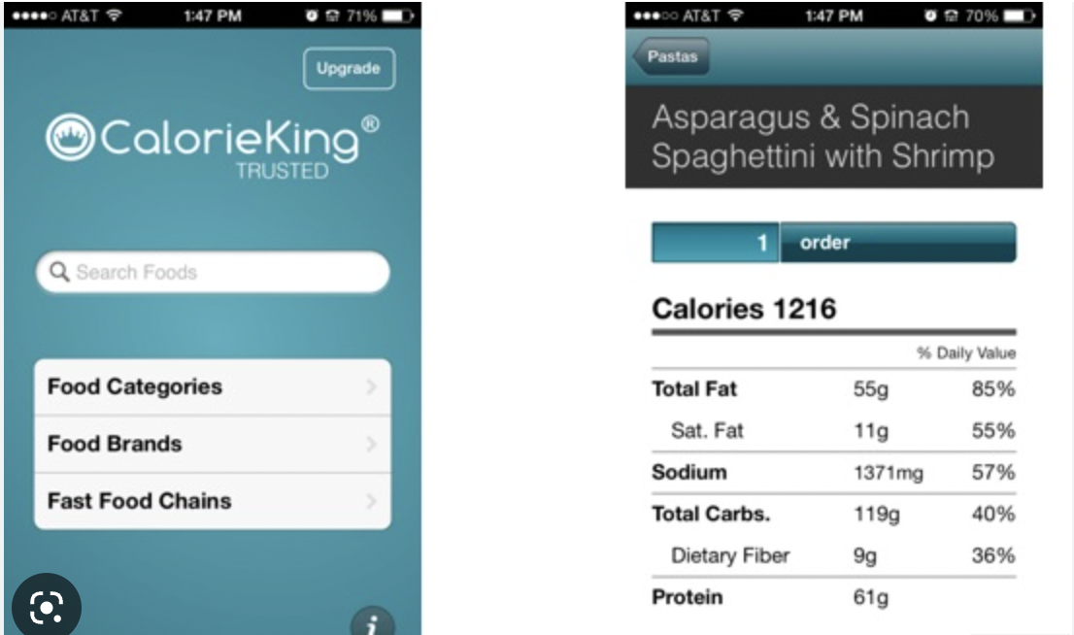
Counting Carbohydrates
20 oz bottle

Slide 42
Outline
All About Diabetes
Diabetes Treatment and Technology
Hypoglycemia
Hyperglycemia
Exercise
Nutrition
Social and Developmental Considerations

Slide 43
The State of Diabetes
Miller, Diabetes Care, 2015

Slide 44
Age-Appropriate Diabetes Care
Age 13-14
Checks BG 6-8 times/day
Counts carbs and calculates insulin doses
Inject insulin/change insulin pump with minimal reminders
Can describe the treatment for hypoglycemia including the use of glucagon
Can describe treatment for hyperglycemia
Verbalizes when to use sick day management and how to follow the guidelines
Carries extra supplies

Slide 45
Age-Appropriate Diabetes Care
Age 15-18
Independent with monitoring and recording blood sugars
Independent with all insulin doses without parents reminding you
Beginning to discuss changes to insulin needs/setting changes/dose changes
Can make setting changes in pump
If using a CGM, anticipates and prevents hypoglycemia
Check BG before driving
Teach friends/roommates how to check BG and administer glucagon

Slide 46
Some Considerations
Understand that becoming independent and capable of self-management is a process and each student is different in achieving various levels of independence
Diabetes is 24/7, 7 days a week

Slide 47
Questions?
z

