Slide 1


THE UNIVERSITY OF ARIZONA – Pediatric Pulmonary
Asthma in School

Slide 2
We respectfully acknowledge the University of Arizona is on the land and territories of Indigenous peoples. Today, Arizona is home to 22 federally recognized tribes, with Tucson being home to the O’odham and the Yaqui. Committed to diversity and inclusion, the University strives to build sustainable relationships with sovereign Native Nations and Indigenous communities through education offerings, partnerships, and community service.

Slide 3
PURPOSE
Working together to expand human potential, explore new horizons and enrich life for all.
MISSION
Continuously improve how we educate and innovate so we can lead the way in developing adaptive problem-solvers capable of tackling our greatest challenges.
CORE VALUES
INTEGRITY • COMPASSION • EXPLORATION • ADAPTATION
INCLUSION • DETERMINATION

Slide 4

AGENDA
Define asthma and be able to recognize an asthma exacerbation
Identify asthma triggers and how changes in the classroom help students avoid these triggers
Understand what medications are used in case of an asthma emergency in the school
Understand what an asthma action plan is and how to follow one
Respiratory illnesses and asthma
TODAY'S
PRESENTATION

Slide 5

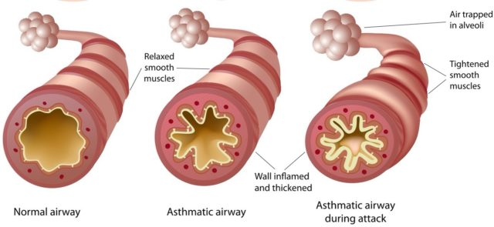
What is Asthma?
Respiratory symptoms that vary over time
  Cough
  Shortness of breath
  Wheeze
  Chest tightness
  Trouble breathing
Chronic
Maybe life threatening
Notes:
•Shortness of breath: The student may complain of being winded, or can’t catch their breath.
•Wheezing: Sounds like a high pitched raspy whistle. You may hear the wheeze when the person exhales. As the episode progresses, you may hear the wheeze when the person inhales and exhales.
•Tightness in the chest: Some kids may describe this sensation as a heaviness in the chest. You may even see them attempt to press down on their chest in an attempt to alleviate the pressure.
•Waking at night with any of the above symptoms, which is a key marker of uncontrolled asthma. These nighttime awakenings may manifest during the day as the child being tired at school or demonstrating an inability to focus. •

Slide 6
What is Asthma?
What does an asthma exacerbation look like
Early asthma warning signs
Shortness of breath
Cough
Feeling tired or weak
Chest tightness
Stomachache
Back pain or itching
Serious asthma warning signs
Medications are not working or do not last
Wheezing
Increased coughing of chest tightness
Inability to do usual activity
SEVERE asthma warning signs
Severe shortness of breath
Difficulty walking or talking
Hypoxia
Increased work of breathing (tripoding, sucking in skin at ribs or neck, nasal flaring)
Blue or gray lips and nail beds

Slide 7
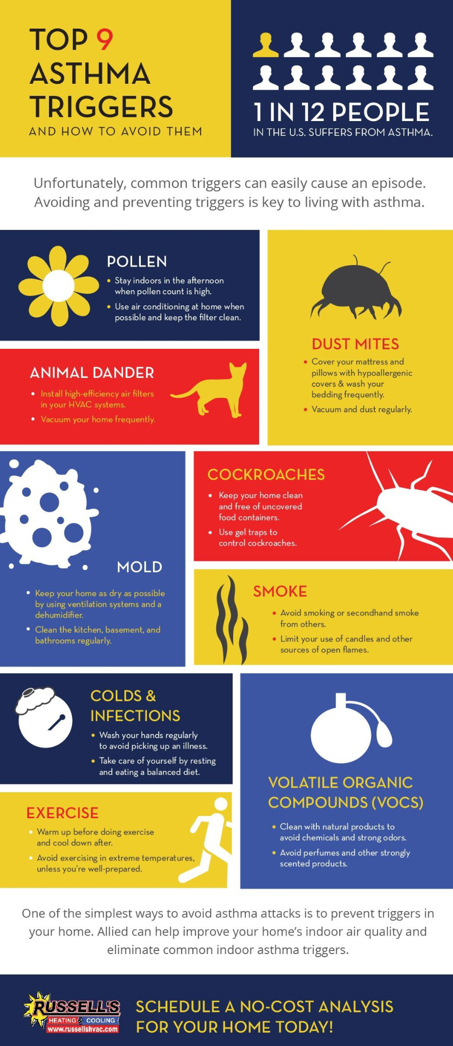
Asthma Triggers
Smoke exposures
Perfumes and strong odors
Air pollution
Hot or cold temperatures and changes in weather
Strong emotions
Exercise
Animals
Mold
Pollen
Rodents and roaches
Dust mites
Respiratory illness

Slide 8
Allergen mitigation
NHLBI Guidelines
Multicomponent allergen-specific mitigation intervention if symptomatic and diagnosed with allergies
Integrated pest management for individuals with asthma who have sensitization or symptoms related to exposure to pests (cockroaches and rodents)
Impermeable pillow/mattress covers only as part of a multicomponent allergen mitigation intervention if dust mite allergic and asthmatic

Slide 9
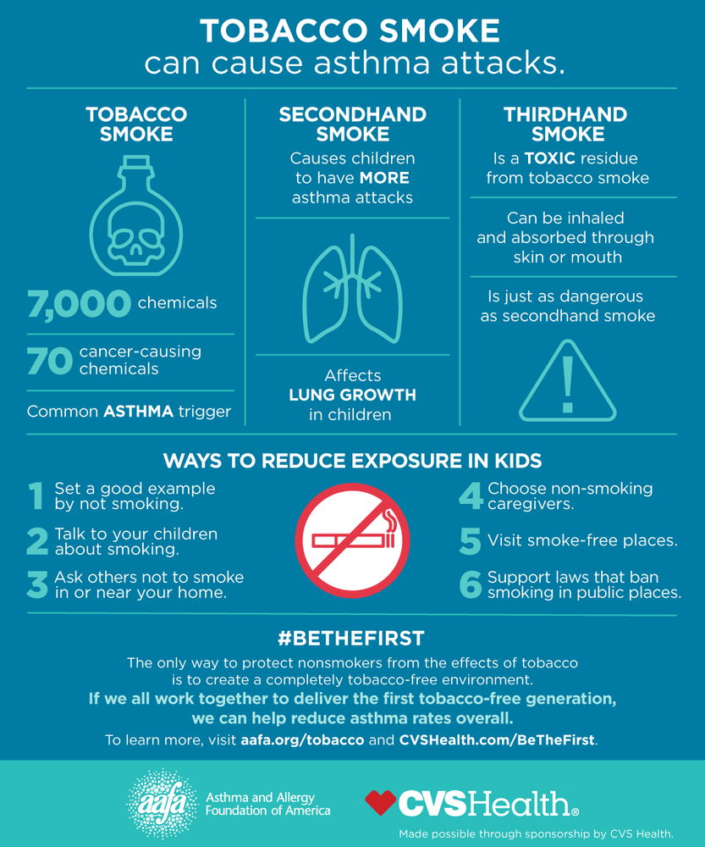
Allergen Mitigation
Smoke
Do not smoke on school grounds
If school staff smokes have them not smoke on their way to work
Use smoke jackets
Wash hands after smoking

Slide 10
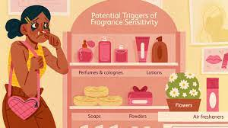
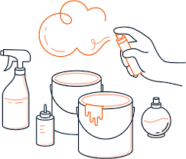
Allergen Mitigation
Perfumes and Strong Odors
Avoid wearing or using scented things in the classroom
Use perfume free cleaning products
Be sure cleaning products with a strong odor are sealed tightly

Slide 11
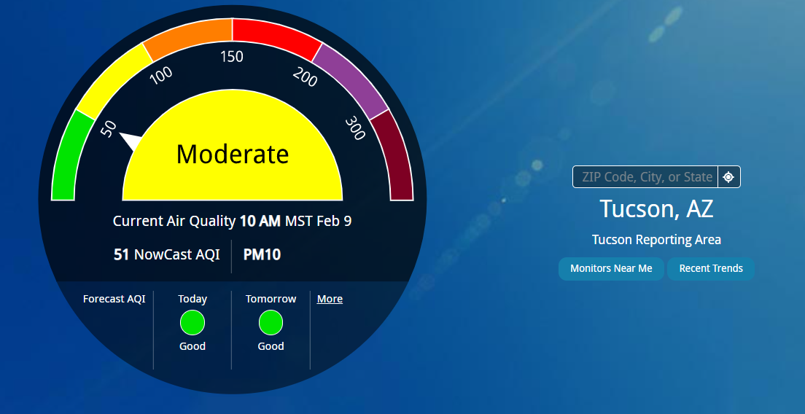
Allergen Mitigation
Air Pollution
airnow.gov
if orange or above stay indoors, keep windows close, and turn on AC if possible
Adopting the Environmental Protection Agency’s Air Quality Flag Program
Notes:
here's how the Air Quality Flag Program works: each day your organization raises a flag that corresponds to how clean or polluted the air is. The color of the flag matches EPA's Air Quality Index (AQI): green, yellow, orange, red, and purple. On unhealthy days, your organization can use this information to adjust physical activities to help reduce exposure to air pollution, while still keeping people active.

Slide 12

Allergen Mitigation
Exercise
Warmup and cool downs
Pre-treatment for exercise
Should be able to exercise if under control
Using rest periods and lower intensity when the student is in the yellow zone
Stop activity in the red zone
Being sure the student has quick access to their inhaler

Slide 13

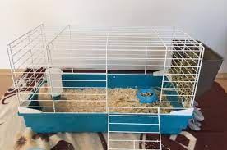
Allergen Mitigation
Pets
Store personal items like backpack and jackets separately
Sit pet allergy children away from those that have pets
Avoid classroom pets if there is a child that is allergic in the classroom

Slide 14
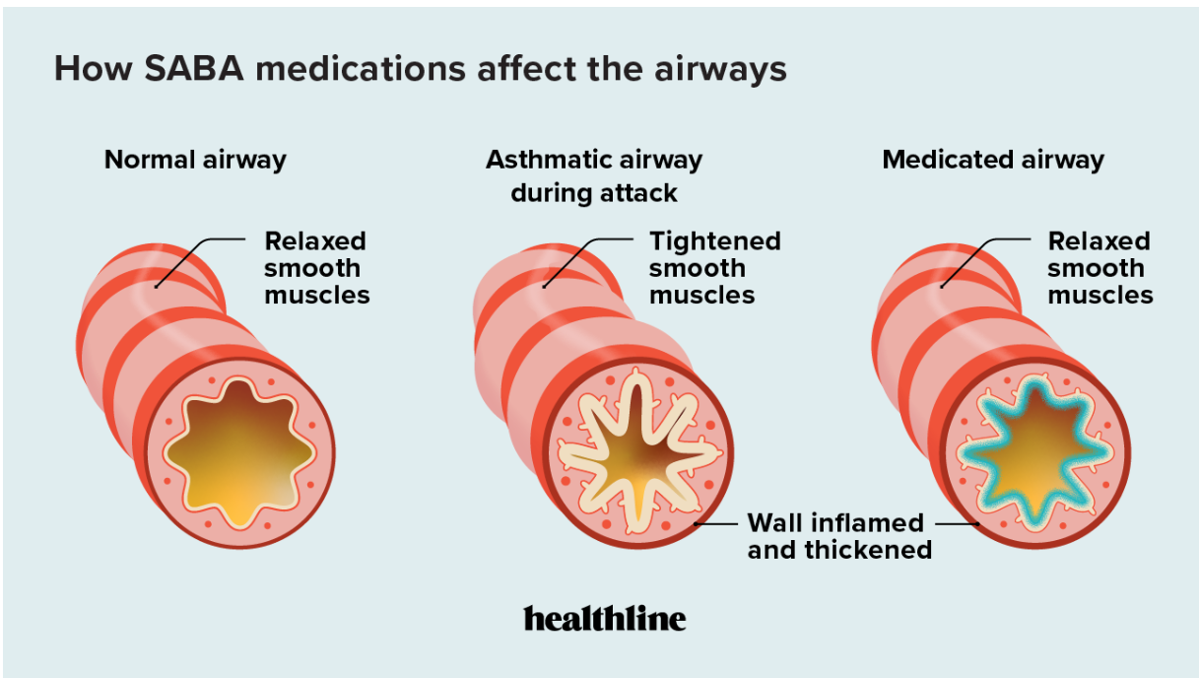
Asthma Medications
Rescue Medication
Albuterol (short acting Beta-agonist)
Ipratropium (anticholinergic)
ICS-Formoterol

Slide 15
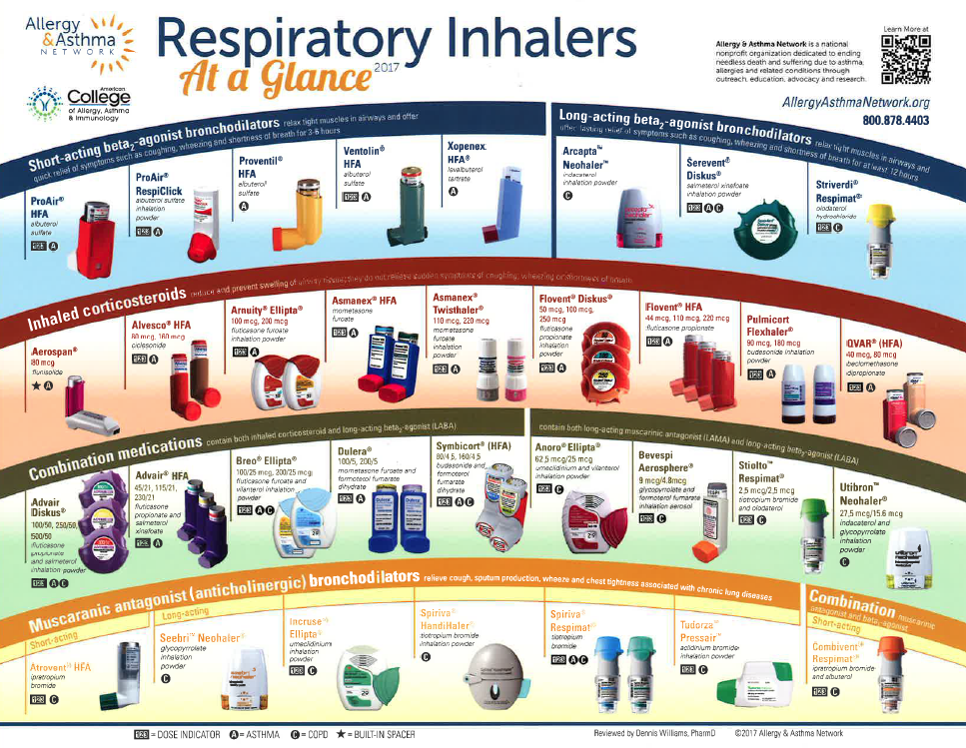
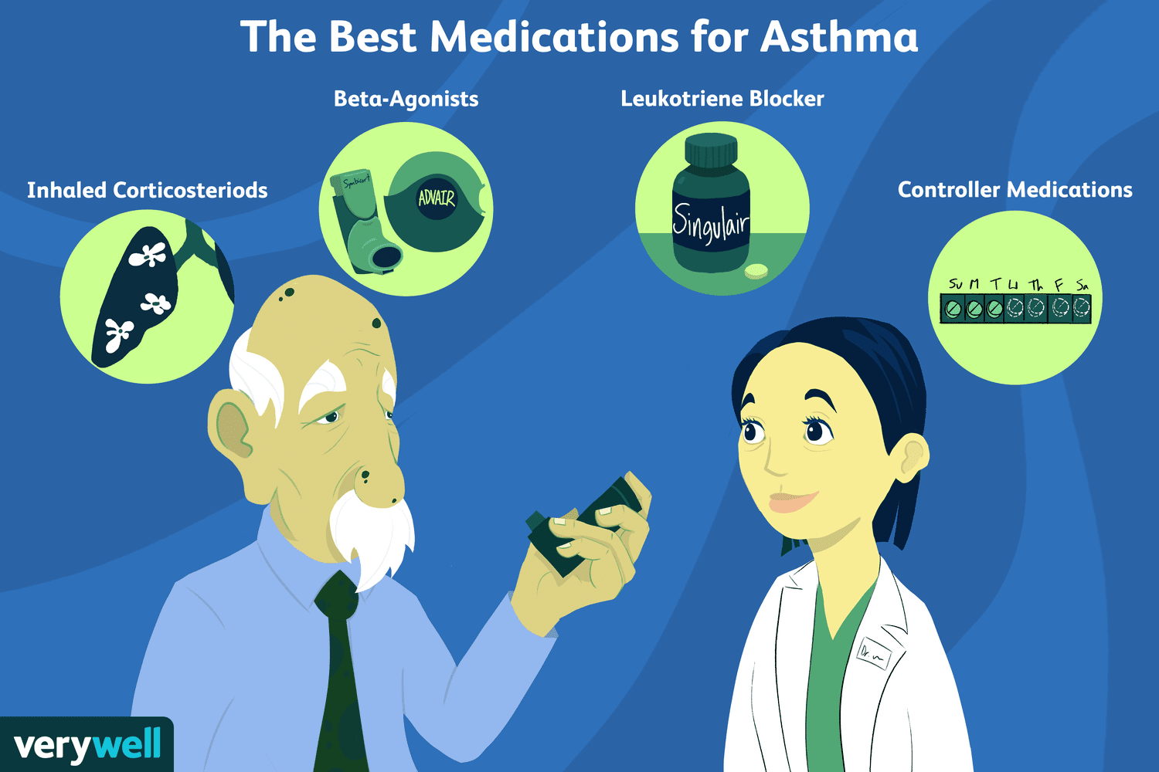
Asthma Medications
Maintenance Medication
Salmeterol and Formoterol (long-acting beta-agonist)
Inhaled Corticosteroid
Montelukast (leukotriene receptor antagonist)
Tiotropium (long acting antimuscarinic)
Biologics

Slide 16
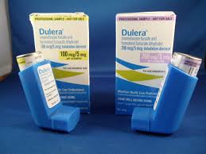
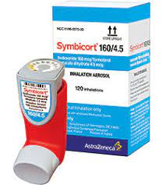
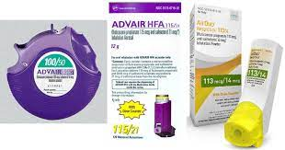
Asthma Medication
Inhaled corticosteroid-Formoterol for as needed treatment
Needs to be Symbicort or Dulera as they have formoterol NOT SALMETEROL (ADVAIR or Airduo) as needed
SMART: single maintenance and reliever therapy
Use of Formoterol-ICS combo for rescue inhaler for patients with mild intermittent asthma
Be careful if in asthma exacerbation can get over the recommended daily dose of formoterol

Slide 17
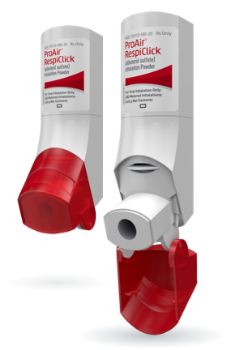
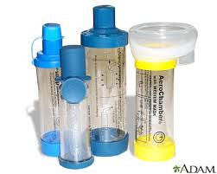
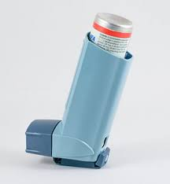
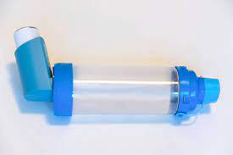
Asthma Medication
Delivery Devices
Meter-Dose inhalers (MDI)
  Breath Actuated Meter Dose Inhaler
Dry Powder Inhalers
Nebulizers
Soft Mist inhalers

Slide 18
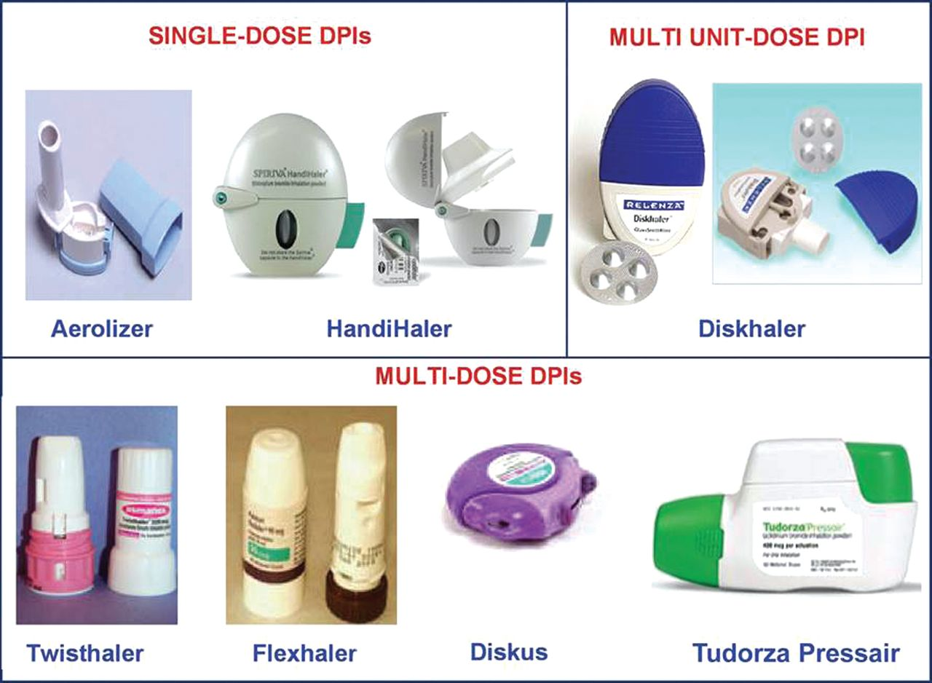
Asthma Medication
Delivery Devices
Meter-Dose inhalers (MDI)
  Breath Actuated Meter Dose Inhaler
Dry Powder Inhalers
Nebulizers
Soft Mist inhalers

Slide 19
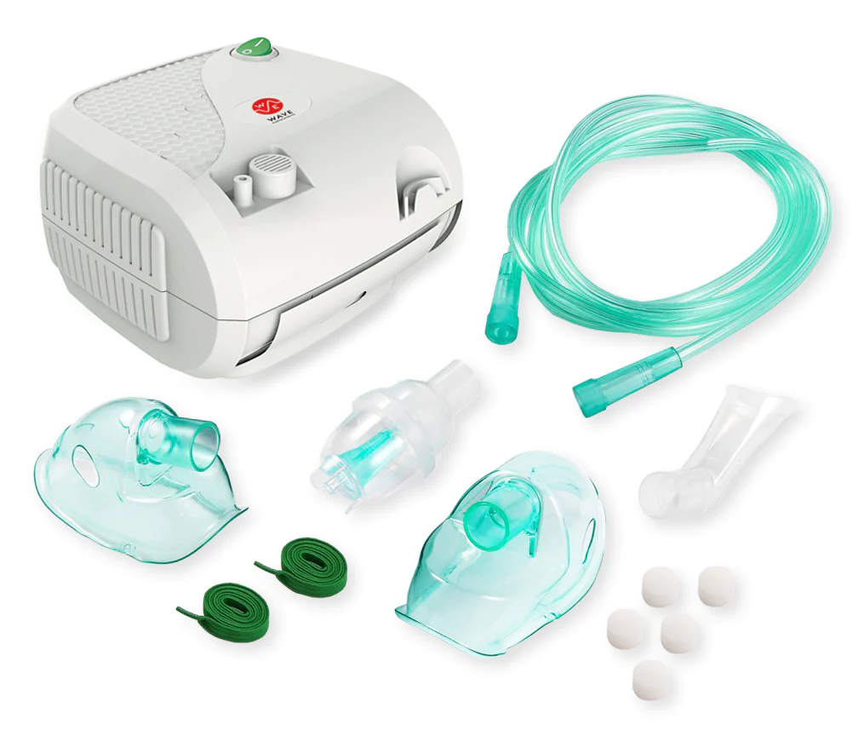
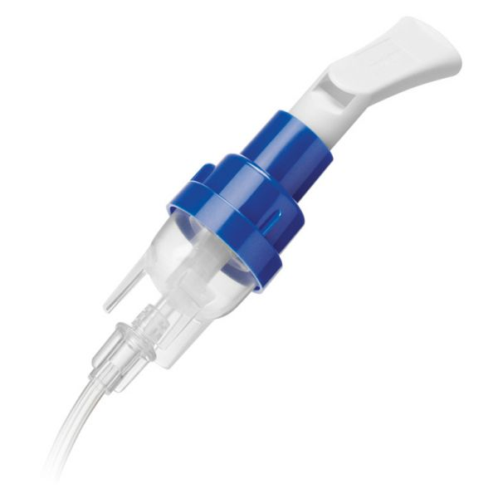
Asthma Medication
Delivery Devices
Meter-Dose inhalers (MDI)
  Breath Actuated Meter Dose Inhaler
Dry Powder Inhalers
Nebulizers
Soft Mist inhalers

Slide 20
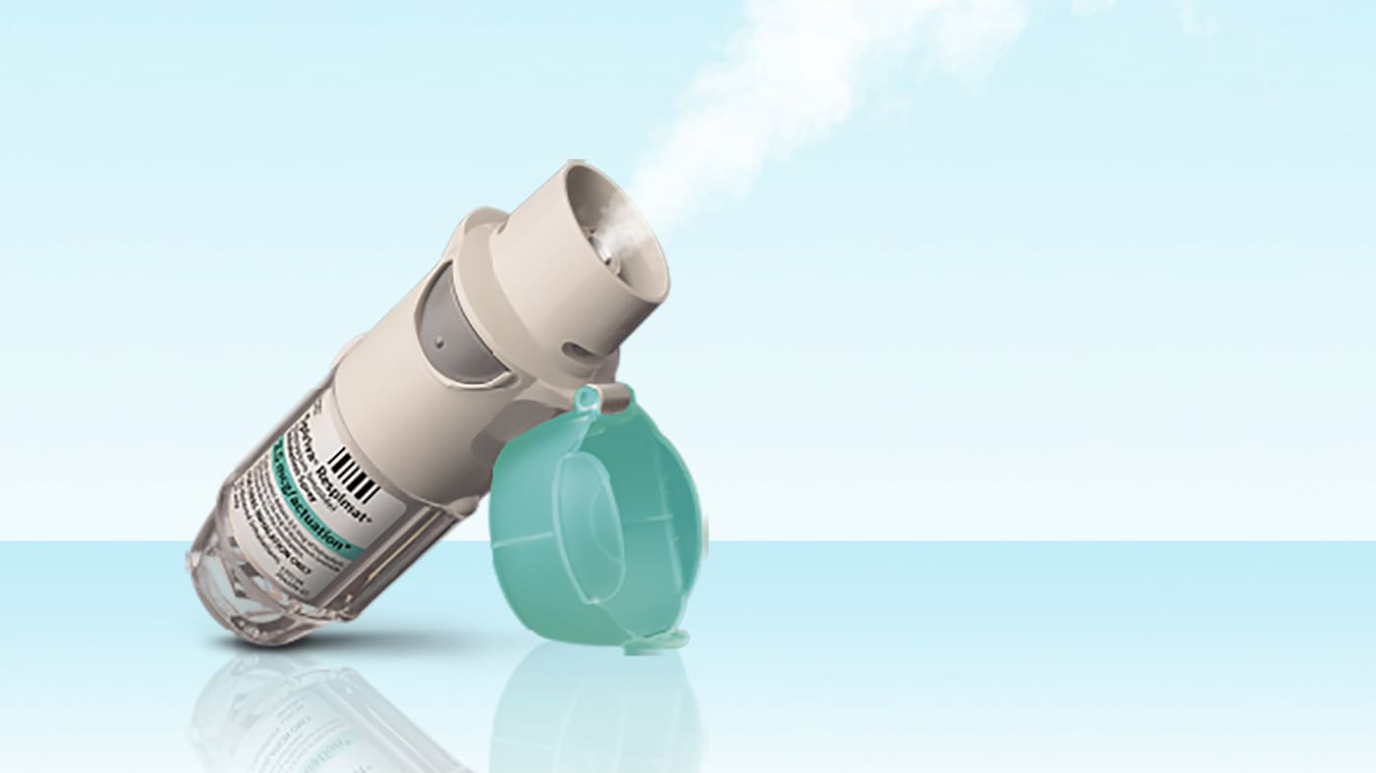
Asthma Medication
Delivery Devices
Meter-Dose inhalers (MDI)
  Breath Actuated Meter Dose Inhaler
Dry Powder Inhalers
Nebulizers
Soft Mist inhalers

Slide 21
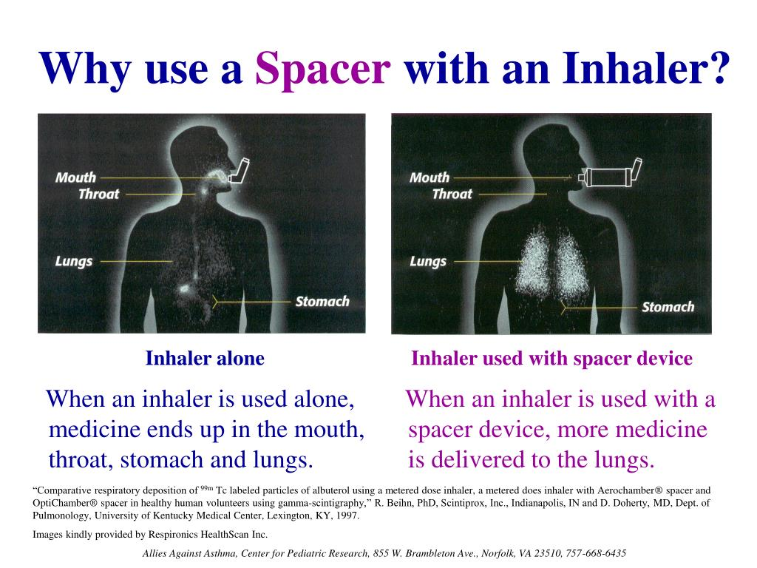
SLIDE TITLE
SUBHEAD

Slide 22
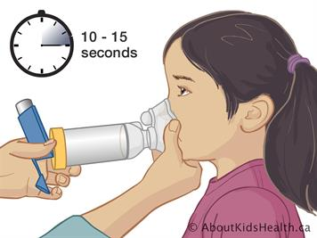
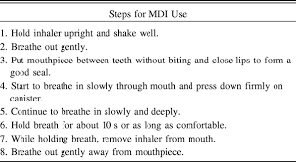
Spacer
https://www.youtube.com/watch?v=kBndCXS8KLw
https://www.youtube.com/watch?v=uGkbreu169Q

Slide 23
What plans should school have for kids
An asthma emergency response plan
Get an asthma action plan from each child
Identify and track students with asthma
Ensure students have immediate and reliable access to quick-relief medication in school
Establish individualized health plans (e.g., Individualized Education Plan, Individualized Health Care Plan) or intensive case management for students with uncontrolled asthma.
Notes:
Develop a system for the school nurse or other health services provider to identify and track students with asthma

Slide 24
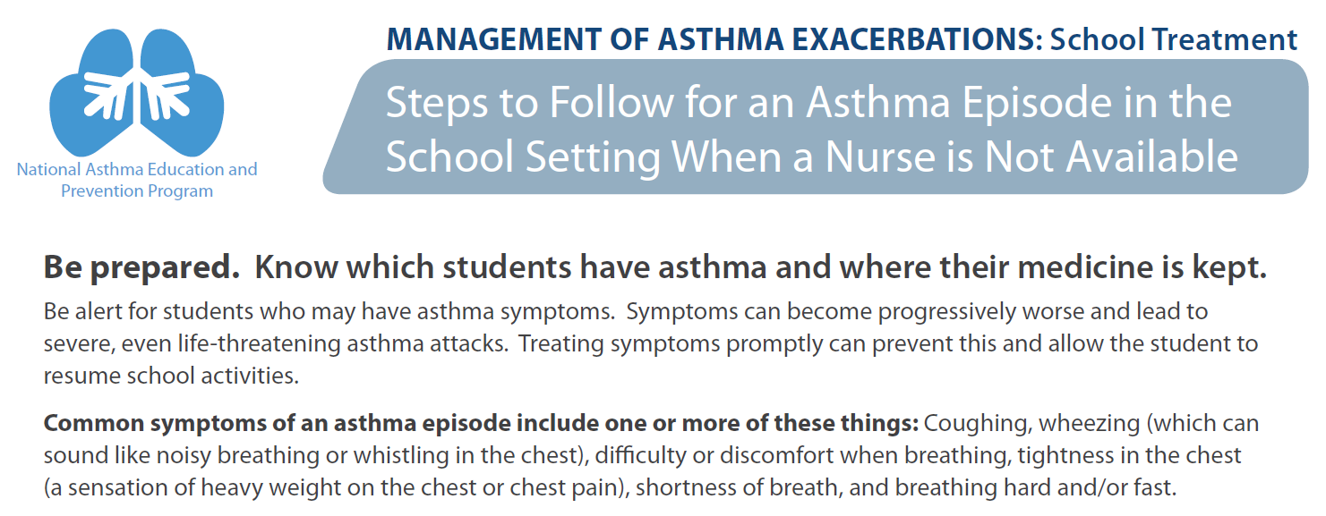
Emergency response plan

Slide 25
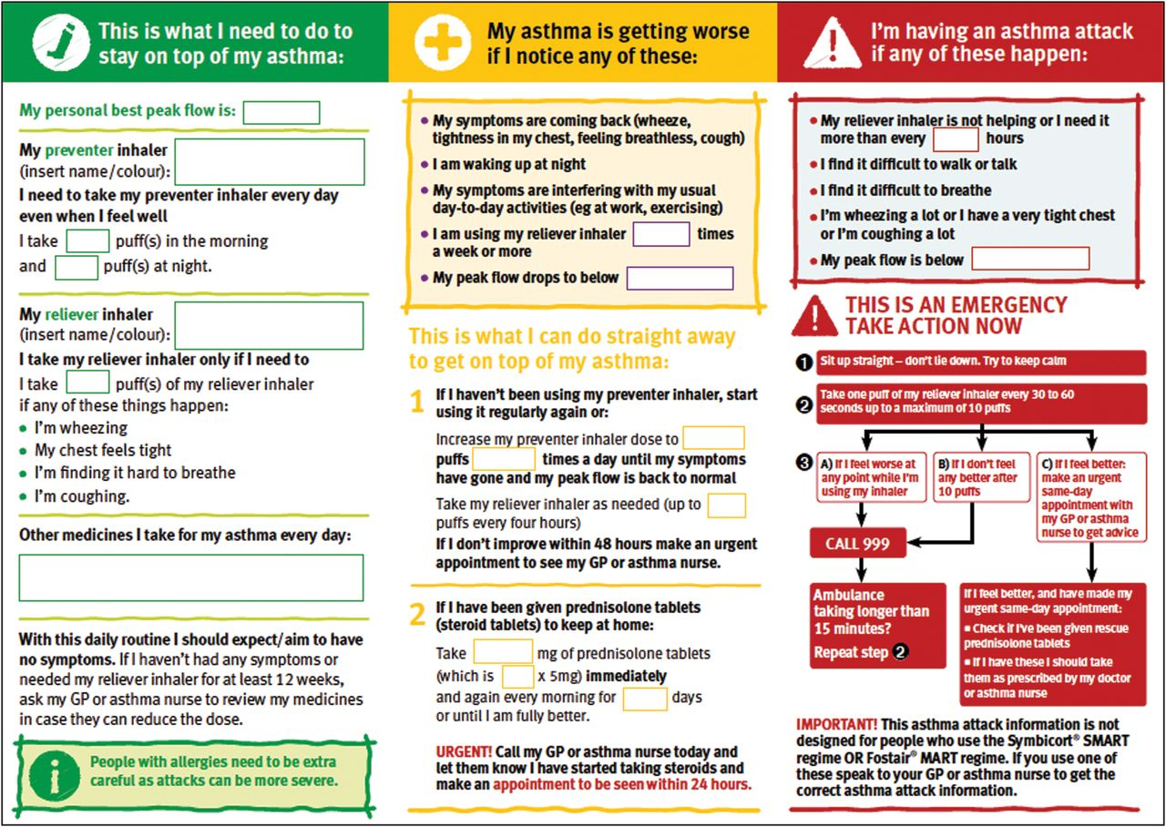
SLIDE TITLE
SUBHEAD

Slide 26
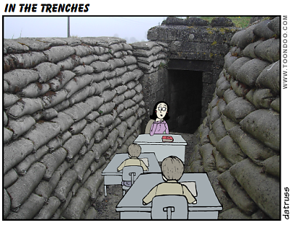

Communication is critical
Communicate with families about a child’s asthma exacerbations and inhaler use in schools
Encourage families to communicate about a child’s asthma with the school
Be sure a child has a physician caring for their asthma
Communicate with a physician if you believe a child’s asthma is out of control

Slide 27
Asthma and Respiratory Illnesses
Viral illnesses are a common asthma trigger
Can asthma exacerbation and viral respiratory illnesses be distinguished
Asthma and COVID-19
  Controlled asthma is not a risk factor for severe COVID-19
Post COVID-19 and asthma like symptoms

Slide 28
Guidelines
The Global initiative for asthma (GINA) guidelines
National Asthma Education and Prevention Program (NHLBI/National heart lung and blood institute) guidelines full guideline 2007
NHLBI: Asthma Management Guidelines: 2020 Focused update
International ERS/ATS guidelines on definition, evaluation and treatment of severe asthma

