Slide 1
Problem Behaviors at School
Anne Bowen, PhD
UA, Pediatric Pulmonary Center

Slide 2
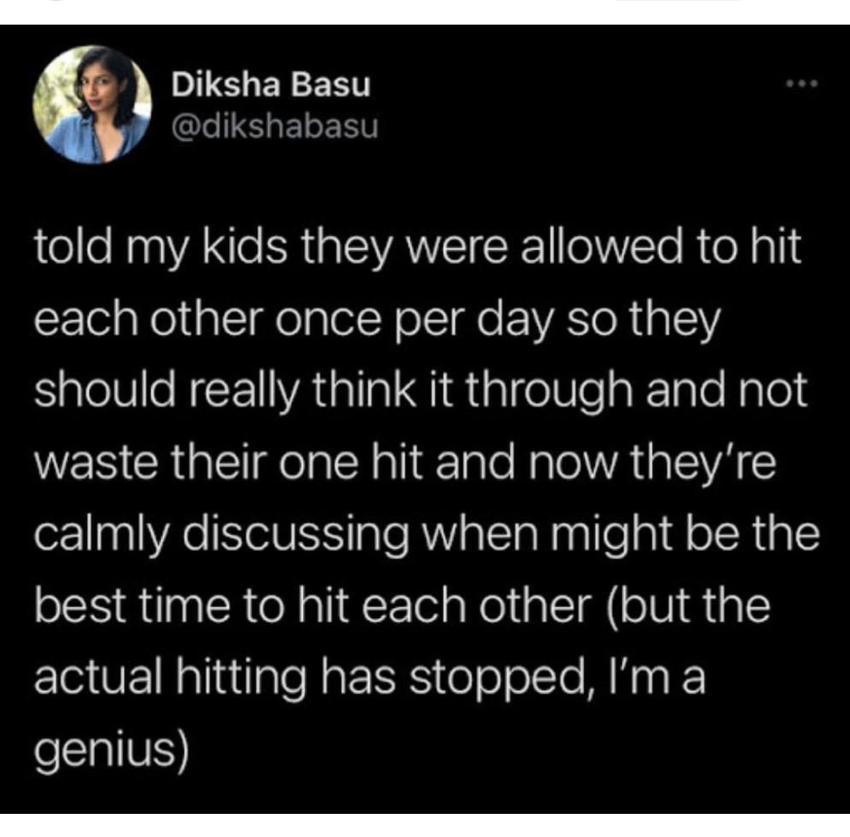

Slide 3
Functonal Behavior Analysis
Antecedent
Behavior
Consequence

Slide 4
Let’s Talk about Behavior

Slide 5
What is Behavior?
Behaviors
Values Supported
Public Behaviors
YOU
Noticing & Choosing
Private Behaviors
Thoughts
(Thoughts, Language)
Sensations
(Emotional feelings)
Noticing

Slide 6
B
Describing Public Behavior
Describing behavior as it is happening now
  Be specific: focus on target behavior
  Be Detailed: everything that is said and done
    Examples: “He swore at the teacher” vs “He stood next to the teacher and said, ‘F*** you.’ in a loud voice
  Be objective: record facts not opinions or interpretations
    He kicked the child viciously, vs He kicked the child in the leg
  What do we see
  What do we hear
  Is the behavior more or less frequent

Slide 7
Functonal Behavior Analysis
Antecedent
Behavior
Consequence

Slide 8
A
What happened just before (Antecedent)
Where:
  Locations in the classroom, playground,
What time
  Work time, center time, announcement, meal, snack, play time
Interactions
  Who is the child interacting with at the time the behavior occurs?
  Teacher, specific children?
Sometimes, changing the environment can change the problem

Slide 9
Functonal Behavior Analysis
Antecedent
Behavior
Consequence

Slide 10
C
What happens after (consequences)
What happened after the behavior?
  Teacher’s response:
    Attended or spoke to the child
    redirect
    not notice
  Another child: how did the child respond
  Response from the environment
    bounce ball that hits the child in the face.

Slide 11
Consequences
Should we change what happens?
  behavior is more frequent
  behavior is decreasing

Slide 12
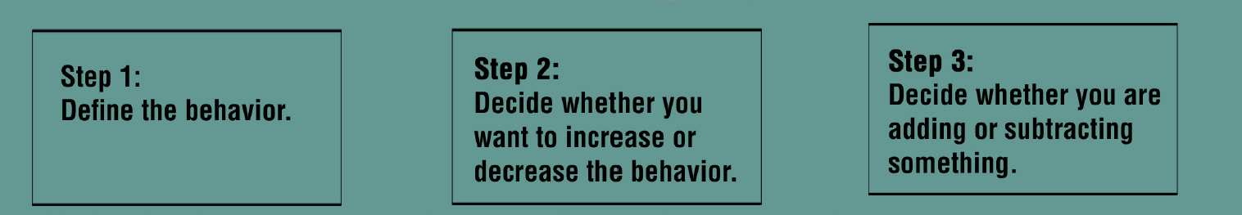
Systematically Assess Problem Behaviors

Slide 13
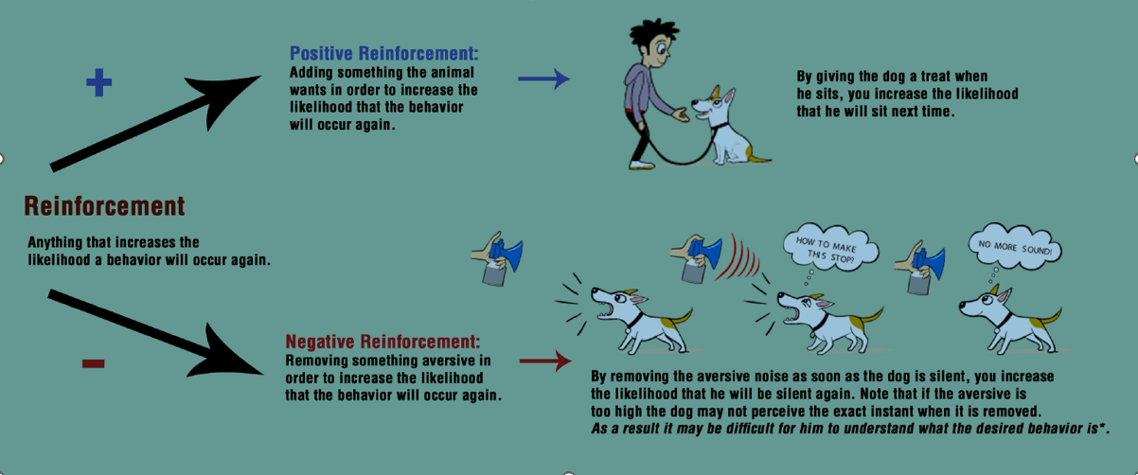
Increasing Frequency of Behaviors

Slide 14
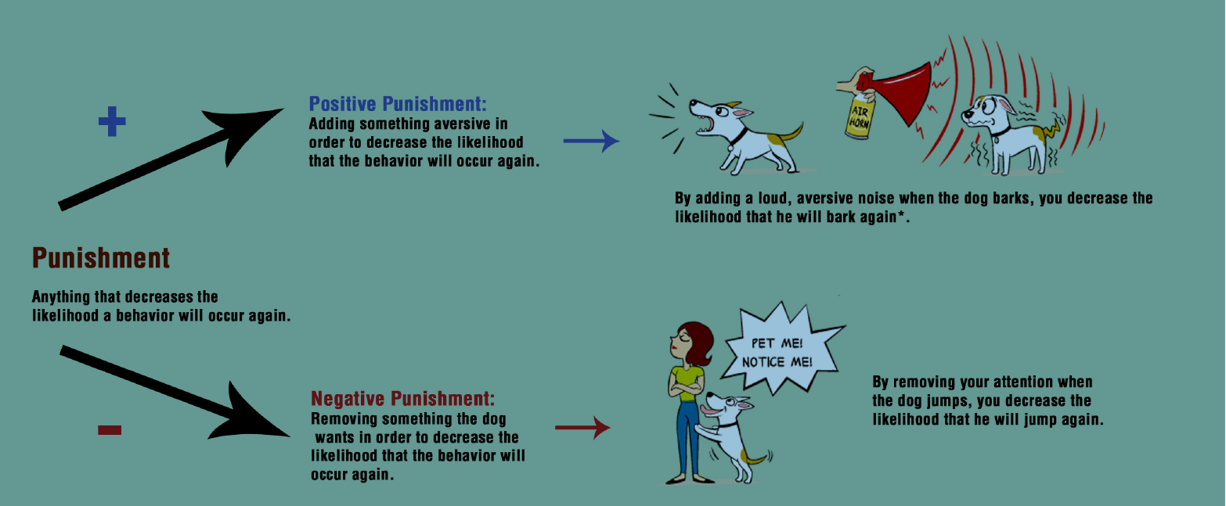
Decreasing the Frequency of Behavior

Slide 15
Conducting a
Functional Behavior Analysis
Antecedent
Behavior
Consequence

Slide 16
EXAMPLES
https://jamboard.google.com/d/1kxbVSETbkxqZzD8Sas5RkIAbgtKJmD_5qaweNg7lwpk/edit?usp=sharing

Slide 17
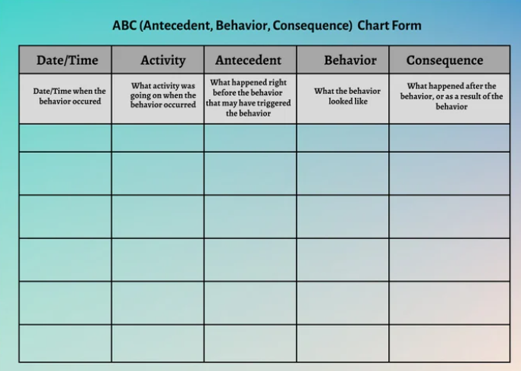

Slide 18
Functional Analysis of a PROBLEM Behavior
(Adolescent)
External Triggers | Internal Triggers (Just before the Problem) | Behavior | Short term positive consequences (Good stuff) | Long-term negative consequences (Not such good stuff)
Who were you with? | What were you thinking about | What did you do? | What did you like about doing this with….. What were some of the good thoughts you had What were some of the good emotions What were some of the good physical feelings | What were some of the negative results? Interpersonal Physical Emotional School Financial other
Where were you? | What did you feel physically | How long did it last
What time of day? | What did you feel emotionally

Slide 19
Functional Analysis of a PROSOCIAL Behavior (Adolescent)
External Triggers | Internal Triggers (Just before the Problem) | Prosocial Behavior | Short term positive consequences (Good stuff) | Long-term negative consequences (Not such good stuff)
Who are you usually with | What are you thinking about | What did you do? | What do you dislike about doing this with….. What do you dislike about where this happens? | What were some of the negative results? Interpersonal Physical Emotional School Financial other
Where are you? | What are you feeling physically | How long does it last
What time of day? | What are you feel emotionally | How often do you do it?

Slide 20
Feelings & Sensations

Slide 21
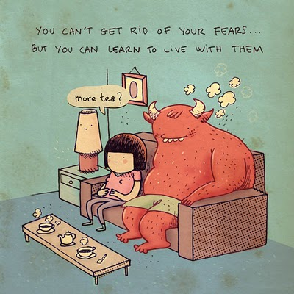
All Feelings are NORMAL

Slide 22
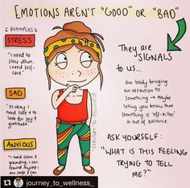

Slide 23
Summary
Feelings are physical
They don’t always feel good, but they won’t hurt us
Waiting to “FEEL BETTER” or for “Motivation” may never happen
You can’t get rid of just one
You can’t have only one either
A full range of feeling is important

Slide 24
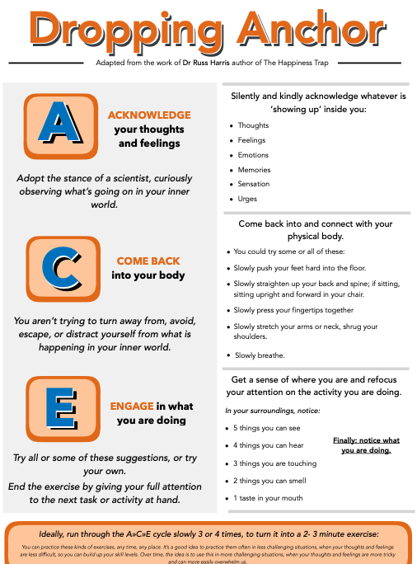
Working with Emotions

Slide 25
What about THOUGHTS?

Slide 26
THOUGHTS
Our minds have lots of opinions
We respond to THOUGHTS as if they are always true
Mind gives us rules that describe how things “should” work, even though the evidence suggests it doesn’t.
Noticing thoughts as suggestions for action, NOT rules.
Helping kids notice’ their thoughts
  I’m noticing I’m having the thought
  My mind said……

Slide 27
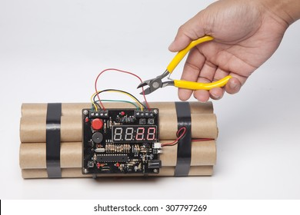
Defusion
Thoughts are learned
The mind isn’t very original
Is the “idea” helpful?
  Yes – follow it
  NO – DO SOMETHING ELSE and let it be (TUG OF WAR)

Slide 28
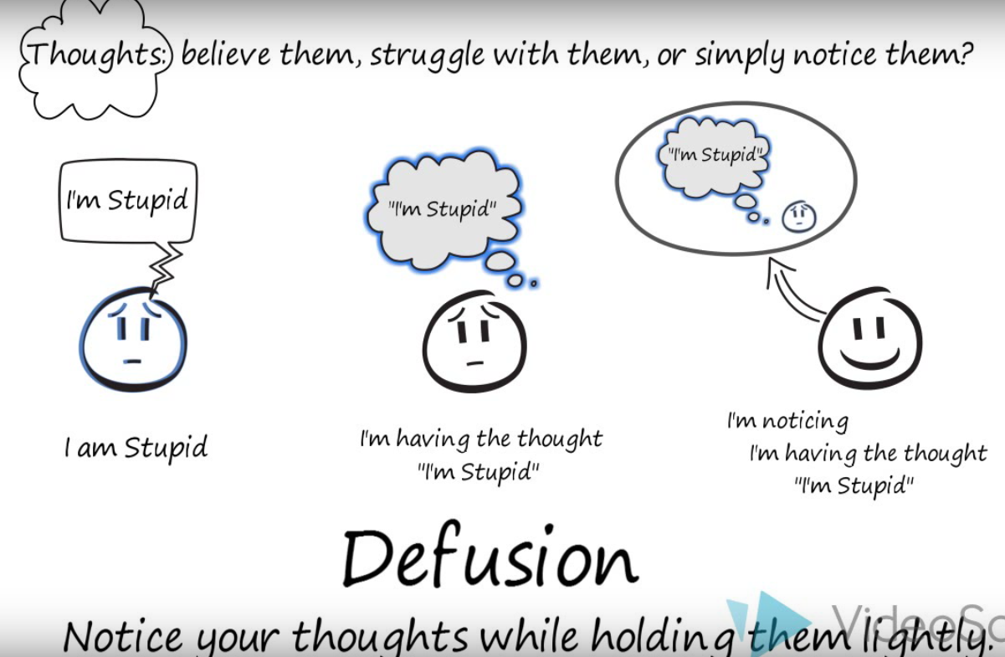

Slide 29
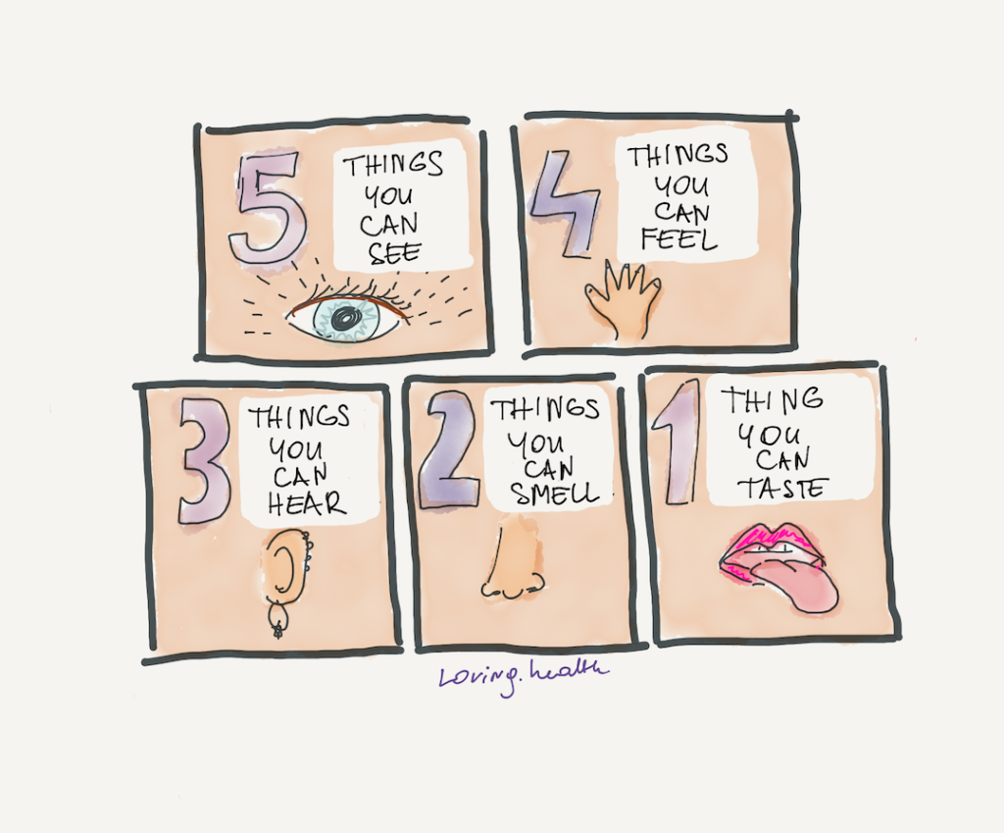
Getting out of your head, & into the sensory world
Flexibly attend to what they are doing
Experience thoughts of the past from the perspective of here and now
Autopilot vs mindfully aware.

Slide 30
Help them Do What Matters
Set Behavioral Commitments to Valued Actions
Skills training
  Problem solving
  Communication Skills
  Refusal Skills
Notice thoughts that get in the way (“Yes but…”)
Practice FEELING, without judgement
  Urge surfing

Slide 31
Behavior Analysis: Classroom Behavior
Antecedent (What happened before) | Behavior | Consequence (What happened after/what did you do) | Is the behavior happening more, same or less often?) Reinforcer or punisher?
Teacher asks class a reading related question? | Child whistles | Teach says “Stop”
Teacher repeats question | Raise hands, response with mocking tone, class laughs | Teacher ignores class, says “ok”
New Questions | Response is silly and inappropriate, class laughs | Teacher says “That’s enough”

