Slide 1
Nutrition and Cystic Fibrosis
Module 1: Cystic Fibrosis Overview

Slide 2
Learning Objectives
Describe the pathophysiology of cystic fibrosis, and specifically how the disease process alters nutrient digestion, absorption, and metabolism.
Utilize cystic fibrosis resources including the Cystic Fibrosis Foundation (CFF) website.
Discuss the interprofessional team approach in working with CF patients and their families.
Describe Life Course Theory (LCT) and how this is used on the context of CF care.

Slide 3
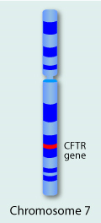
What is cystic fibrosis (CF)?
Genetic, autosomal recessive disorder
Mutations in cystic fibrosis transmembrane regulator (CFTR) gene
  Changes in the CFTR protein result in production of thick mucous in epithelial tissues including in the digestive tract, respiratory tract, and sweat glands
  Watch the video demonstrating function of CFTR in lung cell (link under “Reference Material” for Module 1)
There are five classes of mutations (I-V), with class I, II and III mutations resulting in more severe disease
www.learn.genetics.utah.edu

Slide 4
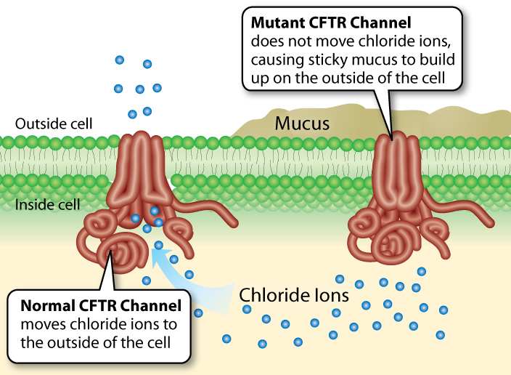
www.learn.genetics.utah.edu/content/disorders/singlegene/cf/

Slide 5
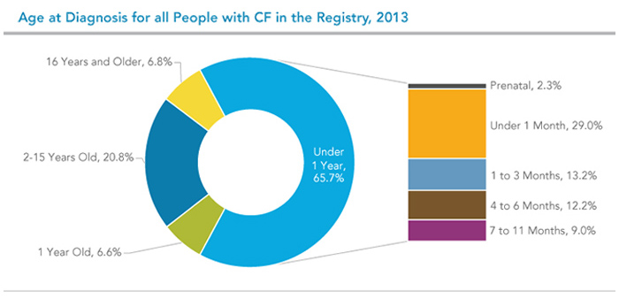
How is CF diagnosed?
Newborn screening for most common genetic mutations
Results are confirmed with sweat chloride test or additional genetic testing
Early detection results in improved health outcomes
www.cff.org

Slide 6
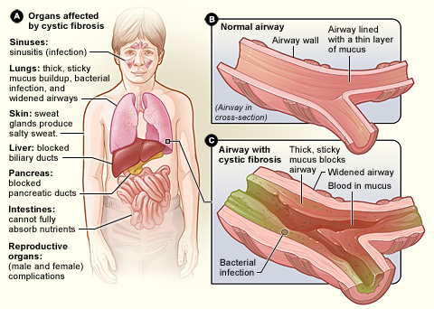
Consequences of CF
Lungs and airways
Nutrition-related
  Malabsorption of nutrients, including fat and fat-soluble vitamins, occurs in patients with pancreatic involvement
  Weight loss, poor growth, and nutrient deficiencies
  Psychosocial issues may also impact nutrition status
www.nhlbi.nih.gov/health/health-topics/topics/cf/signs

Slide 7
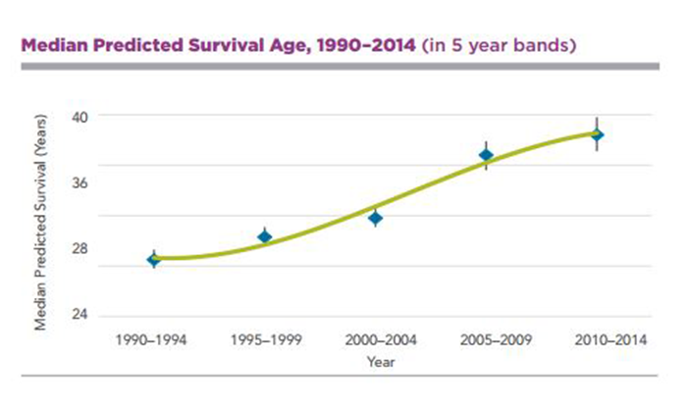
Prognosis
Individuals with CF have seen significant increases in median predicted survival age
Quality health and nutrition interventions are important for increased survival rates and increased quality of life
https://www.cff.org/For-Caregivers/CF-Care-Centers/

Slide 8
CF and the GI Tract
Recall that the GI tract, and specifically the small intestine is where most nutrient digestion and absorption occurs
Most CF patients are pancreatic insufficient - thick mucous in the pancreas blocks the release of digestive enzymes leading to severe malabsorption in the gut
Pancreatic enzyme replacement therapy (PERT) provides the necessary digestive enzymes
  Prescription digestive enzymes taken by mouth immediately before meals
  Pill burden can be high, as several pills may be required each meal and snack
  Adherence to PERT can vary and must be assessed at each CF clinic visit

Slide 9
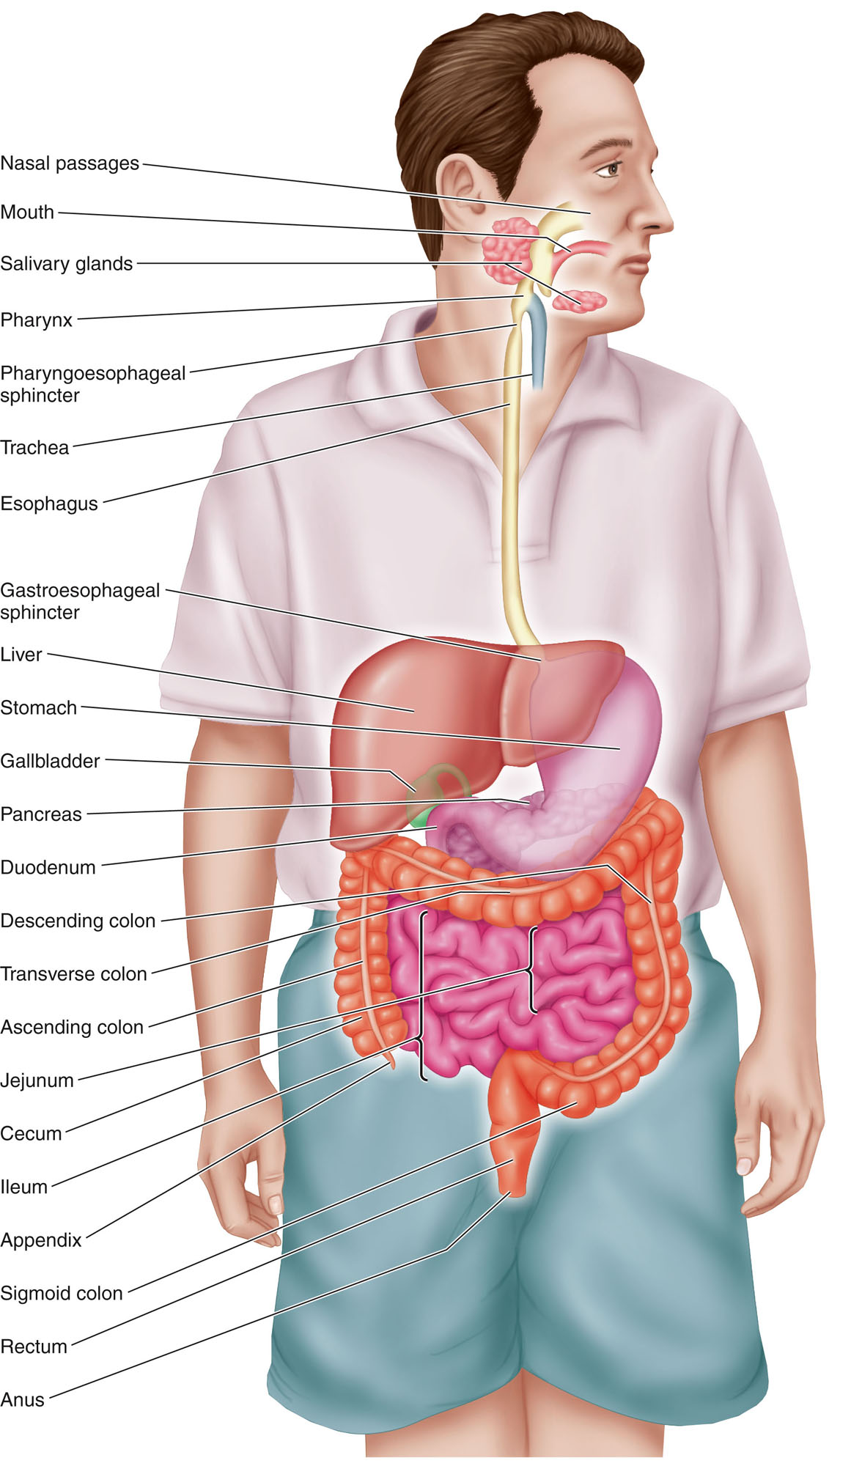
REVIEW QUESTIONS
How are macronutrients digested and absorbed?
How is the pancreas involved in digestion?
If an individual has fat malabsorption, what other nutrients might be affected?
What are the signs and symptoms of fat malabsorption?
If a pancreatic insufficient CF patient does not take prescribed digestive enzymes, what are the consequences?
Would a pancreatic sufficient CF patient need to take digestive enzymes?
Nutrition Therapy and Pathophysiology, Nelms et al.

Slide 10
CF and Nutrition
Poor nutritional status is associated with worse clinical outcomes
Medical nutrition therapy (MNT) is critical component of CF management
High kilocalories (kcals), high fat diets are typically recommended
Dietary supplements and nutrition support may be needed to reach energy requirements and support weight maintenance/gain
  Scandishakes, Ensure, Boost Plus, and pediatric oral supplements
  Enteral nutrition support indicated in failure to thrive, low weight, poor weight gain, and anorexia

Slide 11
CF and Nutrition
CF patients regularly complete a pulmonary function test (PFT) at each CF clinic visit that measures lung function
  FEV₁ = the amount of air that can be forcefully blown out of the lungs in 1 second
  FEV₁ is a good measure of how much mucus is blocking the large airways
  Check out the CCF website information “Basics of Lung Care”
  Watch the video of an actual CF patient completing his PFTs
BMI is inversely correlated with lung function as measure by FEV₁
  It is unclear if low BMI causes suppressed lung function or vice versa
  Patients and parent/caregivers should be educated on the connection to BMI and lung function

Slide 12
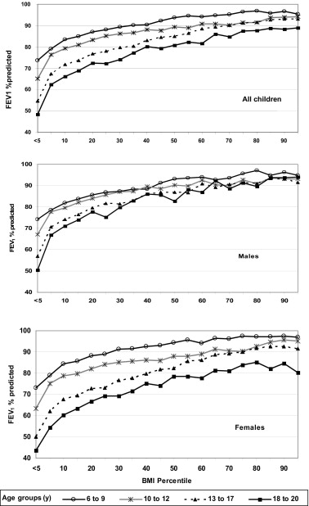
The graphs on the left show the association of BMI percentile and percent predicted FEV₁ for children with CF and PI.
Lower BMI is associated with lower lung function and vice versa
Maintaining weight >50th percentile is recommended by the CFF (>50th percentile wt-for-length for children 2 years or less)
For a 6-year-old female in the 20 percentile for BMI, what is her % predicted FEV1?
Stallings, et al.

Slide 13
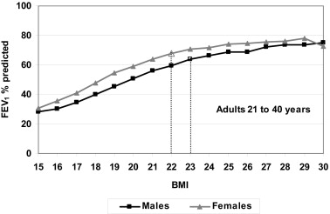
The graph on the right represents the relationship between BMI and percent predicted FEV₁ for CF patients with PI aged 21-40
The same association between BMI and lung holds true for adults as with children
BMI goals
  >22 kg/m² for females
  >23 kg/m² for males
Stallings, et al.

Slide 14
Energy Requirement in CF
REE typically increased in CF 105-130% of expected
  Generally hypermetabolic
  Individualized assessment required to determine accurate estimate of energy needs
CFF guidelines call for energy needs 110-200% estimated energy requirements for age and gender
Recommended kcal adjustment in increments of 10% above estimated energy requirements

Slide 15
Energy Needs in CF - EXAMPLE
Jeremy is an 18-year-old male who was diagnosed with CF at age 3. He is pancreatic insufficient and tries to consume a high kcal, high fat diet. He generally has a low activity level.
Ht: 70 in Wt: 150# BMI: 21.5
What is Jeremy’s estimated energy requirement?
  In the text, Table 2.1 provides the formula for kcals/d for Jeremy’s age and gender: 88.5 – (61.9 x age[yr])+ PA x (26.7 x wt[kg] + 903 x ht[m]) + 25 kcals
  Before using the formula, convert Jeremy’s height and weight into metric units.
    Ht: 70 in x 2.54 cm/in = 177.8 cm/1000 = 1.78 m
    Wt: 150 # x 1 kg/2.2# = 68.2 kg
  Plug numbers into the formula.
  88.5 – (61.9 x 18)+ 1.13(26.7 x 68.2 + 903 x 1.78) + 25 kcals = 2079 kcals/d
  Add 10% for an initial estimate of energy needs for CF.
  2079 kcals/d + 10% = 2287 kcals/d*
  *This final estimate may need to be adjusted based on individual tolerance and weight status

Slide 16
Macronutrient Requirements in CF
Fat – provides 9 kcal/g
  35-40% of total kcals
  Focus on monounsaturated fatty acids (MUFA) and polyunsaturated fatty acids (PUFA) vs saturated fatty acids
  No benefits seen with medium chain triglycerides (MCT)
Protein
  12-15% of total kcals OR 1.5-2 times the RDA
  Compare above recommendations to assess appropriate protein load
Carbohydrate (CHO) - typically minimal loss of CHO in stool of CF patients
  Approximately 50% of total kcals…calculate fat and protein first to determine
  Keep in mind minimum RDAs for pediatric and adult patients
  Moderate fiber intake as tolerated

Slide 17
The Interprofessional Team in CF
“Since cystic fibrosis (CF) is a complex disease, it requires a team approach with you or your child at the center. Your CF care team includes a group of CF health care professionals who partner with you to provide specialized, comprehensive CF care.” (www.cff.org)
RDNs are an integral part of the interprofessional health care team

Slide 18

The Interprofessional Team in CF
www.cff.org
Notes:
CFF website

Slide 19
The Role of the RDN in CF
Helps patients gain or maintain a healthy weight
Develops a nutritional plan that is high in calories, protein, vitamins and minerals
Recommends fat-soluble vitamins, pancreatic enzymes and additional dietary supplements
Works with patients to meet nutritional goals, which may include tube feeding
Helps patients manage CF-related diabetes (CFRD) and bone diseases like osteoporosis
www.cff.org/Living-with-CF/Your-CF-Care-Team/
Notes:
CFF website

Slide 20
References
Nutrition in Cystic Fibrosis, Yen and Radmer Leonard - Chapters 1-3
Cystic Fibrosis Foundation – www.cff.org
University of Utah Health Sciences, Genetic Science Learning Center www.learn.genetics.utah.edu
National Heart, Lung and Blood Institute - www.nhlbi.nih.gov
Nutrition Therapy and Pathophysiology, Nelms et al., 2nd Ed – Chapter 14
Stallings et al. Evidence-based practice recommendations for nutrition-related management of children and adults with cystic fibrosis and pancreatic insufficiency: results of a systematic review. J Am Diet Assoc. 2008; 108(5):832-9.

