Slide 1
Hormone Replacement Therapy Updates for Perimenopausal Women and Effects on Sexual Health
Celia Valenzuela, MD
Associate Clinical Professor
Department of Obstetrics and Gynecology

Slide 2
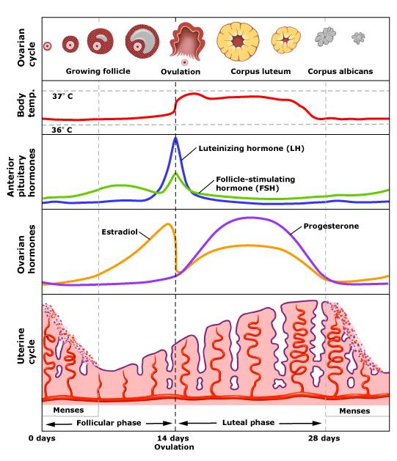
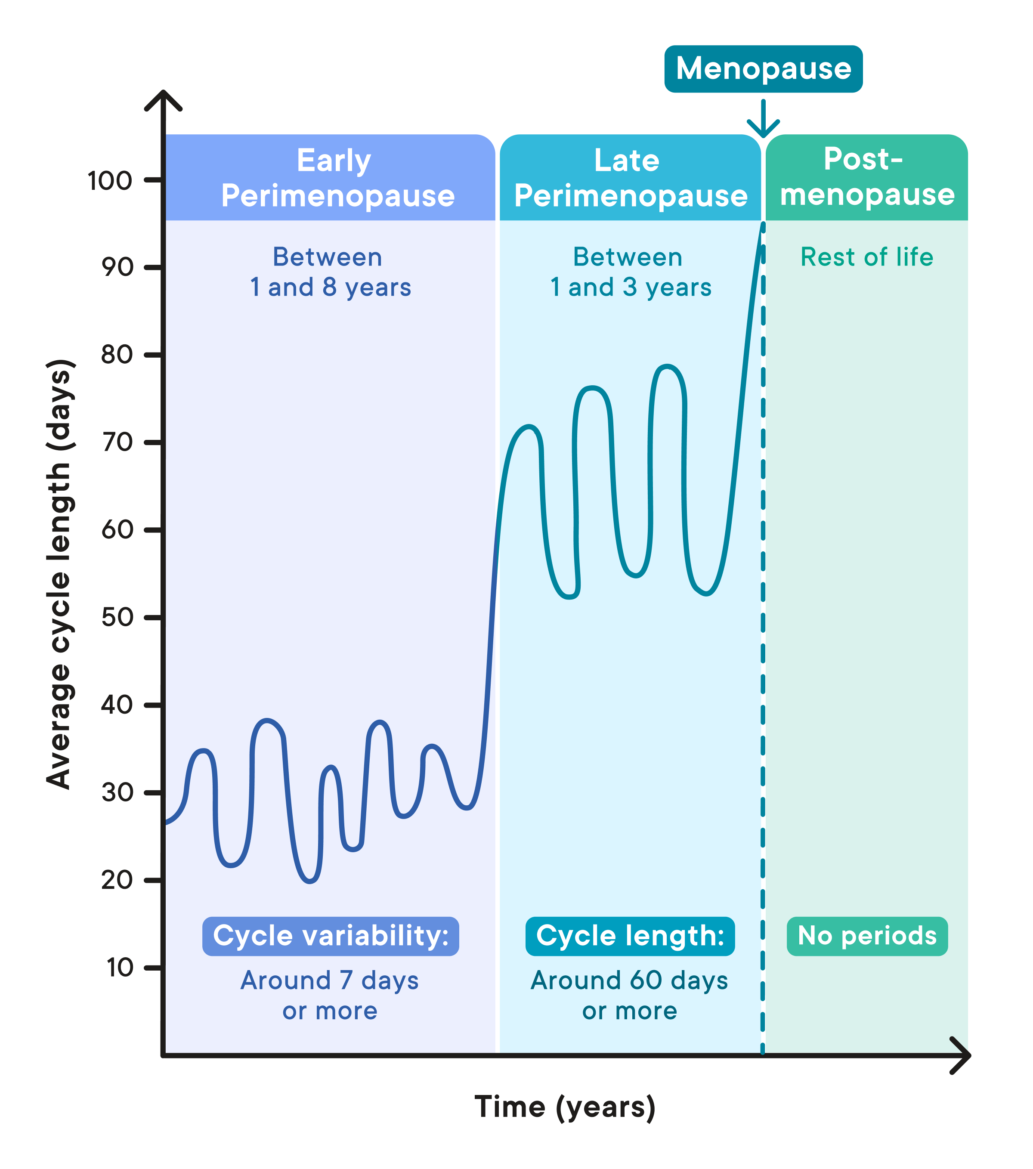
Image credit: https://helloclue.com/articles/cycle-a-z/menopause-and-perimenopause-101
Image credit: https://angea.com.au/our-menstrual-cycle/
Notes:
Let’s start by talking about what perimenopause is.

Slide 3
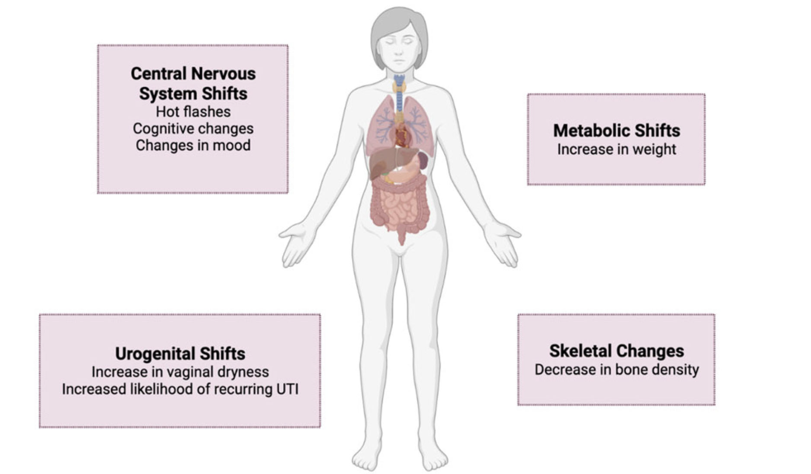
Changes Associated with Cessation of Menses
Dothard MI, Allard SM, Gilbert JA. The effects of hormone replacement therapy on the microbiomes of postmenopausal women. Climacteric. 2023 Jun;26(3):182-192.
Notes:
Figure 1. Symptoms of menopause. Loss of estrogen synthesis and subsequent decline in estrogenic activity has profound effects throughout the body, influencing physiology, cognition, mood and risk of disease. UTI, urinary tract infection.

Slide 4

Sleep Disruption
Common, begins in perimenopause
Strongly associated with VMS and a decreased quality of life
Poorer sleep associated with mood fluctuations, memory problems, metabolic syndrome, obesity, and other CV risk factors
Hormone therapy may improve chronic insomnia
Oral micronized progesterone has mildly sedating effects
“The 2022 Hormone Therapy Position Statement of The North American Menopause Society” Advisory Panel. The 2022 hormone therapy position statement of The North American Menopause Society. Menopause. 2022 Jul 1;29(7):767-794.
Photo credit: https://terriregentcoaching.co.uk/overcoming-menopause-insomnia/
Notes:
During the menopause transition, women with VMS are more likely to report disrupted sleep. (Level I)
Hormone therapy improves sleep in women with bothersome nighttime VMS by reducing nighttime awakenings. Estrogen may have some effect on sleep, independent of VMS. (Level II)

Slide 5
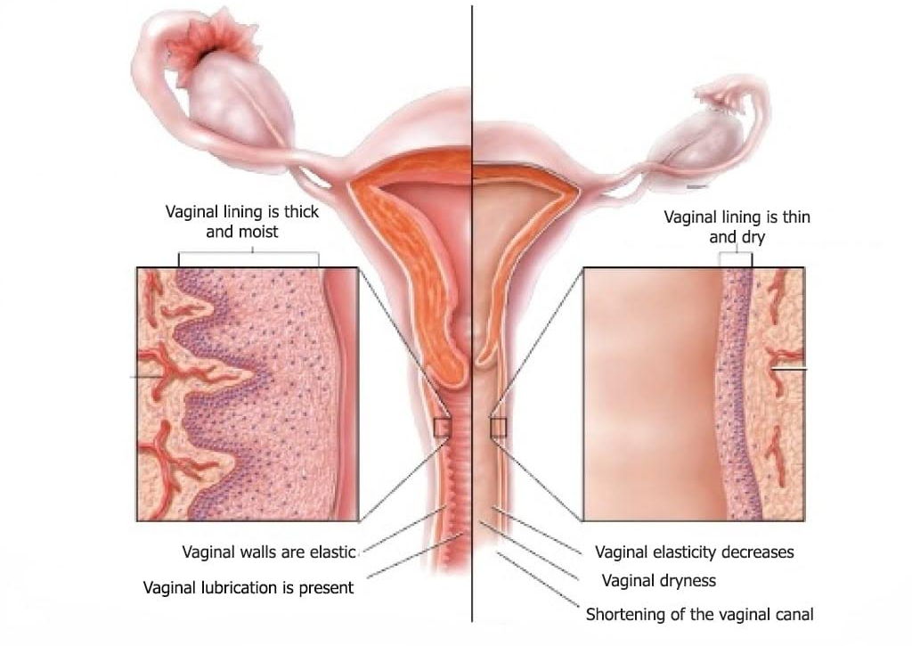
Vaginal Changes
Image credit: https://www.facebook.com/photo.php?fbid=2971923046269918&id=558867797575467&set=a.561222684006645
Notes:
Without estrogen:
Vagina loses collagen, adipose tissue and ability to retain H20
Labia and vulva lose fullness
Blood vessels narrow and secretions from sebaceous glands decrease
Vaginal opening may narrow
Vaginal length may shorten
With loss of glycogen, pH increases (generally > 5)
Environment less hospitable for lactobacilli
More susceptible to pathogens from skin and rectum
From NAMS Position Statement 2022:
The genitourinary syndrome of menopause (GSM) includes the signs and symptoms associated with menopause-related es- trogen deficiency involving changes to the labia, vagina, urethra, and bladder and includes VVA. Symptoms may include genital dryness, burning, and irritation; sexual symptoms of diminished lubrication and pain with sexual activity; and urinary symptoms of urgency, dysuria, and recurrent urinary tract infections (UTI). Estrogen therapy, specifically vaginal ET, is an effective treatment for GSM, with no evidence to suggest a difference in safety or efficacy between the various vaginal ET preparations.45,82,83
Two vaginal therapies, vaginal ET and vaginal dehydroepiandrosterone (DHEA), have been FDA approved for treatment of moderate to severe dyspareunia, a symptom of VVA resulting from menopause. One oral therapy (a SERM) has FDA approval as well.
Vaginal ET increases the number of vessels around the periurethral and bladder neck region and has been shown to reduce the frequency and amplitude of detrusor contractions to promote detrusor muscle relaxation. Estrogen therapy, along with pelvic floor training, pessaries, or surgery, may improve synthesis of collagen and improve vaginal epithelium, but evidence for effectiveness for pelvic organ prolapse is lacking.

Slide 6
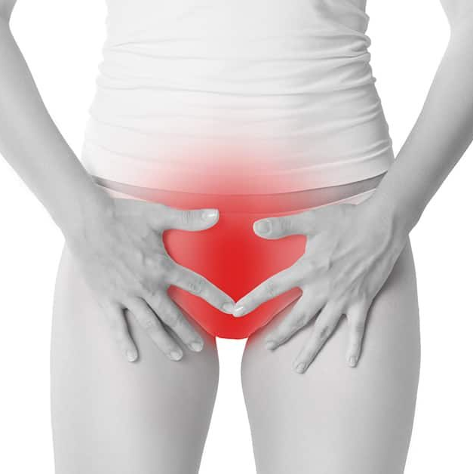
Most Common Vaginal Symptoms
Vaginal dryness
Pruritis (itching)
Discharge – yellow, malodorous
Painful intercourse
Vaginal bleeding or spotting
Unlike hot flushes, symptoms do not improve with time
Photo credit: https://venusmedical.ie/vaginal-dryness/

Slide 7
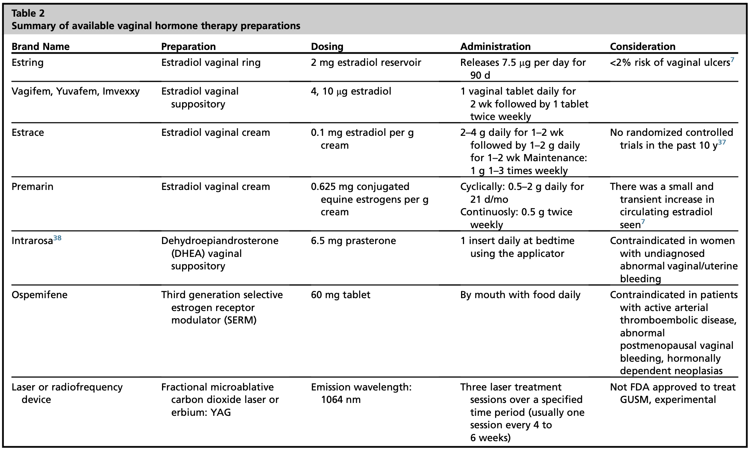
Cox S, Nasseri R, Rubin RS, Santiago-Lastra Y. Genitourinary Syndrome of Menopause. Med Clin North Am. 2023 Mar;107(2):357-369.
Notes:
Key points from NAMS:
Low-dose vaginal ET preparations are effective and generally safe for the treatment of GSM, with minimal systemic absorp- tion, and are preferred over systemic therapies when ET is used only for genitourinary symptoms. (Level I)
For women with breast cancer, low-dose vaginal ET should be prescribed in consultation with their oncologists. (Level III)
Progestogen therapy is not required with low-dose vaginal estrogen, but RCT data are lacking beyond 1 year. (Level II)
Nonestrogen prescription FDA-approved therapies that improve VVA in postmenopausal women include ospemifene and intravaginal DHEA. (Level I)
Systemic hormone therapy does not improve urinary incontinence and may increase the incidence of stress urinary incon- tinence. (Level I)
Low-dose vaginal ET may provide benefit for urinary symptoms, including prevention of recurrent UTIs, overactive bladder, and urge incontinence. (Level II)
Hormone therapy does not have FDA approval for any urinary health indication. (Level I)
Ospemifene
Estrogen agonist in the vagina, appears to have no clinically significant estrogenic effect on the endometrium or breast.
Approved by FDA 02/13 for treatment of moderate to severe dyspareunia caused by vulvovaginal atrophy
Disadvantage = systemic side effects (hot flashes, potential risk of thromboembolism).
No studies to-date have compared with vaginal estrogen therapy
Alternatives
Sexual activity
Improves blood supply
Preserves elasticity
Prevents introital narrowing
Lubricants
K-Y Jelly
Astroglide
K-Y Liquid beads (silicone based)
Replens
Long-acting moisturizer
Polcarbophil-based polymer, binds to vaginal epithelium, releases H20, produces moist film over vaginal tissue
May restore normal vagina pH, does not affect cytology
K-Y Silk-E
Feminease
Contains mineral oil, glycerin, yerba santa

Slide 8

Let’s talk about sex baby …

Slide 9
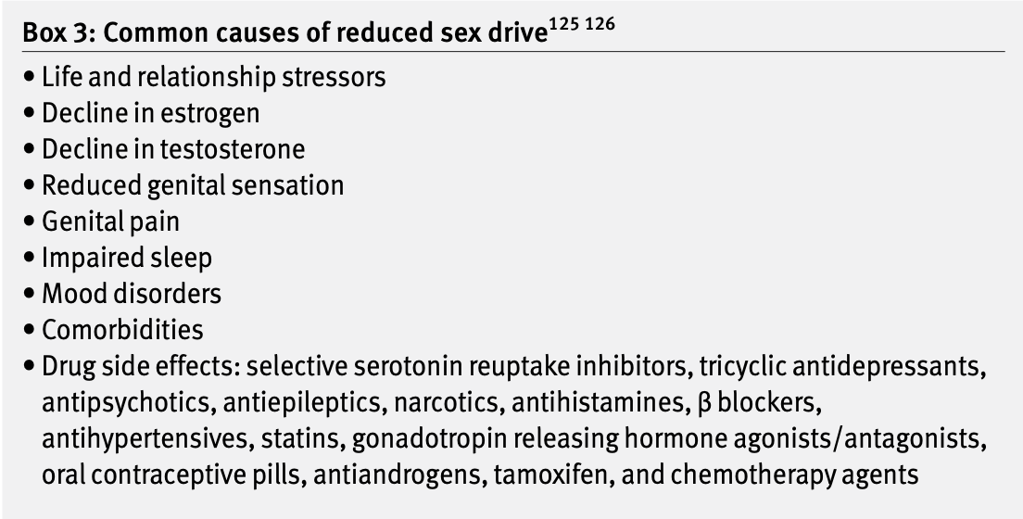

Duralde ER, Sobel TH, Manson JE. Management of perimenopausal and menopausal symptoms. BMJ. 2023 Aug 8;382:e072612. Erratum in: BMJ. 2023 Aug 29;382:p1977. Erratum in: BMJ. 2023 Nov 13;383:p2636.

Slide 10
Sexual Function and Hormone Therapy
Both systemic hormone therapy and low-dose vaginal ET increase lubrication, blood flow, and sensation of vaginal tissues
Systemic hormone therapy generally does not improve sexual function, sexual interest, arousal, or orgasmic response independent of its effect on GSM
Transdermal ET may be better than oral ET due to minimal effect on sex hormone-binding globulin and free testosterone levels
Nonestrogen alternatives FDA approved for dyspareunia include ospemifene and intravaginal DHEA
“The 2022 Hormone Therapy Position Statement of The North American Menopause Society” Advisory Panel. The 2022 hormone therapy position statement of The North American Menopause Society. Menopause. 2022 Jul 1;29(7):767-794.

Slide 11
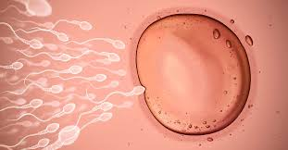
Image credit: https://www.healthline.com/health/where-does-fertilization-occur
Notes:
Let’s talk about preventing pregnancy!!
Postmenopausal hormone (HRT) regimens do not suppress ovulation
Oral contraceptive that contains 20 micrograms estrogen provides effective contraception
Even lowest dose OCP provides 4x estrogen dose in standard (HRT)

Slide 12
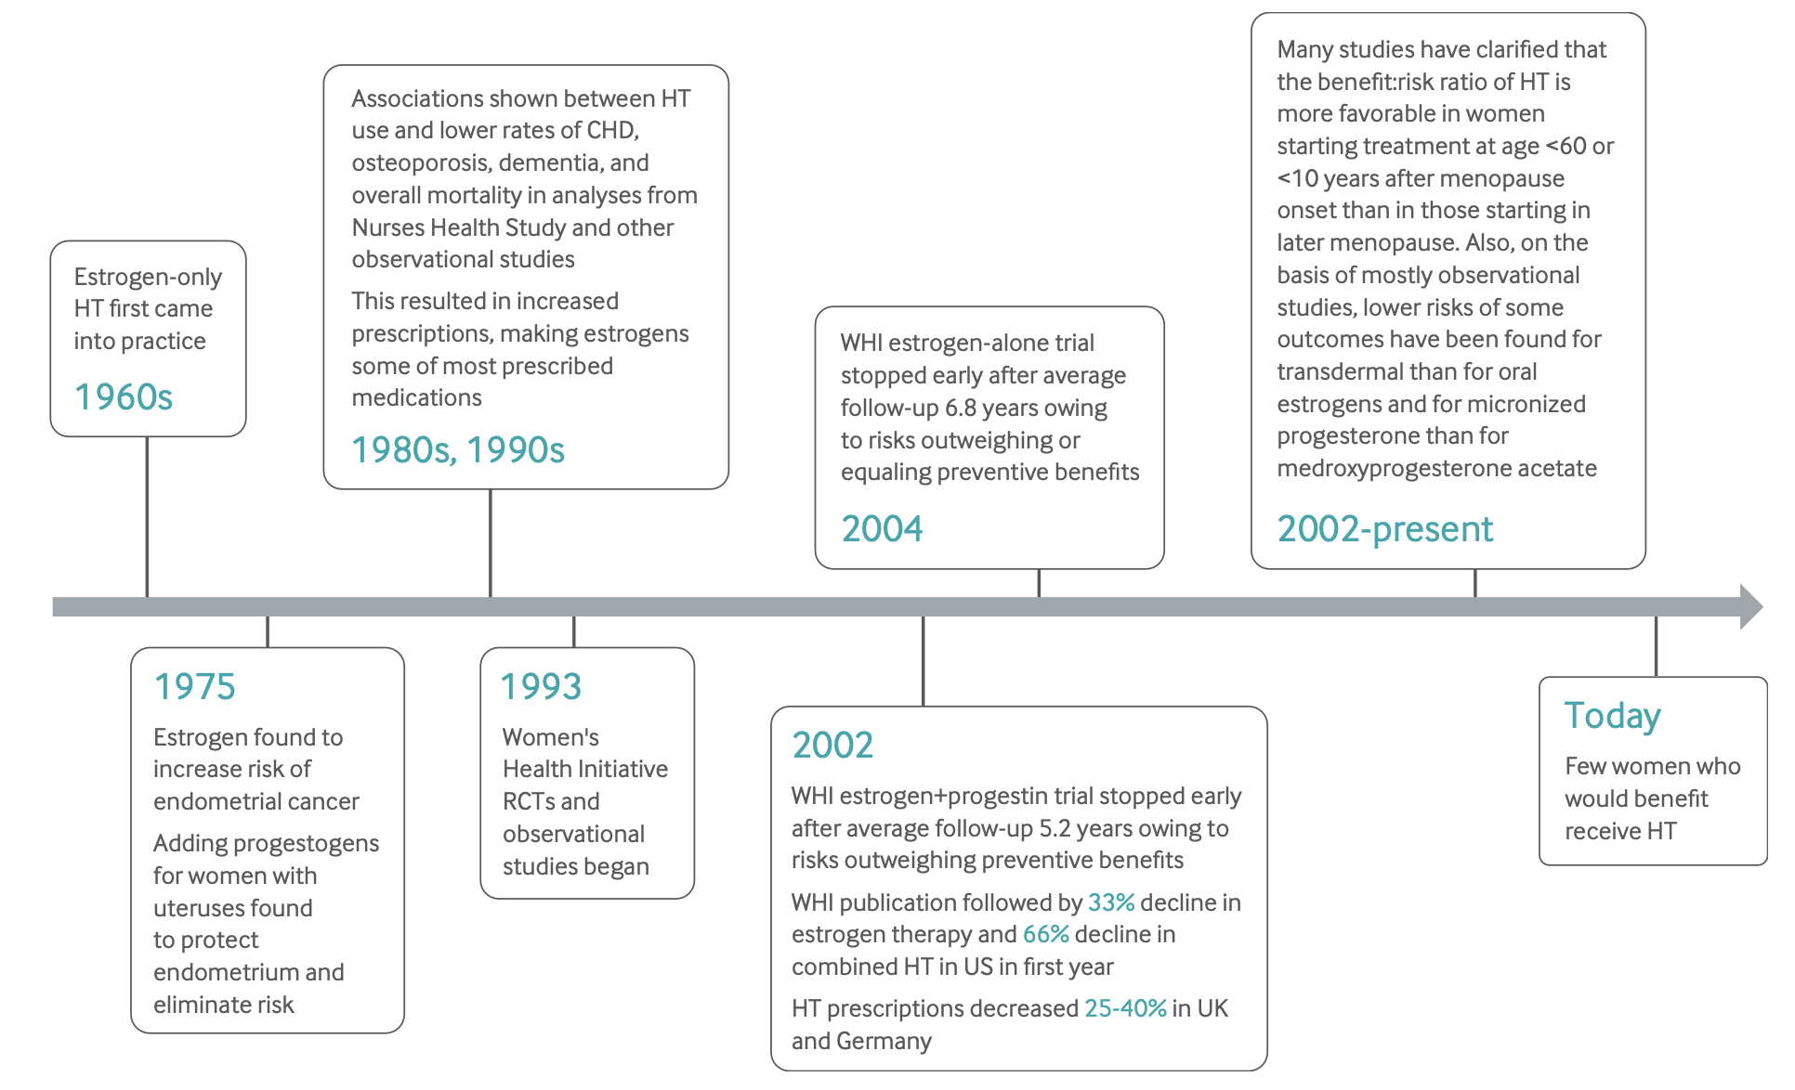
Duralde ER, Sobel TH, Manson JE. Management of perimenopausal and menopausal symptoms. BMJ. 2023 Aug 8;382:e072612. Erratum in: BMJ. 2023 Aug 29;382:p1977. Erratum in: BMJ. 2023 Nov 13;383:p2636.
Notes:
Why are physicians hesitant to prescribe hormone therapy? Let’s look at the history.

Slide 13
Key Findings from WHI
CEE/MPA:
  Increased risks of stroke, pulmonary embolism, breast cancer
  Decreased risks of fractures, colorectal cancer
CEE alone (women without a uterus):
  Increased risk of stroke
  Decreased risk of fracture (breast cancer risk also decreased during long term follow-up)
  Neutral results for most other outcomes
Small absolute risk increases for each (~1 excess event/1000 person years)
  Risks greater in older women
Neither regimen increased risk of all cause mortality
Duralde ER, Sobel TH, Manson JE. Management of perimenopausal and menopausal symptoms. BMJ. 2023 Aug 8;382:e072612. Erratum in: BMJ. 2023 Aug 29;382:p1977. Erratum in: BMJ. 2023 Nov 13;383:p2636.
Notes:
Trials stopped early owing to risks exceeding preventive benefits

Slide 14
What Have We Learned Since the WHI?
Two estrogen receptors, a and b
  Estradiol binds equally to both
  CEE bind predominantly to b, leading to overall more potent clinical effects
CEE more active in increasing inflammatory markers
Levy B, Simon JA. A Contemporary View of Menopausal Hormone Therapy. Obstet Gynecol. 2024 Jul 1;144(1):12-23.
Notes:
Tissue selective estrogen complex: A combination of estrogens and selective estrogen receptor modulators (SERMs). This term is not formally recognized by health authorities.

Slide 15
What Have We Learned Since the WHI?
Synthetic progestins have distinctive receptor binding
  MPA may have contributed to an increased risk for breast cancer
  MPA binds to progesterone receptors and to androgen and glucocorticoid receptors - increases insulin resistance, and increases risk of blood clot when added to estrogen therapy
WHI 20-year follow-up data (Chlebowski et al):
  CEE - 45% statistically significant reduction in breast cancer mortality after 18 years of cumulative follow-up compared with placebo.
  No increase in breast cancer mortality in the group randomized to combined conjugated equine estrogen plus medroxyprogesterone acetate
Levy B, Simon JA. A Contemporary View of Menopausal Hormone Therapy. Obstet Gynecol. 2024 Jul 1;144(1):12-23.
Notes:
Tissue selective estrogen complex: A combination of estrogens and selective estrogen receptor modulators (SERMs). This term is not formally recognized by health authorities.

Slide 16
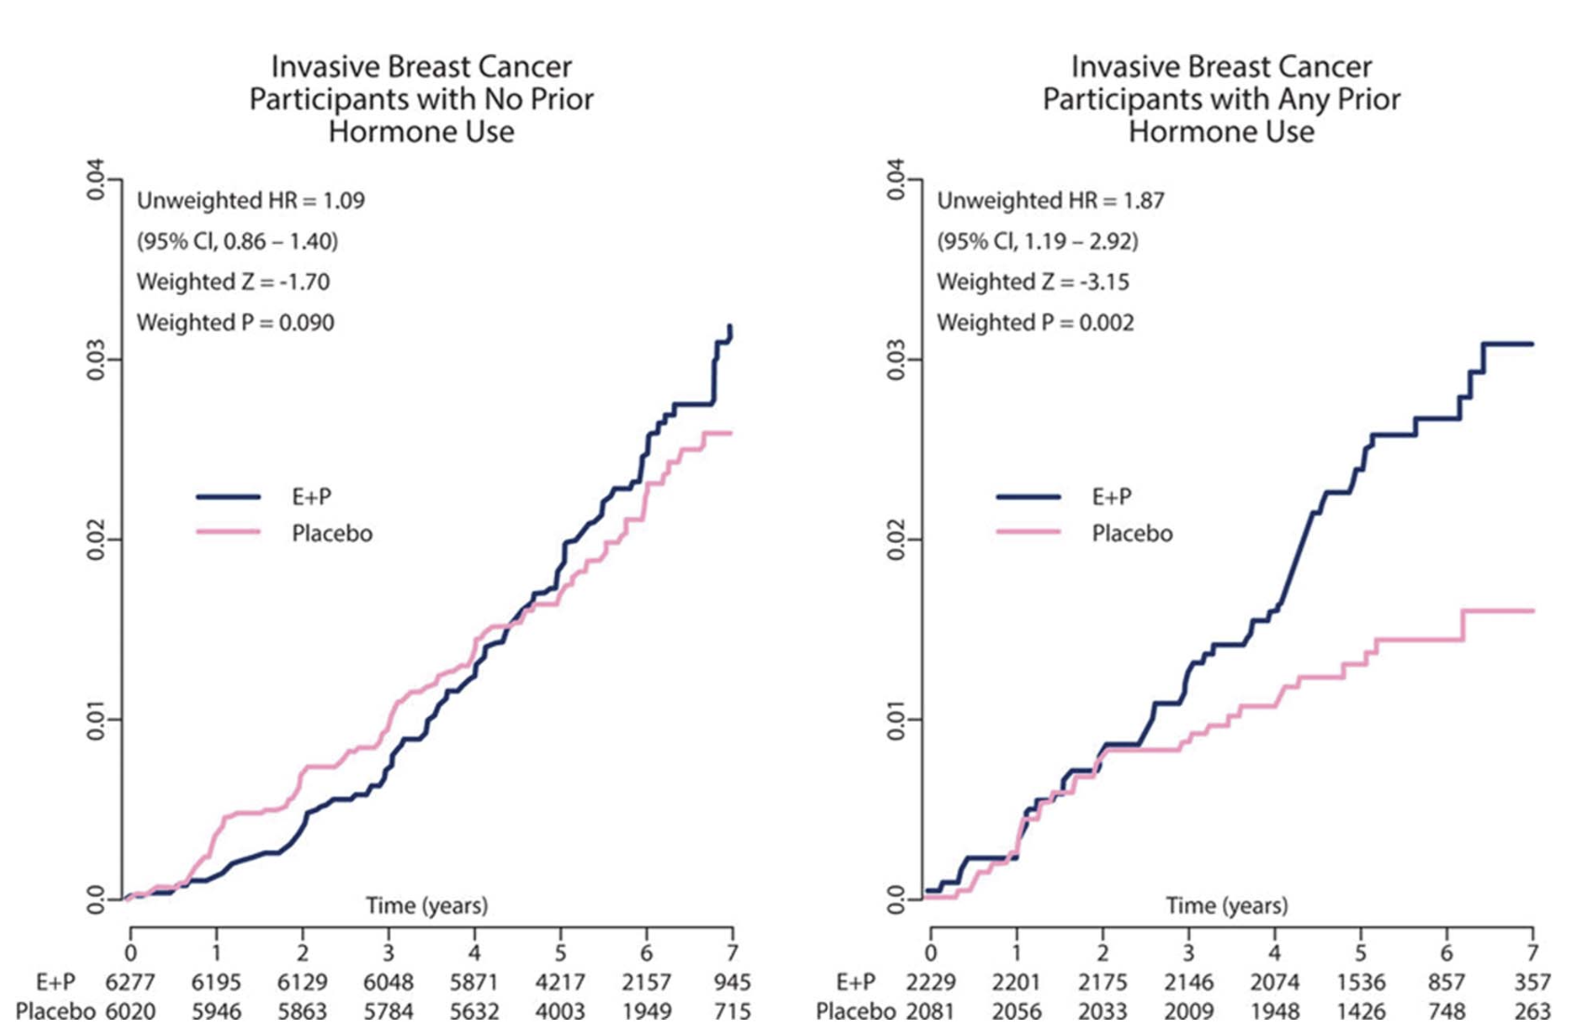
Breast Cancer Risk
2018 review found that breast cancer incidence was not affected by CEE/MPA relative to placebo for up to 11 years in women who had never used menopausal HT
Participants who had used menopausal HT before randomization to placebo group had an unusually low breast cancer incidence
This lower incidence in the placebo group created the controversial breast cancer data
Levy B, Simon JA. A Contemporary View of Menopausal Hormone Therapy. Obstet Gynecol. 2024 Jul 1;144(1):12-23.

Slide 17
DOPS (Danish Osteoporosis Prevention Study)
1,006 patients randomized to 2 mg oral E2 plus progestin when indicated or no HT
Participants enrolled at the onset of menopause and followed for up to 16 years
During the 10 years of treatment, compared with placebo, those randomized to HT experienced significantly lower rates of MI, heart failure, or death with no increase in thromboembolism, cancer, or stroke
Estradiol, as opposed to CEE, appears to be safe for the cardiovascular system and may be protective against CVD and all cause mortality, especially when initiated in women younger than age 60 years or less than 10 years since menopause onset
DOPS was terminated early because of the WHI published findings.
At 16 years, there remained a significant improvement in rates of myocardial infarction, heart failure, and mortality years after exposure in the group randomized to menopausal HT.
Levy B, Simon JA. A Contemporary View of Menopausal Hormone Therapy. Obstet Gynecol. 2024 Jul 1;144(1):12-23.
Notes:
It is unfortunate that the DOPS random- ized trial was terminated early despite positive findings. Long-term treatment and follow-up could have answered existing questions, including whether we continue treatment indefinitely.

Slide 18
ELITE (Early vs Late Intervention Trial with Estradiol
Randomized, double-blind, placebo-controlled study – examined effects of HT on subclinical atherosclerosis
Measure the rate of change in thickness of the carotid artery using ultrasound
Cardiac CT to measure coronary artery calcium at study completion
Estradiol treatment resulted in significantly slower plaque accumulation, but only in women who initiated therapy less than 6 years after menopause and only at the 5-year follow-up.
Conclusions:
Vascular Effects of Early versus Late Postmenopausal Treatment with Estradiol. N Engl J Med. 2016 Mar 31;374(13):1221-31.
Notes:
643 postmenopausal women
stratified according to years since menopause (<6 or >10)
Receive either oral estradiol-17b (1 mg/d) plus sequential micronized vaginal progesterone gel (45 mg/d, days 1–10) or placebo over 5 years
Oral estradiol therapy was associated with less progression of subclinical atherosclerosis than was placebo when therapy was initiated within 6 years after menopause but not when it was initiated 10 or more years after menopause.

Slide 19
Duralde ER, Sobel TH, Manson JE. Management of perimenopausal and menopausal symptoms. BMJ. 2023 Aug 8;382:e072612. Erratum in: BMJ. 2023 Aug 29;382:p1977. Erratum in: BMJ. 2023 Nov 13;383:p2636.
Notes:
Why are physicians hesitant to prescribe hormone therapy? Let’s look at the history.

Slide 20
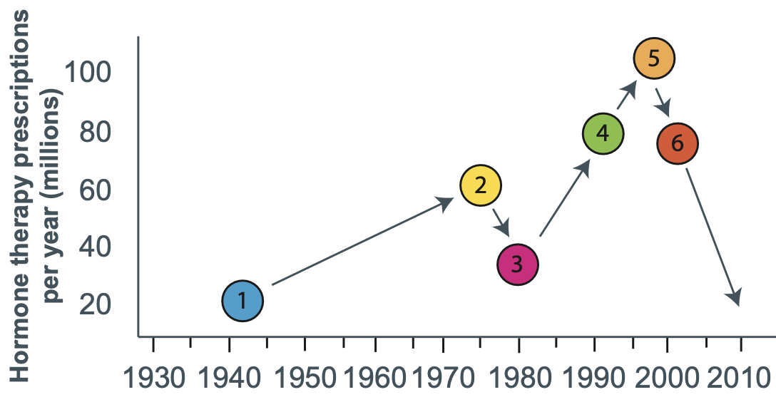
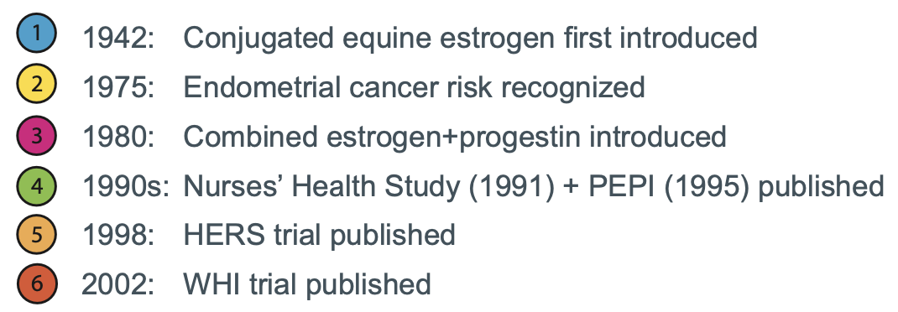
Cho L, Kaunitz AM, Faubion SS, Hayes SN, Lau ES, Pristera N, Scott N, Shifren JL, Shufelt CL, Stuenkel CA, Lindley KJ; ACC CVD in Women Committee. Rethinking Menopausal Hormone Therapy: For Whom, What, When, and How Long? Circulation. 2023 Feb 14;147(7):597-610.
Duralde ER, Sobel TH, Manson JE. Management of perimenopausal and menopausal symptoms. BMJ. 2023 Aug 8;382:e072612. Erratum in: BMJ. 2023 Aug 29;382:p1977. Erratum in: BMJ. 2023 Nov 13;383:p2636.
Notes:
Why are physicians hesitant to prescribe hormone therapy? Let’s look at the history.

Slide 21
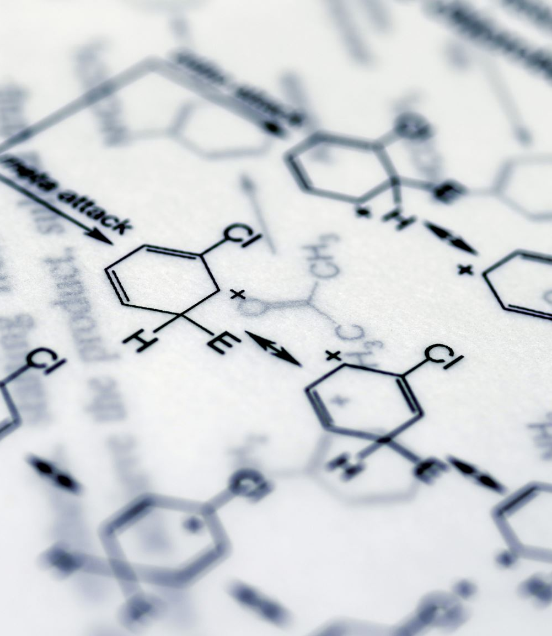
Hormone therapy is FDA approved for four indications:
Moderate to severe VMS
Prevention of osteoporosis in postmenopausal women
Treatment of hypoestrogenism caused by hypogonadism, BO, or POI
Treatment of moderate to severe vulvovaginal symptoms.
“The 2022 Hormone Therapy Position Statement of The North American Menopause Society” Advisory Panel. The 2022 hormone therapy position statement of The North American Menopause Society. Menopause. 2022 Jul 1;29(7):767-794.
Notes:
FDA guidance for treatment of genitourinary symptoms related to menopause in the absence of indications for systemic ET suggests the use of low-dose topical vaginal ET

Slide 22
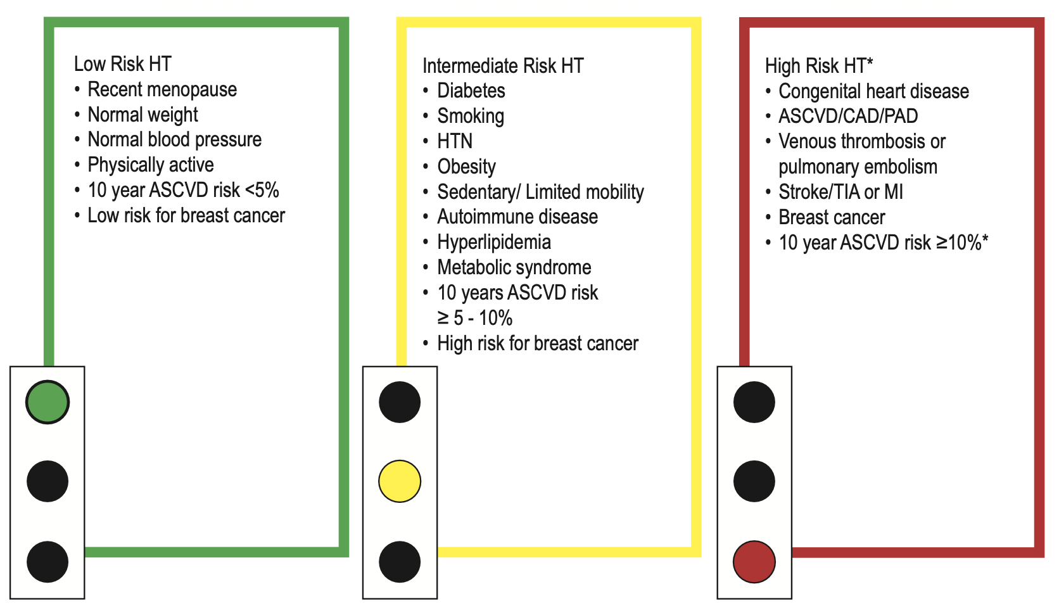
Individual Patient Risk Factors
Cho L, Kaunitz AM, Faubion SS, Hayes SN, Lau ES, Pristera N, Scott N, Shifren JL, Shufelt CL, Stuenkel CA, Lindley KJ; ACC CVD in Women Committee. Rethinking Menopausal Hormone Therapy: For Whom, What, When, and How Long? Circulation. 2023 Feb 14;147(7):597-610.
Notes:
Contraindications
• Breast cancer
• Endometrial cancer (advanced stage hormonal or non-hormonal) • Untreated endometrial hyperplasia or cancer
• Unexplained vaginal bleeding
• Myocardial infarction, stroke, or transient ischemic attack
• Uncontrolled hypertension
• Peripheral artery disease
• Unprovoked venous thromboembolism
• Known clotting disorder
• Cirrhosis
• Active hepatitis
• Porphyria cutanea tarda
Comorbidities of concern
• Controlled hypertension • Hyperlipidemia
• Diabetes
• Smoking
• Provoked venous thromboembolism • Chronic inflammatory states
• HIV
• Gallbladder disease
• Ovarian or cervical cancer with suspected hormone responsiveness

Slide 23

Compounded Bioidentical Hormones
Image credit: https://www.wmccma.com/about-us
What are they?
How do you get them?
Are they better for you?
Notes:
Risk for over-treating, increasing risks
Expensive, generally not covered by health insurances
Often promoted by individuals outside medical community

Slide 24
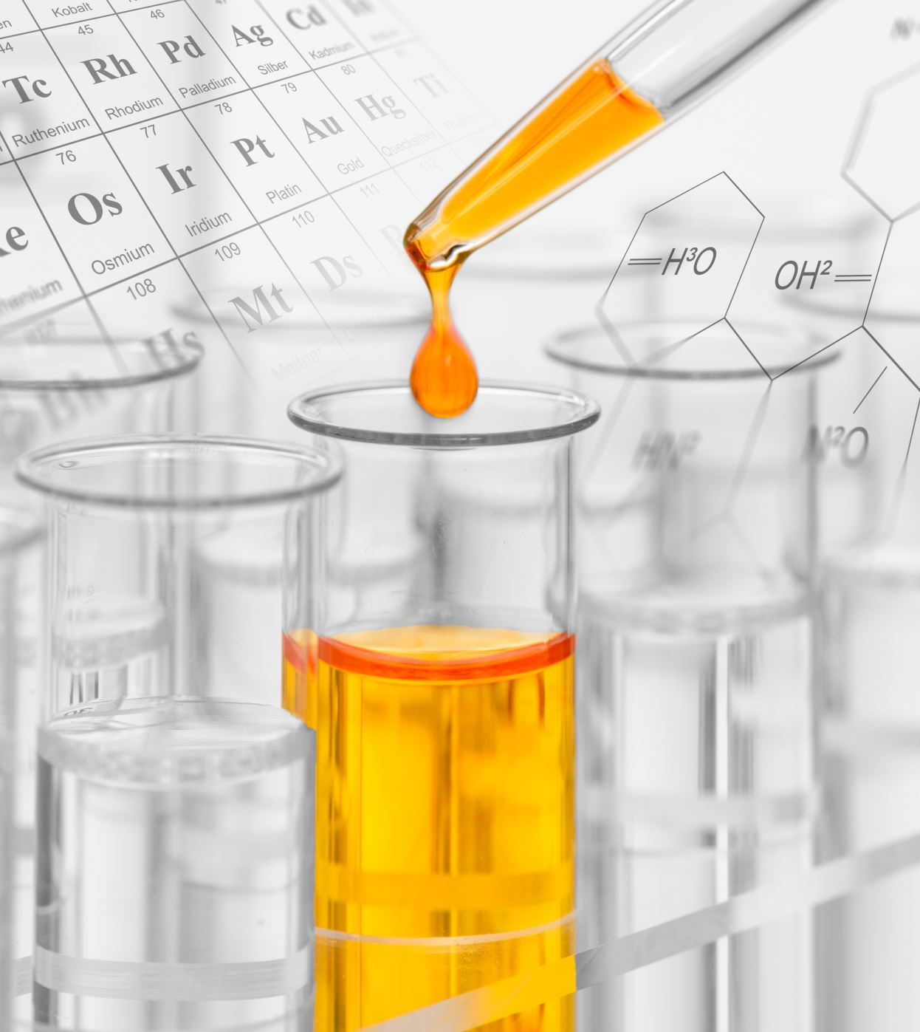
Compounded Bioidentical Hormones
Safety concerns - overdosing and underdosing, impurities and lack of sterility, lack of scientific data, and lack of a label outlining risks.
Salivary and urine hormone testing to determine dosing are unreliable and not recommended. Serum hormone testing is rarely needed.
Could be considered with allergies to ingredients in FDA approved products
“The 2022 Hormone Therapy Position Statement of The North American Menopause Society” Advisory Panel. The 2022 hormone therapy position statement of The North American Menopause Society. Menopause. 2022 Jul 1;29(7):767-794.
Notes:
Compounding is the combining or altering of ingredients by a pharmacist to produce a drug tailored to an individual patient’s special medical needs - for example, by removing a dye or preservative in response to a patient allergy.
Drugs that pharmacists compound are not FDA approved.
One study done by the FDA found that 30% of compounded products failed one or more standard quality tests performed.
From the NAMS Statement:
“The term bioidentical hormone therapy (similar to endogenous) can be misleading because there are both government-approved and compounded bioidentical hormone therapies. Government- approved (in the United States, FDA-approved) bioidentical hormones include estradiol, estrone, and MP, which are regulated and monitored for purity and efficacy. These are dispensed with package inserts containing extensive product information (based on RCTs) and may include black-box warnings for AEs. In contrast, compounded bioidentical hormone therapies are pre- pared by a compounding pharmacist using a provider’s prescription. These therapies may combine multiple hormones (estradiol, estrone, estriol, DHEA, testosterone, progesterone) and use un- tested, unapproved combinations or formulations or are administered in nonstandard or untested routes such as subdermal im- plants, pellets, or troches.”

Slide 25
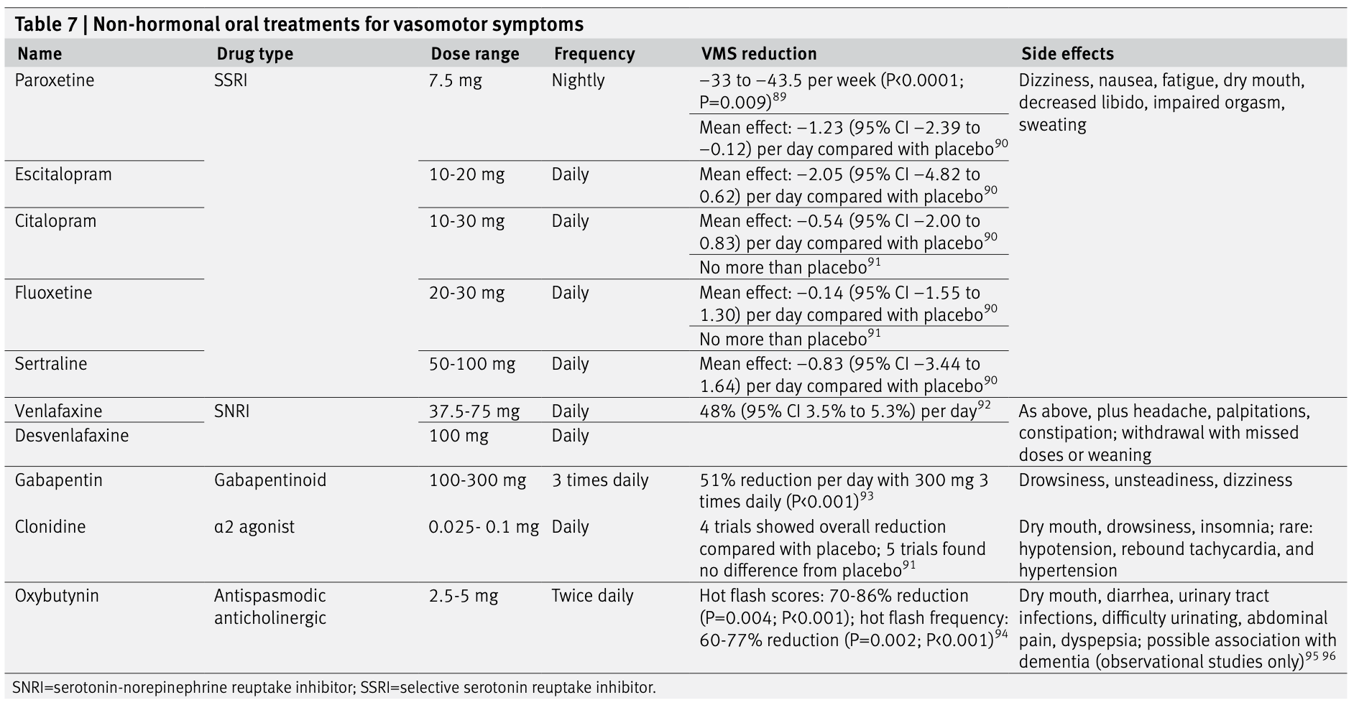
Duralde ER, Sobel TH, Manson JE. Management of perimenopausal and menopausal symptoms. BMJ. 2023 Aug 8;382:e072612. Erratum in: BMJ. 2023 Aug 29;382:p1977. Erratum in: BMJ. 2023 Nov 13;383:p2636.
Notes:
Using this slide only to make a point that there are nonhormonal alternatives for management of vasomotor symptoms

Slide 26
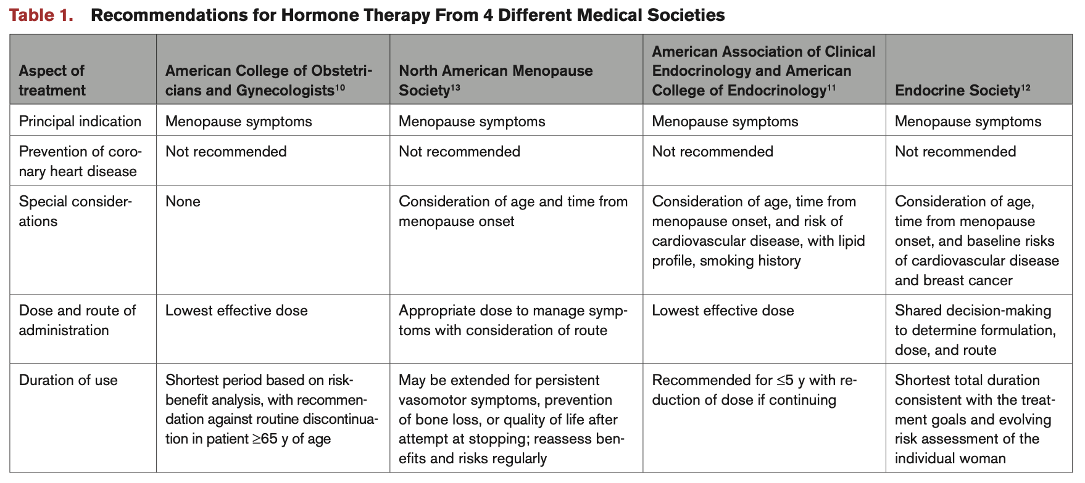
Cho L, Kaunitz AM, Faubion SS, Hayes SN, Lau ES, Pristera N, Scott N, Shifren JL, Shufelt CL, Stuenkel CA, Lindley KJ; ACC CVD in Women Committee. Rethinking Menopausal Hormone Therapy: For Whom, What, When, and How Long? Circulation. 2023 Feb 14;147(7):597-610.
Notes:
Commonalities in recommendations from different expert groups. How long should you use hormones?

