Slide 1
Testosterone recommendations and guidelines for men as they age
Priyanka Bearelly, MD, MPH
Assistant Professor, Urology

Slide 2
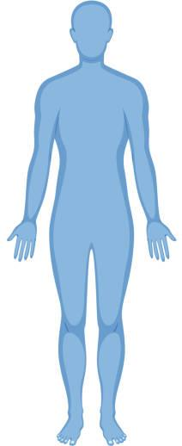
What is the role of testosterone in men?
Skin
Hair growth, balding, acne
Brain
Libido, mood, cognition
Liver
Kidney
Erythropoietin production
Muscle
Reproductive Organs
Development of genitalia,
sexual function, sperm production, prostate growth
Bone
Linear growth, bone density, epiphyseal closure
Notes:
Sexual function (erections, ejaculation)
Bone (bone density, height)
Voice deepening

Slide 3
Background
What is Low Testosterone?
Low testosterone (T): T levels below 300 (ng/dL).
Testosterone levels are highest in the morning (7-9 AM) and naturally decrease throughout the day.
How Common is Low Testosterone?
About 15% of men in their 40s-50s may have low T
Testosterone levels decline by about 1% every year after age 40.
How Do We Measure Testosterone?
A blood test liquid chromatography tandem mass spectrometry.
Notes:
MMAS (mass male aging study) - <300; prevalence 6-12% for men age 40-69
BLAS ( Baltimore longitudinal study of aging) - <325; prevalence 12% (50s); 19% (60s); 28% (70s); 49% (80s)
BACH - <300 (<5 free T); prevalence 5.6% for men age 30-79
Liquid chromatography tandem mass spectrometry – gold standard for checking T level
Free T should be measured by equilibrium dialysis (only 0.5-2% of circulating T is free)
BioT = free +albumin bound T

Slide 4
Background
Harman et al. JCEM 2001
Notes:
MMAS (mass male aging study) - <300; prevalence 6-12% for men age 40-69
BLAS ( Baltimore longitudinal study of aging) - <325; prevalence 12% (50s); 19% (60s); 28% (70s); 49% (80s)
BACH - <300 (<5 free T); prevalence 5.6% for men age 30-79
Liquid chromatography tandem mass spectrometry – gold standard for checking T level
Free T should be measured by equilibrium dialysis (only 0.5-2% of circulating T is free)
BioT = free +albumin bound T

Slide 5
How do I know if I have low testosterone?
Fatigue
Decreased sexual desire
Decreased exercise endurance
“Brain fog”
Depression
Notes:
Decreased exercise endurance – still maintaining a healthy diet and exercising regularly, but you feel that you cannot do the same exercises as easily
Feel like you’re kind of dragging
Brain fog – some people will feel as though they are just less sharp than they used to be, having trouble understanding things

Slide 6
ADAM (Androgen Deficiency in Aging Males) Questionnaire
Do you have a decrease in libido (sex drive)?
Do you have a lack of energy?
Do you have a decrease in strength and/or endurance?
Have you lost height?
Have you noticed a decreased “enjoyment of life”?
Are you sad and/or grumpy?
Are your erections less strong?
Have you noted a recent deterioration in your ability to play sports?
Are you falling asleep after dinner?
Has there been a recent deterioration in your work performance?
Notes:
Positive if #1, #7, or any 3 answers are “yes”
St. Louis University

Slide 7
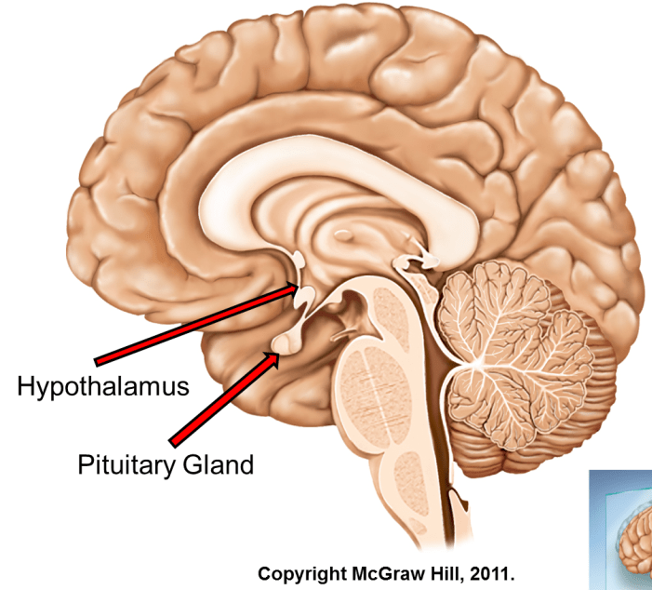
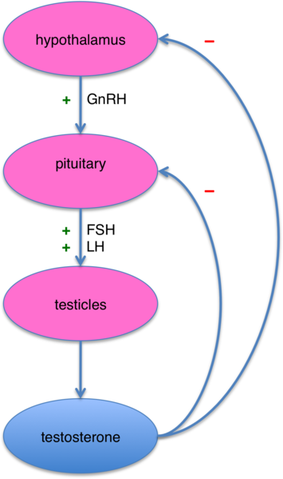
Testosterone Production
Notes:
You’ve probably seen this diagram before, but the hypothalamus stimulates the pituitary which stimulates the testicles to make testosterone. Testosterone and estrogen will then have a negative feedback on the hypothalamus and pituitary. So I would say one of the main things to takeaway is that men who begin testosterone treatment, will ultimately shut down their own biological testosterone production
One thing I didn’t include here is that a small percentage of testosterone does get converted into estrogen. And the more body fat you have, the more of that testosterone gets converted to estrogen.

Slide 8
Causes of low testosterone
Factors That Can Affect Testosterone Levels
Biological/Endocrine Factors
The brain's signals to the testicles may weaken over time (Decreased Pulsatility of Gonadotropins)
The testicles' ability to produce testosterone may decline (Decreased Leydig Cell Response)
Congenital Conditions:
Klinefelter Syndrome and Kallman Syndrome: Genetic conditions that affect testosterone production.
Acquired Factors:
Can include disease, aging, medications, and lifestyle habits like poor diet or lack of exercise.
Notes:
Disease (ie: cancer – RT/chemo)

Slide 9
How to boost testosterone without medication?
Fat Loss: Repeatedly shown to improve testosterone levels
Exercise: Proven to boost testosterone naturally
Supplements: No evidence supports their effectiveness

Slide 10
Benefits of T Supplementation
Increased lean body mass & decreased fat mass
Improved bone mineral density
Improved libido
Improved erectile function
May improve response to PDE5i
May improve diabetic control (insulin sensitivity, A1c)
May improve total cholesterol and triglycerides
May improve depression
Notes:
When a patient comes to you and asks how will they know if the treatment is working. These are some potential benefits, which as you can see seems really appealing.
Improved lean body mass, bone strength, sexual function, depression.
Some things for patients to keep in mind is that with regards to sexual function (like libido and response to PDE5 inhibitors); in most studies, the improvements were most pronounced in men with lower baseline TT levels (<200-300).
Over supplementation of T in eugonadal men has not been shown to improve sexual function or libido.

Slide 11
Initial Evaluation

Slide 12
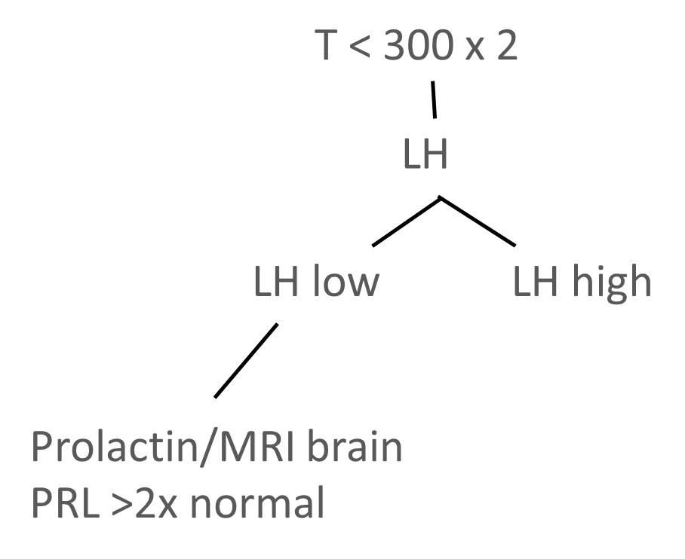
Workup
What to expect at a visit
If your testosterone level is low (T < 150) and your LH (Luteinizing Hormone) is normal/low, you may need an MRI of your brain to understand the cause.
If you have gynecomastia (enlarged breast tissue in men), we will measure estradiol (a hormone).
If you're concerned about fertility and have low testosterone, we will discuss an infertility evaluation.
Before starting treatment, we will check your hemoglobin and hematocrit (Hgb & Hct) due to a risk of polycythemia (increased red blood cells).
For men over 40, we will measure PSA (Prostate-Specific Antigen) before starting treatment to check for prostate health.
Notes:
For the initial evaluation, you should two morning testosterone levels
You should check luteinizing hormone to determine the etiology of their hypogonadism
If the LH is really low, then you should obtain a prolactin level to rule out a prolactinoma
Even if the prolactin is normal, you should get a brain MRI since you can have other pituitary adenomas or brain masses in general
Likewise, if the T is really low, below 150 and the LH is low or abnormally normal (because with a normal axis that value should be high), you should get a brain MRI in that setting as well
-And some other recommendations are listed here
-Estradiol if breast tenderness or gynecomastia
-infertility evaluation if it’s relevant
-and if you are starting a patient on testosterone, then you want baseline levels of estradiol, Hct, and PSA – since these can all be affected by testosterone treatment

Slide 13
Interval Monitoring
After starting treatment, we will check your hormone levels 6-8 weeks later to make sure things are going smoothly.
Hormones
Testosterone (T)
Hemoglobin & Hematocrit (Hct) (to monitor red blood cell count)
Estradiol and PSA (Prostate-Specific Antigen), if needed
PSA (for prostate health) will be checked every 1-2 years.
If needed:
If your testosterone is high and your hematocrit is also high, we may adjust your testosterone dosage.
If your testosterone is normal but hematocrit is high, we may need a blood draw
Once your levels are stable, we will check testosterone and hematocrit at least every 6 months.
Target ranges for treatment:
Testosterone should be between 450-600 ng/dL.
Hemoglobin and Hematocrit should be less than 54% to avoid clot formations.
Notes:
If you start someone on testosterone treatment, you should check labs about 6 weeks later. According to the guidelines you want your target level to fall somewhere between 450 and 600. Realistically, some people will be outside of this range. But in general, you don’t want to be treating people to levels above 1000.
You want the Hct to be less than 54 to reduce the risk of clot formation.
If the Hct is high but the T level is also too high, you can just lower the T dosage. But if the T level is normal, then the patient can be treated with phlebotomy.
Long term patients should get their labs checked about every 6 months. There’s no consensus for when to check labs in relation to timing of the treatment. Some people will check just prior to the next treatment to see what the nadir is. Some will check mid-cycle to get a sense of the average T level that is being reached. You just have to be consistent.

Slide 14
Testosterone therapies

Slide 15
Overview of Therapies
Lifestyle modification (weight loss and exercise) should be considered first line therapy for symptomatic hypogonadism
Treatment of obstructive sleep apnea and sleep disorders
Synthetic T therapies:
Transdermal gel, patch, injection, buccal, nasal, subcutaneous pellets
Alternative agents:
Aromatase inhibitors, selective estrogen receptor modulators, HCG
Notes:
In the interest of time, I’m going to just briefly go over the different kinds of hormonal agents that we can use. But to start it is always a good idea to counsel on weight loss and exercise. And certainly any patients with sleep apnea or sleep disorders should be treated.

Slide 16
Which one to use?
Formulation | Pros | Cons
Patch | Needle free Steady state | Skin irritation/blistering Efficacy depends on absorption
Gel | Needle free Steady state | Efficacy depends on absorption Transference
Intramuscular | Good absorption Tc – cost effective | Injections Peaks and troughs
Pellets | Steady state Intermittent administration | Levels lower toward end of cycle In office procedure Expensive Scar tissue
Intranasal | Needle free May preserve fertility | Administration 2-3 times daily Efficacy depends on absorption
Notes:
Insurance coverage, access to medication, and then patient preference are ultimately going to determine what the patient uses but any of these are safe and reasonable options.
For the topicals, like the patch and gel, the benefit is that there’s no needles and you can get a steady state. The downside is that efficacy depends on absorption. The patch can cause skin irritation and the gels can be transferred from person to person. Between the two gels are far more commonly used.
injections are the most widely used. They work well, they’re cost effective. But it does mean injections, and you can get highs and lows. For the shorter acting formulations, it’s common to reach peak serum levels within 12-24 hours. The pellets can give you a steady state, but it means having an office procedure every 3-6 months. And intranasal is appealing also, but it’s 3 times a day which may not be sustainable.

Slide 17
Alternative Agents
Notes:
These are agents that are usually considered for patients who desire fertility preservation. Most of these are off label uses

Slide 18
Selective Estrogen Receptor Modulator
Clomiphene Citrate
(-)
Hypothalamus
(-)
Selective estrogen receptor modulator
Off label but safe long term¹⁷
Indication: T therapy for those who wish to preserve fertility
Estradiol levels may rise
3x/week
(-)
Pituitary
(-)
Testis (Leydig cell)
Circulating Sex Steroids
T → aromatization → E2
Notes:
The first one is clomiphene, many of you are probably familiar. It’s an estrogen receptor modulator, so you don’t get that negative feedback of estrogen back on the hypothalamus and pituitary. So you end up just ramping up this whole axis and just making more of your own testosterone. You do have to keep in mind that estrogen levels are going to go up too. But since intratesticular testosterone production is maintained, fertility is preserved.

Slide 19
Aromatase Inhibitor
Anastrazole (Arimidex)
(-)
Hypothalamus
(-)
Aromatase inhibitor
Indication: symptoms of gynecomastia, elevated estradiol
1-3 times weekly
(-)
Pituitary
(-)
Testis (Leydig cell)
Estradiol > 60 → venous thromboembolism
Estradiol < 10 → osteoporosis, low libido
Circulating Sex Steroids
T → aromatization → E2
Notes:
Anastrazole is an aromatase inhibitor and prevents the conversion of testosterone to estradiol.
This is a good option for people with high estradiol levels, either at baseline or as a result of being on some other therapy like Clomiphene.
In general, when using anastrozole, you still want to keep estradiol levels within a reasonable range. If it’s too low, you worry about bone density and osteoporosis. It has also been shown in a number of studies that men with lower estradiol levels also report lower libido. On the other hand, if it’s too high then you think about the theoretical risk of forming clots. These numbers I put here are not based on any specific guidelines but rather a general range based off several articles, so these aren’t strict thresholds to be used but can help guide medication adjustments.
With regards to DEXA scans, there are no specific guidelines for men who are on aromatase inhibitors. So we go based off of the guidelines that are set for women with breast cancer who are on aromatase inhibitors. This is not a hard and fast rule, but more of an adaptation based off the breast cancer guidelines, but for patients you have on an aromatase inhibitor, you should consider getting a dexa scan every 3-5 years. You may need to get it sooner for patients who are high risk of fractures (some risk factors can include age >65, BMI < 24, personal history of a fragility fracture if under the age of 50, family history of hip fracture, glucocorticoid use >6mo, prior/current history of smoking). So this is something that should be considered

Slide 20
Human chorionic gonadotropin (hCG)
LH analogue
Indication: T therapy for those who wish to preserve fertility (who may not be responding to clomiphene)
Notes:
And then we have hcg, which is an LH analogue which will stimulate testosterone production. In some cases patients will take it along with testosterone with the hopes of preserving spermatogenesis and testicular size.

Slide 21
Adverse Events

Slide 22
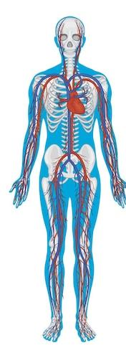
Potential Adverse Events of T Supplementation
Polycythemia: Increased hematocrit (Hct), which can thicken the blood.
Cardiovascular Events:
Current data does not show that testosterone supplementation increases cardiovascular events (e.g., heart attack, stroke).
However, low testosterone may be linked to a higher risk of major heart issues.
Treatment should not be started 3-6 months after a cardiovascular event.
Prostate Events: Possible effects on prostate health, including enlargement.
Fertility: Testosterone supplementation may impact fertility, especially in men trying to conceive.

Slide 23
Safety of Testosterone Supplementation
Involving over 5,000 men aged 45-80 with cardiovascular risk.
No increased overall cardiovascular risk from testosterone treatment.
Pulmonary embolism: Slightly higher risk (0.9% vs. 0.5%) in testosterone users.
Hematocrit (Hct): Testosterone may increase red blood cell count.
Prostate Safety: No clear evidence linking testosterone to prostate cancer. Caution with a history of prostate cancer.
Fertility: Testosterone can reduce sperm production, which typically recovers after stopping treatment.
July 13, 2023
Cardiovascular Safety of Testosterone-Replacement Therapy
A. Michael Lincoff, M.D., Shalender Bhasin, M.B., B.S., Panagiotis Flevaris, M.D., Ph.D., Lisa M. Mitchell, R.N., B.S.N., Shehzad Basaria, M.D., William E. Boden, M.D., Glenn R. Cunningham, M.D., +18, for the TRAVERSE Study Investigators

Slide 24
Thank you
pbearelly@arizona.edu
pbearelly@arizona.edu

Slide 25
References
Page ST, Amory JK, Bowman FD, et al. Exogenous testosterone (T) alone or with finasteride increases physical performance, grip strength, and lean body mass in older men with low serum T. J Clin Endocrinol Metab. 2005;90(3):1502-1510.
Snyder PJ, Kopperdahl DL, Stephens-Shields AJ, et al. Effect of Testosterone Treatment on Volumetric Bone Density and Strength in Older Men With Low Testosterone: A Controlled Clinical Trial. JAMA Intern Med. 2017;177(4):471-479.
Corona G, Giagulli VA, Maseroli E, et al. THERAPY OF ENDOCRINE DISEASE: Testosterone supplementation and body composition: results from a meta-analysis study. Eur J Endocrinol. 2016;174(3):R99-R116.
Buvat J, Montorsi F, Maggi M, et al. Hypogonadal men nonresponders to the PDE5 inhibitor tadalafil benefit from normalization of testosterone levels with a 1% hydroalcoholic testosterone gel in the treatment of erectile dysfunction (TADTEST study). J Sex Med 2011;8:284–293.
Corona G, Monami M, Rastrelli G, et al. Type 2 diabetes mellitus and testosterone: a meta-analysis study. Int J Androl. 2011;34(6 Pt 1):528-540.
Isidori AM, Giannetta E, Greco EA, et al. Effects of testosterone on body composition, bone metabolism and serum lipid profile in middle-aged men: a meta-analysis. Clin Endocrinol (Oxf). 2005;63(3):280-293.
FA Zarrouf, S Artz, J Griffith, etal. Testosterone and depression: systematic review and meta-analysis. Journal of psychiatric practice. 2009; 15: 289-305
Onasanya O, Iyer G, Lucas E, Lin D, Singh S, Alexander GC. Association between exogenous testosterone and cardiovascular events: an overview of systematic reviews [published correction appears in Lancet Diabetes Endocrinol. 2017 Feb;5(2):e1]. Lancet Diabetes Endocrinol. 2016;4(11):943-956.
Alexander GC, Iyer G, Lucas E, Lin D, Singh S. Cardiovascular Risks of Exogenous Testosterone Use Among Men: A Systematic Review and Meta-Analysis. Am J Med. 2017;130(3):293-305.
Cheetham TC, An J, Jacobsen SJ, Niu F, Sidney S, Quesenberry CP, VanDenEeden SK. Association of Testosterone Replacement With Cardiovascular Outcomes Among Men With Androgen Deficiency. JAMA Intern Med. 2017 Apr 1;177(4):491-499.
Bhasin S, Brito JP, Cunningham GR, Hayes FJ, Hodis HN, Matsumoto AM, Snyder PJ, Swerdloff RS, Wu FC, Yialamas MA. Testosterone Therapy in Men With Hypogonadism: An Endocrine Society Clinical Practice Guideline. J Clin Endocrinol Metab. 2018 May 1;103(5):1715-1744.
Liu PY, Swerdloff RS, Christenson PD, Handelsman DJ, Wang C; Hormonal Male Contraception Summit Group. Rate, extent, and modifiers of spermatogenic recovery after hormonal male contraception: an integrated analysis. Lancet. 2006;367(9520):1412-1420.
Boyle P, Koechlin A, Bota M, et al. Endogenous and exogenous testosterone and the risk of prostate cancer and increased prostate-specific antigen (PSA) level: a meta-analysis. BJU Int. 2016;118(5):731-741.
Pastuszak AW, Pearlman AM, Lai WS, et al. Testosterone replacement therapy in patients with prostate cancer after radical prostatectomy. J Urol. 2013;190(2):639-644.
Swerdloff RS, Dudley RE. A new oral testosterone undecanoate therapy comes of age for the treatment of hypogonadal men. Ther Adv Urol. 2020 Jun 30;12:1756287220937232. doi: 10.1177/1756287220937232. Erratum in: Ther Adv Urol. 2021 Aug 20;13:17562872211036391.
Masterson T, Molina M, Ibrahim E, Ramasamy R. Natesto Effects on Reproductive Hormones and Semen Parameters: Results from an Ongoing Single-center, Investigator-initiated Phase IV Clinical Trial. Eur Urol Focus. 2018;4(3):333-335.
Krzastek SC, Sharma D, Abdullah N, Sultan M, Machen GL, Wenzel JL, Ells A, Chen X, Kavoussi M, Costabile RA, Smith RP, Kavoussi PK. Long-Term Safety and Efficacy of Clomiphene Citrate for the Treatment of Hypogonadism. J Urol. 2019 Nov;202(5):1029-1035.
Gittelman M, Jaffe JS, Kaminetsky JC. Safety of a New Subcutaneous Testosterone Enanthate Auto-Injector: Results of a 26-Week Study. J Sex Med. 2019 Nov;16(11):1741-1748.
Lincoff M, Bhasin S, Flevaris P, et al. Cardiovascular Safety of Testosterone-Replacement Therapy. NEJM. 2023 June;389(2):107-117.
Snyder PJ, Bauer DC, Ellenberg SS, et al. Testosterone Treatment and Fractures in Men with Hypogonadism. NEJM. 2024 January; 390(3):203-211

