Slide 1
Sexual Health and Aging
Joy Bulger Beck, MD, MS, FACP
Mini Medical School
Clinical Assistant Professor of Medicine
College of Medicine, University of Arizona - Tucson
November 21, 2024

Slide 3
Objectives
Use scientific evidence to explain trends or misconceptions about sexuality in older adults
Identify key studies or findings related to sexuality and aging
Evaluate various treatment approaches in sexual health for aging adults, considering both physical and psychological factors

Slide 4
Why this topic?
Sexual activity is an important part of health and well being and it correlates with greater enjoyment of life in older adults
Sexual health should be a routine part of health care
People do not become asexual with age, although they may modify their activity as a consequence of physiological changes
Smith, et al
Notes:
Data on sexual activity and enjoyment of life were available for a total of 3,045 men and 3,834 women (mean age 64.4 years in men and 65.3 years in women). Men and women who reported any sexual activity in the past year had significantly higher mean enjoyment of life scores compared with those who were not sexually active (men, 9.75 vs 9.44 [P < .001]; women, 9.86 vs 9.67 [P = .003]). Among sexually active men, frequent (≥2 times a month) sexual intercourse (P < .001) and frequent kissing, petting, or fondling (P < .001) were associated with greater enjoyment of life. Among sexually active women, frequent kissing, petting, or fondling was also associated with greater enjoyment of life (P < .001), but there was no significant association with frequent intercourse (P = .101). Concerns about one's sex life and problems with sexual function were strongly associated with lower levels of enjoyment of life in men and to a lesser extent in women.
Further longitudinal research is needed to confirm a causal association between sexual activity and well-being.
Discussions about sex are infrequent in health care offices, partly because physicians might unwittingly accept misconceptions about the sexual function of older adults
In a sample of older adults in the USA, only 17% reported speaking to their physician about sexual issues in the past 2 years, and 61% of these discussions were initiated by the patient.
Barriers to older adults seeking sexual health advice and treatment
Negative stereotypes regarding the sex lives of older adults persist, despite sexuality being an important factor that influences the quality of life.

Slide 5
Defining Sexuality
Sexuality is a socially mediated and multidimensional phenomenon that includes biological, psychological, and social influences
Sexuality is reflected in specific individual behaviors, fantasies, desires, beliefs, attitudes, values, practices, roles, and relationships perceived as sexual
Can include: sexual intercourse, kissing, hugging, touching, flirting, and acts of bodily and/or emotional intimacy
World Health Organization 2006
Notes:
While this perspective focuses on activity/behavior of actors, it recognizes that different individual perceptions of what is sexual are based on complex social, economical, and political factors.
Thus, what does not seem sexual for someone at one stage of life might be for someone else of different age and social circumstances

Slide 6
Common Misconception
“Most older adults are not sexually active and/or are not interested in sex”
Notes:
While the frequency of sexual activity tends to decline with age, older adults are still sexually active.

Slide 7
Adults Reported to be Sexually Active
Lee, et al
Notes:
According to one study in England, 86% of men and 60% of women age 60-69 reported being sexually active.
As did 59% of men and 34% of women aged 70-79, and 31% of men and 14% of women aged 80 and older.
Even 10% of people older than 90 reported being sexually active in a Swedish study.

Slide 8
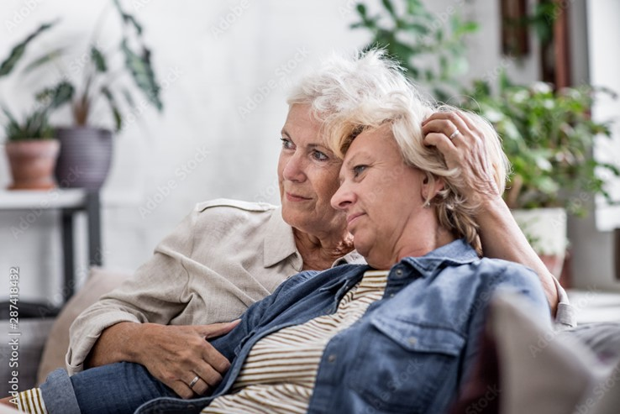
Another Common Misconception
“Sex is always partnered i.e. intercourse”
Notes:
Which is not the reality for many older adults who adapt their sexual activity because of erectile dysfunction, vaginal dryness, arthritis, mobility limitations, effects of medication, or serious health conditions
Additionally, this misconstruction ignores those whose sex partner has passed away or has a serious health condition, and also older people who are LGBTQ. In interactions with older patients, physicians need to consider forms of sexual activity beyond penetrative sex, and to include oral sex, kissing, fondling, and solo sex (masturbation) in the conversation.

Slide 9
Another Common Misconception
“Older adults are not at risk for sexually transmitted infections”

Slide 10
Notes:
STI’s remain common and costly to our nation’s health
In 2018, 26 million people has a new STI costing an estimated $16 BILLION dollars in direct lifetime medical costs

Slide 11
Sex and Quality of Life
Physical Health: improved cardiovascular health and conditioning (DeLamter, et al)
Mental Well-Being: lower levels of psychological distress and higher levels of happiness associated with being sexually active (Flynn, et al)
Emotional Intimacy: emotional connections enhance relationship satisfaction and overall quality of life (Towler, et al)
Notes:
Physical Health: Regular sexual activity in older adults is associated with numerous physical health benefits, including improved cardiovascular health and better overall physical functioning. DeLamater's review highlights that good physical health and continued sexual activity are interlinked, with regular sexual expression contributing to better physical health outcomes. Additionally, Flynn and Gow found that the frequency of sexual behaviors is a significant predictor of quality of life in the physical health domain.^{[1-2]}
Mental Well-Being: Sexual activity and satisfaction are strongly correlated with mental health. Zhang and Liu's longitudinal study demonstrated that being sexually active and having a satisfying sexual relationship are associated with better mental health outcomes, including lower levels of psychological distress and higher levels of happiness. Similarly, Flynn and Gow reported that the importance of sexual behaviors is associated with better psychological health, independent of other factors.^{[2-3]}
Emotional Intimacy: Emotional intimacy is a critical component of sexual health in older adults. Towler et al. found that older adults often view sexual activity as an extension of emotional closeness and relationship satisfaction, which can be maintained despite changes in sexual function. This emotional connection enhances relationship satisfaction and overall quality of life.^{[4]}
In summary, sexual health in aging improves quality of life by enhancing physical health, supporting mental well-being, and fostering emotional intimacy, as evidenced by multiple studies in the medical literature.^{[1-4]}

Slide 12
Analyzed 69 articles investigating the sexuality of adults aged 60+ years
Using thematic analysis to synthesize their findings
Identified 2 overarching themes/categories:
Psychological and relational aspects of sexuality
Health and sexuality
Sinkovic, et. al
Notes:
Published in 2019
published in English language in peer-reviewed journals between 1990 and 2016

Slide 13
Psychological and relational aspects of sexuality
Personal meanings and understandings of sex
What is considered important or quality sex may change over time
Intimacy between partners and development of alternative sexual practices when health was a limitation resulted in greater sexual satisfaction
Sinkovic, et. al
Notes:
erection issues are also sometimes reported to have positive effects. These include increased intimacy between partners, and the development of alternative sexual practices less focused on the penis, which resulted in greater sexual satisfaction

Slide 14
Psychological and relational aspects of sexuality
Couple hood aspects
Change in partners
Difficulty finding partners
Partner communication
More distress if mismatch in sexual satisfaction between partners
Caregiving and sexuality
Sinkovic, et. al
Notes:
In the shift of roles from partner (wife, husband) to caregiver, sexual intimacy often suffered, although emotional intimacy may strengthen through care for some
Change in partners in studies did not always have a negative impact on sexual health in older age: One of the major influences on quality of sex life was a change of partners in old age. Whether it was because of divorce or widowhood, this “second couplehood” had positive effects on both quality and frequency of sexual intercourse

Slide 15
Psychological and relational aspects of sexuality
Sociocultural Aspects
Gender and sex stereotypes can affect psychological aspects of sexuality
Sinkovic, et. al
Notes:
Ageism affects older people’s sexuality, as sex is usually linked with youth and older age with being asexual
Gender stereotypes: women not interested in sex as much as men, men not interested in intimacy and emotional aspects of sex as much as women.
It seems that the search for a new relationship in old age is confronted with age-related barriers regardless of sexual orientation
There is a substantial gender gap in research on older adults’ sexuality, with more research focusing on female sexuality. This is especially evident in the lack of the qualitative research on male desire and pleasure. As the findings of quantitative research on the relationship between age and sexual interest both in men and women are inconsistent (Graham et al., 2017), more qualitative research on sexual desire might shed light on these inconsistencies. For example, a recent qualitative study on a mid-aged cohort of Canadian men (M age = 42.83) reported that male desire was influenced by emotional intimacy and connectedness with the partner, indicating that there might be fewer differences in how men and women experience desire than previously thought (Murray, Milhausen, Graham, & Kuczynski, 2017). An exception to the gender gap is the lack of the research focused on older lesbians and bisexual women. Although some studies included nonheterosexual female participants, limited insight was provided on this population, and more focused research is needed.

Slide 16
OPEN DIALOGUE
Notes:
1,002 people ages 65 to 80
62 percent of the older adults polled said that if they were having a problem with their sexual health, they would talk with their health provider about it, yet only 17 percent had actually done so in the past two years. The majority (88 percent) of those who had talked with their provider about their sexual health said they were comfortable doing so

Slide 17
HELP-SEEKING BEHAVIORS
Lack of available information
Lack of comfort/rapport with health care provider
Seeing sexual function as separate to health
Sinkovic, et. al
Notes:
Men and women seem to cope with sexual problems by positioning them as “normal” effects of aging, thereby reducing feelings of distress
Some may not address sexual issues with doctors because sexual dysfunction can be seen as separate to health.
Lack of available information about sexual issues and lack of rapport with health care providers prevented older men and women from seeking help. Many older people felt that health care providers were not forthcoming with information regarding sexual issues, were too embarrassed to discuss the issue, or were not knowledgeable enough to assist with sexual problems
Building rapport with health care professionals was seen as an important facilitator to the discussion of sexual health issues with health care providers, and having long-standing, continuous contact with one health care provider was seen as essential to building that rapport
Older adults indicated that health care providers should be more open to discussing sexual issues, and discussion should be integrated into standard health care as opposed to treating sexuality as separate to health
Overall, older men and women seem likely to seek medical advice and discuss sexuality with health care providers when they feel a personal connection with them, when they feel confident and empowered to talk about sexuality, and when communication about sex and sexuality has been normalized by health care providers.

Slide 18
How To Maintain Sexual Health in Aging?
Psychosocial Support
Emotional Intimacy
Physical Health
Notes:
Multifaceted approach that includes managing physical health, providing psychosocial support, and fostering emotional intimacy through targeted interventions
My colleagues today will be delving more into the physician aspects of sexual function and treatment for those conditions

Slide 19
Physical Health and Chronic Conditions
Hormonal changes: Decreases in estrogen and testosterone, which can affect libido, arousal, and sexual function
-> Pharmacological Interventions
Medical conditions: Diabetes, cardiovascular diseases, cancer, HIV, and arthritis can impact sexual health
-> Management of Chronic Conditions
Medications: Some medications may have side effects that can impact sexual function
-> Education and communication
Sinkovic, et. al
Notes:
Management of Chronic Conditions: Regular management of chronic diseases such as diabetes, cardiovascular disease, and genitourinary disorders is crucial. The American Heart Association recommends assessing and managing anxiety and depression related to sexual activity in patients with congenital heart disease.^{[1]}
Pharmacological Interventions: For men with erectile dysfunction, phosphodiesterase type 5 inhibitors can be effective and are generally safe for those without contraindications. For women, nonhormonal lubricants and moisturizers can alleviate vaginal dryness, as recommended by the American Society of Clinical Oncology.

Slide 20
Sexual Function and Dysfunctions
Erectile dysfunction (ED): oral medications, injections, or devices may be recommended
Vaginal dryness and atrophy: treatments include lubricants, moisturizers, and hormonal therapies
Desire disorders: Lower libido or desire often requires a holistic approach: potentially including lifestyle changes, hormonal treatment, and therapy

Slide 21
DEPRESSION
Depression has a significant impact on sexual health across multiple studies
Independent risk factor (Wang, et al)
In men, depression has significant association with ED, orgasmic function, intercourse satisfaction, and overally sexual satisfaction (Cheng, et al)
In women, depression during menopause transition associated with lower sexual function (Stevens, et al)
Notes:
Depression has a significant negative impact on sexual health in aging individuals. Multiple studies have demonstrated that depressive symptoms are associated with various aspects of sexual dysfunction in older adults.
In a population-based study of older adults with partners, depressive symptoms were found to be negatively associated with all assessed aspects of sexual health, including sexual activity frequency and satisfaction, even after adjusting for age, physical functioning, anxiety, cognitive ability, and perceived stress.^{[1]} This indicates that depression has a broad and substantial impact on sexual health in both older men and women.
Specifically, in men, depressive symptoms are significantly associated with erectile dysfunction (ED), orgasmic function, intercourse satisfaction, and overall sexual satisfaction. These associations are independent of age, education, and number of health conditions.^{[2]} Additionally, depressive symptoms such as "low mood" and "worthlessness" are particularly predictive of ED.^{[2]}
For women, depressive symptoms during the menopause transition are associated with low sexual function. Factors such as antidepressant usage, low household income, being postmenopausal, and age further exacerbate this association.^{[3]}

Slide 22
How To Maintain Sexual Health in Aging?
Mental Well-Being:
• Psychosocial Counseling
Therapy to address psychological barriers and manage expectations
• Education and Training
Sex Ed for older adults
Medical education and research
Stowell, et al
Notes:
Psychosocial Counseling: Psychotherapy and psychosexual counseling can help address psychological barriers to sexual health. The American Urological Association suggests that counseling can improve communication about sexual concerns and reduce anxiety.^{[3].} Therapy can help address psychological barriers, manage expectations, and improve communication skills in intimate relationships
• Education and Training: Providing education to both healthcare providers and older adults about sexual health can help reduce stigma and improve knowledge (Stowell); Older people have specific needs relating to their sexual health. Sexual education for older adults: Many older adults are unaware of sexual health issues relevant to aging. Education can include safe sex practices, normalizing sexual changes with age, and addressing myths about sexuality in later life.
Health and social care professionals working with older people may benefit from education/training around sexuality in later life. Evidence on effective interventions and strategies is limited.

Slide 23
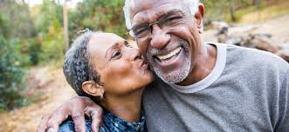
How To Maintain Sexual Health in Aging?
Emotional Intimacy:
Couples Therapy: Interventions to improve communication, expand sexual activities
Address Relational Satisfaction and Sexual Beliefs
Scheinkman, et al
Vasconcelos, et al
Notes:
Emotional Intimacy:
• Couples Therapy: Interventions such as Sensate Focus exercises and expanding sexual activities beyond penetration can enhance emotional intimacy and resilience in relationships, as described by Scheinkman et al..^{[5]}
• Relational Satisfaction: Addressing relationship satisfaction and sexual beliefs is important for sexual well-being. Vasconcelos et al. emphasize the role of relationship satisfaction and positive sexual beliefs in maintaining sexual health.

Slide 24
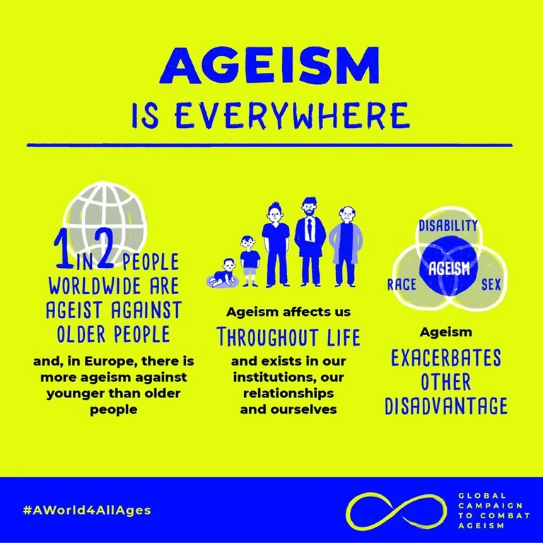
Improve Social and Environmental Factors
Social stigma and ageism
Residential and care facility considerations
Notes:
Social stigma and ageism: , which can discourage older adults from seeking support!
Address societal views that associate aging with a loss of sexual interest or capacity.
Residential and care facility considerations: Older adults in assisted living or nursing homes may face restrictions or lack privacy. Advocacy and policy changes to support both sexual rights and safety in such settings.

Slide 25
TAKE HOME POINTS
Sexual health in aging is associated with improved quality of life and should be a routine part of health care
To address sexual health concerns in aging, treatment is a multifaceted approach including managing physical health, mental wellbeing, emotional intimacy
Further research is needed, but we currently have a lot of mental and physical resources available to help

Slide 26
RESOURCES
American Association of Sexuality, Educators, Counselors, and Therapists
https://www.aasect.org/
American Geriatrics Society
https://www.healthinaging.org/a-z-topic/sexual-health
American Sexual Health Association
https://www.ashasexualhealth.org/
American Urology Association
https://www.auanet.org/
International Society for the Study of Women’s Sexual Health
https://www.isswsh.org/search
National Council on Aging
https://www.ncoa.org/older-adults/health/physical-health/sexual-health/
National LGBTQIA+ Health Education Center
https://www.lgbtqiahealtheducation.org/publication/sexual-health-and-older-lgbtqia-adults/
Sexual Medicine Society of North America
https://www.smsna.org/
The Menopause Society
https://menopause.org/
This Photo by Unknown Author is licensed under CC BY-SA
Notes:
The ISSWSH is a multidisciplinary, academic, and scientific organization with the following purposes:
To provide opportunities for communication among scholars, researchers, and practitioners about women's sexual function and sexual experience,
To support the highest standards of ethics and professionalism in research, education, and clinical practice of women's sexuality, and
To provide the public with accurate information about women's sexuality and sexual health

Slide 27
References and QUESTIONS?
Cheng JY, Ng EM, Ko JS. Depressive symptomatology and male sexual functions in late life. J Affect Disord. 2007 Dec;104(1-3):225-9. doi: 10.1016/j.jad.2007.03.011. Epub 2007 Apr 24. PMID: 17459486.
DeLamater J. Sexual expression in later life: a review and synthesis. J Sex Res. 2012;49(2-3):125-41. doi: 10.1080/00224499.2011.603168. PMID: 22380585.
Flynn TJ, Gow AJ. Examining associations between sexual behaviours and quality of life in older adults. Age Ageing. 2015 Sep;44(5):823-8. doi: 10.1093/ageing/afv083. Epub 2015 Jul 14. PMID: 26178206.
Lee DM, Nazroo J, O'Connor DB, Blake M, Pendleton N. Sexual Health and Well-being Among Older Men and Women in England: Findings from the English Longitudinal Study of Ageing. Arch Sex Behav. 2016 Jan;45(1):133-44. doi: 10.1007/s10508-014-0465-1. Epub 2015 Jan 27. PMID: 25624001.
Sinković M, Towler L. Sexual Aging: A Systematic Review of Qualitative Research on the Sexuality and Sexual Health of Older Adults. Qual Health Res. 2019 Jul;29(9):1239-1254. doi: 10.1177/1049732318819834. Epub 2018 Dec 25. PMID: 30584788.
Smith L, Yang L, Veronese N, Soysal P, Stubbs B, Jackson SE. Sexual Activity is Associated with Greater Enjoyment of Life in Older Adults. Sex Med. 2019 Mar;7(1):11-18. doi: 10.1016/j.esxm.2018.11.001. Epub 2018 Dec 13. PMID: 30554952; PMCID: PMC6377384.
Steckenrider J. Sexual activity of older adults: let's talk about it. Lancet Healthy Longev. 2023 Mar;4(3):e96-e97. doi: 10.1016/S2666-7568(23)00003-X. Epub 2023 Feb 2. PMID: 36739874.
Stevens EB, Wolfman W, Hernandez-Galan L, Shea AK. The association of depressive symptoms and female sexual functioning in the menopause transition: a cross-sectional study. Menopause. 2024 Mar 1;31(3):186-193. doi: 10.1097/GME.0000000000002309. Epub 2024 Feb 13. PMID: 38350036.
Stowell M, Hall A, Warwick S, Richmond C, Eastaugh CH, Hanratty B, McDermott J, Craig D, Spiers GF. Promoting sexual health in older adults: Findings from two rapid reviews. Maturitas. 2023 Nov;177:107795. doi: 10.1016/j.maturitas.2023.107795. Epub 2023 Jul 5. PMID: 37454470.
Towler LB, Graham CA, Bishop FL, Hinchliff S. Sex and Relationships in Later Life: Older Adults' Experiences and Perceptions of Sexual Changes. J Sex Res. 2023 Nov-Dec;60(9):1318-1331. doi: 10.1080/00224499.2022.2093322. Epub 2022 Jul 19. PMID: 35852483.
Wang V, Depp CA, Ceglowski J, Thompson WK, Rock D, Jeste DV. Sexual health and function in later life: a population-based study of 606 older adults with a partner. Am J Geriatr Psychiatry. 2015 Mar;23(3):227-33. doi: 10.1016/j.jagp.2014.03.006. Epub 2014 Mar 19. PMID: 24840610.
World Health Organization. Defining sexual health: report of a technical consultation on sexual health, 28-31 January 2002, Geneva. World Health Organization, 2006.
Zhang Y, Liu H. A National Longitudinal Study of Partnered Sex, Relationship Quality, and Mental Health Among Older Adults. J Gerontol B Psychol Sci Soc Sci. 2020 Sep 14;75(8):1772-1782. doi: 10.1093/geronb/gbz074. PMID: 31132123; PMCID: PMC7489086.

