Slide 1


Applying for USMLE Accommodations 101
An Introductory Guide to Applying for Accommodations for the USMLE Step 1 and 2 Examinations
Notes:
My name is Bryan Little and I'm a fourth-year medical student at the University of Arizona Tucson.
In partnership with the office of student success, I created this presentation "applying for USMLE accommodations 101" to provide additional guidance to students with disabilities on the basics ofthe application process for USMLE testing accommodations.
The information in this presentation is applicable to students applying for both step one and step two accommodations. Presentation was created to provide a brief overview and strongly encourage students to visit the USMLE website and the various hyperlinks in this PowerPoint for additional details. Additionally, as this recording was made in 05/2023, I strongly encourage you to check the primary source material referenced for updates to the process.

Slide 2
Acknowledgements
The majority of this presentation is adapted from UCSF School of Medicine USMLE Step Exam Guide.
  Link to document: UCSF STEP EXAM GUIDE FOR ACCOMMODATIONS

Slide 3
Important FYIs About Obtaining Accommodations for the USMLE Step Exam(s)
Having previously received testing/academic accommodations in school and/or for standardized exams (MCAT), it does not mean they will be granted by the USMLE.
  Having previously received them increases your chances but still does
Accommodations requests for the Step examinations are made directly to the USMLE.
  This is different from the process of obtaining accommodations for University of Arizona (“in-house”) exams.
  There is a Higher threshold for approval relative to most other institutional DRCs.
Providing yourself sufficient time to navigate this process is essential to ensuring you remain on track to graduate on-time/progress without disruption.
  NOTE: Obtaining necessary documentation takes time (letters, official score reports).
  General rule of thumb: Anticipate this process will take longer than you plan it will.
Though there is no extra cost to the USMLE to apply for accommodations, the ancillary (out of pocket) costs can get expensive depending on your needs.
  Psychoeducational evaluations range from $1500-$5000+ (and not covered by most insurance plans).
  There are costs associated with obtaining official score reports from standardized tests and academic transcripts.

Slide 4
MOST IMPORTANT ADVICE
START EARLY
START EARLY
START EARLY

Slide 5
Why Start Early?
Allows ample time to complete any medical evaluations to strengthen your application.
All individuals applying for accommodations are be required to fill out a detailed application and must include their USMLE number.
While application is under review you will NOT be able to schedule your exam.
  If you are approved for accommodations, you will receive a registration ticket within 5 days of the approval and only then can you register for the exam.
Extended processing time for application
  NBME typically utilizes a minimum of 60 business days (and often times longer) to render an initial decision.
Time for appeals
  Unfortunately, many students who apply for accommodations are either denied or only granted partial accommodations.
  Beginning early allows you the best chance to avoid having to take leave of absence (LOA) or academic delay should the process extend longer than anticipated.

Slide 6
First Steps
Schedule an appointment with a Learning Specialist (LS) to discuss your intent to apply for accommodations.
  We strongly encourage you to meet and discuss even if you’re undecided if you want to use them on the exam.
  Your LS can provide is equipped to assist you through most aspects of the application process and can pr
If you have not already done so, register for accommodations through the University of Arizona Disability Resource Center (DRC).
  We STRONGLY advise doing so prior to starting your 1st year (pre-clerkship) coursework.
  Website: Connect with DRC | Disability Resource Center (arizona.edu)
If you have previously received testing/academic accommodations at any point in your academic history, obtain as much documentation to being to your DRC and LS meetings.

Slide 7
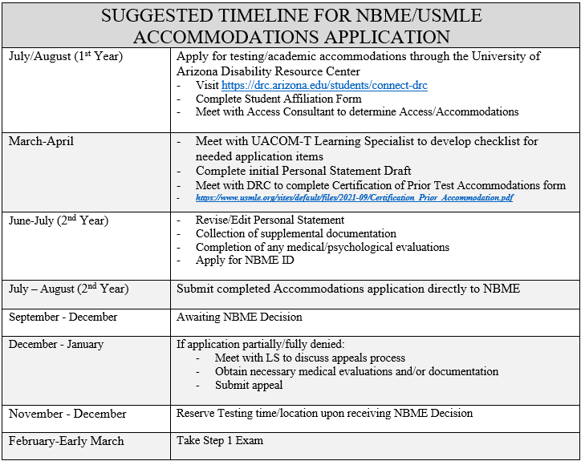
https://www.usmle.org/step-exams/test-accommodations/guidelines

Slide 8
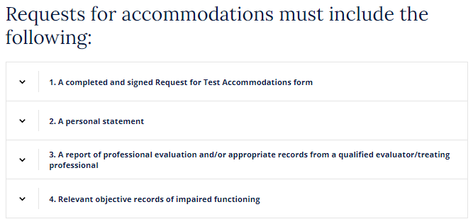
The Application
The application consists of the following (per USMLE Website):
Guidelines | USMLE

Slide 9
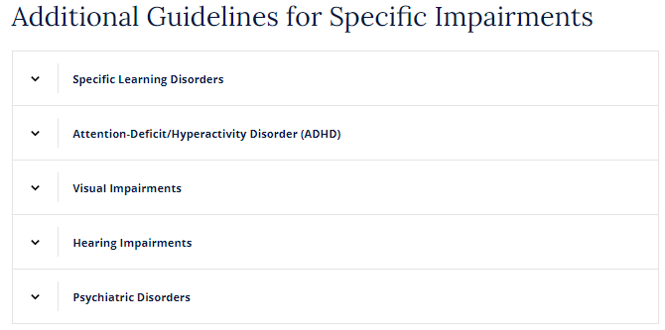
UA Letter of Support

Slide 10
Application Contents
A completed and signed Request for Test Accommodations form.
  Download and complete appropriate form pertaining to your circumstance.
  If previously received accommodations: Completion of the Certification of Previous Testing Accomm. doc
  Forms | USMLE
A personal statement
  Provide a written statement describing the disability for which you are requesting accommodations.
  Include specific information about the disability-related symptoms and how they affect your academic, occupational, social and other important areas of functioning.
  Describe the extent to which your daily functioning is impaired and how that impairment interferes with your ability to access the examination under standard conditions.
  Provide a clear rationale for the requested accommodation(s) and describe how each requested accommodation will alleviate the functional limitations caused by your disability.
(A) report(s) of professional evaluation and/or appropriate records from a qualified evaluator/treating professional.
Relevant objective records of impaired functioning.
https://www.usmle.org/step-exams/test-accommodations/guidelines

Slide 11
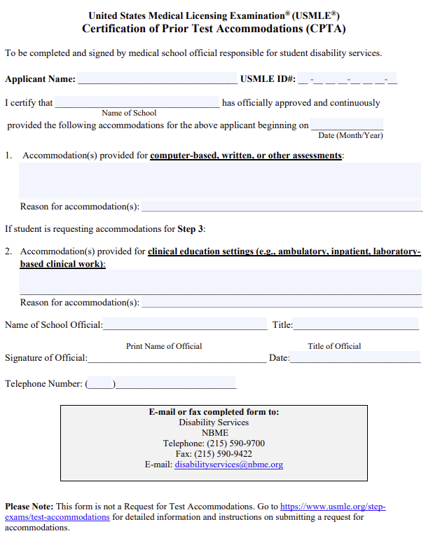
CPTA Form
Download at: Certification of Prior Test Accommodations (CPTA) (usmle.org)

Slide 12
Application Contents
3. A report of professional evaluation and/or appropriate records from a qualified evaluator/treating professional
  A comprehensive report of evaluation should include:
    A description of the onset, frequency, intensity, and duration of relevant symptoms as well as the extent to which the symptoms impact your daily functioning across multiple environments (e.g., social, academic, occupational, etc.).
    A statement of the presenting problem and background history.
    A description of the assessment procedure as well as specific diagnostic tests administered.
    A detailed analysis and interpretation of the findings.
    Actual results (e.g., scores) of all diagnostic procedures and tests utilized in the evaluation.
    If a diagnosis is indicated, the evaluator should describe a professionally recognized diagnosis based on criteria outlined in the most current edition of the Diagnostic and Statistical Manual of Mental Disorders (DSM) or the International Statistical Classification of Diseases and Related Health Problems (ICD).
    A description of the full extent of the individual's functional limitations due to the disability and how it impacts the individual’s access to the examination under standard testing conditions.
    A description of the functional impact on physical, perceptual, and cognitive abilities in the context of the specific examination setting and format (e.g., computer-based examination; clinical or performance-based examination) compared to most people in the general population.
    A clear rationale for the recommended accommodations and/or assistive devices.
https://www.usmle.org/step-exams/test-accommodations/guidelines

Slide 13
Application Contents
4. Relevant objective records of impaired functioning
  Objective records of functioning should be submitted to document the real-world current impact of the disability and demonstrate how a major life activity relevant to the setting and context of the specific examination is substantially limited.
  Examples of supporting documentation include but are not limited to:
    Prior clinical evaluations, diagnostic reports, treatment/educational plans, or relevant medical records.
    Written feedback from teachers or supervisors.
    Official academic records and transcripts.
    Official score reports for nationally normed standardized tests (e.g., SAT, ACT, MCAT, LSAT, GRE, GMAT, professional licensing or certifying exams, etc.).
    Performance evaluations from training programs, military service, or employment settings (e.g., part-time/full-time volunteer/paid jobs, clerkship/internship/residency, etc.).
    Official records verifying approved accommodations from schools or other testing agencies listing the specific accommodations approved and dates that they were provided.
https://www.usmle.org/step-exams/test-accommodations/guidelines

Slide 14
Other Supporting Documents
Documentation of any diagnosed disabilities and associated accommodations offered as a result
  School, workplace, etc.
  Documentation for formal accommodations received for any standardized examinations (SAT/ACT, MCAT, etc.)
Transcripts from elementary school, high school, and/or college
  should be provided if they clearly show the impact of your disability on your grades.
Letter from a professor, advisor or an employer providing further evidence of the impact of your disability on learning or performance while in school or on the job
  e.g. a letter from a former supervisor describing performance issues or additional support required on the job as a result of disability related difficulties) can help to substantiate the impact of a disability
Letters from professors, teachers, guidance counselors or other people who can describe your previous academic performance may be helpful if they can show how your work was impacted by disability, or how the use of accommodations and strategies improved your performance.
Notes:
Related to the previous slide, this slide details additional samples of supporting documentation. An example of this documentation includes: proof of use of formal accommodations for previous such as SAT etc., hurts from a professor an advisor to the impact of your disability on learning or performance,. The important thing to note is that you want this supportive documentation to irrefutably support the impairment caused by your disability. When advising others to draft these letters on your behalf, be sure to emphasize the purpose of the letter is to highlight dysfunction and impairment. This different from a letter of recommendation and that highlighting successful coping strategies resilience on your part may actually counterproductive. Weird as this might sound, you want these letters to highlight the negative.

Slide 15
Types of Accommodations
Extended time (Standard time +25% 50% 75% 100%):
Additional/Extended rest breaks
Multiple Day Testing (exam-dependent)
Assistive software/technology
Personal Item Exemption
https://www.usmle.org/step-exams/test-accommodations/guidelines

Slide 16
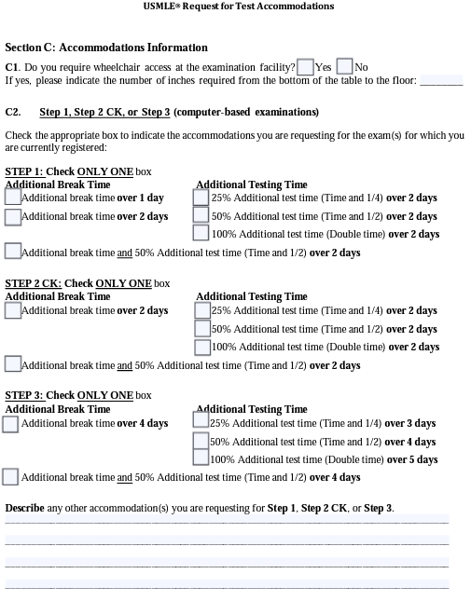
Available Options
The USMLE has recently changed the options available to the SWD seeking extra break time and/or extended testing time.
Pick the option which is best supported by recent literature and/or recommendations from qualified evaluators.
Summary of general accommodations offerings.

Slide 17
Extended Time
Standard time +25%, 50%, 75%, 100%
More likely to be approved if:
  Concrete evidence from your documentation that support the disability-related need for the accommodation
    e.g. very low academic fluency scores
  Established history of receiving formal (and similar) accommodations in the past.
Your request should be based on the amount of time you have received historically, as this is what you know works for you.
  Ex: Don’t request 100% extended time if you have never been approved for 100% extended time before.
Provide (a) clear rationale(s) for all requests in your application.
  May be worthwhile to do some independent research on your specific disability/impairment
Consider the specific structure of the exam and the impact of extended time on taking the exam.
  For example, approval for 100% extended time (double time) may necessitate that the exam be administered over two days given the length of the exam with standard time.
https://www.usmle.org/step-exams/test-accommodations/guidelines

Slide 18
Additional/Extended Rest Breaks
ALL test takers are given 45 minutes of break time for authorized breaks during the exams.
You may request to have additional rest breaks added to the exam day as an accommodation.
Individuals with health concerns needing monitoring are eligible to request additional breaks
  EX: Diabetes needing to check blood sugar levels, grab something to eat, or to take medications. (See also: personal item exemptions).
If you have ADHD or another disability that benefits from the opportunity to take a brief break to clear your head, this accommodation may be worth considering.
  It may be more appropriate than extended time as it gives you the opportunity to refocus your thoughts versus extended time, which can lead to exhausting testing conditions.
If this accommodation is approved, the NBME will tell you how the approved breaks will be structured so you are prepared on the day of the exam for what will be provided.
https://www.usmle.org/step-exams/test-accommodations/guidelines

Slide 19
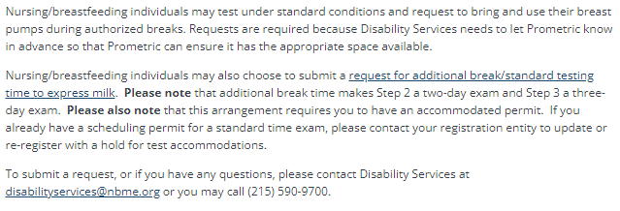
Additional Break Time for Nursing/Breastfeeding
Per the NBME (USMLE) Website

Slide 20
Multiple Day Testing
This accommodation may be of significant benefit to someone whose cognition, physical ability and energy level, or eyesight fatigues over a period of intense focus.
Supporting documentation should specify the amount of time a test taker can work on an exam per day.
Previously approved
  ADHD
  Specific Learning Disorders
  Pregnant or postpartum individuals
  Migraines/Chronic headaches (associated with extended screen time)
NOTE: Any individual who applied/is approved for any amount of extended test time will have to take examination over 2 days
https://www.usmle.org/step-exams/test-accommodations/guidelines

Slide 21
Testing in Private Environment
This accommodation may be appropriate for the following conditions:
  Anxiety
  Distractibility/Inattention (ADHD)
  Panic attacks
  Specific Learning Disorder
If you require a private space for talking out loud or briefly stepping away from the computer to assist with comprehension, focus, or managing anxiety you may find that a private environment is necessary to allow you to use these key techniques to maximize your performance and to manage your symptoms without disturbing others.
  It is important to decide whether breaks might be helpful in order to use calming techniques in addition to, or in lieu of, this accommodation.
If approved, remember that testing centers have very limited individual rooms. Therefore, you will need to secure a space well in advance (or need to travel some distance to find a center with such provisions).
  Investigate options for testing centers at the beginning of the scheduling process so you are fully aware of your options.
https://www.usmle.org/step-exams/test-accommodations/guidelines

Slide 22
Assistive Software/Technology
You should consider requesting only the software or assistive technology that is necessary to facilitate access to the specific exam format.
  Note: Not all the assistive technology you use in a normal course or in doing your course readings will prove useful on a specific exam.
Your request should:
  Document your history of using such software
  Specify why that specific software is necessary for this exam, both due to:
    Format of the exam
      e.g. the format of the exam involves reading patient case examples, and thus includes a significant amounts of reading
    Nature of your disability
      e.g., you experience a significant amount of eye fatigue, and thus need large print and reverse contrast screen colors; you are very familiar with ZoomText software after 5 years of daily use and should have access to the same software during the exam due to familiarity with keyboard shortcuts, and settings).
Make sure your medical provider/evaluator note their recommendations for the specific device, software or technology needed to facilitate equal access to the exam materials in the documentation.
https://www.usmle.org/step-exams/test-accommodations/guidelines

Slide 23
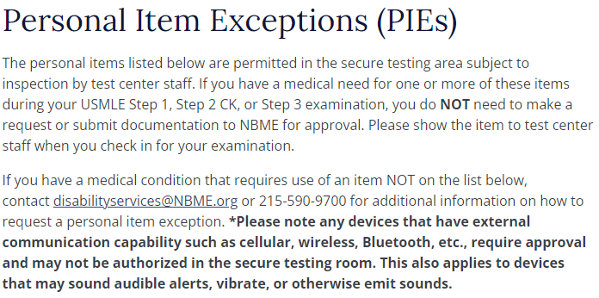
Per the USMLE (NBME) Website re: Personal Item Exemptions

Slide 24
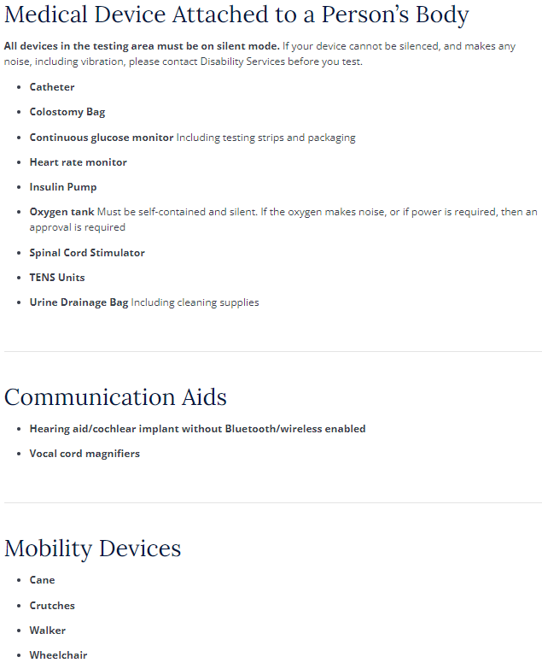
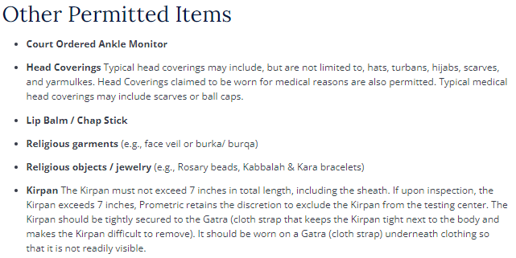
Permitted Items (PIEs)

Slide 25
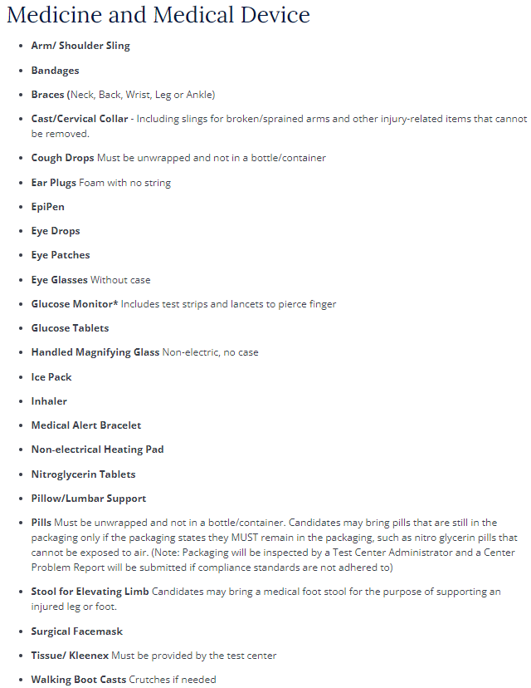
Permitted Items (PIEs)

Slide 26
Personal Item Exemption
If you need to bring anything related to your disability and considered “non-standard” such as, you will need to have this approved in advance of the exam.
  EX:
    Food/Water/Medication
    Special cushion
    Hearing aids or cochlear implants
    Other medical devices
These requests generally do not require the same “burden of proof” that other accommodations require.
Often the documentation requirement is a letter of support from a medical doctor stating the nature of the condition and the reason why the item is needed.
A good rule of thumb is to declare ANYTHING and allow the NBME to determine if such a declaration is not needed.
The NBME provides specific advice on this issue:
  http://www.usmle.org/test-accommodations/PIEs.html
https://www.usmle.org/step-exams/test-accommodations/guidelines

Slide 27
Newly (or recently) Diagnosed w/o a History of Accommodations
If you do not have a history of accommodation or have been recently diagnosed with a disability you must answer the question “why now?”
The NBME will want to know why you have successfully gained entry to medical school without accommodations, but now have difficulty accessing the education curriculum.
The examiner who diagnosed you will also be required to speak to these issues. ENSURE that your evaluator is able/willing to provide a thorough assessment.
Remember: Ensure the documentation/assessments utilized are <3 years. The NBME will likely not consider older documentation
https://www.usmle.org/step-exams/test-accommodations/guidelines

Slide 28
Newly (or recently) Diagnosed SWD
Without History of Accommodations
Advice/Tips from previous UA applicants with new diagnoses
  Consider obtaining multiple assessments (psychoeducation assessments, psychological evaluations)
  Ensure your evaluator is experienced with constructing appropriate reports
  If you do not have a documented childhood history of a disorder, consider obtaining letters of support from those who know you from childhood to attest to your level of impairment.
  Obtain letter of support which strengthen your case in establishing a history of your disorder
    Family
    Former employers/teachers/professors
  Start collecting your documentation EARLY.
    Achieved test results and secondary education documentation can take weeks to receive
    Medical records (particularly mental health records) can also be difficult to obtain
  Do some research beforehand on your specific disability/disorder.
    Many (inexperienced) practitioners may not be familiar with current literature relating to the appropriate of accommodations for your particular disorder. A working knowledge can be helpful.
    Knowledge of “accepted” assessments/subtests can save you time/money
  Explore alternative accommodations which may be more appropriate for your specific case
  Determine if your desired accommodations is worth it
    Particularly if applying “late”, know this process is arduous and can take away time/energy from Step preparation (and ultimately not guaranteed).
https://www.usmle.org/step-exams/test-accommodations/guidelines

Slide 29
TIPS: Personal Statement
This is your only opportunity to share your personal experience of living with a disability.
    This is often the most time-consuming part of the application process but one of the most important and compelling parts of the request.
Points of Consideration
  Explain the nature of your disability and why you are requesting accommodations.
    Include a description of the day-to-day impact of your disability - not just the impact on academic tasks, like taking exams (e.g., impact on interpersonal relationships, employment, course withdrawals, personal organization, driving record, financial management, etc).
  Focus on your areas of difficulty rather than your strengths.
    This can feel awkward, because oftentimes students with disabilities are taught to put their “best foot forward” and emphasize their strengths when speaking about themselves. However, the personal statement is not the time to talk about how well you have been doing. It is actually the place to emphasize and highlight what has been difficult. It is essential that you connect your accommodations to any successes.
    The burden to prove that the requested accommodations are necessary is on the student.
    Be very clear about the barriers posed by the test, and the anticipated outcome if the accommodation you are requesting is not in place. The barrier must be grounded in the nature of your condition and substantiated by the documentation you are providing.
  Pay close attention to the language you use to describe your needs.
    The cover letter should not refer to a preference for an accommodation, but rather should emphasize your need for the accommodation. Your job is to explain why the accommodations you are requesting are necessary to ensure your access to the exam. For example, you should not say things like “I would do better with” or “to ensure my success,” as accommodations are designed to ensure access, not success. You should also avoid using phrases such as “learning differences,” as agencies are only interested in disabilities that require accommodations.
https://www.usmle.org/step-exams/test-accommodations/guidelines

Slide 30
Timeline/Order of Operations
Submit application to USMLE for your examination designating your intent to apply for accommodations.
After ~one week, you will receive confirmation and instructions on how to submit your documentation to the USMLE Disability Resources.
  NOTE: There is no time limit but it is STRONGLY advised that you have your application materials ready for submission when initially signing up to for the examination.
Submit application materials to the USMLE and indicate when ready for them to begin their formal review.
  Once you give word, this is when the 60 business day clock begins
  NOTE: Keep in mind once you give the go ahead that your application is “complete”, you can submit additional documentation but THE 60 BUSINESS DAY CLOCK RESETS
  Keep in mind that the clock does not begin until disability services confirms they have all necessary documentation.
During the 60 business day waiting period
  Keep an eye on your email as the USMLE may contact you with questions/clarification and may ask for additional documentation.

Slide 31
Considerations Once Your Application is Submitted
Consider obtaining any additional evaluations/documentation which you feel could strengthen your application (for appeal).
If your decision waiting time falls within your dedicated study period.
  Strongly consider preparing as though you will not be granted your requested accommodation.
Keep in touch with your learning specialist (and House Dean)
  They can provide assistance/guidance on things such as clerkship (re)scheduling should a decision not be rendered in time (and/or scheduling of your exam gets tricky).

Slide 32
If Your Application Is (partially) Denied
Request for reconsideration (appeal)
  You are allowed ONE reconsideration review per registration.
    RECONSIDERATION REQUEST FOR TEST ACCOMMODATIONS (usmle.org)
  You must have a current eligibility period.
    Your reconsideration will be discontinued if:
      Your eligibility expires.
      You test before completion of the review
  It is YOUR responsibility to monitor your registration status and eligibility periods throughout the ENTIRE process.

Slide 33
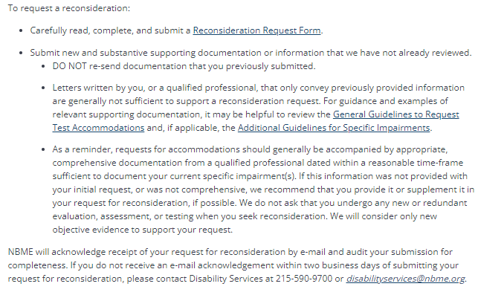
The Reconsideration Process
Review the letter provided by the USMLE detailing their rationale.
Contact your learning specialist to discuss whether an appeal may be appropriate for your case.
Consider if consultation with a disability lawyer may be appropriate.
Review the RECONSIDERATION REQUEST form from the USMLE website.
Obtain any supplemental documentation needed which may be helpful to strengthen your application.
Reconsideration | USMLE

Slide 34
Summary
Accommodations are not guaranteed.
Start the process early and stay on schedule.
  The process is arduous.
Documentation of your diagnosis is key!
  Generally speaking: The more, the better.
Your learning specialist is your ally. Keep them informed.
Knowledge is power.
  Conducting research ahead of time on your condition and what experts consider as “reasonable accommodations” can expedite the process and save you some later headaches.
To the extent you can, reach out to peers who have previously gone through the process to provide additional advice/guidance.

Slide 35
Additional Resources
We are working on creating UACOM-specific documentation to further assist you through this process. Thank you for your patience.
Docs With Disabilities Podcast
Meeks, L. M., Jain, N. R., & Laird, E. P. (2020). Equal Access for Students with Disabilities: The Guide for Health Science and Professional Education, 2nd Edition. Springer Publishing. https://doi.org/10.1891/9780826182234

